Slide 1
Advanced Sync-O-Matic 3000 Documentation
Dr. Charles Severance
http://www.netfact.com/crs/projects/syncomat/

Slide 2
Introduction
This is a collection of advanced topics in the use of Sync-O-Matic.
It assumes that you have viewed the basic Sync-O-Matic documentation and tutorials
It is in no particular order...

Slide 3
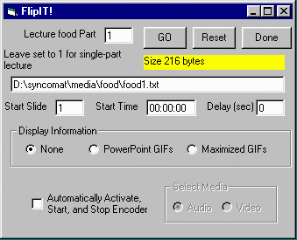
FlipIT! User Interface

Slide 4
FlipIT!
FlipIT! Is quite a Rube Goldberg device
  Can simply record timings
  Can record timings and display PowerPoint GIFS
Can start and stop the RealAudio and RealVideo Encoders at the right time
Encoding and lecturing simultaneously can seem overwhelming at first

Slide 5
Multipart Lectures
You must specify which “part” (1, 2 .. ) this particular segment will be - if it will not be multipart - just use 1
The file names for the events, audio, and video will be automatically determined

Slide 6
FlipIT! Settings
Reset empties the events file - If you don’t reset, new events will be appended to the file
For a multi-part lecture you can set the starting slide to something larger than 1
You can also set the starting time
You can pause timing in the middle and these fields will be set properly to restart

Slide 7
More FlipIT!
Delay allows the encoder to get started before the timings are started
As you make timings, FlipIT can display nothing, Small GIFs or full-screen GIFs
You can automatically start and stop the encoder to record audio or video
Done exits
See the tutorial for details on GO :)

Slide 8
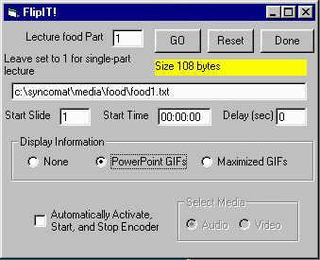
Once In FlipIT!
Set the which segment you are creating
SM-3000 thinks in terms of multi-segment lectures so food1.txt will be the timings for the first (or only) segment

Slide 9
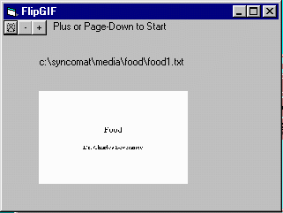
FlipIT! Choices
We will use the PPT
GIF option
Optionally enable
Encoder
Then press “GO”
FlipGIF comes up

Slide 10
Lecturing In A Studio
Your office/basement might not be ideal
  You want both audio and video
  You want files for multiple bandwidths
  You want good lighting and helpful staff
  You want professional quality
Go to a studio
  Record to tape
  Can digitize many times many ways

Slide 11
Two Approaches
Teacher uses FlipIT to display slides and capture timings
Teacher uses PowerPoint Viewer and studio staff track slide changes

Slide 12
Using FlipIT in Studio
Changes
  Don’t select either Encoder
  Use Maximal GIF screen for display on TV
  Use + to start lecture and advance slide
  Use X (or + on last slide) to finish lecture
Make sure to segment numbers between segments

Slide 13
Using PowerPoint Viewer
Teacher simply gives lecture in Studio using viewer
Need slide start times - several choices
  Staff writes on 6-Up printout during taping
  Note them while digitizing the material
Use TimeIT to enter all of the starting times into each of the files \syncomat\media\food\food1.txt

Slide 14
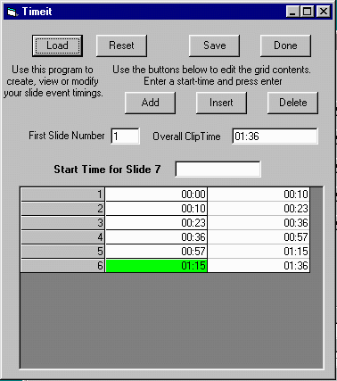
TimeIt!
Slide timing view/editor
Mini-spreadsheet
Will re-sequence automatically
Type “start-times” for each slide and press enter
Can highlight row and edit, insert or delete

Slide 15
Digitizing and Producing
After lecture is complete, digitize into \syncomat\media\food\food1.rm
Create \syncomat\media\food\food1.txt
Make sure to export the PowerPoint slides to HTML in \syncomat\htm_sld\food\
Once all is in place - at SM-3000 Execute | Make Lecture

Slide 16
Real 2.0 Audio (antique)
You may want to support the original RA 2.0 (14.4kbps) player
  Set Audio Events path to the cevents32 and SM-3000 will cevent32 style audio events - the old format requires a streaming server for synchronized multimedia
You can provide 14.4 audio using the newer (>3.0) players as well

Slide 17
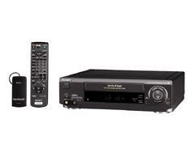
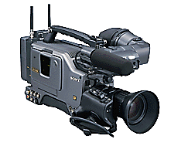
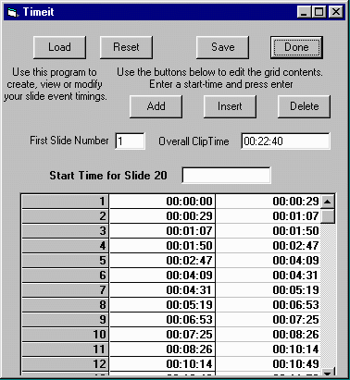
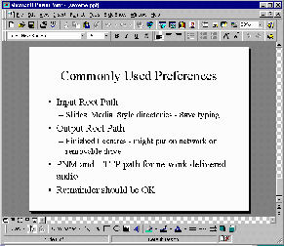
Media Directory
Audio/Video
Timing
Real Encoder
AVI Capture
PowerPoint
HTML
Directory
HTML Export

Slide 18
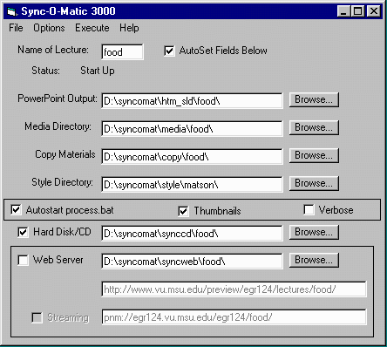
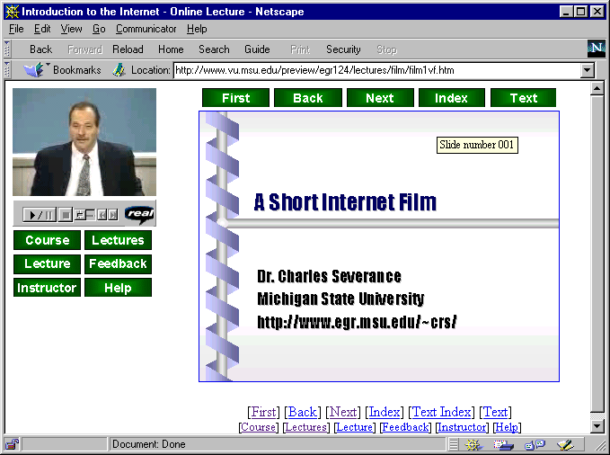


Media Directory
Audio/Video
Timing
PowerPoint
HTML
Directory
CD-ROM
Version
Directory
Web
Version
Directory
Upload

