Slide 1
A Quick-Start for the
Sync-O-Matic 3000
Dr. Charles Severance
http://www.netfact.com/crs/projects/syncomat/

Slide 2
Introduction
In this tutorial we will go through the production of a Sync-O-Matic lecture step by step. This tutorial is designed to quickly get you started with a minimum of effort.
To learn more, consult other Sync-O-Matic documentation modules.

Slide 3
Preparation
Download and install Sync-O-Matic according to the web instructions
Download and install the RealProducer and RealPlayer
Install and test video capture card
Explore the RealEncoder and RealPlayer so you are familiar with them

Slide 4
Outline
Create PowerPoint and Save as HTML
Run Sync-O-Matic
Set Preferences
Record a lecture using VideoFlip
Produce and view a lecture on local disk
Produce, upload and view a lecture on the web

Slide 5
Create PowerPoint
Use PowerPoint-97
  Use CTRL-K to ad hyper-links to slides
  Use Note pages - they will be copied to the slides and URL-like strings will be turned into hyperlinks
Limit use of color backgrounds for modem applications
  Mostly white - 3K Colored background 30K

Slide 6
Save food.ppt As HTML
File | Save as HTML - Wizard Answers:
  Page style - irrelevant
  Select GIF - 800x600 1/2 screen is good
  Information page/page colors - irrelevant
  Buttons and placement - irrelevant
  Select “Include Slide Notes In Page”
  Directory c:\syncomat\htm_sld\
PowerPoint adds “food” subdirectory

Slide 7
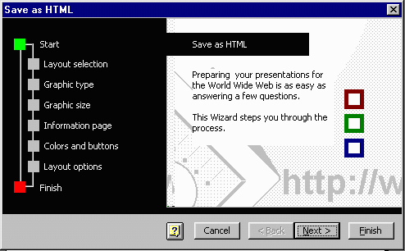
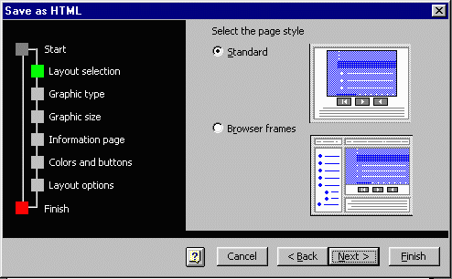
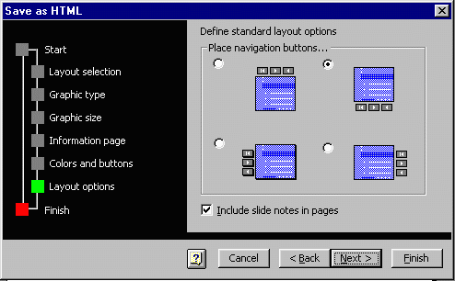
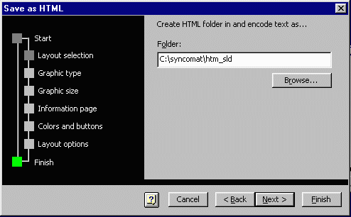

Slide 8
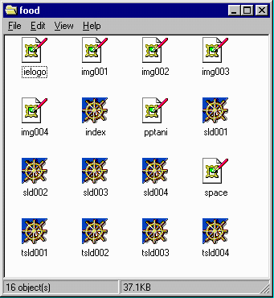
Results from PowerPoint
IMG001.GIF
SLD001.HTM
INDEX.HTM
TSLD001.HTM
Various Microsoft
GIFs
The “001” files have one for each slide

Slide 9
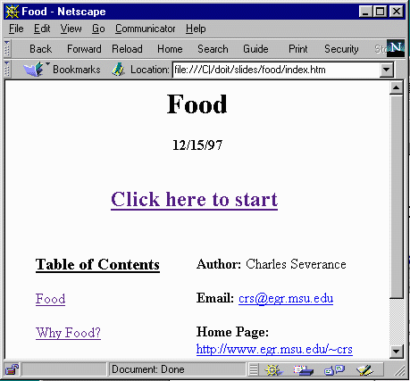
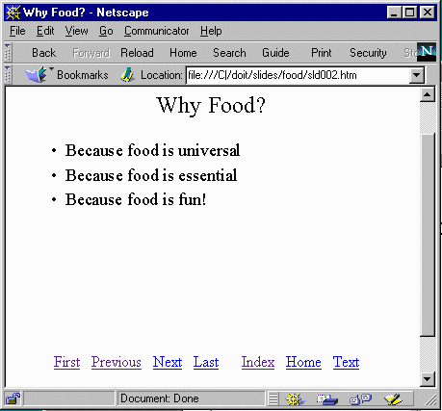
What It Looks Like

Slide 10
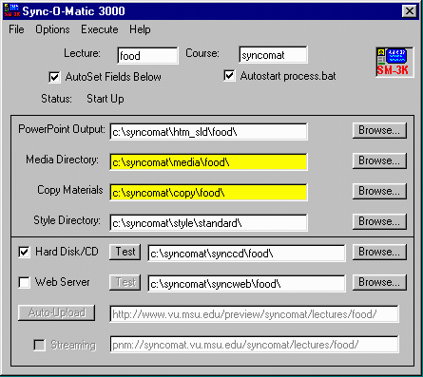
Run SM-3000!
As you type in the lecture name at the top and it sets all the paths below, based on the preferences

Slide 11
Set Preferences
You will only have to do this once
There are many preferences but we only have to set one for now
Run Options | Preferences

Slide 12
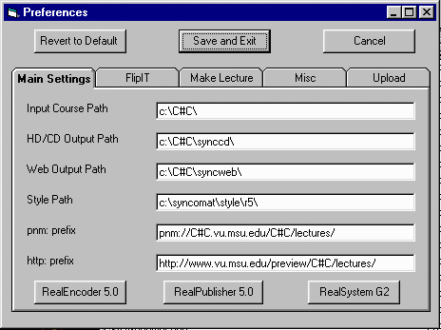
(2) Press “Save and Exit”
(1) Press button based on which encoder is installed

Slide 13
VideoFlip
Even though you have three “Flip” choices under execute we will use VideoFlip
FlipIT! is too powerful and too complex
AudioFlip! Produces files which end in .ra - the new convention is to use .rm
So, use Execute | VideoFlip

Slide 14
What VideoFlip Will Do
Pop up a notice box telling you what to do when the encoder comes up - please read
Start the encoder
Bring up the slide flip window
Wait for you to setup the encoder
When you advance to the first slide - VideoFlip starts the encoder
When you exit the slide tool - VideoFlip stops the encoder

Slide 15
VideoFlip! Notes
While this works surprisingly well, there is some “duct tape” involved
You must follow the steps (on the previous slide) carefully or your audio/video will not record successfully
It is important to be familiar with the use and operation of the encoder BEFORE you try using VideoFlip!

Slide 16
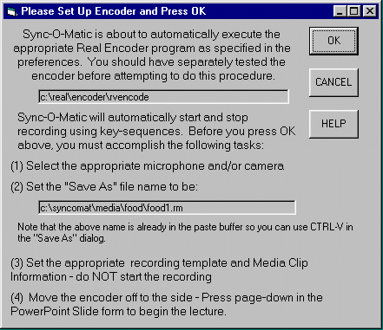
VideoFlip! Reminder
Please read every single word of this dialog box before pressing “OK”. After the second or third time, you will ignore it.
You are about to enter a complex process and this dialog is trying to guide you through it :)

Slide 17
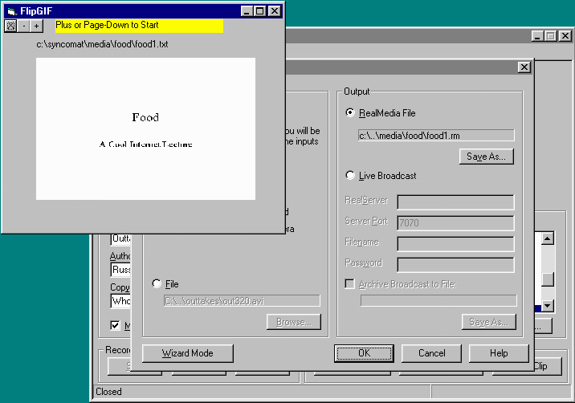
After you press OK lots of boxes pop up
Slide Flip Window
RealEncoder Setup Window
RealEncoder
Window

Slide 18
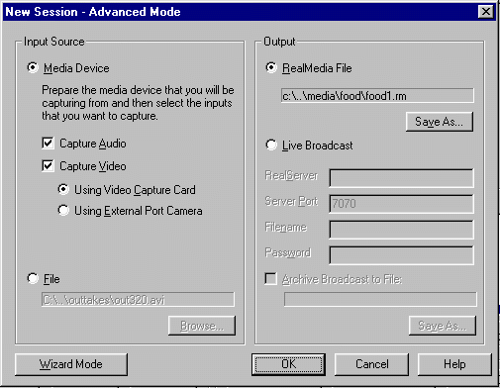
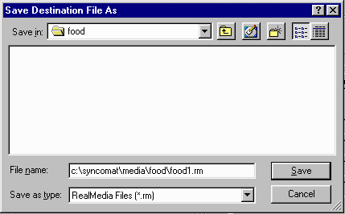
(1) Setup Media Device
(2) Set Media File Name
(3) Use CTRL-V (paste) to get right name
(4) Press Save then OK

Slide 19
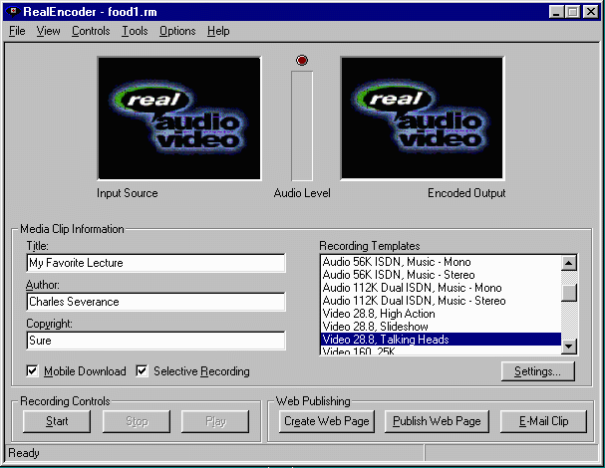
Set all of these values - remember you are already supposed to be a RealEncoder expert :)
Do NOT press the Start Button
At this screen, you do everything except press the start button- in a moment, the start button will be pressed automatically but Sync-O-Mat as the timers are started.

Slide 20
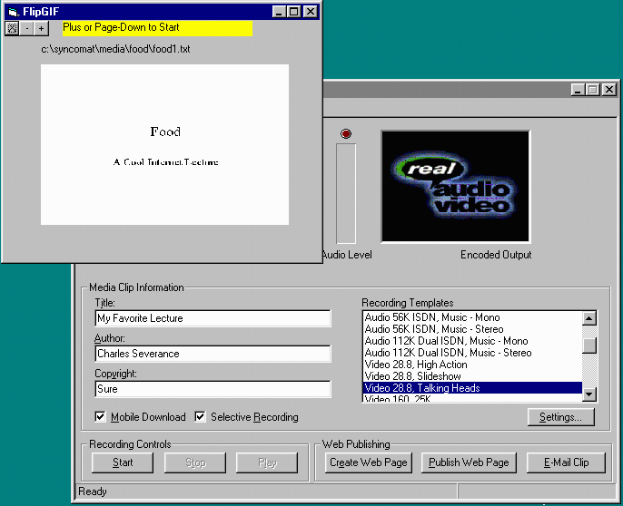
Ready to Lecture

Slide 21
Time to Lecture!
Press the “+” button
  Brings up the first slide in FlipGIF
  Send keystrokes to start Encoder
  Starts Internal Timer
To go to the next slide press “+”
  Advances slide in FlipGIF
  Stores elapsed time \syncomat\media\food\food1.txt

Slide 22
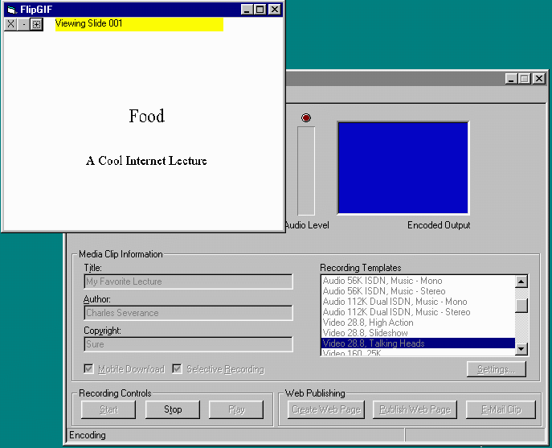
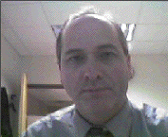
While Lecturing

Slide 23
More Lecturing
Don’t use “-” it is not well implemented
On the last slide, when done, either press the + or the X
  Records the elapsed time for last slide
  Turns off internal timer
  Stops the Encoder software

Slide 24
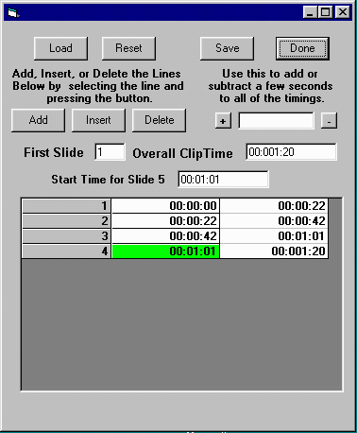
Lecture Complete
Press “Done” in
FlipIT to exit
Enter TimeIT
Load | food1.txt
TimeIT allows you
to edit the timing
if necessary
Press Done

Slide 25
Assuming Everything OK
Keep the defaults on Sync-O-Matic screen
  Destination \syncomat\synccd\food - will be created and/or emptied at start of process
  Location - CD-ROM/Hard Drive
Press Icon (or Execute | Make Lecture)
  Status will be shown as it makes progress

Slide 26
Wait for
“All Done”
Then press “Test” and a browser will be opened

Slide 27
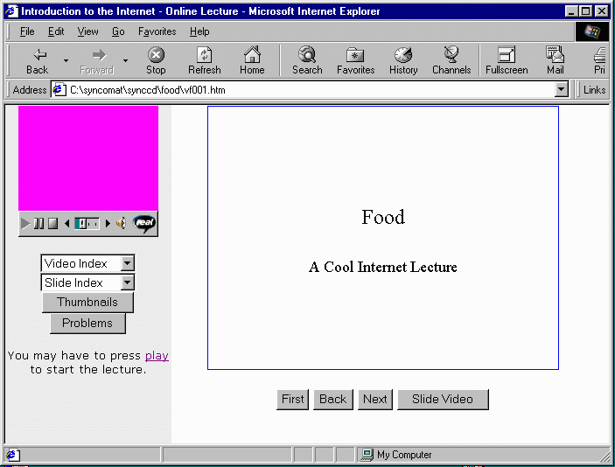
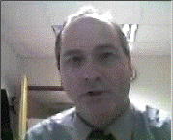
Looking good...

Slide 28
On to the Web
Once a lecture works off disk we can move it to the web
We will do the simpler pseudo-streaming example - streaming is covered in other documents
We must know the URL that we will upload the material to before we start

Slide 29
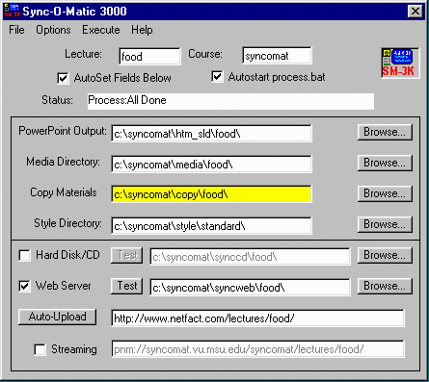
(3) Re-make the lecture
(4) Wait for “All Done”
(1) Uncheck Hard Disk and check Web Server
(2) Enter web base URL for lecture here

Slide 30
Once Web Version is Done
Use FTP to upload the contents of c:\syncomat\syncweb\food\ to the web server in the appropriate location
Use any FTP client such as DOS or WS_FTP depending on what you feel comfortable with
Press the “Test” button for the web

Slide 31
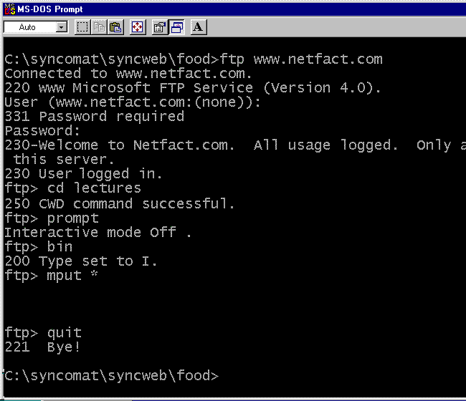

Slide 32

Looking even better...

Slide 33
Conclusion
This is a basic start
Take a look at the Basic Sync-O-Matic Documentation slides
Probably the next steps would be to experiment with streaming or possibly configure and use auto-upload instead of FTP

