Slide 1
Web-Delivered Lectures:
Experience
Dr. Richard J. Enbody
Computer Science & Engineering
Michigan State University

Slide 2
Outline
Introduction
Philosophy
My course: CPS 230 VU
Issues
Experiences
Feedback
References
Notes:
Rhetorical questions are ones I don’t plan to answer. The answers will happen. We are not in a position to affect the outcome very much.
Real Questions fall into the area that we educators and our institutions may be able to have an impact on.
The answers are my answers - they are not intended to be precise answers but instead to be thought provoking answers.

Slide 3
Target
We want to reach students who cannot attend class either because of location or time constraints.
The solution must be asynchronous: anytime and anywhere.

Slide 4
Comparison
Asynchronous
is not as good as a live classroom
is not as good as synchronous, interactive delivery
Can it be sufficiently effective?

Slide 5
Goals
Asynchronous anytime, anywhere, now:
Use infrastructure that exists
  Web delivery
  Low technology: 28.8 modem
Easy development
  Existing course material
  Software tools to facilitate development

Slide 6
Philosophy
Do it now.
  Get something working to experiment with.
Personalize.
  Students need to feel that they are interacting with a person.
  Talking head

Slide 7
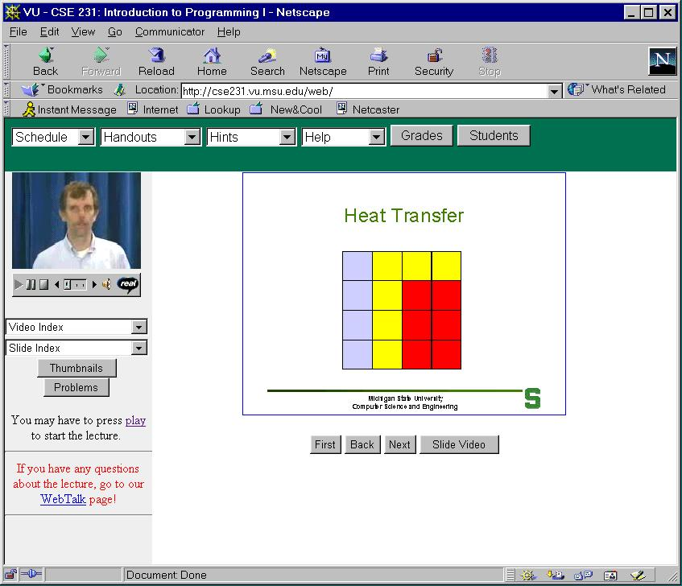

Slide 8
Track Record
Develop Sync-O-Matic
Offer experimental course EGR 124 (Fall 1996)
Offer mainstream required course CPS 230 (Fall 1998) [now CSE 231]
Develop Chalkboard

Slide 9
Philosophy
The human element is essential. We believe video helps personalize the experience.
Our target is the asynchronous learner.
Some synchronous elements needed:
  deadlines (efficiency)
  interaction (personalization)

Slide 10
CPS 230
Introductory programming course (C++). Standard CS1 course.
14-week Semester.
Calculus prerequisite.
First course for CS & CPE majors, but has large service component.
Large regular offering (250 students)

Slide 11
CPS 230 (con’t)
Weekly in-lab assignments (2 hours: credit/no_credit)
Weekly homework projects (graded).
Three exams
UNIX-based
All work done on department computers

Slide 12
Synchronous
Weekly deadlines.
  Weekly lab and project
  All students on the same weekly schedule.
  Necessary for efficiency.
  Regular deadlines help keep students participating in the class
  Identifies problems quickly

Slide 13
Weekly Page
Weekly reading from text
Two lectures
Weekly lab assignment
Weekly homework assignment
Solution to previous week’s work
Note from instructor

Slide 14
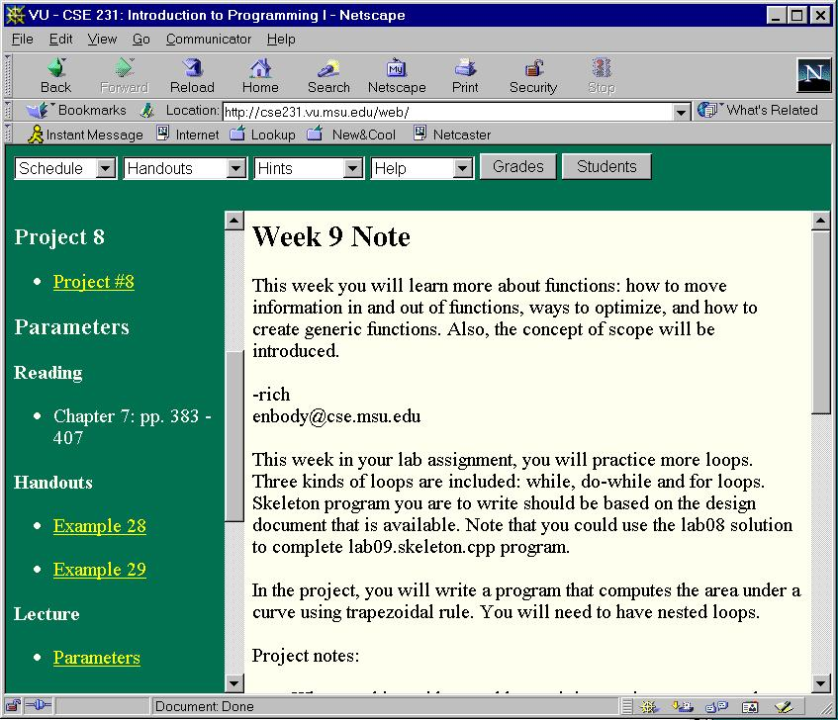

Slide 15
Exams
Exams are live for local VU students or proctored remotely
Multiple choice (yuk!)

Slide 16
Interaction
Assignments are handed in electronically.
Assignments and exam results are returned electronically
Email and UNIX “talk” are primary interaction media.

Slide 17
Interaction
Fixed office hours don’t work. If many students could make a particular time, they wouldn’t need VU.
Some synchronous communication with someone is needed.
Only one communication point is a bottleneck.

Slide 18
Interaction
Regular contact is necessary
  For example, broadcast an email weekly for any reason to let the students know you are there and in touch.

Slide 19
CSE 231 VU
First offered in FS98
Includes
  high school students
  handicapped students
  study abroad students
  LifeLong Ed. “nontraditional” students
  athletes and band members
  majority are on-campus MSU students

Slide 20
Communication Tool
Combines email, chat room, and newsgroup:
  Email <=> Newsgroup
  Chat => Newsgroup

Slide 21
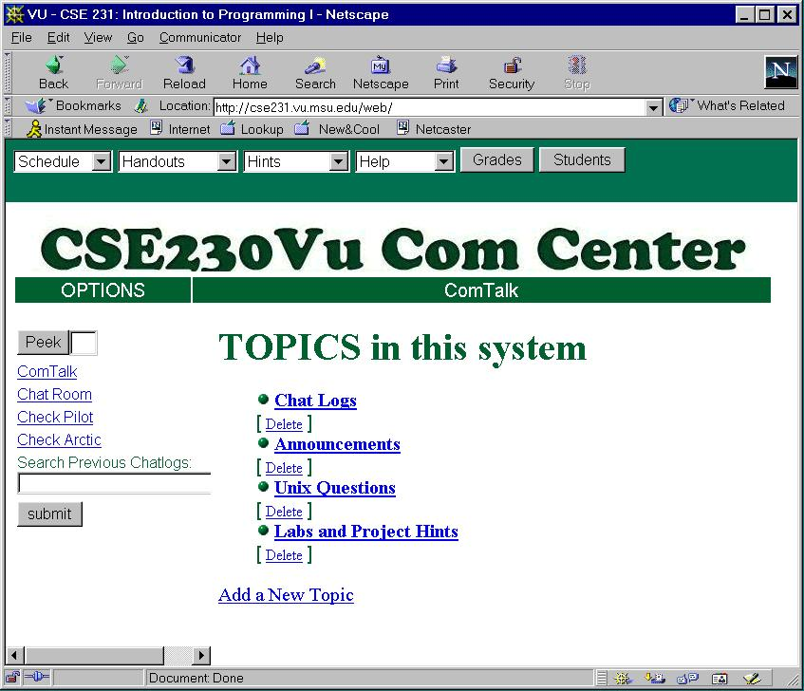

Slide 22
Ideas: Community of Learners
Need to be able to establish synchronous communication:
  “Who’s out there? Please join me in chat.”
Need to personalize communication
  Web biographies
  Pictures in communication (possibly a graphic)

Slide 23
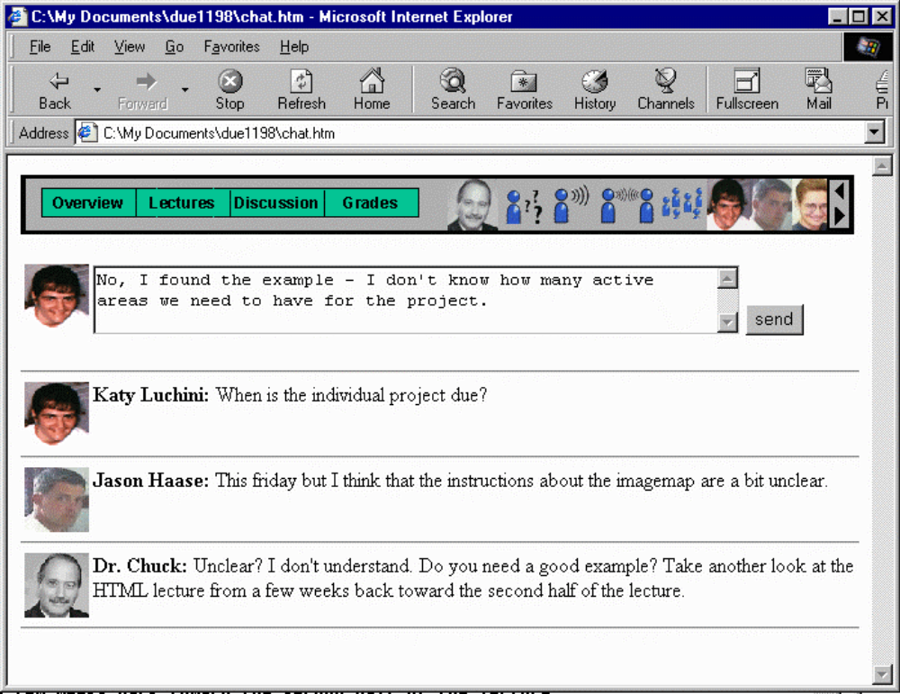

Slide 24
Ideas: Active Learning
Short lecture segment:
  10 to 15 minutes
Simple exercise between segments:
  “write a for loop which prints odd integers”
  provide feedback
Repeat
  Short lecture segment,
  exercise, etc.

Slide 25
Tracking
At this point there is insufficient data for tracking success in following courses.
  Too few students continue to next CS course (not unique to VU section).
  Overloaded courses often prevent enrollment in next course in the next term.
  Off-campus students may not continue at MSU

Slide 26
What we do know
Distribution of grades is similar in VU and regular sections
  slightly better: self-selection?
Drop out rate is higher in VU sections
  Non-traditional students “testing the water”
  Particularly attractive to over-committed
  Startup overhead

Slide 27
Experience
Only make a mature class VU: feedback loop is degraded.
VU does not save time: creation and management take time.
Creating student-student interaction is critical to success.
VU does not scale easily: bigger is harder

Slide 28
Student Feedback
“Like the Truman show: Enbody is playing somewhere at any time.”
“The only class I didn’t skip or fall asleep in.”
“I can put the kids to sleep and then attend a lecture at home.”
“Very easy to procrastinate.”

Slide 29
References
VU at MSU is http://www.vu.msu.edu
  CSE 231 “Preview”
URL http://www.cse.msu.edu/~enbody
Email: enbody@cse.msu.edu

