Slide 1

K&R Chapter 4 Functions and Program Structure
Dr. Charles R. Severance
www.cc4e.com
code.cc4e.com (sample code)
online.dr-chuck.com

Slide 2
Chapter 4 – Unique Areas
Section 4.1 – Automatic variables, parameters and the stack, Oh My!
Section 4.3 – Why arrays pass by reference – the rest is Chapter 5
Section 4.7 – Register variables
Section 4.10 – Recursion – because recursion ☺
Section 4.11 – Pre-processor – Compiler architecture

Slide 3
What is a “stack”
A stack is a dynamic memory structure that gets larger when we “push” new data onto it and shrinks when we “pop” data from it.
stk = list()
stk.append("one")
print('Stack 1:', stk)
stk.append("two")
print('Stack 2:', stk)
stk.append("three")
print('Stack 3:', stk)
print('Pop!', stk.pop())
print('Stack 4:', stk)
Stack 1: ['one’]
Stack 2: ['one', 'two’]
Stack 3: ['one', 'two', 'three']
Pop! three
Stack 4: ['one', 'two']
one
Also known as “Last in First Out” or LIFO Queue.
kr_04_01.py

Slide 4
What is a “stack”
A stack is a dynamic memory structure that gets larger when we “push” new data onto it and shrinks when we “pop” data from it.
stk = list()
stk.append("one")
print('Stack 1:', stk)
stk.append("two")
print('Stack 2:', stk)
stk.append("three")
print('Stack 3:', stk)
print('Pop!', stk.pop())
print('Stack 4:', stk)
Stack 1: ['one’]
Stack 2: ['one', 'two’]
Stack 3: ['one', 'two', 'three']
Pop! three
Stack 4: ['one', 'two']
two
one
one
Also known as “Last in First Out” or LIFO Queue.
kr_04_01.py

Slide 5
Using a stack to implement call by value
#include <stdio.h>
void one(op)
int op;
{
printf("One op before %d\n",op);
op = op - 10;
printf("One op after %d\n",op);
}
int main() {
int ma = 42;
printf("Main ma before %d\n",ma);
one(ma);
printf("Main ma after %d\n",ma);
}
Call by value says that within a function, you can change a parameter and it does not affect the copy of the variable in the main()
Parameters are “isolated to within the function”
Main ma before 42
One op before 42
One op after 32
Main ma after 42
kr_04_01.c

Slide 6
Stack
void one(op)
int op;
{
int tn = 10;
printf("One op before %d\n",op);
op = op - tn;
printf("One op after %d\n",op);
}
int main() {
int ma = 42;
printf("Main ma before %d\n",ma);
one(ma);
printf("Main ma after %d\n",ma);
}
A stack is a dynamic memory structure that gets larger when we “push” new data onto it and shrinks when we “pop” data from it.
Main ma before 42
ma
42
main automatic variables
Time ->
kr_04_01.c

Slide 7
Stack
void one(op)
int op;
{
int tn = 10;
printf("One op before %d\n",op);
op = op - tn;
printf("One op after %d\n",op);
}
int main() {
int ma = 42;
printf("Main ma before %d\n",ma);
one(ma);
printf("Main ma after %d\n",ma);
}
tn
10
one automatic vars
stack
frame
op
42
one parameters
Main ma before 42
One op before 42
ma
42
ma
42
main automatic variables
Time ->
kr_04_01.c

Slide 8
Stack
void one(op)
int op;
{
int tn = 10;
printf("One op before %d\n",op);
op = op - tn;
printf("One op after %d\n",op);
}
int main() {
int ma = 42;
printf("Main ma before %d\n",ma);
one(ma);
printf("Main ma after %d\n",ma);
}
tn
tn
10
10
stack
frame
op
42
op
32
Main ma before 42
One op before 42
One op after 32
ma
42
ma
42
ma
42
Time ->
kr_04_01.c

Slide 9
Stack
void one(op)
int op;
{
int tn = 10;
printf("One op before %d\n",op);
op = op - tn;
printf("One op after %d\n",op);
}
int main() {
int ma = 42;
printf("Main ma before %d\n",ma);
one(ma);
printf("Main ma after %d\n",ma);
}
tn
tn
10
10
stack
frame
op
42
op
32
Main ma before 42
One op before 42
One op after 32
Main ma after 42
main auto vars
ma
42
ma
42
ma
42
ma
42
Time ->
kr_04_01.c
one auto vars
one parm vars

Slide 10
Stack
void one(op)
int op;
{
int tn = 10;
printf("One op before %d\n",op);
op = op - tn;
printf("One op after %d\n",op);
}
int main() {
int ma = 42;
printf("Main ma before %d\n",ma);
one(ma);
printf("Main ma after %d\n",ma);
}
Main ma before 42
One op before 42
One op after 32
Main ma after 42
main auto vars
ma
42
ma
main automatic variables
42
Time ->
kr_04_01.c

Slide 11
Are arrays call by value in C? Sort of.
def zap(y):
print('Y start zap:',y)
y = 'CHANGED'
print('Y end zap:',y)
x = 'ORIGINAL'
print('X before zap:',x)
zap(x)
print('X after zap:',x)
void zap(char y[]) {
printf("Y start zap: %s\n",y);
strcpy(y, "CHANGED");
printf("Y end zap: %s\n",y);
}
int main(){
char x[] = "ORIGINAL";
printf("X before zap: %s\n",x);
zap(x);
printf("X after zap: %s\n",x);
}
X before zap: ORIGINAL
Y start zap: ORIGINAL
Y end zap: CHANGED
X after zap: ORIGINAL
X before zap: ORIGINAL
Y start zap: ORIGINAL
Y end zap: CHANGED
X after zap: CHANGED
kr_04_02.py
kr_04_02.c

Slide 12
void zap(char y[]) {
printf("Y start zap: %s\n",y);
strcpy(y, "CHANGED");
printf("Y end zap: %s\n",y);
}
int main(){
char x[] = "ORIGINAL";
printf("X before zap: %s\n",x);
zap(x);
printf("X after zap: %s\n",x);
}
The array *location* is passed *by value* (i.e. a copy is made into the stack frame) but no copy is made of the data in the array. Since the function *knows where* the data is, it can change the data.
O
R I G I N A L
\0
X before zap: ORIGINAL
Y start zap: ORIGINAL
Y end zap: CHANGED
X after zap: CHANGED
stack
frame
y
x
kr_04_02.c

Slide 13
Register Variables
Register variables are another nod to assembly language programmers who were concerned about the performance of their code
You can’t get the “memory address” of a variable declared as register
Likely completely ignored in modern compilers
register int x;
register char c;

Slide 14
Recursion, see recursion
When a function calls itself, it is called “recursion”
Recursion is a powerful programming concept
Recursion is essential to writing good code in special situations
Parsing expressions like (5 * 2) + ( ( 6 + 5 ) * 9 )
Traversing tree-like structures
Simple recursion examples (like this one) are very bad uses of recursion and mislead you as to the applications of recursion
We just want to see how a call stack makes recursion possible

Slide 15
Stack
sumup(3) = 1 + 2 + 3 = 6
int sumup(int above)
{
int below;
int sum;
int retval;
printf("In: %d\n",above);
if ( above <= 1 ) return 1; // Stop
below = above - 1;
printf("Down: %d\n",below);
sum = sumup(below); // Recurse
printf("Back: %d\n",sum);
retval = above + sum;
printf(”Ret: %d\n",retval);
return retval;
}
int main()
{
int sup = sumup(3);
printf("Sup: %d\n",sup);
}
retval
In: 3
Down: 2
In: 2
Down: 1
In: 1
Back: 1
Ret: 3
Back: 3
Ret: 6
Sup: 6
stack
frame
3
sum
1
below
1
above
2
retval
sum
below
2
above
3
sup
kr_04_03.c

Slide 16
The C Pre Processor
While C solved many of the problems that led to the ability to build portable applications, things were always in flux
Language evolution
Library evolution
Hardware evolution
Operating system evolution
The pre-processor allowed for adjusting to these changes without breaking backwards compatibility
… The second incompleteness theorem, an extension of the first, shows that the system cannot demonstrate its own consistency.
--- Gödel's incompleteness theorems

Slide 17
Transform C Source code to C Source code
#include <stdio.h>
#ifdef USE_LONG
#define INT_32 long
#else
#define INT_32 int
#endif
int main() {
int i;
INT_32 ipaddress;
// ...
}
int printf(const char * restrict, ...)
int putc(int, FILE *);
int putchar(int);
int puts(const char *);
int remove(const char *);
void rewind(FILE *);
int scanf(const char * restrict, ...)
int main() {
int i;
int ipaddress;
// ...
}
gcc –E kr_04_04.c
kr_04_04.c

Slide 18
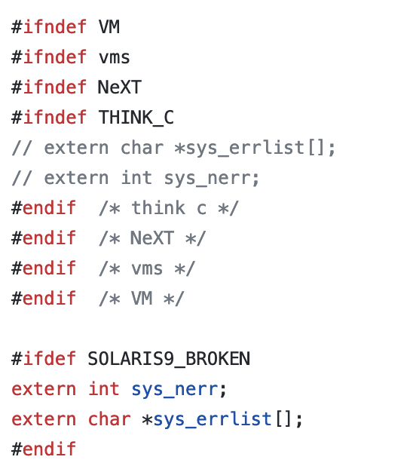
Delivering real portability …
In this example C snippet from XMosaic 1.2 from 1994, we see constant effort to use the pre-processor so we can compile the program on a wide range of operating systems and even versions of those operating systems.
The code makes network connections and handles errors
https://github.com/csev/xmosaic-1.2/blob/master/libwww/HTTCP.c#L47

Slide 19
Summary
Void type – the universal pointer
Passing arrays by reference
Recursion
The Pre Processor

Slide 20
Acknowledgements / Contributions
These slides are Copyright 2023- Charles R. Severance (online.dr-chuck.com) as part of www.cc4e.com and made available under a Creative Commons Attribution 4.0 License. Please maintain this last slide in all copies of the document to comply with the attribution requirements of the license. If you make a change, feel free to add your name and organization to the list of contributors on this page as you republish the materials.
Initial Development: Charles Severance, University of Michigan School of Information
Insert new Contributors and Translators here including names and dates
Continue new Contributors and Translators here

