Slide 1
Flow of control 2000
EECS 280
Jim Eng/ Charles Severance
Reading: Savitch Chapter 7

Slide 2
Outline
Multiway branches, continued
Loops loops loops
  while loops
  do-while loops
  for-loops
Breaking out of a loop
Designing loops
Debugging loops

Slide 3
But first … a word about drivers and stubs
You could write all of project 2 at once and then start testing it
OR, you could write it piece by piece, testing each one as you go
For example, forget about min, max, average and dump -- write the main command processor.
Instead of calling function, cout the input

Slide 4
Nested if-statements
All if-statements and if-else statements have other statements nested inside
A multiway branch can be achieved by nesting one or more if-else statement inside an if-else statement

Slide 5
One nested-if example
if(month == 1)
cout << “January”;
else if(month == 2)
cout << “February”;
else if(month == 3)
cout << “March”;
else
…
else if(month == 12)
cout << “December”;
else
cout << “\n error message of some sort”;

Slide 6
Switch
switch(month)
{
case 1: cout << “January”;
break;
case 2: cout << “February”;
break;
case 3: cout << “March”;
break;
...
case 12: cout << “December”;
break;
default: cout << “\n error message”;
break;
}

Slide 7
Switch
switch(month)
{
case 1: cout << “January”;
break;
case 2: cout << “February”;
break;
case 3: cout << “March”;
break;
...
case 12: cout << “December”;
break;
default: cout << “\n error message”;
break;
}
Controlling expression
Must be of type:
bool int
char enum

Slide 8
Switch
switch(month)
{
case 1: cout << “January”;
break;
case 2: cout << “February”;
break;
case 3: cout << “March”;
break;
...
case 12: cout << “December”;
break;
default: cout << “\n error message”;
break;
}
Break statement
Causes switch statement
to end

Slide 9
Switch
switch(month)
{
case 1: cout << “January”;
break;
case 2: cout << “February”;
break;
case 3: cout << “March”;
break;
...
case 12: cout << “December”;
break;
default: cout << “\n error message”;
break;
}
Default case
Executes if
no other cases match

Slide 10
Switch
switch(day)
{
case 15:
case 30: cout << “payday”;
break;
default: cout << “not payday”;
break;
}

Slide 11
To switch or not
Branching governed by the value of a simple expression of an appropriate type?
Reasonable number of cases?
Ranges of values?
Mixed conditions?

Slide 12

Are you afraid of loops?
The infinite loop is like
a giant whirlpool from
a bad sci-fi movie
You slip in without expecting it
There’s no way out
UNLESS ...
the superhero arrives
in time

Slide 13
How, when, why do we enter and exit loop?
While-loop
  check condition and enter if true
  check condition before each iteration
  repeat loop body while condition is true,
  exit when false
  loop body should make some change
  so condition eventually becomes false

Slide 14
While-loop syntax
while ( <expression> )
<statement>
while ( <expression> )
{
<statement>
<statement>
...
}

Slide 15
While-loop example
char displayBalance;
cout << "Display monthly balances? (y/n) ";
cin >> displayBalance;
while((displayBalance != 'y’) && (displayBalance != 'n’))
{
cout << endl << "Please enter \'y\' or \'n\'.
<< endl;
cout << "Display monthly balances? (y/n) ";
cin >> displayBalance;
}

Slide 16
How, when, why do we enter and exit loop?
Do-while loop
  enter unconditionally
  check condition after each iteration
  repeat as long as condition is true,
  exit when false
  loop body should make some change
  so condition eventually becomes false

Slide 17
Do-while loop syntax
do
<statement>
while ( <expression> );
do {
<statement>
<statement>
...
} while ( <expression> );

Slide 18
Do-while loop example
char displayBalance;
do {
cout << "Display monthly balances? (y/n) ";
cin >> displayBalance;
} while((displayBalance != 'y’) && (displayBalance != 'n’));

Slide 19
Do-while loop example
char displayBalance;
do {
cout << "Display monthly balances? (y/n) ";
cin >> displayBalance;
if ((displayBalance != 'y’) && (displayBalance != 'n’))
cout << endl << "Please enter \'y\' or \'n\'.
<< endl;
} while((displayBalance != 'y’) && (displayBalance != 'n’));

Slide 20
How, when, why do we enter and exit loop?
For- loop
  initialize loop-control variable on entry
  check condition and enter loop body if condition is true
  update loop-control variable after executing loop body
  check condition after each iteration

Slide 21
How, when, why do we enter and exit loop?
For- loop, continued
  repeat as long as condition is true,
  exit when false
  update should make some change in loop-control variable so condition eventually becomes false
  every for-loop can be implemented as a while-loop

Slide 22
For-loop syntax
for( <init>; <test>; <update> )
<statement>
for( <init>; <test>; <update> )
{
<statement>
<statement>
...
}

Slide 23
While vs. for
int factorial = 1;
int n = 10;
while ( n > 0 )
{
factorial *= n;
n++;
}
int factorial = 1;
for(int n = 10; n > 0; n++)
factorial *= n;

Slide 24
Nested for-loops
const int MAX = 9;
cout << setw(6) << " |";
for(int i = 0; i < MAX; i++) // prints column labels
cout << setw(4) << i;
cout << endl;
cout << "-----|";
for(int i = 0; i < MAX; i++) // prints horizontal line
cout << "----";
for(int i = 0; i < MAX; i++) // handles rows
{
cout << endl << setw(4) << i << " |";
for(int j = 0; j < MAX; j++) // handles columns
cout << setw(4) << i*j; // within rows
}

Slide 25
Output
| 0 1 2 3 4 5 6 7 8
-----|------------------------------------
0 | 0 0 0 0 0 0 0 0 0
1 | 0 1 2 3 4 5 6 7 8
2 | 0 2 4 6 8 10 12 14 16
3 | 0 3 6 9 12 15 18 21 24
4 | 0 4 8 12 16 20 24 28 32
5 | 0 5 10 15 20 25 30 35 40
6 | 0 6 12 18 24 30 36 42 48
7 | 0 7 14 21 28 35 42 49 56
8 | 0 8 16 24 32 40 48 56 64

Slide 26
Breaking out of loops
Sometimes necessary to exit a loop in the middle of an iteration
break, as in switch statement, exits loop body
breaks ends execution of innermost loop
Use judiciously

Slide 27
Choosing a loop
Counting, summing, etc. (mathematical sequences or series)
  for-loop?
Number of iterations known in advance
  for loop
Some value in the input (a “sentinel”) indicates end of input
  while or do-while loop

Slide 28
Choosing a loop ...
Can user be queried about ending the loop
  while or do-while loop
Other indicator: eof, for example
  while or do-while loop
While or do-while?
  Iterate at least once? do-while
  Possibly zero iterations? while

Slide 29
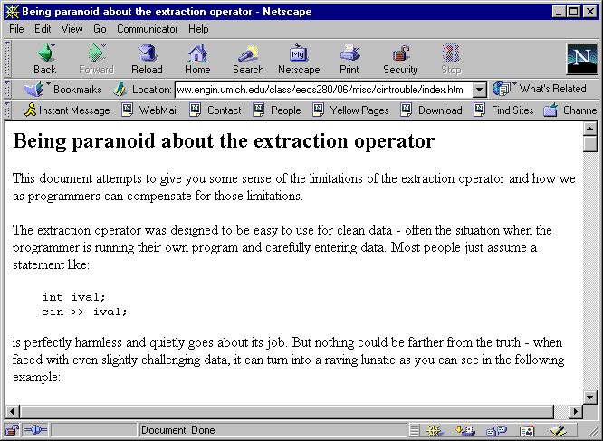
Chuck’s paranoia ...

Slide 30
Attempting to handle eof
% a.out
Enter a number
1
You entered 1
Enter a number
2
You entered 2
Enter a number
3
You entered 3
Enter a number
You entered 3
%
int i;
while ( ! cin.eof() )
{
cout << "Enter a number" << endl;
cin >> i;
cout << "You entered " << i << endl;
}

Slide 31
Better ...
% a.out
Enter a number
1
You entered 1
Enter a number
2
You entered 2
Enter a number
3
You entered 3
Enter a number
%
int i;
while ( ! cin.eof() )
{
cout << "Enter a number"
<< endl;
cin >> i;
if ( !cin.eof() )
cout << "You entered "
<< i << endl;
}

Slide 32
But still not quite perfect ...
a.out | more
Enter a number
1
You entered 1
Enter a number
2
You entered 2
Enter a number
three
You entered 2
Enter a number
You entered 2
Enter a number
... And so on forever!
int i;
while ( ! cin.eof() )
{
cout << "Enter a number"
<< endl;
cin >> i;
if ( !cin.eof() )
cout << "You entered "
<< i << endl;
}

Slide 33
Debugging loops
Off-by-one errors
  wrong initialization? wrong test?
Infinite loops
  testing a floating-point value for equality or inequality?
  wrong loop test?
  Updating the loop-control variable?

Slide 34
Debugging loops
Localize the problem
  how far in your program did you get?
  Insert extra cout’s
  which loop are you caught in?
  a.out | more
Trace the values of variables
  insert extra cout’s to show where the error occurs

Slide 35
Testing a loop
Zero iterations of loop body
One iteration of loop body
Maximum number of iterations
One less than the maximum
Others

Slide 36
Summary
Multiway branches
  nested-if
  switch
More about loops

Slide 37
Next time
Read Chapter 9 except Section 9.4
Arrays
Arrays in Functions
Review for midterm exam
Assigned rooms for exam

