Slide 1
Defining ADTs
EECS280
Charles Severance / Jim Eng
Savitch 8

Slide 2
Overview
Separate compilation
  Interface, implementation, application
  Clashes caused by multiple includes
Insertion, extraction revisited
Many odds and ends

Slide 3
Separate compilation
Header file defines the interface (i.e. the class definition)
Implementation file implements all the public features of the class
Application file uses the class

Slide 4
What’s included where?
The header file is included in the application file
The header file is included in the implementation file
#include <iostream>
#include <strstream>
#include <iomanip>
#include “ComplexNumber.h
That’s it.

Slide 5
Compiling in g++
Compile both application and implementation files (not header file)
% g++ TestNumbers.cpp ComplexNumber.cpp
% a.out

Slide 6

Using ComplexNumbers

Slide 7
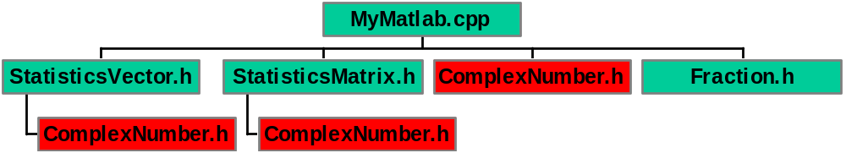
Using ComplexNumbers

Slide 8
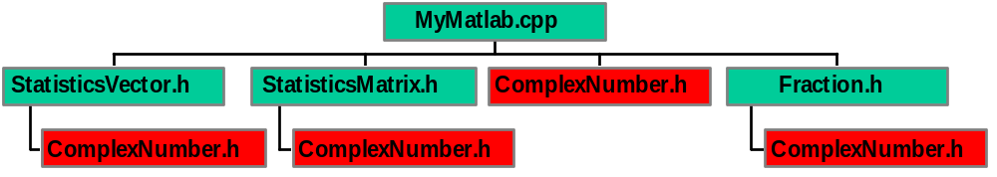
Using ComplexNumbers

Slide 9
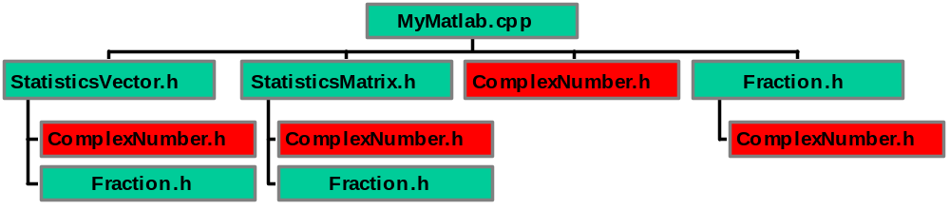
Using ComplexNumbers

Slide 10
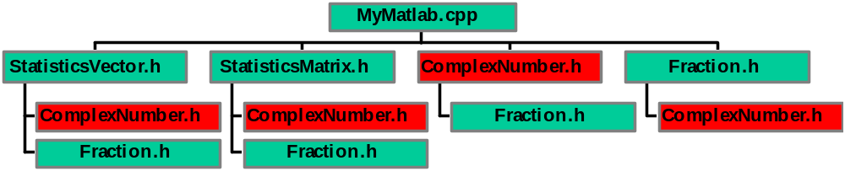
Using ComplexNumbers

Slide 11
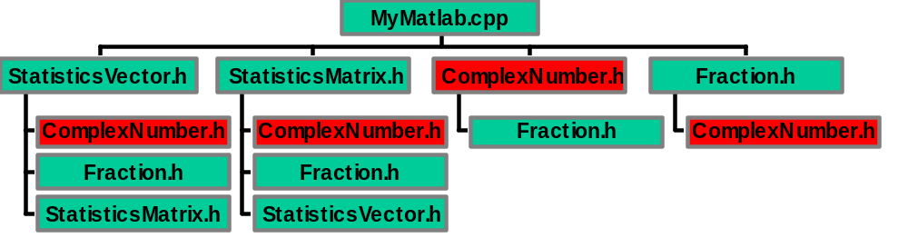
Using ComplexNumbers

Slide 12
Cannot define same thing twice
Have you seen this error message?
Error: ... attempt to redefine ****
Error: ... cannot redefine ****
You would see lots of them if you tried to include a header files that define classes that have already been defined

Slide 13
Then how do we do this?

Slide 14
Use #ifndef … #endif
#define COMPLEXNUMBERS_H puts the identifier COMPLEXNUMBERS_H in a list of defined identifiers
#ifndef COMPLEXNUMBERS_H checks whether COMPLEXNUMBERS_H is in the list of defined identifiers
If it is, the code between the #ifndef directive and #endif is not executed

Slide 15
#include <iostream>
using namespace std;
#ifndef COMPLEXNUMBERS_H
#define COMPLEXNUMBERS_H
class ComplexNumber
{
public:
ComplexNumber(double r, double i);
ComplexNumber(double r);
ComplexNumber();
. . .
private:
double RealPart;
double ImaginaryPart;
};
#endif //COMPLEXNUMBERS_H

Slide 16
Helper functions
Examples from P3, P4 (parsing file):
  skip_eol()
  skip_ws()
  getNumber()
  getWord()
  getCommand()
Declared private

Slide 17
Overloading insertion operator
ostream& operator << (ostream& outstr, const ComplexNumber& n)
{
if( n.ImaginaryPart == 0.0 )
outstr << n.RealPart;
else
outstr << '(' << n.RealPart << ','
<< n.ImaginaryPart << ')';
return outstr;
}

Slide 18
Using the insertion operator
ComplexNumber x(302,207);
cout << endl << " x = " << x << endl;

Slide 19
Using the insertion operator
ComplexNumber x(302,207);
cout << endl << " x = " << x << endl;
x = (302.0,207.0)

Slide 20
Using the insertion operator
ComplexNumber x(302,207);
cout << endl << " x = " << setw(10) << x << endl;
x.setNumber(30.2, 207);
cout << endl << " x = " << setw(10) << x << endl;
x.setNumber(3.02, 2.07);
cout << endl << " x = " << setw(10) << x << endl;

Slide 21
Using the insertion operator
ComplexNumber x(302,207);
cout << endl << " x = " << setw(10) << x << endl;
x.setNumber(30.2, 207);
cout << endl << " x = " << setw(10) << x << endl;
x.setNumber(3.02, 2.07);
cout << endl << " x = " << setw(10) << x << endl;
x = (302.0,207.0)
x = (30.2,207.0)
x = (3.0,2.1)

Slide 22
Overloading insertion operator
ostream& operator << (ostream& outstr, const ComplexNumber& n)
{
if( n.ImaginaryPart == 0.0 )
outstr << n.RealPart;
else
outstr << '(' << n.RealPart << ','
<< n.ImaginaryPart << ')';
return outstr;
}

Slide 23
Using strstream to format output
ostream& operator <<
(ostream& outstr, const ComplexNumber& n)
{
char s[62];
ostrstream outbuf(s, 62);
if( n.ImaginaryPart == 0.0 )
outbuf << n.RealPart << ends;
else
outbuf << '(' << n.RealPart << ','
<< n.ImaginaryPart << ')' << ends;
outstr << s;
return outstr;
}

Slide 24
Using the revised version
ComplexNumber x(302,207);
cout << endl << " x = " << setw(16) << x << endl;
x.setNumber(30.2, 207);
cout << endl << " x = " << setw(16) << x << endl;
x.setNumber(3.02, 2.07);
cout << endl << " x = " << setw(16) << x << endl;

Slide 25
Using the revised version
ComplexNumber x(302,207);
cout << endl << " x = " << setw(16) << x << endl;
x.setNumber(30.2, 207);
cout << endl << " x = " << setw(16) << x << endl;
x.setNumber(3.02, 2.07);
cout << endl << " x = " << setw(16) << x << endl;
x = (302,207)
x = (30.2,207)
x = (3.02,2.07)

Slide 26
Can we set precision?
We’d like to get information from the outstr parameter about the output format of the ostream (fixed? showpoint? precision?) and pass it to the outbuf (strstream)
outbuf.flags( outstr.flags() );
// sets fixed and showpoint
outbuf.precision( outstr.precision() );
// sets precision

Slide 27
Testing strstream formatting
ComplexNumber x(302,207);
cout << endl << " x = " << setw(16) << x << endl;
x.setNumber(30.2, 207);
cout << endl << " x = " << setw(16) << x << endl;
x.setNumber(3.02, 2.07);
cout << endl << " x = " << setw(16) << x << endl;
x = (302.0,207.0)
x = (30.2,207.0)
x = (3.0,2.1)

Slide 28
Overloading extraction
As with insertion, the first parameter (left operand) and return type for extraction are stream references (istream instead of ostream, of course)
Second param (right operand) is reference to an object of type ComplexNumber
What the function accepts defines the legal inputs for the class
We want to accept f, (f), and (f, f), where f is any floating-point number

Slide 29
istream& operator >> (istream& instr, ComplexNumber& n)
{
double r(0), i(0);
char ch(0);
instr >> ch;
if( ch == '(' )
{
cin >> r >> ch;
if( ch == ',' )
instr >> i >> ch;
if( ch != ')' )
instr.clear(ios::badbit); // set state
}
else
{
instr.putback(ch);
instr >> r;
}
if(instr)
n.setNumber( r, i );
return instr;
}
(12,24)
(12)
12
(12, bob)

Slide 30
Good / fail / bad
“Good” means a value has been read without error detected
“Fail” means an error has been detected, no value has been read into the variable, and the stream is unchanged (other than the failbit being set)
“Bad” means the stream is corrupted, and no value has been read into the variable

Slide 31
// tests in do-while loop
cout << "Enter x: ";
cin >> x;
if( cin.eof() )
exit(1);
if( cin.bad() ) {
cout << " ==> cin bad" << endl;
cin.clear();
cout << " ==> x: " << x << endl;
cout << " ==> rest of line: ";
show_rol(cin);
}
else if ( cin.fail() ) {
cout << " ==> cin fail" << endl;
cin.clear();
cout << " ==> x: " << x << endl;
cout << " ==> rest of line: ";
show_rol(cin);
}
else {
cout << " ==> cin good" << endl;
cout << " ==> x: " << x << endl;
cout << " ==> rest of line: ";
show_rol(cin);
}

Slide 32
// tests in do-while loop
cout << "Enter x: ";
cin >> x;
if( cin.eof() )
exit(1);
if( cin.bad() ) {
cout << " ==> cin bad" << endl;
cin.clear();
cout << " ==> x: " << x << endl;
cout << " ==> rest of line: ";
show_rol(cin);
}
else if ( cin.fail() ) {
cout << " ==> cin fail" << endl;
cin.clear();
cout << " ==> x: " << x << endl;
cout << " ==> rest of line: ";
show_rol(cin);
}
else {
cout << " ==> cin good" << endl;
cout << " ==> x: " << x << endl;
cout << " ==> rest of line: ";
show_rol(cin);
}
Enter x: (1,2)
==> cin good
==> x: (1.0,2.0)
==> rest of line:
Do it again? (y/n) y
Enter x: (3,4 bob
==> cin bad
==> x: (1.0,2.0)
==> rest of line: ob
Do it again? (y/n) y
Enter x: (5, bob
==> cin bad
==> x: (1.0,2.0)
==> rest of line: bob
Do it again? (y/n) y
Enter x: (6 bob
==> cin bad
==> x: (1.0,2.0)
==> rest of line: ob
Do it again? (y/n) y

Slide 33
Enter x: (bob
==> cin bad
==> x: (1.0,2.0)
==> rest of line: bob
Do it again? (y/n) y
Enter x: 7bob
==> cin good
==> x: 7.0
==> rest of line: bob
Do it again? (y/n) y
Enter x: (8,9)
==> cin good
==> x: (8.0,9.0)
==> rest of line:
Do it again? (y/n) y
Enter x: (10)
==> cin good
==> x: 10.0
==> rest of line:
Do it again? (y/n) y
Enter x: bob
==> cin fail
==> x: 10.0
==> rest of line: bob
Do it again? (y/n) y
Enter x: 11bob
==> cin good
==> x: 11.0
==> rest of line: bob
Do it again? (y/n) n

Slide 34
This code is not robust
What happens if user enters “(12” and presses the enter-key?
What should happen?
How can we make it more robust?

Slide 35
istream& operator >> (istream& instr, ComplexNumber& n)
{
double r(0), i(0);
char ch(0);
instr >> ch;
if( ch == '(' )
{
cin >> r >> ch;
if( ch == ',' )
instr >> i >> ch;
if( ch != ')' )
instr.clear(ios::badbit); // set state
}
else
{
instr.putback(ch);
instr >> r;
}
if(instr)
n.setNumber( r, i );
return instr;
}

Slide 36
What about the += operator?
Member function or friend?

Slide 37
What about the += operator?
Member function or friend?
y += 2;

Slide 38
What about the += operator?
Member function or friend? The right operand provides an essential bit of information, but the operator acts on the left operand.
ComplexNumber& ComplexNumber::operator += (const ComplexNumber& n)
{
RealPart += n.RealPart;
ImaginaryPart += n.ImaginaryPart;
return *this;
}
So it’s a member function.

Slide 39
What’s this?
ComplexNumber& ComplexNumber::operator += (const ComplexNumber& n)
{
RealPart += n.RealPart;
ImaginaryPart += n.ImaginaryPart;
return *this;
}

Slide 40
The this pointer
this is a pointer to the calling object
Not needed in most functions, but when overloading assignments, it’s needed to return the value of the object to which the assignment is made
Notice that *this dereferences the pointer
Details, examples in Appendix 9

Slide 41
const qualifier
We’ve seen that reference parameters are usually more efficient than value parameters, and that the const qualifier makes it safe to pass by reference when the referenced value should not change
double getReal();
bool equal(const ComplexNumber& n)
{
. . . n.getReal() . . .
}
double getReal() const;

Slide 42
Hmmmm….
Recall that we overloaded the addition operator as follows:
ComplexNumber operator + ( const ComplexNumber& n1, const ComplexNumber& n2)
{
cout << " ==> addition: " << n1 << " + "
<< n2 << endl;
ComplexNumber n(n1);
n.RealPart += n2.RealPart;
n.ImaginaryPart += n2.ImaginaryPart;
return n;
}
But we have not defined a constructor with a ComplexNumber parameter
So how do we create a copy of n1?

Slide 43
Hmmmm hmmmm….
Recall that our only definition of addition involved two ComplexNumber operands:
ComplexNumber operator + ( const ComplexNumber& n1, const ComplexNumber& n2);
Yet if you add a value of type double to a ComplexNumber, you’ll get a result of type ComplexNumber:
double y(8.7);
ComplexNumber x(12,6), sum1, sum2;
sum1 = x + y;
sum2 = y + x;
cout << "sum1 = " << sum1
<< ", sum2 = " << sum2 << endl;

Slide 44
Hmmmm hmmmm….
Recall that our only definition of addition involved two ComplexNumber operands:
ComplexNumber operator + ( const ComplexNumber& n1, const ComplexNumber& n2);
Yet if you add a value of type double to a ComplexNumber, you’ll get a result of type ComplexNumber:
double y(8.7);
ComplexNumber x(12,6), sum1, sum2;
sum1 = x + y;
sum2 = y + x;
cout << "sum1 = " << sum1
<< ", sum2 = " << sum2 << endl;
sum1 = (20.7,6.0), sum2 = (20.7,6.0)

Slide 45
Constructors enable automatic type conversion
The reason is that the compiler constructs a new ComplexNumber, if it can, using one of our constructors:
ComplexNumber(double r, double i);
ComplexNumber(double r);
ComplexNumber();
In this case, the second constructor can be used to create a ComplexNumber from a double

Slide 46
double y(8.7);
ComplexNumber x(12,6), sum1, sum2;
sum1 = x + y;
sum2 = y + x;
cout << "sum1 = " << sum1
<< ", sum2 = " << sum2 << endl;
==> constructor for ComplexNumber(12.0, 6.0)
==> constructor for ComplexNumber()
==> constructor for ComplexNumber()
==> constructor for ComplexNumber(8.7)
==> addition: (12.0,6.0) + 8.7
==> constructor for ComplexNumber(8.7)
==> addition: 8.7 + (12.0,6.0)
sum1 = (20.7,6.0), sum2 = (20.7,6.0)

Slide 47
Up Next
Savitch - 9.4
Arrays in classes, arrays of objects
Fractions example
Coming soon: Chapter 11

