Slide 1
Linked Lists
Jim Eng/Charles Severance
Savitch: Chapter 14

Slide 2
Overview
A piece of the big example
Creating a simple linked list
Tracing linked list operations in CodeWarrior
A template for a linked list

Slide 3


Slide 4
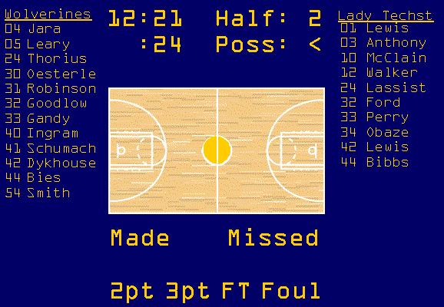

Slide 5
A list of ShotAttempts
struct ShotNode
{
ShotAttempt attempt;
ShotNode* link;
}

Slide 6
struct ShotAttempt {
int period;
TimeType time;
TimeType shotclock;
PlayerType * player;
Point position;
int value;
bool made;
bool fouled;
}

Slide 7
hometeam
Jara
Leary
Thorius
Susana
Michaela
Anne
visitors
4
5
24
Oesterle
Robinson
Goodlow
Gandy
Heather
Infini
Raina
Stephanie
30
31
32
33
Ingram
Schumacher
Dykhouse
Bies
Alayne
Christie
Katie
LeeAnn
40
41
42
44

Slide 8
struct PlayerNode {
int number;
string fname;
string lname;
int att2pt;
int made2pt;
int att3pt;
int made3pt;
int attFT;
int madeFT;
int fouls;
int offRebounds;
int defRebounds;
int assists;
int steals;
PlayerNode* link;
}

Slide 9
struct PlayerNode {
int number;
string fname;
string lname;
PlayerNode* link;
}

Slide 10
struct IndexedNode {
int index;
int data;
IndexedNode* link;
}

Slide 11
struct IndexedNode {
int index;
int data;
IndexedNode* link;
}
class IndexedList {
public:
private:
IndexedNode* head;
}

Slide 12
struct IndexedNode {
int index;
int data;
IndexedNode* link;
}
class IndexedList {
public:
IndexedList();
~IndexedList();
private:
IndexedNode* head;
}

Slide 13
IndexedList::IndexedList()
{
head = NULL;
}
IndexedList::~IndexedList()
{
// fill in later
}

Slide 14
struct IndexedNode {
int index;
int data;
IndexedNode* link;
}
class IndexedList {
public:
IndexedList();
~IndexedList();
void insert( IndexedNode* newnode );
void insert( int index, int data );
private:
IndexedNode* head;
}

Slide 15
void IndexedList::insert( IndexedNode* newnode )
{
newnode->link = NULL;
if( ! head ) {
head = newnode;
return;
}
if( newnode->index < head->index ) {
newnode->link = head;
head = newnode;
return;
}

Slide 16
IndexedNode* prev = head;
IndexedNode* curr = prev->link;
while( curr &&
(newnode->index > curr->index) )
{
prev = curr;
curr = curr->link;
}
newnode->link = curr;
prev->link = newnode;
}

Slide 17
head
newnode
Gandy
Stephanie
33

Slide 18
head
Gandy
Stephanie
33
newnode
Ingram
Alayne
40

Slide 19
head
Gandy
Ingram
Stephanie
Alayne
33
40
newnode
Bies
LeeAnn
44

Slide 20
head
Gandy
Ingram
Bies
Stephanie
Alayne
LeeAnn
33
40
44
newnode
Goodlow
Raina
32

Slide 21
head
Gandy
Goodlow
Ingram
Stephanie
Raina
Alayne
33
32
40
Bies
LeeAnn
44
newnode
Schumacher
Christie
41

Slide 22
head
Gandy
Goodlow
Ingram
Stephanie
Raina
Alayne
33
32
40
Schumacher
Bies
Christie
LeeAnn
41
44
newnode
Jara
Susana
4

Slide 23
head
Jara
Gandy
Goodlow
Susana
Stephanie
Raina
4
33
32
Ingram
Schumacher
Bies
Alayne
Christie
LeeAnn
40
41
44

Slide 24
void IndexedList::insert
( int index, int data )
{
IndexedNode* newnode = new IndexedNode;
newnode->index = index;
newnode->data = data;
newnode->link = NULL;
insert(newnode);
}

Slide 25
int main()
{
IndexedList list;
list.insert(15,15);
list.insert( 7,22);
list.insert(22, 7);
list.insert(10,19);
list.insert(12,21);
return 0;
}

Slide 27
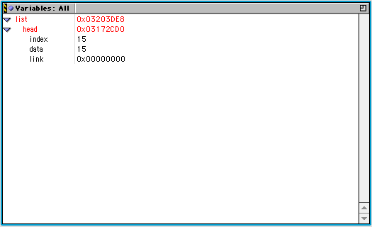
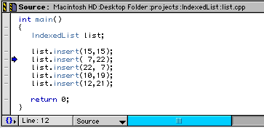

Slide 28
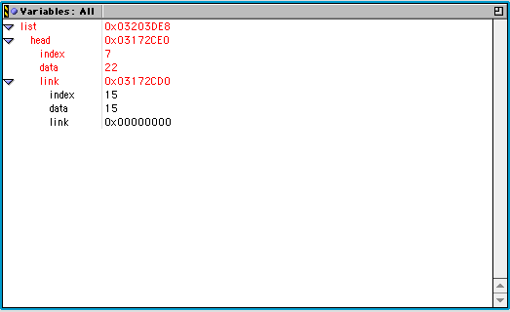
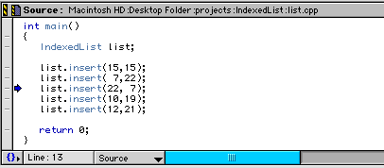

Slide 29
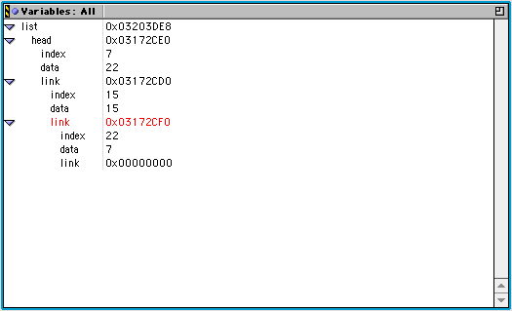
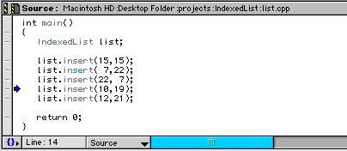

Slide 30
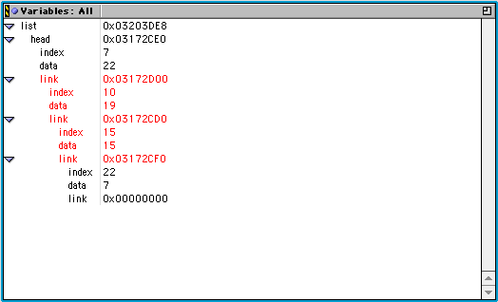
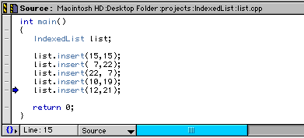

Slide 32
More about debugging
CodeWarrior: What if insert fails
g++: Use cout

Slide 33
class IndexedList {
public:
IndexedList();
~IndexedList();
void insert( IndexedNode* newnode );
void insert( int index, int data );
IndexedNode* getNode(int index);
private:
IndexedNode* head;
}

Slide 34
IndexedNode* IndexedList::getNode(int index)
{
if( (! head) || (index < head->index) )
return NULL;
IndexedNode* curr = head;
while( curr && (index > curr->index) )
curr = curr->link;
if( curr && (index == curr->index) )
return curr;
else
return NULL;
}

Slide 35
IndexedList list;
list.insert(15,15);
list.insert( 7,22);
list.insert(22, 7);
list.insert(10,19);
list.insert(12,21);
list.insert(19,11);
for( int i = 5; i < 25; i++ ) {
IndexedNode* node = list.getNode( i );
if( node )
cout << setw(3) << i << " ==> "
<< setw(6) << (node->data)
<< endl;
else
cout << setw(3) << i
<< " ==> Not found" << endl;
}

Slide 36
5 ==> Not found
6 ==> Not found
7 ==> 22
8 ==> Not found
9 ==> Not found
10 ==> 19
11 ==> Not found
12 ==> 21
13 ==> Not found
14 ==> Not found
15 ==> 15
16 ==> Not found
17 ==> Not found
18 ==> Not found
19 ==> 11
20 ==> Not found
21 ==> Not found
22 ==> 7
23 ==> Not found
24 ==> Not found

Slide 37
class IndexedList {
public:
IndexedList();
~IndexedList();
void insert( IndexedNode* newnode );
void insert( int index, int data );
IndexedNode* getNode(int index);
private:
IndexedNode* head;
}

Slide 38
Template for IndexedList
Type of the “data” element may be int, double, char, string, struct ---, class ---, etc.
How to do it:
  Label program elements as templates
  Specify class parameter for data element
  Substitute references for data element type
  Substitute references to IndexedNode and IndexedList

Slide 39
template<class T>
struct IndexedNode
{
int index;
T data;
IndexedNode* link;
};

Slide 40
template<class T>
class IndexedList
{
public:
IndexedList();
~IndexedList();
void insert( IndexedNode<T>* newnode );
void insert( int index, T data );
IndexedNode<T>* getNode(int index);
private:
IndexedNode<T>* head;
};

Slide 41
template<class T>
IndexedList<T>::IndexedList()
{
head = NULL;
}
template<class T>
IndexedList <T>::~IndexedList()
{
// to be defined later
}

Slide 42
template<class T>
void IndexedList<T>::insert
( IndexedNode<T>* newnode )
{
newnode->link = NULL;
if( ! head ) {
head = newnode;
return;
}
if( newnode->index < head->index ) {
newnode->link = head;
head = newnode;
return;
}

Slide 43
IndexedNode<T>* prev = head;
IndexedNode<T>* curr = prev->link;
while( curr &&
(newnode->index > curr->index) )
{
prev = curr;
curr = curr->link;
}
newnode->link = curr;
prev->link = newnode;
}

Slide 44
template<class T>
void IndexedList<T>::insert
( int index, T data )
{
IndexedNode<T>* newnode
= new IndexedNode<T>;
newnode->index = index;
newnode->data = data;
newnode->link = NULL;
insert(newnode);
}

Slide 45
template<class T>
IndexedNode<T>*
IndexedList<T>::getNode(int index)
{
if( (! head) || (index < head->index) )
return NULL;
IndexedNode<T>* curr = head;
while( curr && (index > curr->index) )
curr = curr->link;
if( curr && (index == curr->index) )
return curr;
else
return NULL;
}

Slide 46
Using the template
Instantiate IndexedNode and IndexedList and specify type of data element

Slide 47
IndexedList<int> list;
list.insert(15,15);
list.insert( 7,22);
list.insert(22, 7);
list.insert(10,19);
list.insert(12,21);
list.insert(19,11);
for( int i = 5; i < 25; i++ ) {
IndexedNode<int>* node = list.getNode( i );
if( node )
cout << setw(3) << i << " ==> "
<< setw(6) << (node->data)
<< endl;
else
cout << setw(3) << i
<< " ==> Not found" << endl;
}

Slide 48
5 ==> Not found
6 ==> Not found
7 ==> 22
8 ==> Not found
9 ==> Not found
10 ==> 19
11 ==> Not found
12 ==> 21
13 ==> Not found
14 ==> Not found
15 ==> 15
16 ==> Not found
17 ==> Not found
18 ==> Not found
19 ==> 11
20 ==> Not found
21 ==> Not found
22 ==> 7
23 ==> Not found
24 ==> Not found

Slide 49
IndexedList<double> list;
list.insert(15,1.5);
list.insert( 7,2.2);
list.insert(22,0.7);
list.insert(10,1.9);
list.insert(12,2.1);
list.insert(19,1.1);
for( int i = 5; i < 25; i++ ) {
IndexedNode<double>* node = list.getNode( i );
if( node )
cout << setw(3) << i << " ==> "
<< setw(6) << (node->data)
<< endl;
else
cout << setw(3) << i
<< " ==> Not found" << endl;
}

Slide 50
5 ==> Not found
6 ==> Not found
7 ==> 2.2
8 ==> Not found
9 ==> Not found
10 ==> 1.9
11 ==> Not found
12 ==> 2.1
13 ==> Not found
14 ==> Not found
15 ==> 1.5
16 ==> Not found
17 ==> Not found
18 ==> Not found
19 ==> 1.1
20 ==> Not found
21 ==> Not found
22 ==> 0.7
23 ==> Not found
24 ==> Not found

Slide 51
IndexedList<char> list;
list.insert(15,'a');
list.insert( 7,'b');
list.insert(22,'c');
list.insert(10,'d');
list.insert(12,'e');
list.insert(19,'f');
for( int i = 5; i < 25; i++ ) {
IndexedNode<char>* node = list.getNode( i );
if( node )
cout << setw(3) << i << " ==> "
<< setw(6) << (node->data)
<< endl;
else
cout << setw(3) << i
<< " ==> Not found" << endl;
}

Slide 52
5 ==> Not found
6 ==> Not found
7 ==> b
8 ==> Not found
9 ==> Not found
10 ==> d
11 ==> Not found
12 ==> e
13 ==> Not found
14 ==> Not found
15 ==> a
16 ==> Not found
17 ==> Not found
18 ==> Not found
19 ==> f
20 ==> Not found
21 ==> Not found
22 ==> c
23 ==> Not found
24 ==> Not found

Slide 53
struct PlayerNode {
int number;
string fname;
string lname;
int att2pt;
int made2pt;
int att3pt;
int made3pt;
int attFT;
int madeFT;
int fouls;
int offRebounds;
int defRebounds;
int assists;
int steals;
PlayerNode* link;
}

Slide 54
Using a complex data element
Make sure that all operations used on data of the parameterized type in the template are defined for the complex type (in this case: operator=)
struct Player
{
string fname;
string lname;
};

Slide 55
IndexedList<Player> list;
Player p;
p.fname = "Raina";
p.lname = "Gooodlow";
list.insert(32, p);
p.fname = "LeAnn";
p.lname = "Bies";
list.insert(44, p);
p.fname = "Anne";
p.lname = "Thorius";
list.insert( 24, p);

Slide 56
p.fname = "Susana";
p.lname = "Jara";
list.insert( 4, p);
p.fname = "Infini";
p.lname = "Robinson";
list.insert( 31, p);
p.fname = "Jennifer";
p.lname = "Smith";
list.insert( 54, p);
p.fname = "Alayne";
p.lname = "Ingram";
list.insert( 40, p);

Slide 57
for( int i = 0; i < 100; i++ )
{
IndexedNode<Player>* node
= list.getNode( i );
if( node )
cout << setw(3) << i << " ==> "
<< (node->data).fname
<< " "
<< (node->data).lname
<< endl;
}

Slide 58
4 ==> Susana Jara
24 ==> Anne Thorius
31 ==> Infini Robinson
32 ==> Raina Gooodlow
40 ==> Alayne Ingram
44 ==> LeAnn Bies
54 ==> Jennifer Smith

Slide 59
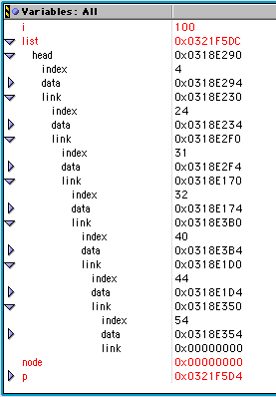
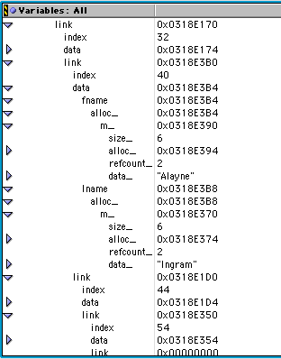

Slide 60
Next
Indexed lists
Iterating through linked lists
Read Project 7 assignment, Savitch Ch. 14

