Slide 1
Strings and Arrays
Jim Eng/Charles Severance
EECS280

Slide 2
There are three terrible bugs in this code. Find them.
…
char ch;
while( isspace(ch) && ! cin.eof() ) {
cin.get(ch);
}
if ( isdigit(ch) ) {
…..
}

Slide 3
There are three terrible bugs in this code. Find them.
Uninitialized data - Will the loop run or not?
…
char ch;
while( isspace(ch) && ! cin.eof() ) {
cin.get(ch);
}
if ( isdigit(ch) ) {
…..
}
Cannot test before you read
If you hit eof, why use the data?

Slide 4
char ch;
do {
cin.get(ch);
} while( isspace(ch) && ! cin.eof() ) ;
if ( cin.eof() || cin.fail() ) break;
if ( isdigit(ch) ) {
…..
}

Slide 5
Bonus: What is wrong here??
while ( ! cin.eof() ) {
cin.get(ch);
if ( cin.eof() || cin.fail() ) break;
while ( isspace(ch) && ch != ‘\n’ ) {
cin.get(ch);
break;
}
if ( isdigit(ch) ) {

Slide 6
I feel validated as a teacher :)
while ( ! cin.eof() ) {
cin.get(ch);
if ( cin.eof() || cin.fail() ) break;
while ( isspace(ch) && ch != ‘\n’ ) {
cin.get(ch);
break;
}
if ( cin.eof() || cin.fail() ) break;
if ( isdigit(ch) ) {
Kind of a short loop :)
Don’t speak too soon about validation

Slide 7
More C++ (Standard) Strings
Several member functions
  find(str)
  find_first_of(str)
  find_last_of(str)
  insert(pos,len,str)
  replace(pos,len,str)
These functions can accept C-Strings, C++ Strings, or characters

Slide 8
morestr.cpp - More member functions in the C++ String class
str1 = "Hello world";
cout << "str1 = " << str1 << endl;
cout << "find of world = " << str1.find("world") << endl;
cout << "find first of = " << str1.find_first_of(" od") << endl;
cout << "find last of = " << str1.find_last_of(" od") << endl;
str1.insert(6,"cruel ");
cout << "str1 = " << str1 << endl;
str1.replace(6,5,"nice ");
cout << "str1 = " << str1 << endl;
str1 = Hello world
find of world = 6
find first of = 4
find last of = 10
str1 = Hello cruel world
str1 = Hello nice world

Slide 9
More C-String Stuff
There is a series of conversion routines
  atol, atoi, atof
  Convert from characters (ASCII) to long, integer, and double respectively
Similar to scanf, and extraction
  Skip leading isspace()
  Liberal interpretation of what is a number
  Stop when a character "makes no sense"

Slide 10
testato.cpp - Testing atoi and atof
while ( ! cin.eof () ) {
cout << "Enter something" << endl;
getline(cin,str1);
if ( cin.fail() || cin.eof() ) break;
errno = 0;
i = atoi(str1.c_str());
cout << "errno = " << errno << " i= " << i << endl;
errno = 0;
d = atof(str1.c_str());
cout << "errno = " << errno << " d= " << d << endl;
}
}
#include <iostream>
#include <string>
using namespace std;
#include <stdlib.h>
#include <errno.h>
int main() {
string str1;
int i;
double d;
Note: for a complete description see man atoi on UNIX

Slide 11
Enter something
123
errno = 0 i= 123
errno = 0 d= 123
Enter something
123.4
errno = 0 i= 123
errno = 0 d= 123.4
Enter something
bob
errno = 0 i= 0
errno = 0 d= 0
Enter something
12bob
errno = 0 i= 12
errno = 0 d= 12
Enter something
123.4
errno = 0 i= 123
errno = 0 d= 123.4
Enter something
-123
errno = 0 i= -123
errno = 0 d= -123
Enter something
- 1 2 3
errno = 0 i= 0
errno = 0 d= 0
Enter something
1 2 3
errno = 0 i= 1
errno = 0 d= 1
Enter something
+45
errno = 0 i= 45
errno = 0 d= 45
Enter something
1.234E3
errno = 0 i= 1
errno = 0 d= 1234
Enter something
5.0E30
errno = 0 i= 5
errno = 0 d= 5e+30
Enter something
Whew!
errno = 0 i= 0
errno = 0 d= 0

Slide 12
October 10, 2000
Playing with ActiveX in Visual C++
Connecting Visual Basic and C++
Parameter type "BSTR" - which is a special type of string
void Ccb2kactivexCtrl::SetDirName(LPCTSTR lpszNewValue)
{
// TODO: Add your code to handle method here
}

Slide 13
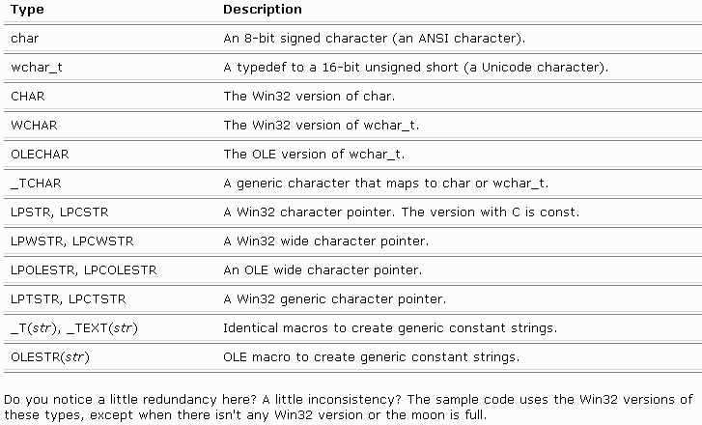
From the VC++ documentation...... Too many strings

Slide 14
void Ccb2kactivexCtrl::SetDirName(LPCTSTR lpszNewValue)
{
string mystring; // C++ Standard string
mystring = lpszNewValue; // On a lark
....
}
This happy moment was brought to you by Polly Morhpism Enterprises.

Slide 15
Super Triple Extra Bonus: What is wrong here??
cin.get(ch);
if ( isdigit(ch) ) {

Slide 16
Arrays of Strings (C++)
The syntax to declare an array of strings is the same as the syntax to declare an array of integers
starr[0]
bob was here
// A 100 element string array
string starr[100];
starr[0] = "bob was here";
starr[2] = "hello world";
cout << starr[1].length();
cout << starr[2].cstr();
starr[1]
(empty)
starr[2]
hello world
starr[3]
starr[99]

Slide 17
Using String Array Elements
Once you find an element of the string using the [ ] operator, the result is a string that you can treat like a normal string
starr[2]
hello world
starr[2][4] = 'x';
cout << starr[1].length();
cout << starr[2].erase(4,2);
starr[2][0]
starr[2][4]
starr[2] [0]
A string
A character in a string

Slide 18
Bonus: What is wrong here??
char ch;
while( isspace(ch) && ! cin.eof() ) {
cin.get(ch);
}

Slide 19
Multidimensional Arrays
C++ Supports 2 (and higher) dimensional arrays
  Fully populated arrays (square)
  Partially filled "rows" - ragged - usually C-Style strings of varying lengths
For this section, we will only cover fully populated arrays

Slide 20
Array Syntax
C++ treats a 2-D array as an array of 1-D arrays, so the syntax is a little different than FORTRAN, BASIC or COBOL
int red[4][3];
red[0][0] = 0;
red[1][2] = 255;
red[0][0]
red[0][1]
red[0][2]
red[1][0]
red[1][1]
red[1][2]
red[2][0]
red[2][1]
red[2][2]
red[3][0]
red[3][1]
red[3][2]

Slide 21
An Array of Arrays
int sum(int inarr[], int size) {
int i,sum = 0;
for ( i=0; i < size; i++ ) sum = sum + inarr[i];
return sum;
}
int main() {
int red[4][3];
int xsum;
.....
xsum = sun(red[2]);
}

Slide 22
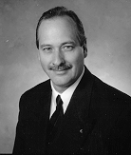

Images in Computers
Array application:
To store images in computers they are broken into Pixels - Picture Elements
The “size” of a pixel
is determined when
the image is created
An example of
pixel size would be
75 “dots-per-inch”

Slide 23
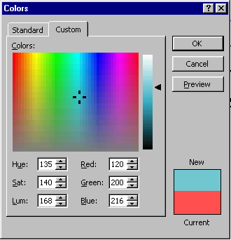
Red, Green, and Blue
By varying levels of Red, Green and Blue, each pixel can have a wide range of colors
Play with the color selector
in a word-processor
In this example, each
color is represented
by a number from 0-255

Slide 24

A Simple Data Structure for Images
int red[480][640];
int green[480][640];
int blue[480][640];
// Wouldn't it be neat if
// we had a built-in
// type called
// "pixel" ??
pixel picture[480][640];
640 "columns"
480
"rows"

Slide 25
An Array of C-Strings
A two dimensional array is (almost) a one dimensional array of C-Strings
Of course you must
maintain the end of
string indicator and
track string size for
each "row"
Fully populated
char stuff[50][80];
strcpy(stuff[25],"testing bob");
cout << stuff[25];
stuff[2][0] = 'a';
stuff[2][1] = 'b';
stuff[2][2] = '\0';
cout << stuff[2];

Slide 26
Fully Populated
This type of array is fully populated but the end-of-string convention allows us to store C-Strings of varying length
char stuff[4][10];
strcpy(stuff[3],"test");
stuff[2][0] = 'a';
stuff[2][1] = 'b';
stuff[2][2] = '\0';
0
1
2
3
4
5
6
7
8
9
0
?
?
?
?
?
?
?
?
?
?
1
?
?
?
?
?
?
?
?
?
?
2
a
b
\0
?
?
?
?
?
?
?
3
t
e
s
t
\0
?
?
?
?
?

Slide 27
So why does this work?
#include <iostream>
char str[4][10] =
{ "bob", "was", "here", "today" };
int main() {
cout << str[3] << endl;
}

Slide 28
Ragged Character Arrays
Undefined as of now
Quick heads up
An array of pointers to character strings
Declaration syntax
is different
Storage layout is
different
Access is similar
char **xyz;
// or
char *xyz[];
xyz[3][2] = 'x';
cout << xyz[9];
strcpy(xyz[4],"hello world");

Slide 29
Bonus: What is wrong here??
char ch;
while( isspace(ch) && ! cin.eof() ) {
cin.get(ch);
}

Slide 30
Summary
Uninitialized data
Checking for End-Of-File
C++ Strings: find insert and replace
C Strings: atoi atof atol
Arrays of C++ Strings
Multidimensional Arrays
Arrays of C Strings

Slide 31
Up Next
Chapter 6

Slide 32
// Demonstrate input and output
cout << "Enter several words\n";
getline(cin,str);
cout << "getline(cin,str) returns:" << str << "\n";
cout << "Enter more words\n";
cin >> str;
cout << "cin >> str returns:" << str << "\n";
getline(cin,str); // Throw away the rest
// Demonstrate assignments
str1 = str;
str2 = "A string constant";
Enter several words
several words
getline(cin,str) returns:several words
Enter more words
more words
cin >> str returns:more

