Slide 1
I/O streams
(Introduction to objects and classes)
EECS 280
Jim Eng/Charles Severance
Reading: Savitch Chapter 5

Slide 2
Outline
“Objects” as a basis for programming
Classes to implement objects
I/O streams as examples of objects
  cout, cin
  files
Manipulating stream objects

Slide 3
“Communicating” with objects
Giving information
Getting information
Controlling behavior

Slide 4
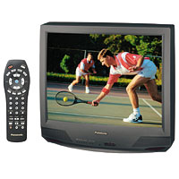
“Communicating” with objects
Giving information
Getting information
Controlling behavior

Slide 5
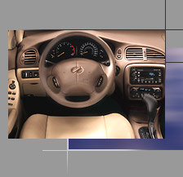

“Communicating” with objects
Giving information
Getting information
Controlling behavior

Slide 6
“Objects” in programs
Think of data structures as objects
Provide methods for communicating with them
  Giving information
  Getting information
  Controlling behavior
Limit other functions from accessing their data except in the ways provided

Slide 7
Object syntax
The functions associated with an object are called “member functions” of the class
A call to a member function refers to a particular instance of that class
Use the dot-operator:
  an_object.do_something();

Slide 8
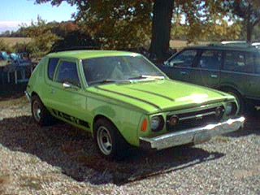
mycar ?
Automobile
mycar(1976, “Gremlin”)
destination =
gps.find(“Meadowbrook”);
mycar.driveTo(destination);
mycar.setSpeed(65.0);
speed = mycar.getSpeed();
if(mycar.getEnginTemp() > 210)
{
mycar.setSpeed(30.0);
destination =
gps.find(“gas station”);
mycar.driveTo(destination);
}

Slide 9
Procedural programming
Programming languages such as C provided no direct support for relating particular functions to particular data
  speed = 95.0;
  if(enginTemp > 210)
  enginTemp = 200;

Slide 10

I/O streams as objects
cout
  cout << “Test”;
  cout << 18.5;
  cout.precision(2);
cin
  cin >> a_number;
  cin >> a_character;
  cin >> a_string;
cout
Your program
cin

Slide 11
How’s that different?
In C (and other procedural languages) you must format each number as you output it
printf(“%8.2f %8.2f”, a_num, another_num);

Slide 12
cout vs. printf
In C++ you talk to a stream, and it remembers
  cout.setf(ios::fixed);
  cout.setf(ios::showpoint);
  cout.precision(2);
  cout.width(8);
  cout << a_num << “ “ << another_num;

Slide 13
What’s a stream?
A flow of data (characters, numbers, strings, bit patterns) into or out of a program
Data flowing into a program is an
input stream
Data flowing out of a program is an output stream

Slide 14
Data sources
Data might flow from a device
- keyboard
- mouse
- joystick
- microphone
- digital camera
- network
- motion detector
- scanner
- CDROM, DVD
- floppy drive
- Zip drive
- hard drive
etc.

Slide 15
Data destinations
Data might flow to a device
- monitor
- printer
- speakers
- network
- alarm
- 3D goggles
- Recordordable
CDROM drive
- floppy drive
- Zip drive
- hard drive
etc.

Slide 16
Files
Several of those devices involve storage of data in discrete collections known as “files”
Files can be stored on magnetic media (floppies, hard drives), optical media (CD-ROMs, DVDs)
Files can flow across networks

Slide 17
Our use of files
MP3s, GIFs, JPEGs, MPEGs, PDFs, DOCs, WPDs, WAVs, ZIPs, HTML
Source files for a C++ program
Executable file output by compiler
Data with persistent value stored in a digital form to allow later retrieval
  outputs from your program
  inputs to your program
Notes:
Data stored in particular format that preserves its meaning

Slide 18
Files as streams
Known examples of streams: cout, cin
With cout (short for console-output), we write to the monitor chronologically, from left to right, top to bottom
With cin (short for …), we read from the keyboard chronologically
Analogy to file I/O

Slide 19
What we do to a stream object
Open it
Read from it OR write to it
Close it
Possibly control its behavior in other ways

Slide 20
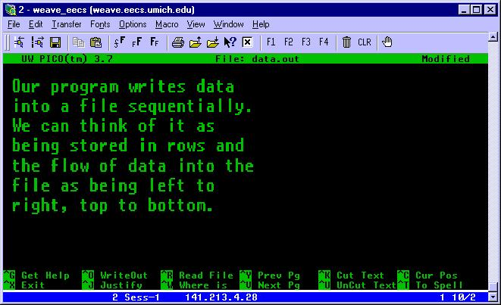

Writing to a file stream
cout writes
to the monitor
in our telnet
window
If we open a
file within a
program, we
can write to it using
similar methods

Slide 21
Writing to cout
#include <iostream.h>
int num1(22),
num2(1234567890);
cout << num1 << endl
<< num2 << endl;

Slide 22
Writing to cout
#include <iostream.h>
int num1(22),
num2(1234567890);
cout << num1 << endl
<< num2 << endl;
22¶
1234567890¶

Slide 23
Writing to cout, a file
#include <iostream.h>
// cout is already
// declared and opened
int num1(22),
num2(1234567890);
cout << num1 << endl
<< num2 << endl;
// cout closes when
// the program ends
#include <fstream.h>
ofstream out_stream;
out_stream.open(“data.txt”)
int num1(22),
num2(12);
out_stream << num1 << endl
<< num2 << endl;
out_stream.close();

Slide 24
More writing to cout
double x1(22.89),
x2(2147483647);
cout.setf(ios::fixed);
cout.setf(ios::showpoint);
cout.setf(ios::right);
cout.width(22);
cout.precision(3);
cout << x1 << x2;
cout << endl;
cout << “A string\n”;

Slide 25
More writing to cout
.................22.8902147483647.000¶
A string¶
¶
double x1(22.89),
x2(2147483647);
cout.setf(ios::fixed);
cout.setf(ios::showpoint);
cout.setf(ios::right);
cout.width(22);
cout.precision(3);
cout << x1 << x2;
cout << endl;
cout << “A string\n”;

Slide 26
More writing to cout
#include <iomanip.h>
cout.setf(ios::fixed);
cout.setf(ios::showpoint);
cout.setf(ios::right);
cout.precision(3);
cout << setw(22) << x1
<< setw(22) << x2
<< endl;
cout << “A string\n”;

Slide 27
More writing to cout
.................22.890........2147483647.000¶
A string¶
¶
#include <iomanip.h>
cout.setf(ios::fixed);
cout.setf(ios::showpoint);
cout.setf(ios::right);
cout.precision(3);
cout << setw(22) << x1
<< setw(22) << x2
<< endl;
cout << “A string\n”;

Slide 28
More writing to cout, a file
#include <iomanip.h>
double x1(22.89),
x2(2147483647);
cout.setf(ios::fixed);
cout.setf(ios::showpoint);
cout.setf(ios::right);
cout.precision(3);
cout << setw(22) << x1
<< setw(22) << x2
<< endl;
cout << “A string\n”;
#include <iomanip.h>
double x1(22.89),
x2(2147483647);
out_stream.setf(ios::fixed);
out_stream.setf(ios::showpoint);
out_stream.setf(ios::right);
out_stream.precision(3);
out_stream << setw(22) << x1
<< setw(22) << x2
<< endl;
out_stream << “A string\n”;

Slide 29
Other useful formatting tools
setprecision()
  cout << setprecision(2) << x1;
setf(ios::left), setf(ios::right)
  cout.setf(ios::left);
setf(ios::showpos)
  cout.setf(ios::showpos);

Slide 30
ofstream and ifstream
#include <fstream.h>
ofstream out_stream;
out_stream.open(“data.out”);
if (out_stream.fail())
{
cout << “Error message\n”;
exit(1);
}
out_stream << some_variable;
out_stream.close();
#include <fstream.h>
ifstream in_stream;
in_stream.open(“data.in”);
if (in_stream.fail())
{
cout << “Didn’t open file\n”;
exit(1);
}
in_stream >> some_variable;
in_stream.close();
// Savitch p. 229

Slide 31
Filename as input
#include <fstream.h>
#include <iostream.h>
char filename[16];
cout << “Enter file name (15 characters max): “;
cin << filename;
ifstream in_stream;
in_stream.open(filename);
if( ! in_stream ) // !in_stream == in_stream.fail()
{
cout << “Couldn’t open “ << filename << endl;
exit(1);
}
// Savitch pp. 231-232

Slide 32
Summary
“Objects” as a basis for programming
Classes to implement objects
I/O streams as examples of objects
  cout, cin
  files
Manipulating I/O stream objects
File I/O is like Console I/O

Slide 33
Next time
cin
More manipulations
Character I/O
Inheritance
More func with flow of control
Read Savitch Chapter 7

