Slide 1
Using I/O streams
EECS 280
Charles Severance/Jim Eng
Reading: Savitch Chapter 5

Slide 2
Outline
Polymorphism with objects
Inheritance
Character I/O
Detecting input errors
Avoiding input errors
Character functions

Slide 3

A question from
Wednesday’s lecture
We talked about objects, streams, files, classes, and member functions.
We saw examples using cout, cin, ifstreams, and ofstreams.
Where, in all of that, was the polymorphism?

Slide 4
Polymorphism in review
Using the same function name to mean different things
For example, overloading the ‘+’ operator to do addition of integers (with integer result), floats (with float result), doubles (with double result), etc.
The types of the operands determine which of these distinct functions is used

Slide 5
Writing to cout, a file
#include <iostream.h>
// cout is already
// declared and opened
int num1(22),
num2(1234567890);
cout << num1 << endl
<< num2 << endl;
// cout closes when
// the program ends
#include <fstream.h>
ofstream out_stream;
out_stream.open(“data.txt”)
int num1(22),
num2(12);
out_stream << num1 << endl
<< num2 << endl;
out_stream.close();

Slide 6
More writing to cout, a file
#include <iomanip.h>
double x1(22.89),
x2(2147483647);
cout.setf(ios::fixed);
cout.setf(ios::showpoint);
cout.setf(ios::right);
cout.precision(3);
cout << setw(22) << x1
<< setw(22) << x2
<< endl;
cout << “A string\n”;
#include <iomanip.h>
double x1(22.89),
x2(2147483647);
out_stream.setf(ios::fixed);
out_stream.setf(ios::showpoint);
out_stream.setf(ios::right);
out_stream.precision(3);
out_stream << setw(22) << x1
<< setw(22) << x2
<< endl;
out_stream << “A string\n”;

Slide 7
ofstream and ifstream
#include <fstream.h>
ofstream out_stream;
out_stream.open(“data.out”);
if (out_stream.fail())
{
cout << “Error message\n”;
exit(1);
}
out_stream << some_variable;
out_stream.close();
#include <fstream.h>
ifstream in_stream;
in_stream.open(“data.in”);
if (in_stream.fail())
{
cout << “Didn’t open file\n”;
exit(1);
}
in_stream >> some_variable;
in_stream.close();
// Savitch p. 229

Slide 8
Polymorphism revisited
Using the same function name to mean different things
The types of the operands (the object’s class and the types of the arguments) determine which of these distinct functions is used

Slide 9
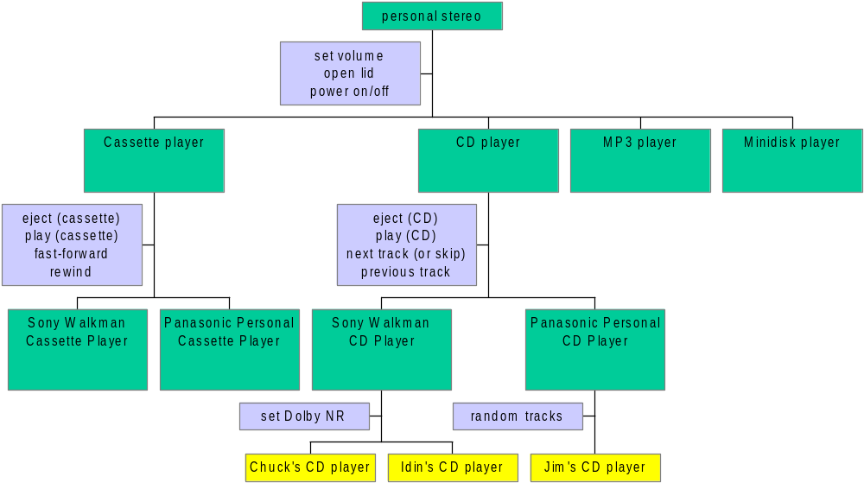
Inheritance: personal stereos

Slide 10
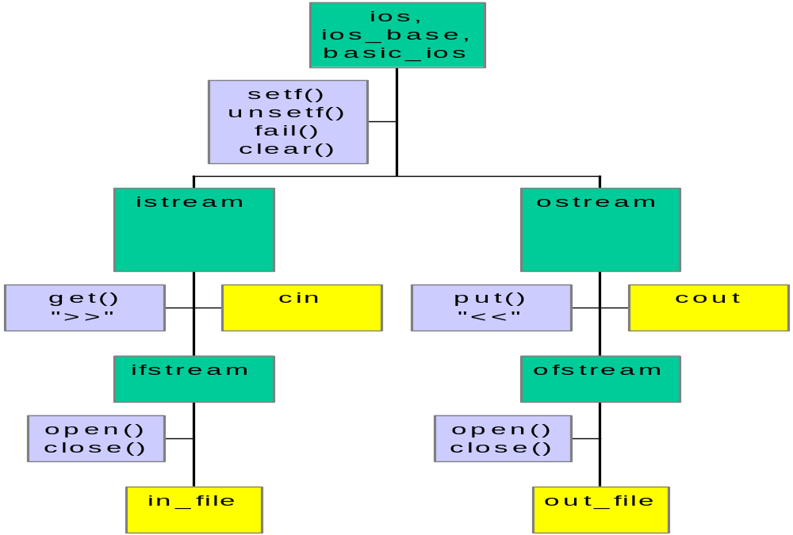
I/O stream heirarchy

Slide 11
Input operations
Use the extraction operator on istream objects to get int’s, strings, doubles, ...
int n;
cin >> n;
in_stream >> n;
char a_str [16];
cin >> a_str;
in_stream >> a_str;
double x;
cin >> d;
in_stream >> d;
char ch;
cin >> ch;
in_stream >> ch;

Slide 12

Input operations
Use the extraction operator on istream objects to get int’s, strings, doubles, ...
int n;
cin >> n;
in_stream >> n;
char a_str [16];
cin >> a_str;
in_stream >> a_str;
double x;
cin >> d;
in_stream >> d;
char ch;
cin >> ch;
in_stream >> ch;

Slide 13
“>>” is not defined for chars
The “>>” operator is intended for formatted input: objects, for example, or formatted numeric data
Use get() to read individual characters
char ch;
cin.get( ch );
in_stream.get( ch );
We could define “>>” operator for chars

Slide 14
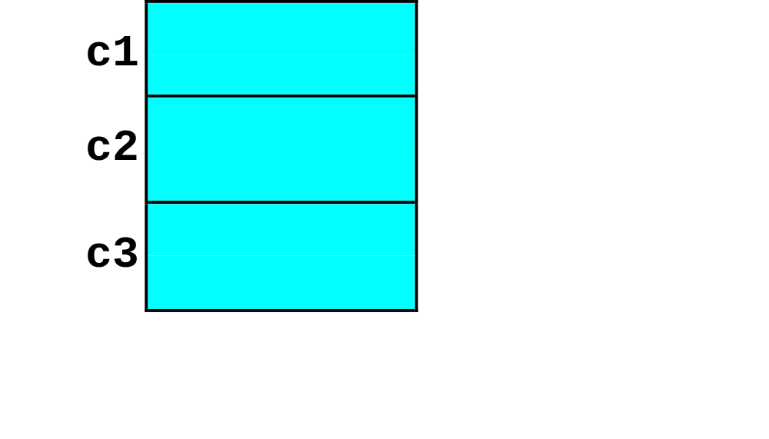
What does get() get?
char c1, c2, c3;
cin.get( c1 );
cin.get( c2 );
cin.get( c3 );
AB¶
CD¶

Slide 15
Searching for an end-of-line
char symbol;
do
{
cin.get( symbol );
cout << symbol;
} while (symbol != ‘\n’);
char ch;
while (cin.get(ch) != ‘\n’);

Slide 16
Sample code
int num1, num2;
cout << "Enter a number: ";
cin >> num1;
cout << "Enter a number: ";
cin >> num2;
cout << num1 << " " << num2 << endl;

Slide 17
Sample run
% test8
Enter a number: 21
Enter a number: 32
21 32
% test8
Enter a number: 21.8
Enter a number: 21 0
% test8
Enter a number: 21abcd
Enter a number: 21 0
%

Slide 18
Reading from the input stream
cout << "Enter a number: ";
cin >> num1;
cout << "Enter a number: ";
cin >> num2;
cout << num1 << " " << num2 << endl;

Slide 19
Reading from the input stream
cout << "Enter a number: ";
cin >> num1;
cout << "Enter a number: ";
cin >> num2;
cout << num1 << " " << num2 << endl;

Slide 20
Reading from the input stream
cout << "Enter a number: ";
cin >> num1;
cout << "Enter a number: ";
cin >> num2;
cout << num1 << " " << num2 << endl;

Slide 21
The most common error …
“The most common error when using istreams is to fail to notice that input didn’t happen as expected because the input wasn’t of the expected type. ...”
- Bjarne Stroustrop
The C++ Programming Language
Third edition

Slide 22
The most common error ...
“… One should … check the state of an input stream before relying on values supposedly read in …”
- Bjarne, again

Slide 23
Checking state of the istream
cout << "Enter a number: ";
cin >> num1;
if( cin.fail() )
{
cout << endl << "Bad data" << endl;
exit(1);
}
cout << "Enter a number: ";
cin >> num2;
if( cin.fail() )
{
cout << endl << "Bad data" << endl;
exit(1);
}
cout << num1 << " " << num2 << endl;

Slide 24
Sample run
% test8
Enter a number: 21
Enter a number: 32
21 32
% test8
Enter a number: 21.8
Enter a number:
Bad data
% test8
Enter a number: 21abcd
Enter a number:
Bad data
%

Slide 25
<stream>.fail() == !<stream>
ifstream in_stream;
in_stream.open(“data.in”);
if (in_stream.fail())
{
cout << “Couldn’t open “ << filename << endl;
exit(1);
}
ifstream in_stream;
in_stream.open(filename);
if( ! in_stream )
{
cout << “Couldn’t open “ << filename << endl;
exit(1);
}

Slide 26
Searching for an end-of-line
char symbol;
do
{
cin.get( symbol );
cout << symbol;
} while (symbol != ‘\n’);
char ch;
while (cin.get(ch) != ‘\n’);

Slide 27
Clearing out debris
cout << "Enter a number: ";
cin >> num1;
// …
do
{
cin.get(ch);
} while( ch != ‘\n’ );
cout << "Enter a number: ";
cin >> num2;
if( cin.fail() )
{
cout << endl << "Bad data" << endl;
exit(1);
}
cout << num1 << " " << num2 << endl;

Slide 28
Reading from the stream
% test8
Enter a number: 12.98
Enter a number: 32
12 32
%

Slide 29
Predefined character functions
Header file ctype.h has many useful functions
isalpha(c) returns true if character c is alphabetic; false otherwise
isdigit(c) returns true if character c is a digit between ‘0’ and ‘9’; false otherwise

Slide 30
More ctype functions
isupper(c) returns true if character c is an uppercase letter; false otherwise
islower(c) returns true if character c is a lowercase letter; false otherwise
isspace(c) returns true if character c is a whitespace character*; false otherwise
* whitespace characters: space, tab, newline, etc.

Slide 31
Two more ctype functions
toupper(c) returns uppercase equivalent of c
tolower(c) returns lowercase equivalent of c

Slide 32
Summary
Polymorphism revisited
Inheritance
Character I/O
Checking the state of the stream
Predefined character functions

Slide 33
Next time
More flow of control
  Boolean expressions
  Multiway branches
  More about loops
Read Savitch Chapter 7

