Slide 1
Flow of control, more thereof
EECS 280
Jim Eng/ Charles Severance
Reading: Savitch Chapter 7

Slide 2
Outline
Boolean expressions
Multiway branches
More about loops

Slide 3
Boolean expressions
if (displayBalance == 'y');
// print column headers
cout << endl << setw(40)
<< "Month Payment Interest Balance"
<< endl << setw(40)
<< "----- ------- -------- -------"
<< endl;

Slide 4
displayBalance == 'y’
Relational operators (==, !=, >, <, >=, <=) evaluate to true or false
Evaluation of these expressions is similar to evaluation of arithmetic expressions
If the values of the variables are known, the value of the expressions can be computed

Slide 5
A familiar example?
char displayBalance;
cout << endl << "Display monthly balances? (y/n) ";
cin >> displayBalance;
while((displayBalance != 'y’) && (displayBalance != 'n’))
{
cout << endl << "Please enter \'y\' or \'n\'."
<< endl;
cout << "Display monthly balances? (y/n) ";
cin >> displayBalance;
}

Slide 6
(displayBalance != 'y’) && (displayBalance != 'n’)
Compund expression: Two (or more) subordinate expressions joined by a logical operator
If value of the variable displayBalance is known, we can compute the values of the subordinate expressions
For the whole expression to be true, both subordinates must be true

Slide 7
exp1 exp2   displayBalance != 'y’ && displayBalance != 'n'
If displayBalance == ‘y’, exp1 is false and exp2 is true
If displayBalance == ‘n’, exp1 is true and exp2 is false
Otherwise, both are true

Slide 8
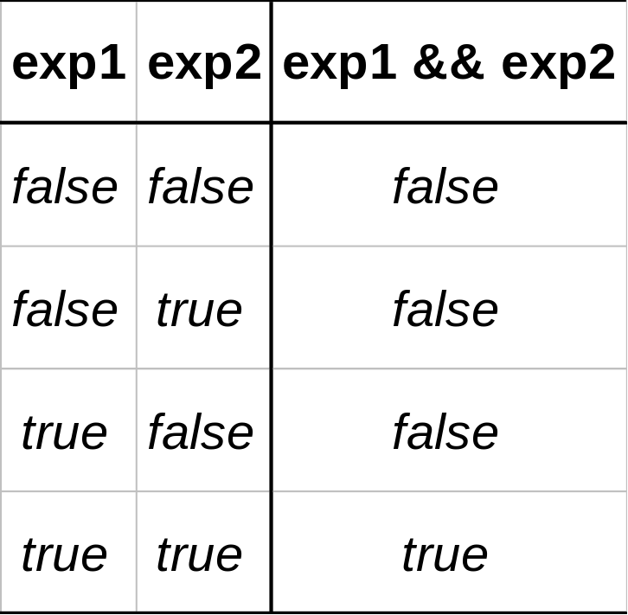
Truth table: exp1 && exp2
&&
AND

Slide 9
Another boolean expression
if((displayBalance == 'y’) || (displayBalance == 'n’))
{
do_something();
}
else
{
do_something_else();
}

Slide 10
(displayBalance == 'y’) || (displayBalance == 'n’)
The “||” operator means “or”
For the whole expression to be false, both subordinate expressions must be false

Slide 11
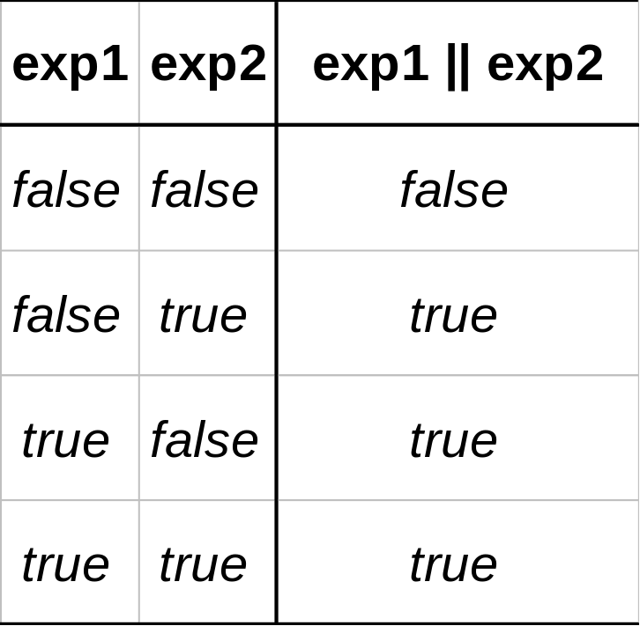
Truth table: exp1 || exp2
||
OR

Slide 12
One more boolean expression
if(! (displayBalance == 'y’))
{
do_something();
}
else
{
do_something_else();
}

Slide 13
! (displayBalance == 'y’)
The “!” operator means “not”
For the whole expression to be true, the subordinate expression must be false

Slide 14
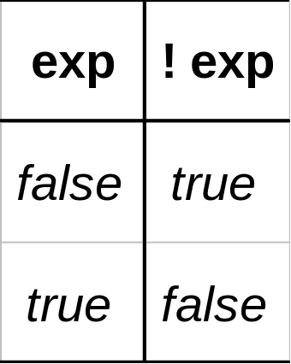
Truth table: ! exp
!
NOT

Slide 15
Sort-circuit evaluation: &&
In a boolean expression, if the major logical operator is &&, once we know either element is false, we know the whole expression is false
Subexpressions are evaluated left to right
Evaluation stops when we can tell the expression is false

Slide 16
Sort-circuit evaluation: ||
If the major logical operator is ||, once we know either element is true, we know the whole expression is true
Evaluation stops when we can tell the expression is true

Slide 17
Precedence
Unary operators:
Binary arithmetic operators:
Binary arithmetic operators:
Relational operators:
Relational operators:
Boolean operator:
Boolean operator:
+, -, ++, - -
*, /, %
+, -
<, >, <=, >=
==, !=
&&
||

Slide 18
Examples (from page 365)
Assume: count is 0, limit is 10
(count == 0) && (limit < 20)
count == 0 && limit < 20

Slide 19
More examples (from page 365)
Assume: count is 0, limit is 10
(limit > 20) || (count < 5)
!( ((count < 10) || (x < y)) && (count >= 0)

Slide 20
Boolean datatype
New datatype: bool
Variables of type bool have two possible values: true and false
Values of type int can be evaluated as if they are bools
  Zero evaluates to false
  Nonzero values evaluate to true

Slide 21
Functions that return bools
Recall the predefined character functions from header file ctype.h
isalpha(c) returns true if character c is alphabetic; false otherwise
isdigit(c) returns true if character c is a digit between ‘0’ and ‘9’; false otherwise

Slide 22
More ctype functions
isupper(c) returns true if character c is an uppercase letter; false otherwise
islower(c) returns true if character c is a lowercase letter; false otherwise
isspace(c) returns true if character c is a whitespace character*; false otherwise

Slide 23
Your own boolean functions
Replace long complex boolean expressions with a function call
Return a boolean from functions that require more than simple evaluation of expressions
For example, an I/O operation whos ultimate purpose to to answer a yes-no question

Slide 24
Returning a boolean value
bool displayBalances()
{
char yORn;
cout << endl << "Display monthly balances? (y/n) ";
cin >> yORn;
while( yORn != 'y' && yORn != 'n' )
{
cout << endl << "Please enter 'y' or 'n'."
<< endl;
cout << "Display monthly balances? (y/n) ";
cin >> yORn;
}
return yORn == ‘y’;
}

Slide 25
Using a bool variable
Bool wantsMonthlyBalances = displayBalances();
if( wantsMonthlyBalances )
cout << endl << setw(40)
<< "Month Payment Interest Balance"
<< endl << setw(40)
<< "----- ------- -------- -------"
<< endl;
...
if( wantsMonthlyBalances )
...

Slide 26
Nested if-statements
All if-statements and if-else statements have other statements nested inside
A multiway branch can be achieved by nesting one or more if-else statement inside an if-else statement

Slide 27
Nested-if example
if (fuel_gauge_reading < 0.75)
{
if (fuel_gauge_reading < 0.25)
cout << “Fuel very low.”;
}
else
cout << “Fuel over 3/4”;

Slide 28
Dangling else
if (fuel_gauge_reading < 0.75)
if (fuel_gauge_reading < 0.25)
cout << “Fuel very low.”;
else
cout << “Fuel over 3/4”;

Slide 29
Another nested-if example
if(month == 1)
cout << “January”;
else
if(month == 2)
cout << “February”;
else
if(month == 3)
cout << “March”;
else
…
else if(month == 12)
cout << “December”;

Slide 30
Accepted style for nested-if
if(month == 1)
cout << “January”;
else if(month == 2)
cout << “February”;
else if(month == 3)
cout << “March”;
else
…
else if(month == 12)
cout << “December”;
else
cout << “\n error message of some sort”;

Slide 31
Switch
switch(month)
{
case 1: cout << “January”;
break;
case 2: cout << “February”;
break;
case 3: cout << “March”;
break;
...
case 12: cout << “December”;
break;
default: cout << “\n error message”;
break;
}

Slide 32
Switch
switch(day)
{
case 15:
case 30: cout << “payday”;
break;
default: cout << “not payday”;
break;
}

Slide 33
do-while loop
char displayBalance;
do {
cout << "Display monthly balances? (y/n) ";
cin >> displayBalance;
} while((displayBalance != 'y’) && (displayBalance != 'n’));

Slide 34
do-while loop
char displayBalance;
do {
cout << "Display monthly balances? (y/n) ";
cin >> displayBalance;
if ((displayBalance != 'y’) && (displayBalance != 'n’))
cout << endl << "Please enter \'y\' or \'n\'.
<< endl;
} while((displayBalance != 'y’) && (displayBalance != 'n’));

Slide 35
for-loop
const int MAX = 9;
cout << setw(6) << “|“;
for(int i = 0; i < MAX; i++)
cout << setw(4) << i;
cout << endl;
for(int i = 0; i < MAX; i++)
{
cout << endl << setw(4) << i << “ |”
for(int j = 0; j < MAX; j++)
cout << setw(4) << i*j;
}
cout << endl << endl;

Slide 36
Summary
Boolean expressions
Multiway branches
  nested-if
  switch
More about loops
  do-while
  for-loop

