Slide 1
Arrays in functions
EECS 280
Charles Severance / Jim Eng
Reading: Savitch Chapter 9

Slide 2
Last lecture
Declaring and referencing arrays
Arrays in memory
Initializing arrays
Array elements as function arguments

Slide 3
Outline
Arrays as function arguments
Array processing
Partially filled arrays
Searching
Sorting

Slide 4
Array elements as arguments
void take_one_down( bool & bottle )
{
bottle = false;
}
take_one_down( on_the_wall[index] );

Slide 5
Array elements as arguments
void displayBottle( int size )
{
cout << "This bottle contains " << size
<< " ounces of beer" << endl;
}
displayBottle( beer_bottle[index] );

Slide 6
Entire arrays as parameters
When we passed an element of an array as an argument to a parameter, the function needed no information about the array itself
To pass an entire array, we have to provide the function with information about the size and structure of the array
Similar to call-by-reference

Slide 7
Array parameter syntax
Declaring: use square brackets after the parameter name:
void processArray( double nums[] );
Calling: use just the array name as the argument:
double values;
...
processArray( values );

Slide 8
Array parameters
References to array elements within the function appear to be no different from other array references
void processArray( double nums[] )
{
nums[0] = 1000.00;
int i = 12;
nums[i] = 15;
}

Slide 9
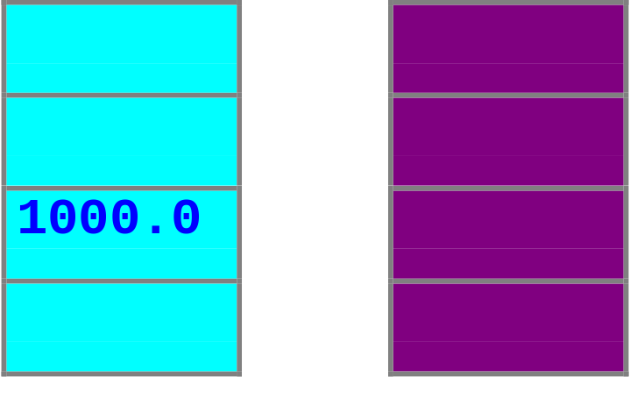
Actions performed within a function on an array parameter are performed on the array argument
void processArray( double nums[] )
{
nums[2] = 1000.00;
}
values
nums
processArray( values );

Slide 10
Parameter declaration
Declaration tells function about structure of the array
void process( double nums[] );
But not about its size …
Even if the declaration references a size
void process( double nums[100] );

Slide 11
Providing info about size
Global constant?
const int size(100);
Additional parameter?
void process(double nums[], int size);

Slide 12
Preventing changes
Prevent changes to an array parameter within a function with the const modifier
void print(const double nums[], int size);
Attempts to change array elements cause syntax errors
Call-by-value?

Slide 13
Actual size not known?
Suppose the actual number of elements is not known in advance, but an upper limit is
Partially filled array
Declare the array using the upper limit
Pass the array with a size parameter specifying the number of elements actually in use

Slide 14
Searching an unsorted array
16
8
10
22
4
2
18
24
14
12
6
20
void search( const int a[],
int num_used,
int target )
// Precondition: num_used <= declared
// size of a[]
// Precondition: elements a[0] through
// a[num_used - 1] have
// values
// Returns index of first occurrence of
// target in a[], otherwise -1

Slide 15
Searching an unsorted array
16
8
10
22
4
2
18
24
14
12
6
20
int index = 0;
bool found = false;
while((! found) && (index < num_used))
if( target == a[index] )
found == true;
else
index++;
if( found )
return index;
else
return -1;

Slide 16
Searching for minimum
16
8
10
22
4
2
18
24
14
12
6
20
void min( const int a[], int num_used )
// Precondition: num_used <= declared
// size of a[]
// Precondition: elements a[0] through
// a[num_used - 1] have
// values
// Returns index of first minimum

Slide 17
Searching for minimum
16
8
10
22
4
2
18
24
14
12
6
20
int min = 0;
for(int index = 1; index < num_used; index ++)
if( a[index] < a[min] )
min = index;
return min;

Slide 18
Sorting an array
16
8
10
22
4
2
18
24
14
12
6
20

Slide 19
Selection sort
16
8
10
22
4
2
18
24
14
12
6
20
void sort(int a[], int num_used)
// Precondition: num_used <= declared
// size of a[]
// Precondition: elements a[0] through
// a[num_used - 1] have
// values

Slide 20
Selection sort

Slide 21
Selection sort
16
8
10
22
4
2
18
24
14
12
6
20
for(int i = 0; i < num_used; i++)
place i^{th} smallest element in a[i]

Slide 22
Selection sort
16
8
10
22
4
2
18
24
14
12
6
20
2
8
10
22
4
16
18
24
14
12
6
20

Slide 23
Selection sort
16
8
10
22
4
2
18
24
14
12
6
20
2
8
10
22
4
16
18
24
14
12
6
20
2
4
10
22
8
16
18
24
14
12
6
20

Slide 24
Selection sort
16
8
10
22
4
2
18
24
14
12
6
20
2
8
10
22
4
16
18
24
14
12
6
20
2
4
10
22
8
16
18
24
14
12
6
20
2
4
6
22
8
16
18
24
14
12
10
20

Slide 25
Selection sort
16
8
10
22
4
2
18
24
14
12
6
20
2
8
10
22
4
16
18
24
14
12
6
20
2
4
10
22
8
16
18
24
14
12
6
20
2
4
6
22
8
16
18
24
14
12
10
20
2
4
6
8
22
16
18
24
14
12
10
20

Slide 26
Selection sort
16
8
10
22
4
2
18
24
14
12
6
20
2
8
10
22
4
16
18
24
14
12
6
20
2
4
10
22
8
16
18
24
14
12
6
20
2
4
6
22
8
16
18
24
14
12
10
20
2
4
6
8
22
16
18
24
14
12
10
20
2
4
6
8
10
16
18
24
14
12
22
20

Slide 27
Selection sort
16
8
10
22
4
2
18
24
14
12
6
20
2
8
10
22
4
16
18
24
14
12
6
20
2
4
10
22
8
16
18
24
14
12
6
20
2
4
6
22
8
16
18
24
14
12
10
20
2
4
6
8
22
16
18
24
14
12
10
20
2
4
6
8
10
16
18
24
14
12
22
20
2
4
6
8
10
12
14
16
18
20
22
24

Slide 28
Selection sort
16
8
10
22
4
2
18
24
14
12
6
20
2
8
10
22
4
16
18
24
14
12
6
20
2
4
10
22
8
16
18
24
14
12
6
20
2
4
6
22
8
16
18
24
14
12
10
20
2
4
6
8
22
16
18
24
14
12
10
20
2
4
6
8
10
16
18
24
14
12
22
20
2
4
6
8
10
12
14
16
18
20
22
24
2
4
6
8
10
12
14
16
18
20
22
24

Slide 29
Summary
Arrays are great
  C++ implementation of array parameter lets you write/use same function for different size arrays
Figure out the big picture
Pay attention to the details

