Slide 1
Templates
Jim Eng/Charles Severance
Savitch: 13.1

Slide 2
Overview
A brief return to pointers
What is a template?
Templates for algorithm abstraction
Templates for data abstraction

Slide 3
*
In a variable declaration
  Form: <DataType>* <Variable>;
  Declares a pointer which can be used to access a variable of type <DataType>
  Examples: int* iptr; int *iptr, *jptr;
In a variable reference
  Form: *<Variable>;
  Accesses the contents of <Variable>
  Examples: *iptr = 5; k = *iptr;

Slide 4
&
In a variable declaration
  Form: <DataType>& <Variable>;
  Declares a constant reference which can be used to access a variable of type <DataType>
  Examples: int& iptr; int &iptr;
In a variable reference
  Form: &<Variable>;
  Returns the address of <Variable>
  Examples: iptr = &k;

Slide 5
new
Form: new <DataType>
Allocates space on the heap (dynamic allocation) and returns a pointer
For simple types, casts the allocated space to the type (and initializes?)
For classes, calls the appropriate constructor
Examples: new int, new int(12),
new StatisticsVector(true),
new string("Remember Dec. 4th")

Slide 6
new[]
Form: new <DataType>[<Int_Expr>]
Allocates space for array of objects, returns a pointer to the first element in the array
For simple types, casts the allocated space to the type (and initializes?)
For classes, calls appropriate constructor
Examples: new int[10],
new int[] = {12,10,7,3,0},
new StatisticsVector[500]

Slide 7
Why use pointers?
Pass by reference in functions
Access to dynamically allocated variables
  Serious programs almost always need to allocate memory dynamically
  For non-trivial tasks, programmer cannot predict the user's needs reliably
  Costs of too much or too little memory
Special case: linked structures

Slide 8
What we'd like to do
Chuck = new person(72, 180, 20, 20,
… , 1600)
Forget pointers entirely
Treat Chuck as an ordinary variable
Yet have Chuck allocated dynamically and stored on the heap

Slide 9
Thinking of *iptr as a variable
Suppose we have an automatic variable
  int i;
And a dynamic variable:
  int* iptr = new int;
Anything i can do, *iptr can do (better)
  i++ (*iptr)++
  cout << i; cout << (*iptr);
  j = i * i; (*jptr) = (*iptr)
  * (*iptr);

Slide 10
What is a template?
Some definitions:
  "a pattern, mold, or the like, usually consisting of a thin plate of wood or metal, serving as a gauge or guide in mechanical work"
  "a strand of DNA or RNA that serves as a pattern for the synthesis of a complementary strand of nucleic acid or protein"
  "a blueprint for the text, graphics, and formatting of a document"
Random House Dictionary, Microsoft Word User's Guide

Slide 11
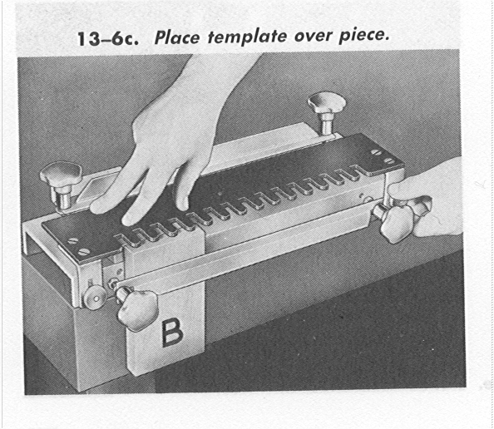
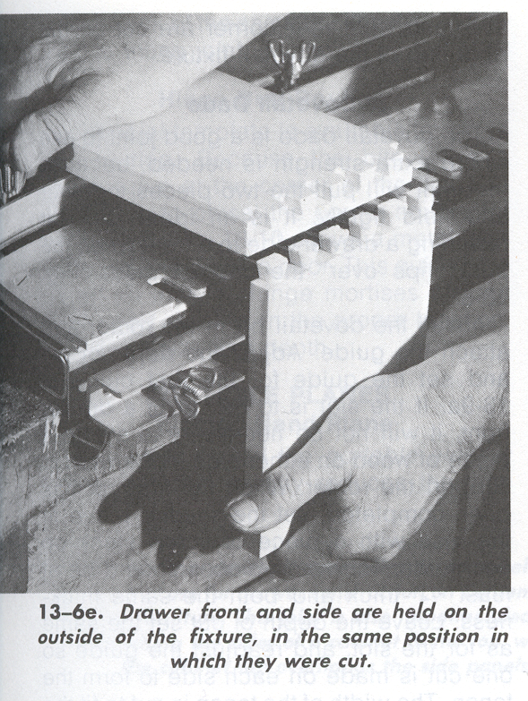
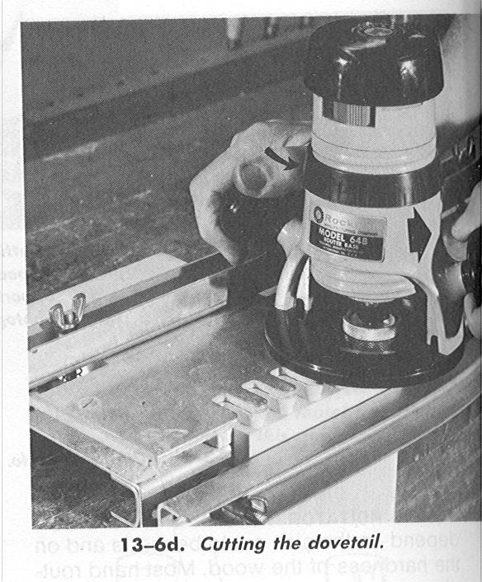
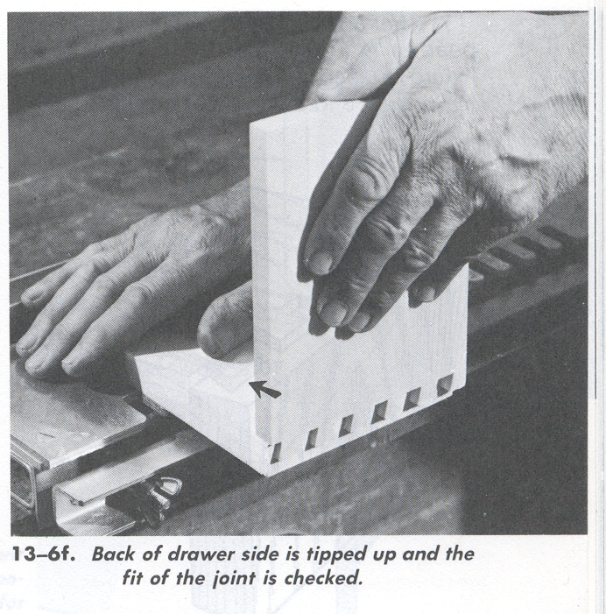
Feirer and Hutchings, Carpentry & Building Construction, MacMillan 1986

Slide 12
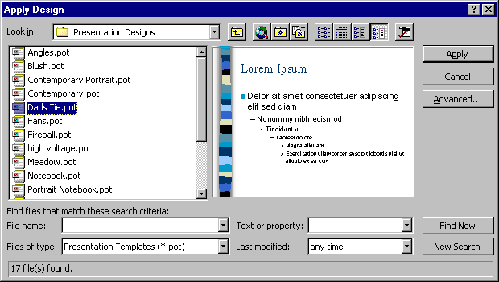

Slide 13
Template characteristics
Templates enable rapid duplication of an object or structure
Some features are copied exactly
Others features may be customized

Slide 14
Templates for programs?
A pattern for a program element
  copy some features exactly
  customize other features
Treat the "customized" features as parameters in the creation of the program element
Let the template define the features that are copied exactly

Slide 15
An example
Chapter 9: Programming with arrays
Display 9.11: Searching an array
int search(const int a[], int number_used, int target);
//Precondition: number_used is <= the declared size of a.
//Also, a[0] through a[number_used -1] have values.
//Returns the first index such that a[index] == target,
// provided there is such an index, otherwise returns -1.

Slide 16
void fill_array(int a[], int size, int& number_used);
//Precondition: size is the declared size of the array a.
//Postcondition: number_used is the number of values
// stored in a.
//a[0] through a[number_used-1] have been filled with
// nonnegative integers read from the keyboard.
do {
cout << "Enter a number to search for: ";
cin >> target;
result = search(arr, list_size, target);
if (result == -1)
cout << target << " is not on the list.\n";
else
cout << target << " is stored in array position "
<< result << endl
<< "(Remember: The first position is 0.)\n";
cout << "Search again?(y/n followed by return): ";
cin >> ans;
}while ((ans != 'n') && (ans != 'N'));

Slide 17
% g++ search.cpp
% a.out
Enter up to 20 nonnegative whole numbers.
Mark the end of the list with a negative number.
20 133 12 15 196 23 55 7 87 134 -1
Enter a number to search for: 55
55 is stored in array position 6
(Remember: The first position is 0.)
Search again?(y/n followed by return): y
Enter a number to search for: 133
133 is stored in array position 1
(Remember: The first position is 0.)
Search again?(y/n followed by return): n
End of program.
%

Slide 18
int search(const int a[],
int number_used,
int target)
{
int index = 0;
bool found = false;
while ((!found) && (index < number_used))
if (target == a[index])
found = true;
else
index++;
if (found)
return index;
else
return -1;
}

Slide 19
int search(const double a[],
int number_used,
double target)
{
int index = 0;
bool found = false;
while ((!found) && (index < number_used))
if (target == a[index])
found = true;
else
index++;
if (found)
return index;
else
return -1;
}

Slide 20
int search(const T a[],
int number_used,
T target)
{
int index = 0;
bool found = false;
while ((!found) && (index < number_used))
if (target == a[index])
found = true;
else
index++;
if (found)
return index;
else
return -1;
}

Slide 21
template<class T>
int search(const T a[], int number_used,
T target)
{
int index = 0;
bool found = false;
while ((!found) && (index < number_used))
if (target == a[index])
found = true;
else
index++;
if (found)
return index;
else
return -1;
}

Slide 22
template<class T>
int search(const T a[], int number_used, T target);
//Precondition: number_used is <= the declared size of a.
//Also, a[0] through a[number_used -1] have values.
//Returns the first index such that a[index] == target,
//provided there is such an index, otherwise returns -1.

Slide 23
template<class T>
int search(const T a[], int number_used, T target);
//Precondition: number_used is <= the declared size of a.
//Also, a[0] through a[number_used -1] have values.
//Returns the first index such that a[index] == target,
//provided there is such an index, otherwise returns -1.
template<class T>
void fill_array(T a[], int size, int& number_used);
//Precondition: size is the declared size of the array a.
//Postcondition: number_used is the number of values
// stored in a.
//a[0] through a[number_used-1] have been filled with
// nonnegative integers read from the keyboard.

Slide 24
template<class T>
void fill_array(T a[], int size, int& number_used)
{
cout << "Enter up to " << size
<< " nonnegative whole numbers.\n"
<< "Mark the end of the list"
<< " with a negative number.\n";
T next;
int index = 0;
cin >> next;
while ((next >= 0) && (index < size))
{
a[index] = next;
index++;
cin >> next;
}
number_used = index;
}

Slide 25
int arr[DECLARED_SIZE], list_size, target;
fill_array(arr, DECLARED_SIZE, list_size);
char ans;
int result;
do {
cout << "Enter a number to search for: ";
cin >> target;
result = search(arr, list_size, target);
if (result == -1)
cout << target << " is not on the list.\n";
else
cout << target << " is stored in array position "
<< result << endl
<< "(Remember: The first position is 0.)\n";
cout << "Search again?(y/n followed by return): ";
cin >> ans;
}while ((ans != 'n') && (ans != 'N'));
cout << "End of program.\n";
return 0;

Slide 26
% g++ intsearch.cpp
% a.out
Enter up to 20 nonnegative whole numbers.
Mark the end of the list with a negative number.
12 15 19 22 81 133 55 92 87 72 67 38 -1
Enter a number to search for: 72
72 is stored in array position 9
(Remember: The first position is 0.)
Search again?(y/n followed by return): y
Enter a number to search for: 19
19 is stored in array position 2
(Remember: The first position is 0.)
Search again?(y/n followed by return): n
End of program.
%

Slide 27
double arr[DECLARED_SIZE], target; int list_size;
fill_array(arr, DECLARED_SIZE, list_size);
char ans;
int result;
do {
cout << "Enter a number to search for: ";
cin >> target;
result = search(arr, list_size, target);
if (result == -1)
cout << target << " is not on the list.\n";
else
cout << target << " is stored in array position "
<< result << endl
<< "(Remember: The first position is 0.)\n";
cout << "Search again?(y/n followed by return): ";
cin >> ans;
}while ((ans != 'n') && (ans != 'N'));
cout << "End of program.\n";
return 0;

Slide 28
% g++ dblsearch.cpp
% a.out
Enter up to 20 nonnegative whole numbers.
Mark the end of the list with a negative number.
0.0 1.1 2.2 3.3 4.4 5.5 6.6 7.7 8.8 -1
Enter a number to search for: 7.7
7.7 is stored in array position 7
(Remember: The first position is 0.)
Search again?(y/n followed by return): y
Enter a number to search for: 7.5
7.5 is not on the list.
Search again?(y/n followed by return): y
Enter a number to search for: 2.2
2.2 is stored in array position 2
(Remember: The first position is 0.)
Search again?(y/n followed by return): n
End of program.
%

Slide 29
Recall ComplexNumber.h
public:
ComplexNumber(double r, double i);
ComplexNumber(double r);
ComplexNumber();
void setNumber(double r, double i);
void getNumber(double& r, double& i);
// unary operators
friend ComplexNumber operator +
(const ComplexNumber& n);
friend ComplexNumber operator -
(const ComplexNumber& n);

Slide 30
// binary operators
friend ComplexNumber operator +
(const ComplexNumber& n1,
const ComplexNumber& n2);
friend ComplexNumber operator -
(const ComplexNumber& n1,
const ComplexNumber& n2);
friend ComplexNumber operator *
(const ComplexNumber& n1,
const ComplexNumber& n2);
friend ComplexNumber operator /
(const ComplexNumber& n1,
const ComplexNumber& n2);
ComplexNumber& operator +=
(const ComplexNumber& n);

Slide 31
friend ostream& operator <<
(ostream& outstr,
const ComplexNumber& n);
friend istream& operator >>
(istream& instr,
ComplexNumber& n);
private:
double RealPart;
double ImaginaryPart;

Slide 32
Would the template for the fill_array function work if called for an array of ComplexNumbers?

Slide 33
template<class T>
void fill_array(T a[], int size, int& number_used)
{
cout << "Enter up to " << size
<< " nonnegative whole numbers.\n"
<< "Mark the end of the list"
<< " with a negative number.\n";
T next;
int index = 0;
cin >> next;
while ((next >= 0) && (index < size))
{
a[index] = next;
index++;
cin >> next;
}
number_used = index;
}

Slide 34
Would the template for the fill_array function work if called for an array of ComplexNumbers?
Would the template for the search function work if called for an array of ComplexNumbers?

Slide 35
template<class T>
int search(const T a[], int number_used,
T target)
{
int index = 0;
bool found = false;
while ((!found) && (index < number_used))
if (target == a[index])
found = true;
else
index++;
if (found)
return index;
else
return -1;
}

Slide 36
Algorithm abstraction
Generalize an algorithm
Ignore incidental details
Focus on overall algorithm
In C++, templates support algorithm abstraction

Slide 37
Summary
Templates let you define functions or classes with parameters for class names
Function templates are one support for algorithm abstraction in C++

Slide 38
Next
Templates for data abstraction
Savitch 13.2

