Slide 1
Linked Lists
Jim Eng/Charles Severance
Savitch: Chapter 14

Slide 2
Overview
Creating a list of objects
Adding to the head of a list
Operations on lists
An example

Slide 3
const int StringSize = 10;
struct ListNode {
char item[StringSize];
int count;
ListNode* link;
}
typedef ListNode* ListNodePtr;
ListNodePtr head = new ListNode;

Slide 4
const int StringSize = 10;
struct ListNode {
char item[StringSize];
int count;
ListNode* link;
}
typedef ListNode* ListNodePtr;
ListNodePtr head = new ListNode;
head
???

Slide 5
const int StringSize = 10;
struct ListNode {
char item[StringSize];
int count;
ListNode* link;
}
typedef ListNode* ListNodePtr;
ListNodePtr head = new ListNode;
head
0x8b148153
???
???
???

Slide 6
const int StringSize = 10;
struct ListNode {
char item[StringSize];
int count;
ListNode* link;
}
typedef ListNode* ListNodePtr;
ListNodePtr head = new ListNode;
(*head).count = 10;
head
0x8b148153
???
10
???

Slide 7
const int StringSize = 10;
struct ListNode {
char item[StringSize];
int count;
ListNode* link;
}
typedef ListNode* ListNodePtr;
ListNodePtr head = new ListNode;
// (*head).count = 10;
head->count = 10;
head
0x8b148153
???
10
???

Slide 8
const int StringSize = 10;
struct ListNode {
char item[StringSize];
int count;
ListNode* link;
}
typedef ListNode* ListNodePtr;
ListNodePtr head = new ListNode;
head->count = 10;
head
0x8b148153
???
10
???

Slide 9
const int StringSize = 10;
struct ListNode {
char item[StringSize];
int count;
ListNode* link;
}
typedef ListNode* ListNodePtr;
ListNodePtr head = new ListNode;
head->count = 10;
strcpy(head->item, "rolls");
0x8b148153
"rolls"
head
10
???

Slide 10
const int StringSize = 10;
struct ListNode {
char item[StringSize];
int count;
ListNode* link;
}
typedef ListNode* ListNodePtr;
ListNodePtr head = new ListNode;
head->count = 10;
strcpy(head->item, "rolls");
head->link = NULL;
0x8b148153
"rolls"
head
10
0x00000000

Slide 11
const int StringSize = 10;
struct ListNode {
char item[StringSize];
int count;
ListNode* link;
}
typedef ListNode* ListNodePtr;
ListNodePtr head = new ListNode;
head->count = 10;
strcpy(head->item, "rolls");
head->link = NULL;
node
0x8b148153
"rolls"
head
10
0x00000000

Slide 12
head_insert function
Create new node on heap (with a pointer to access it)
Place data in the new node
head

Slide 13
head_insert function
temp
Create new node on heap (with a pointer to access it)
Place data in the new node
head

Slide 14
head_insert function
temp
Create new node on heap (with a pointer to access it)
Place data in the new node
Make link point to first node of the list
head

Slide 15
head_insert function
temp
Create new node on heap (with a pointer to access it)
Place data in the new node
Make link point to first node of the list
head

Slide 16
head_insert function
temp
Create new node on heap (with a pointer to access it)
Place data in the new node
Make link point to first node of the list
Make head point to the new node
head

Slide 17
head_insert function
Create new node on heap (with a pointer to access it)
Place data in the new node
Make link point to first node of the list
Make head point to the new node
head

Slide 18
ListNodePtr temp = new ListNode;
temp
0x8b148221
???
???
???
head
0x8b148153
"rolls"
10
0x00000000

Slide 19
ListNodePtr temp = new ListNode;
temp->count = 3;
temp
0x8b148221
???
3
???
head
0x8b148153
"rolls"
10
0x00000000

Slide 20
ListNodePtr temp = new ListNode;
temp->count = 3;
strcpy(temp->item, "jam");
temp
0x8b148221
"jam"
3
???
head
0x8b148153
"rolls"
10
0x00000000

Slide 21
ListNodePtr temp = new ListNode;
temp->count = 3;
strcpy(temp->item, "jam");
temp->link = head;
temp
0x8b148221
"jam"
3
0x8b148153
head
0x8b148153
"rolls"
10
0x00000000

Slide 22
ListNodePtr temp = new ListNode;
temp->count = 3;
strcpy(temp->item, "jam");
temp->link = head;
head = temp;
temp
0x8b148221
"jam"
3
0x8b148153
head
0x8b148221
"rolls"
10
0x00000000

Slide 23
ListNodePtr temp = new ListNode;
temp->count = 3;
strcpy(temp->item, "jam");
temp->link = head;
head = temp;
"jam"
3
0x8b148153
head
0x8b148221
"rolls"
10
0x00000000

Slide 24
Empty-list head_insert function
Create new node on heap (with a pointer to access it)
Place data in the new node
head

Slide 25
Empty-list head_insert function
temp
Create new node on heap (with a pointer to access it)
Place data in the new node
Make new node's link point to first node of the list (i.e. NULL)
head

Slide 26
Empty-list head_insert function
temp
Create new node on heap (with a pointer to access it)
Place data in the new node
Set new node's link to NULL
Make head point to the new node
head

Slide 27
Empty-list head_insert function
Create new node on heap (with a pointer to access it)
Place data in the new node
Set new node's link to NULL
Make head point to the new node
head

Slide 28
head
0x8b148369
"coffee"
2
0x8b148221
"jam"
3
0x8b148153
"rolls"
10
0x00000000

Slide 29
head
0x8b148369
"coffee"
2
Some list operations:
Insert at head
Remove from head
Insert at tail
Remove from tail
Insert in middle
Remove from middle
Search for item
Output list
Sort list
0x8b148221
"jam"
3
0x8b148153
"rolls"
10
0x00000000

Slide 30
Operations on an individual node might require references to the node itself and (possibly) its neighbors
previous
thisnode
next

Slide 31
For example, moving to the next node:
previous
thisnode
next

Slide 32
For example, moving to the next node:
previous = thisnode;
previous
thisnode
next

Slide 33
For example, moving to the next node:
previous = thisnode;
thisnode =
thisnode->link;
previous
thisnode
next

Slide 34
For example, moving to the next node:
previous = thisnode;
thisnode =
thisnode->link;
next =
thisnode->link;
previous
thisnode
next

Slide 35
But, what if we're at the end of the list?
i.e.
thisnode->link
== next
== NULL
previous
thisnode
next

Slide 36
Next node is null
previous = thisnode;
previous
thisnode
next

Slide 37
Next node is null
previous = thisnode;
thisnode =
thisnode->link;
previous
thisnode
next

Slide 38
Next node is null
previous = thisnode;
thisnode =
thisnode->link;
next =
thisnode->link;
previous
thisnode
next

Slide 39
Next node is null
previous = thisnode;
thisnode =
thisnode->link;
next =
thisnode->link;
Segmentation fault
previous
thisnode
next

Slide 40
Some list operations:
Insert at head
Remove from head
Insert at tail
Remove from tail
Insert in middle
Remove from middle
Search for item
Output list
Sort list
previous
thisnode
next

Slide 41
Find position (between previous and thisnode)
previous
thisnode

Slide 42
Find position (between previous and thisnode)
Create node on heap (with pointer to access it)
Place data in new node
previous
newnode
thisnode

Slide 43
Find position (between previous and thisnode)
Create node on heap (with pointer to access it)
Place data in new node
Make new node's link
point to thisnode
previous
newnode
thisnode

Slide 44
Find position (between previous and thisnode)
Create node on heap (with pointer to access it)
Place data in new node
Make new node's link
point to thisnode
Make previous's link
point to new node
previous
newnode
thisnode

Slide 45
Find position (between previous and thisnode)
Create node on heap (with pointer to access it)
Place data in new node
Make new node's link
point to thisnode
Make previous's link
point to new node

Slide 46
Example
Scorekeeping system for varsity basketball
Keep record of each shot taken
  Time & shot clock (from official clock)
  Player, team
  Where shot taken (x-y coordinates on floor)
  Made/Missed/Fouled
  Value of shot
Also used by GameDay web interface

Slide 47
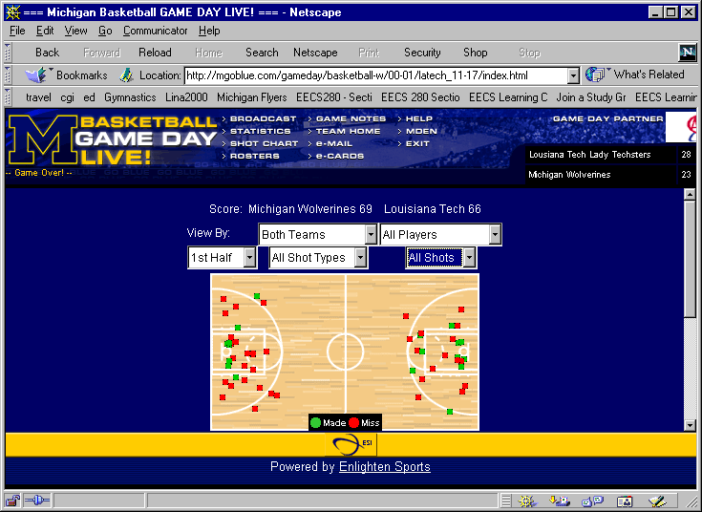

Slide 48
Backend: Scorekeeper's interface
Touch-screen
Easy to use
Simple sequence to record any activity
Everything to record shots (rebounds? Substitutions? Etc.) on main screen
Other screens to access other information

Slide 49
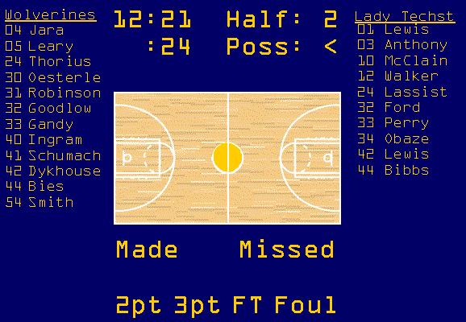

Slide 50
Underlying implementation
List of shot attempts
  period (1st half, 2nd half, 1st OT, etc.)
  time
  shot clock
  player, team
  location (x, y)
  made/missed
  type (2pt, 3pt, free-throw)

Slide 51
struct ShotAttempt {
int period;
TimeType time;
TimeType shotclock;
PlayerType * player;
Point position;
int value;
bool made;
bool fouled;
}

Slide 52
A class, maybe?
Morph ShotAttempt into a class with constructors, member functions, friends
ShotAttempt( int period,
TimeType time,
TimeType shotclock,
  PlayerType* player,
  Point position,
  int value,
  bool made,
  bool fouled );
Member functions, friends

Slide 53
A list of ShotAttempts
struct ShotNode
{
ShotAttempt attempt;
ShotNode* link;
}

Slide 54
Next
More list operations
Reading: Savitch Chapter 14

