Slide 1
Standard libraries
Jim Eng/Charles Severance
Reading: Stepanov article

Slide 2
Overview
Rest of semester
Preparation for Monday
STL
  Iterators
  Containers
  Algorithms
Course evaluations

Slide 3
Rest of semester
Friday: Exceptions (catch and throw)
Thursday: Project 7 Q&A session
  7 p.m. Chrysler Auditorium
Monday: Recursion
  Reading: Savitch Chapter 12
Tuesday: Project 7 due at 11:59 p.m.
  No submissions accepted after 11:59 p.m. Wednesday

Slide 4
Rest of semester 2
Wednesday Dec. 13: Inheritance
  Reading: Savitch Chapter 15
Thursday Dec. 14: Review session (Q&A)
  7 p.m. Chrysler Auditorium
Friday Dec. 15: Final exam
  10:30 a.m. to 12:30 p.m. unless you’ve arranged for the alternate exam period

Slide 5
Preparation for Monday
Monday == Dec. 4, 3:30 p.m. @ Michigan League
Some unfamiliar syntax:
  try { . . . } catch { . . . }
  throw Range_error() ;
  fnc( … ) : a(…), b(…) { … }
  vector<int>::iterator

Slide 6
Bjarne said:
void f(Range arg, int i)
try {
Range v1(0,3,10);
Range v2(7,9,100);
v1 = v2;
. . .
}
catch (Range_error) {
cerr << “Oops: range error in f()”;
}

Slide 7
Bjarne said:
void f(Range arg, int i)
try {
Range v1(0,3,10);
Range v2(7,9,100);
v1 = v2;
. . .
}
catch (Range_error) {
cerr << “Oops: range error in f()”;
}

Slide 8
Bjarne said:
void f(Range arg, int i)
try {
Range v1(0,3,10);
Range v2(7,9,100);
v1 = v2;
. . .
}
catch (Range_error) {
cerr << “Oops: range error in f()”;
}

Slide 9
What that means
Try to do something
If there’s an error (of a certain kind) handle it this way
try {
. . .
}
catch (Range_error) {
. . .
}

Slide 10
Bjarne said:
void check(int v) const
{
if(v < low || high <= v)
throw Range_error();
}

Slide 11
Bjarne said:
void check(int v) const
{
if(v < low || high <= v)
throw Range_error();
}
This is a private member function (helper)
in class Range, which has private member
variables value, low and high

Slide 12
What that means
Report an error
Be gentle but firm about it
  (i.e. make sure you’re heard)
More about “catch & throw” Friday
throw Range_error();

Slide 13
Bjarne said:
Range(int lw, int v, int hi)
: low(lw), value(v), high(hi)
{
check(v);
}
This is a constructor in class Range, which has private members value, low and high

Slide 14
Bjarne said:
Range(int lw, int v, int hi)
: low(lw), value(v), high(hi)
{
check(v);
}
This is a constructor in class Range, which has private members value, low and high

Slide 15
Bjarne said:
void f(vector<int>& v, int x)
{
vector<int>::iterator p
= find_if( v.begin(), v.end(),
less_than<int>(x) );
}
This is a function demonstrating use of the user-defined class less_than and the STL algorithm find_if

Slide 16
Bjarne said:
void f(vector<int>& v, int x)
{
vector<int>::iterator p
= find_if( v.begin(), v.end(),
less_than<int>(x) );
}
This is a function demonstrating use of the user-defined class less_than and the STL algorithm find_if

Slide 17
Bjarne said:
void f(vector<int>& v, int x)
{
vector<int>::iterator p
= find_if( v.begin(), v.end(),
less_than<int>(x) );
}
This is a function demonstrating use of the user-defined class less_than and the STL algorithm find_if

Slide 18
Bjarne said:
void f(vector<int>& v, int x)
{
vector<int>::iterator p
= find_if( v.begin(), v.end(),
less_than<int>(x) );
}
This is a function demonstrating use of the user-defined class less_than and the STL algorithm find_if

Slide 19
What that means
In the context of the template for vector a type names “iterator” is defined
This statement declares one of those
vector<int>::iterator p

Slide 20
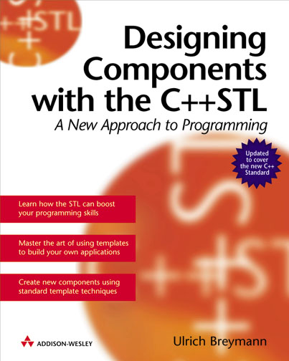
STL
Some of the material from that book
Some from Bjarne
Some from Alexander Stepanov
Examples run with CodeWarrior
☞

Slide 21
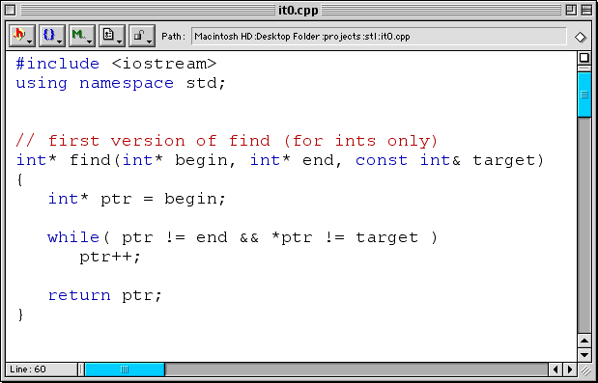

Slide 22
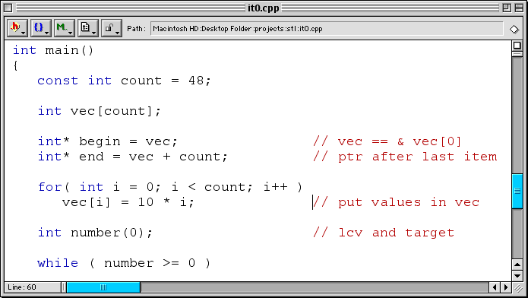

Slide 23
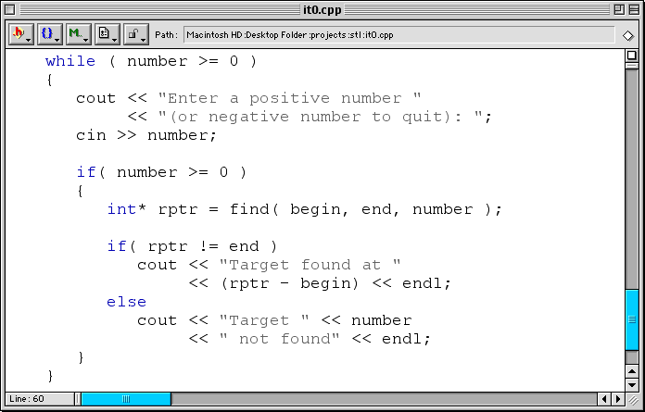

Slide 25
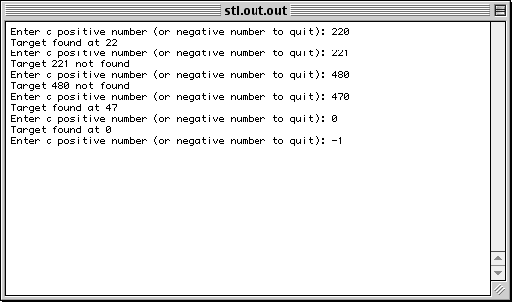

Slide 26
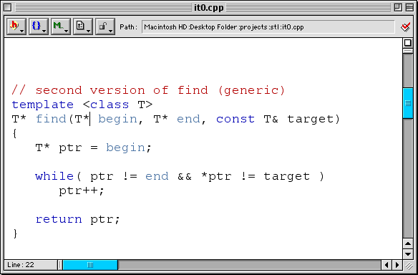

Slide 27
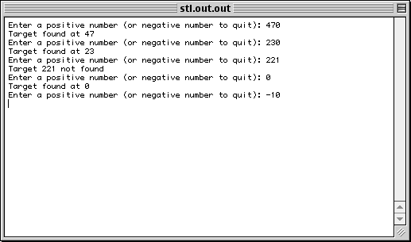

Slide 28
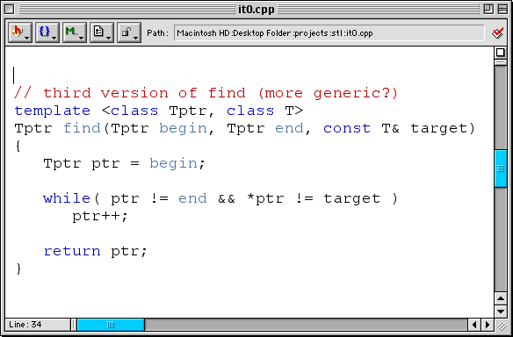

Slide 29
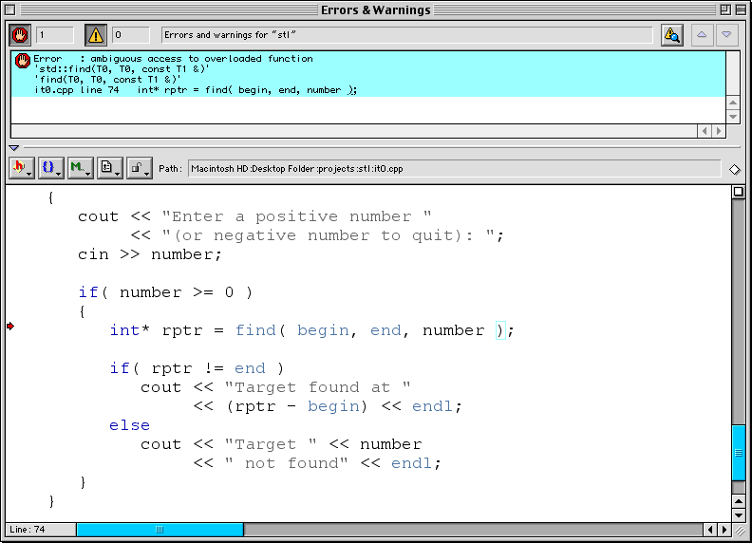

Slide 30
Error : ambiguous access to overloaded function
'std::find(T0, T0, const T1 &)'
'find(T0, T0, const T1 &)'
it0.cpp line 74 int* rptr = find( begin, end, number );

Slide 31
Error : ambiguous access to overloaded function
'std::find(T0, T0, const T1 &)'
'find(T0, T0, const T1 &)'
it0.cpp line 74 int* rptr = find( begin, end, number );

Slide 32
Error : ambiguous access to overloaded function
'std::find(T0, T0, const T1 &)'
'find(T0, T0, const T1 &)'
it0.cpp line 74 int* rptr = find( begin, end, number );

Slide 33
Error : ambiguous access to overloaded function
'std::find(T0, T0, const T1 &)'
'find(T0, T0, const T1 &)'
it0.cpp line 74 int* rptr = find( begin, end, number );

Slide 34
Error : ambiguous access to overloaded function
'std::find(T0, T0, const T1 &)'
'find(T0, T0, const T1 &)'
it0.cpp line 74 int* rptr = find( begin, end, number );

Slide 36
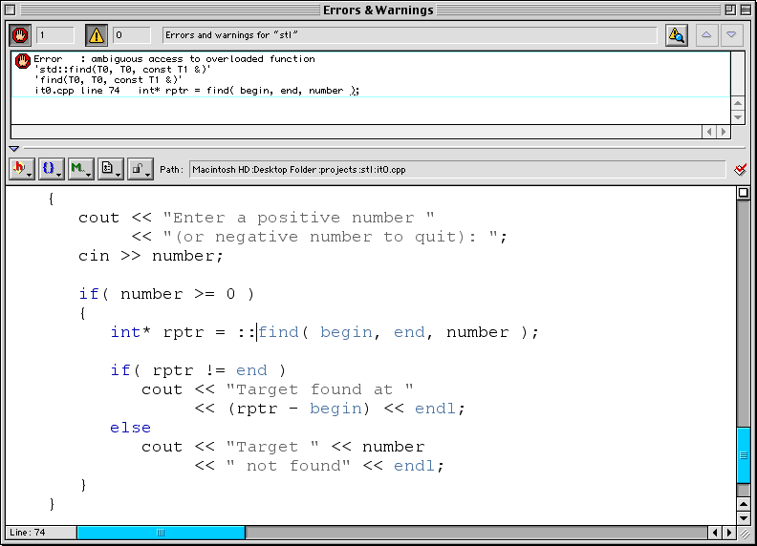

Slide 37
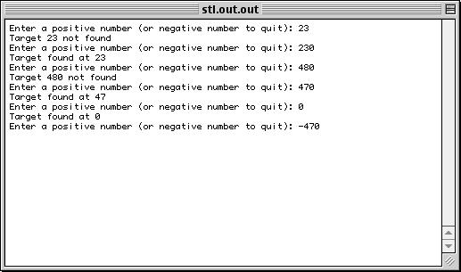

Slide 38
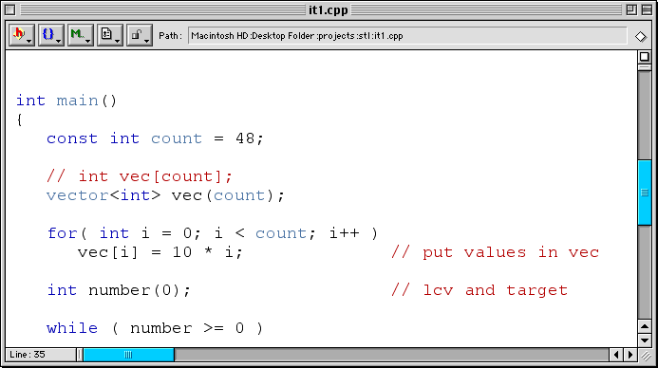

Slide 39
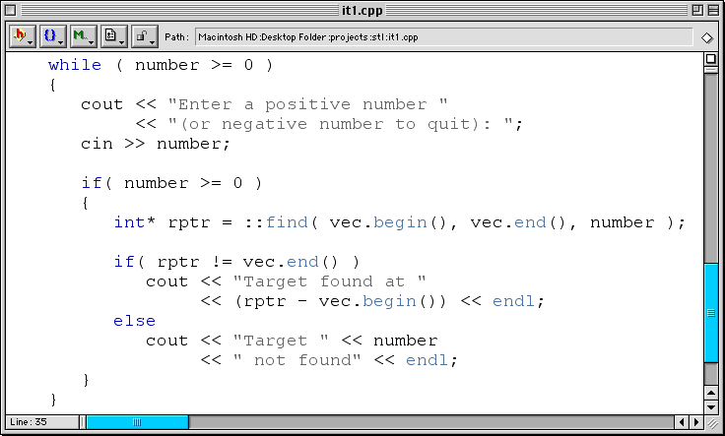

Slide 40
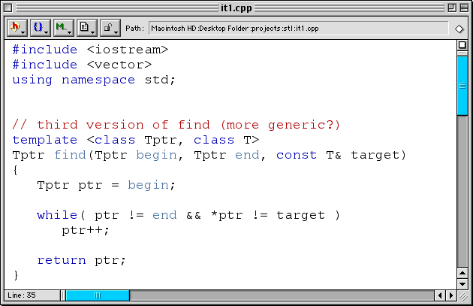

Slide 41
Next
Friday: Exceptions (a.k.a catch and throw)
Reminder: Project 7 Q&A session
  Thursday 7 p.m.
  Chrysler Auditorium
  Optional

