Slide 1
Standard libraries
Jim Eng/Charles Severance
Reading: Stepanov article

Slide 2
Overview
Queue revisited: Singly linked list with tail
STL
  Iterators
  Containers
  Algorithms

Slide 3
Queue
❍
❍
❍
❍
❍
❍
❍
❍
A convenient arrangement for "storage" of "objects"
❍

Slide 4
Queue
❍
❍
❍
❍
❍
❍
❍
❍
A convenient arrangement for "storage" of "objects"
Add objects to "end" of line (tail)
❍

Slide 5
Queue
❍
❍
❍
❍
❍
❍
❍
❍
A convenient arrangement for "storage" of "objects"
Add objects to "end" of queue (tail)
Remove objects from "front" of queue (head)

Slide 6
Operations
❍
❍
❍
❍
❍
❍
Adding objects to "tail" of queue, a.k.a. ENQUEUE
Removing objects from "head" of queue, a.k.a. DEQUEUE

Slide 7
Need to know
❍
❍
❍
❍
❍
❍
❍
What kind of objects are in queue?
Where is the queue?
Where is tail?
Where is head?

Slide 8
Doubly linked list
Each node has links for next node and previous node
Possible to move forward or backward through a linked list
Enables efficient implementation of some data structures, such as queue, with linked lists

Slide 9
Doubly linked list
head
tail
data
data
data

Slide 10
Doubly linked list
head
tail
data
data
data
A set of links connecting the nodes from the head backwards through the list toward the tail

Slide 11
Doubly linked list
head
tail
data
data
data
A set of links connecting the nodes from the tail forwards through the list toward the head

Slide 12
Singly linked list with tail pointer
head
tail
data
data
data
Pointer to tail allows addition of new nodes at tail

Slide 13
Doubly linked lists
Any application where it's useful to traverse a list in both directions

Slide 14
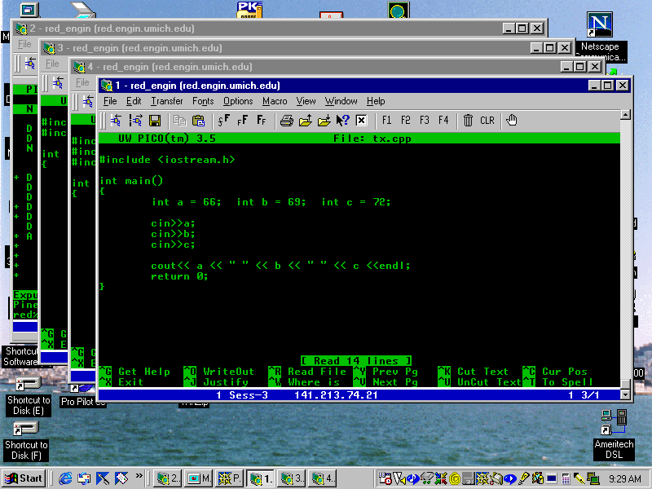

Slide 15
Doubly linked list
head
tail

Slide 16
Standard Template Library
Iterators
Containers
Algorithms

Slide 17
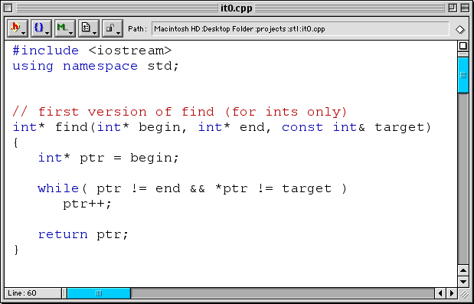

Slide 18
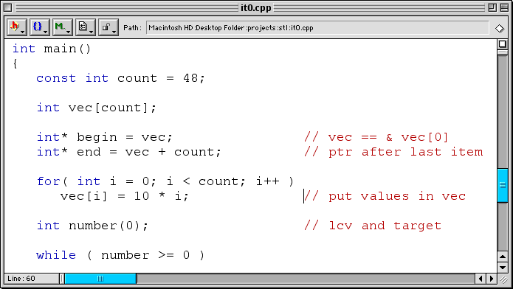

Slide 19
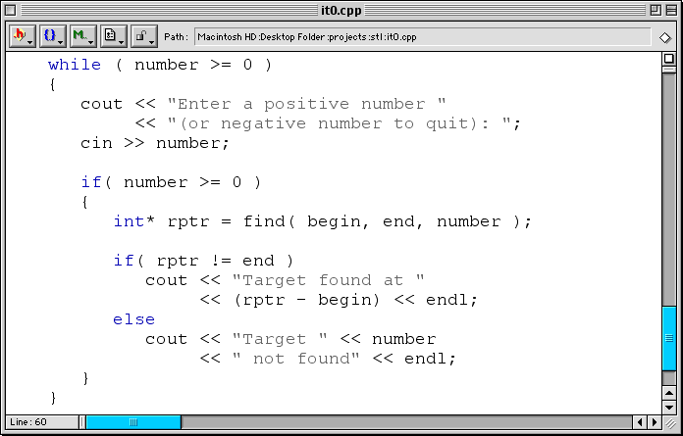

Slide 20
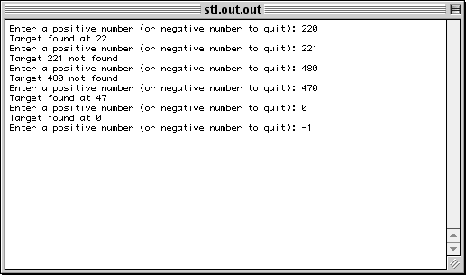

Slide 21
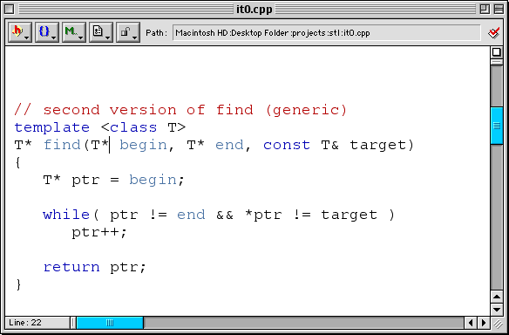

Slide 22
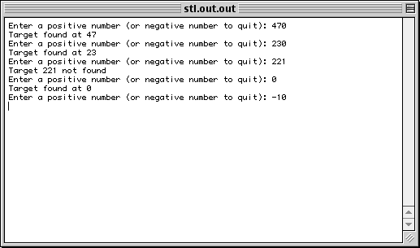

Slide 23
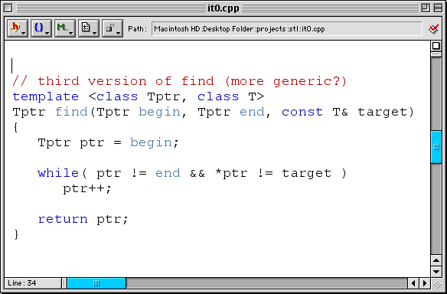

Slide 24
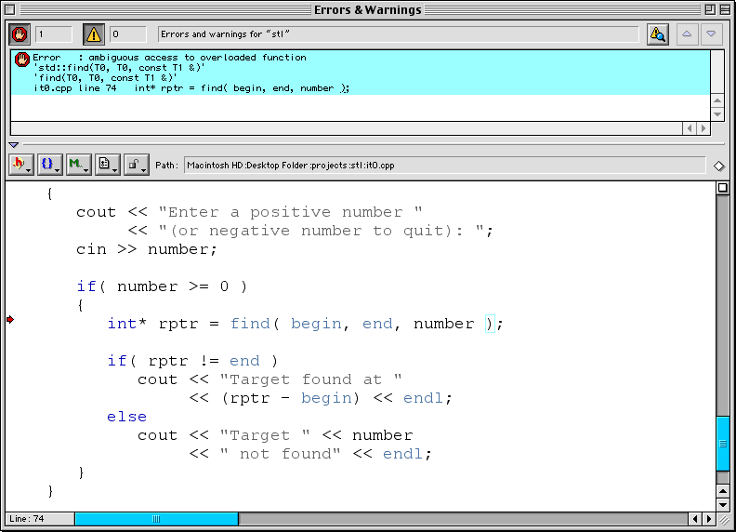

Slide 25
Error : ambiguous access to overloaded function
'std::find(T0, T0, const T1 &)'
'find(T0, T0, const T1 &)'
it0.cpp line 74 int* rptr = find( begin, end, number );

Slide 26
Error : ambiguous access to overloaded function
'std::find(T0, T0, const T1 &)'
'find(T0, T0, const T1 &)'
it0.cpp line 74 int* rptr = find( begin, end, number );

Slide 27
Error : ambiguous access to overloaded function
'std::find(T0, T0, const T1 &)'
'find(T0, T0, const T1 &)'
it0.cpp line 74 int* rptr = find( begin, end, number );

Slide 28
Error : ambiguous access to overloaded function
'std::find(T0, T0, const T1 &)'
'find(T0, T0, const T1 &)'
it0.cpp line 74 int* rptr = find( begin, end, number );

Slide 29
Error : ambiguous access to overloaded function
'std::find(T0, T0, const T1 &)'
'find(T0, T0, const T1 &)'
it0.cpp line 74 int* rptr = find( begin, end, number );

Slide 31
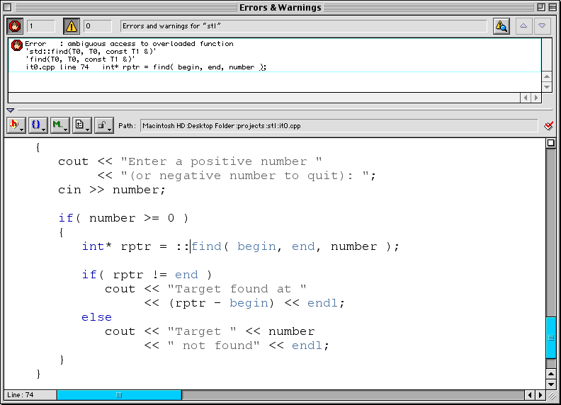

Slide 32
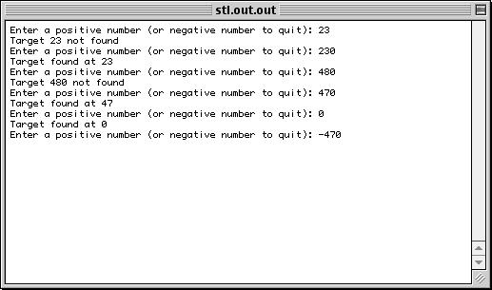

Slide 33
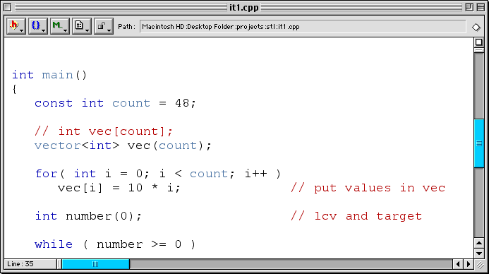

Slide 34
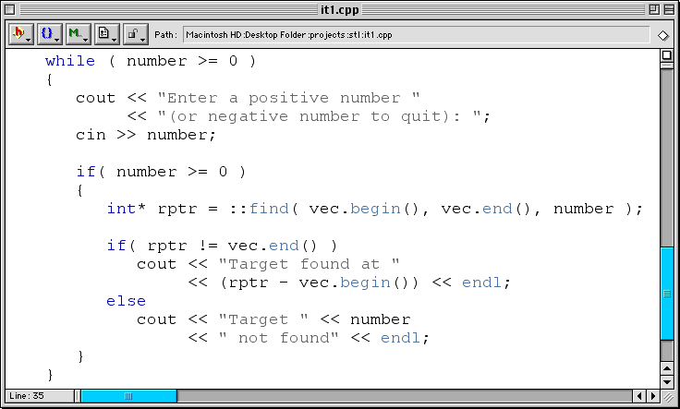

Slide 35
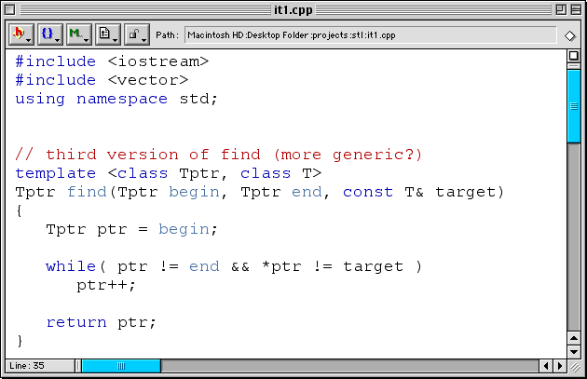

Slide 40
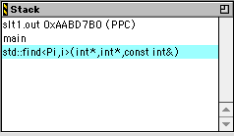
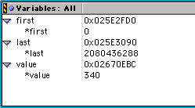

Slide 42
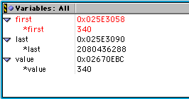

Slide 45
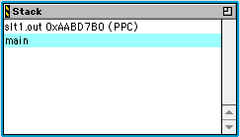
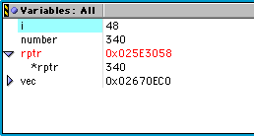

Slide 46
Containers
Objects that store other objects
Control allocation and deallocation of these objects:
  Constructors
  Destructors
  Insert operations
  Erase operations
Objects must be copyable, assignable

Slide 47
Some operations on containers

Slide 48
Some operations on containers

Slide 49
Some operations on containers

Slide 50
Types of containers
(Also queue, stack)
(Also multimap, multiset)

Slide 51
Sequences
A sequence organizes a set of objects (all of same type) into linear arrangement
List best for frequent insertion and deletion from middle of sequence
Deque best for frequent insertion or deletion at beginning or end of sequence
Vector is default

Slide 52
Some operations on sequences

Slide 53
Some operations on sequences

Slide 54
Associative containers
An associative container indexes data on keys
Associative container parameterized on Key and ordering relation Compare
Set and map support unique keys; multiset and multimap support equivalent keys
For set and multiset, key is same type as data; for map and multimap, it isn’t

