Slide 1
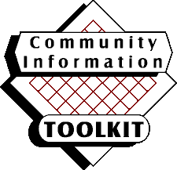
Community Information Toolkit
Tools for Launching Your Community Information Network
Four videos: 1. Introduction to Community Networking: observations of experts and from pioneering community networks in Michigan. A good overview for all participants.
2. Beginning Webmastering: an overview of HTML, an introduction to authoring tools, how to use scanners, digital cameras, and image editing software.
3. Advanced Web Content Choices: understanding image maps, animated GIFs, Shockwave, JavaScript, Java, Active X, VRML.
4. Web Site Maintenance and Administration: Understanding how to run your own server.
Videos
Training
Materials
A set of PowerPoint presentations on basic Web publishing, using authoring tools such as FrontPage and Netscape Composer, principles of Web design, and an overview of best practices, suitable for use in training your community team.
Book
A 250 page guidebook with details on the topics covered in the videos and training materials– plus detailed instructions on installing a Windows NT server and the Toolkit software, as well as a chapter on Best Practices in Community Networking.
A set of software tools that provide a community calendar, a community discussion forum, and a mechanism for authorizing users of the system. These tools are ready to run after a simple installation process; also, the Toolkit includes the source code for the tools, so that any site with a Windows NT database and Microsoft Interdev can adapt the tools to meet local needs.
Software
All Toolkit components will be available via the Web and via CD-ROM, including: Video content in RealVideo format; PowerPoint files for the Training Materials and the Videos.; the entire contents of the Book, in Acrobat PDF form suitable for printing; the Software, in source and executable forms. VHS (or other formats) tapes of the videos are available by special arrangement with the
Library of Michigan.

