Slide 1

FrontPage Basics
Contributed by
Richard Truxall,
The Library Network
Community
Information
Toolkit
www.mel.org/citoolkit
Copyright © 1999,
Library of Michigan Foundation
Re-use of these materials for non-profit training purposes is allowed without further permission, provided this notice is prominently displayed

Slide 2
FrontPage Basics
Richard Truxall
The Library Network
rtruxall@tln.lib.mi.us

Slide 3
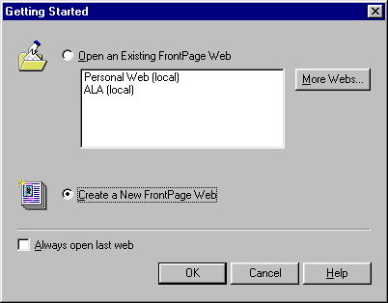
Creating a FrontPage Web from
Existing HTML Documents

Slide 4
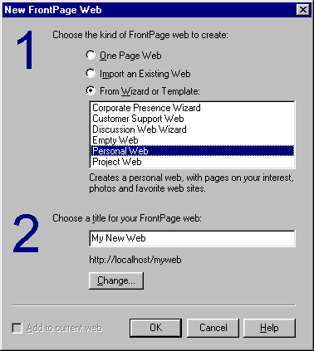
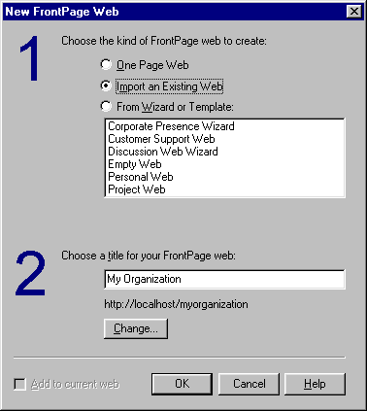
You will then see...
Change to...

Slide 5
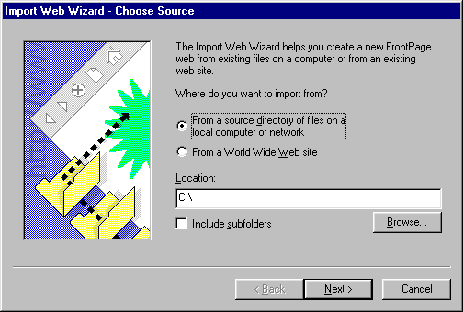
You will need to browse for HTML files on your computer or on a floppy...

Slide 6
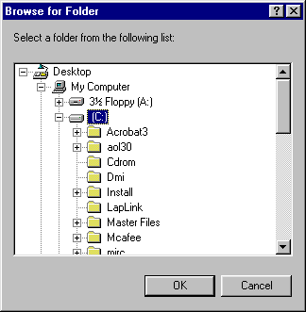
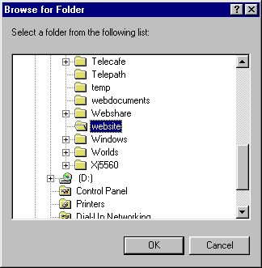
Browsing for your HTML Files...
Once You Find the Directory…
just highlight it...

Slide 7
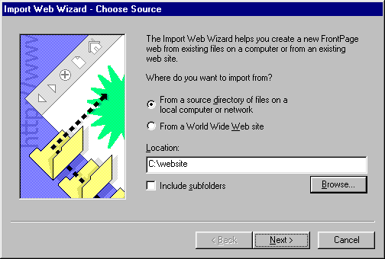
Showing You the Directory Location… If it’s Ok, just click on Next...

Slide 8
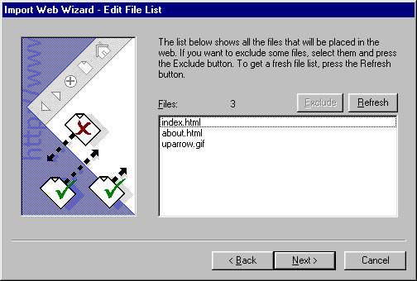
You will then see a list of the files in that directory… If they’re ok, just hit the Next Button...

Slide 9
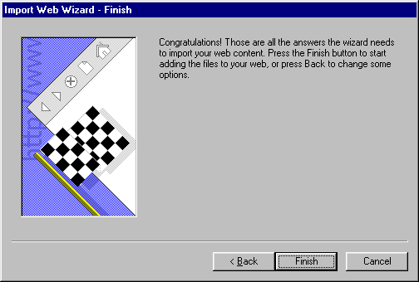
The Finish Button Should Finish the Process...

Slide 10
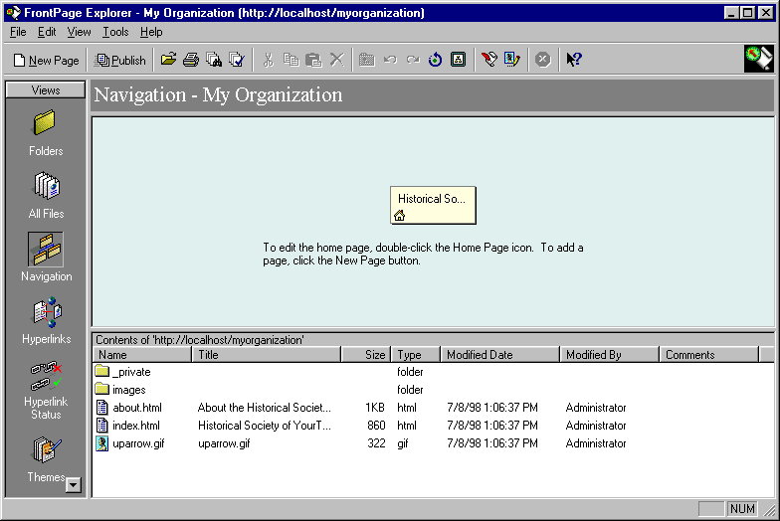
Navigation View

Slide 11
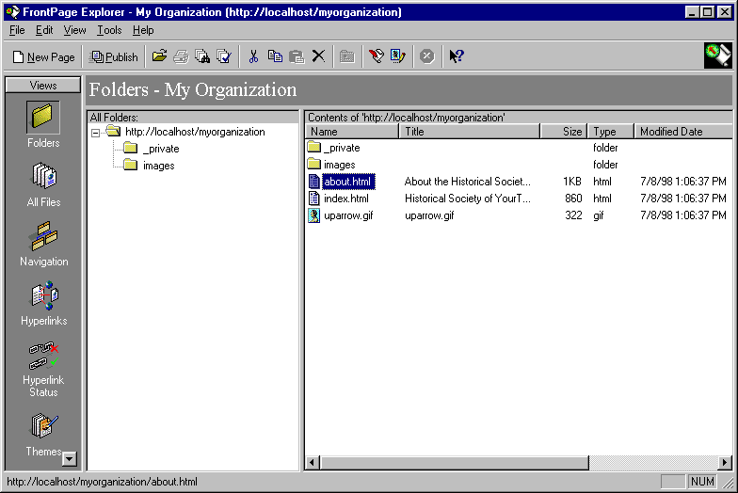
Folder View

Slide 12
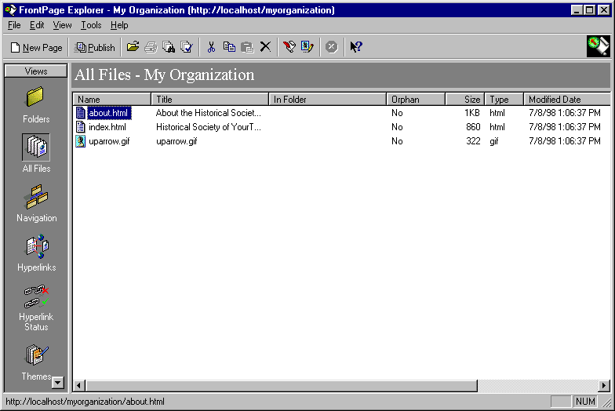
All Files View

Slide 13
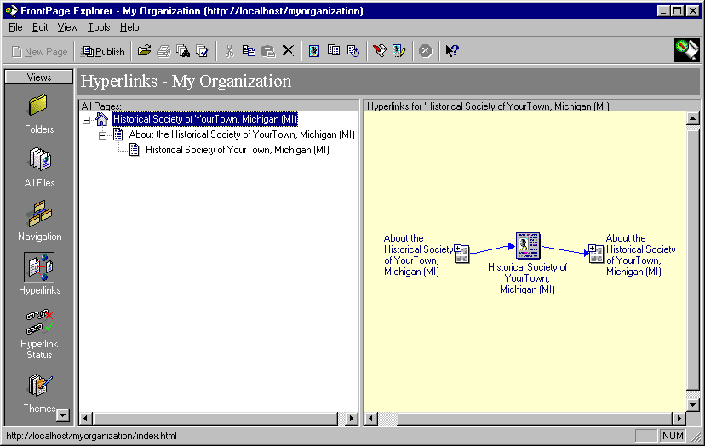
Hyperlink View

Slide 14
Editing Pages from
Navigation View

Slide 15
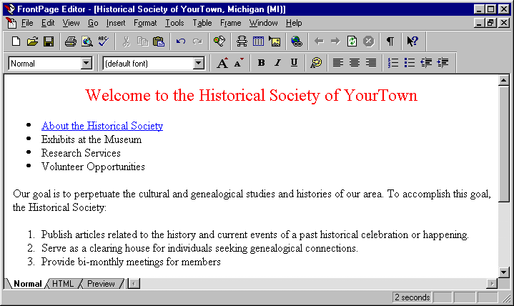
The FrontPage Editor In Normal View

Slide 16
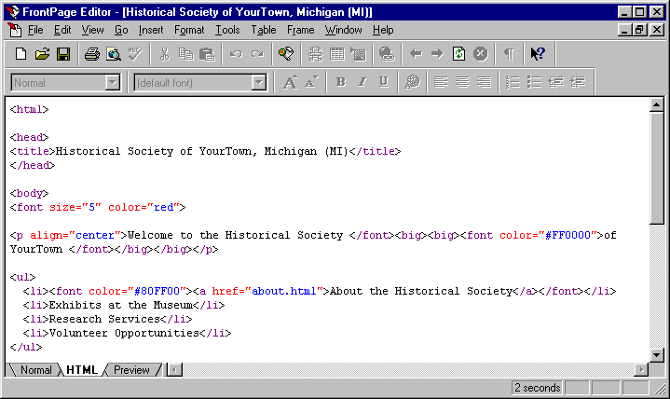
The FrontPage Editor in HTML View

Slide 17
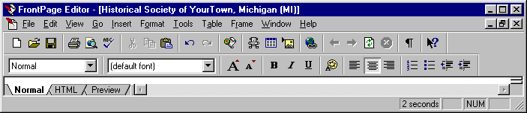
Format Toolbar

Slide 18
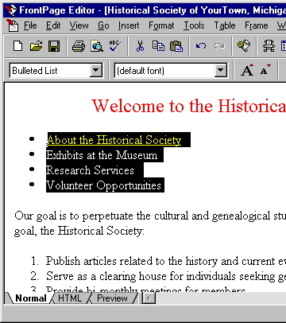
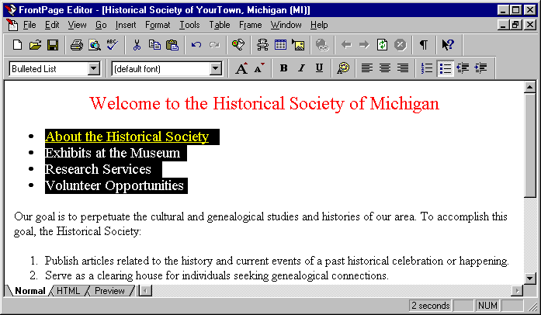
Changing Font Size
Highlight the Text to be Changed
The result after clicking on the Increase Text Size button

Slide 19
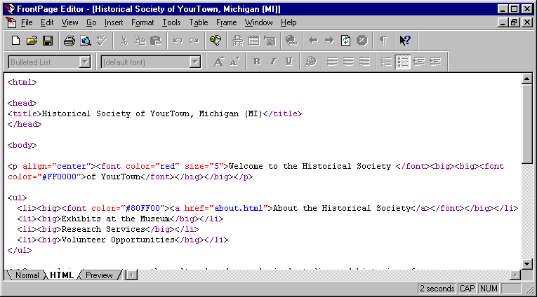
The Same Page Viewing the HTML
Notes:
Notice the differences in the tags used by FrontPage. As opposed to the standard <font size=4>, FrontPage used the <big> tag to increase the font size. While the results look good, it is always important to note the differences between standard HTML tags and the tags used by FrontPage. Sometimes the unusual tags can cause problems when viewing a document with a browser other than Microsoft’s Internet Explorer.

Slide 20
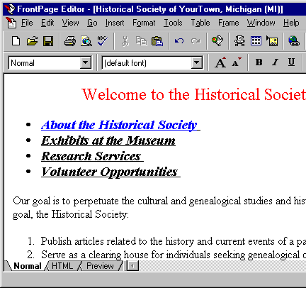
Changing Other Font Styles
Highlight the Text to be Changed
The result after clicking on the Bold, Italics and Underline buttons

Slide 21
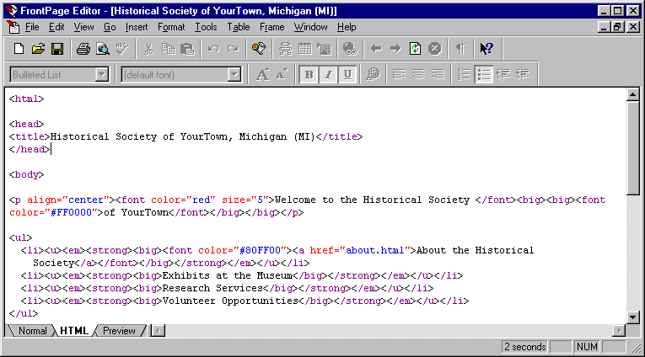
The Same Page Viewing the HTML

Slide 22

Seeing the Results of Your Changes

Slide 23
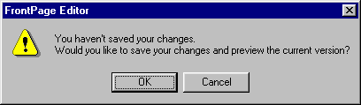
If you haven’t saved the document you’re previewing, you will be prompted to save.
If you click on Cancel, you will be taken back to the FrontPage Editor

Slide 24
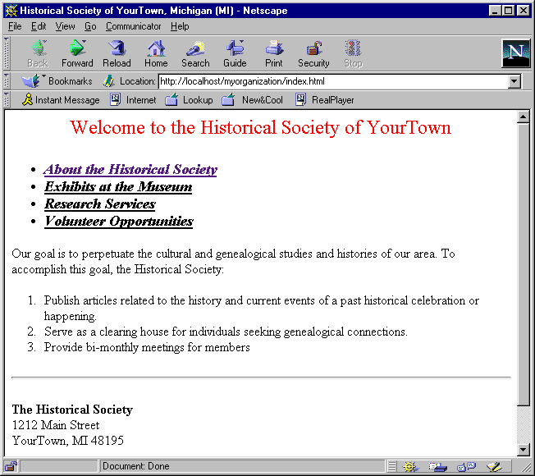
The Results in Your Default Browser
Notes:
Once you’ve viewed your document in a browser, you should then close the browser window! Otherwise, you will open numerous browser windows making you computer cluttered with excess browser windows.

Slide 25
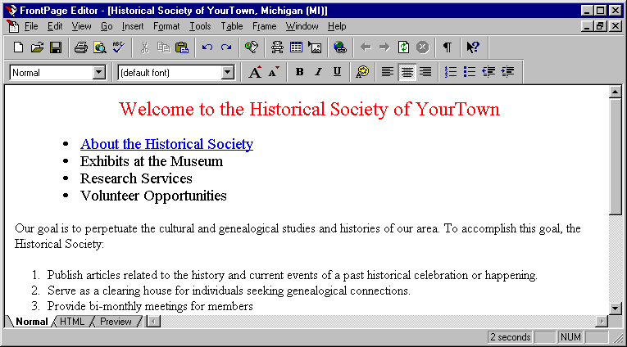
Undo the Bolding, Italics and Underline
Then Save the Document…
and Exit FrontPage

Slide 26
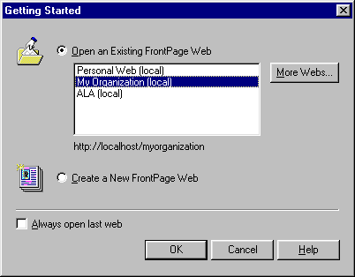
Opening an Existing FrontPage Web

Slide 27
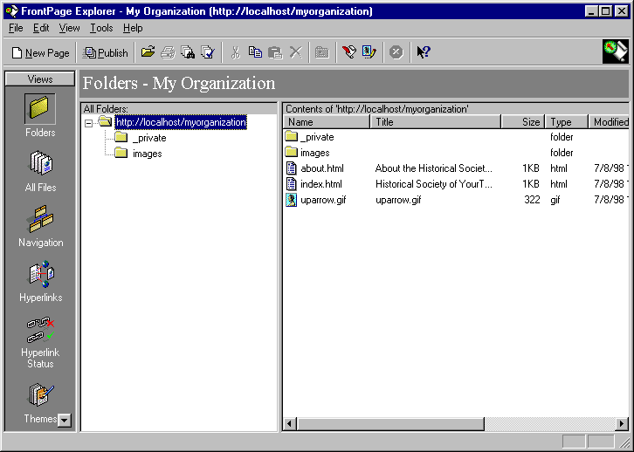
An Opened FrontPage Web in Folder View

Slide 28
You will now be viewing your document and can make any desired changes...

Slide 29
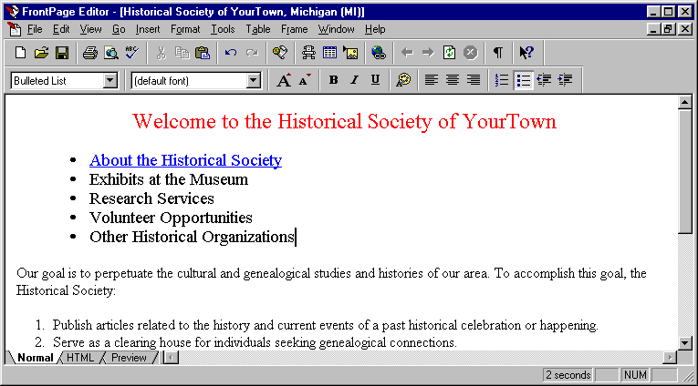
Creating a Link to an internal document

Slide 30
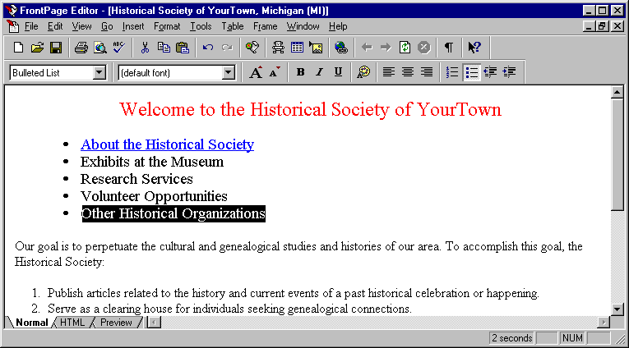
Highlight the Item You want to Link to...

Slide 31
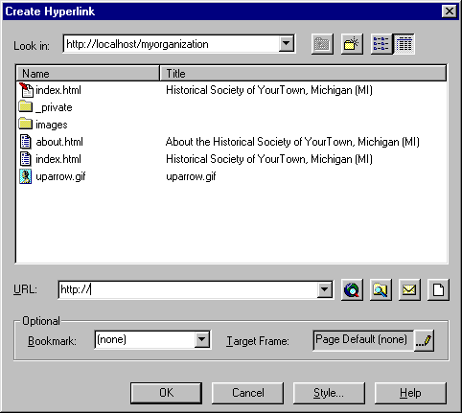
Linking to a New Document

Slide 32
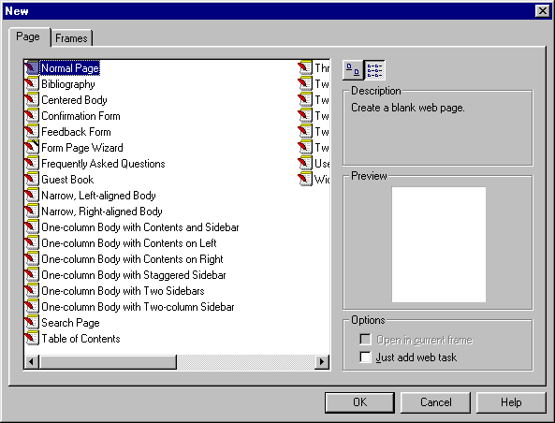
List of Pre-Created Templates

Slide 33
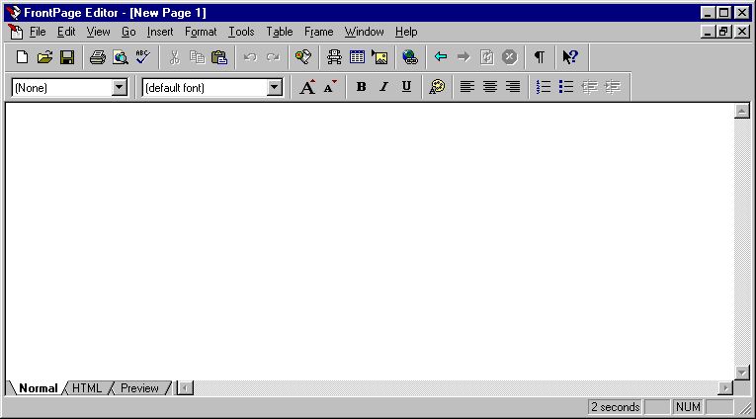
A New Web Document, without any information

Slide 34
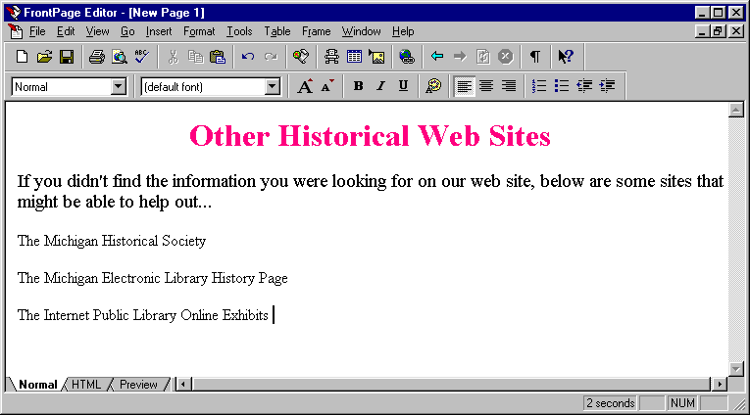
Begin Adding Information to Your
New Page

Slide 35
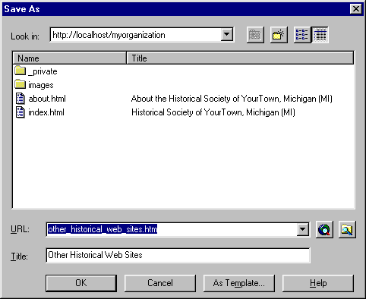
Saving Your New Document

Slide 36
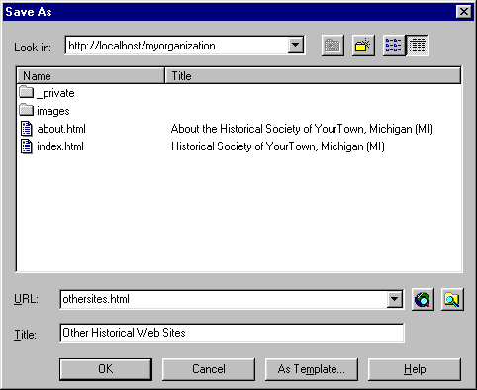
Changing the Name of the Document
Be sure to give the document a logical, but short, name.

Slide 37
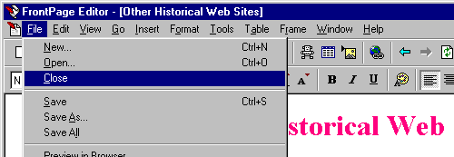
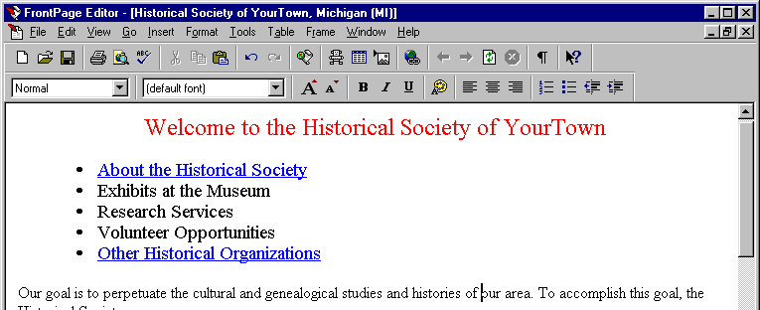
Close your newly created document, and you will see your original document with a new link...

Slide 38
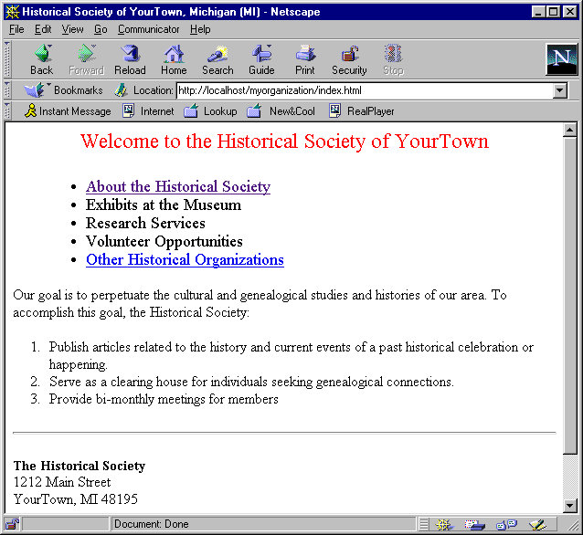
Preview Your Document in
Your Browser

Slide 39
Be Sure to Test Your New Link!

Slide 40
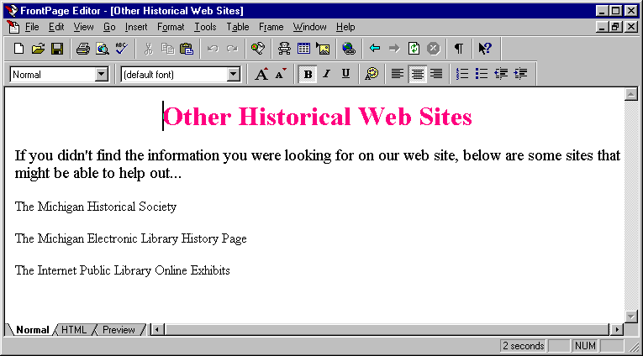
Inserting a Link to an External Web Page

Slide 41
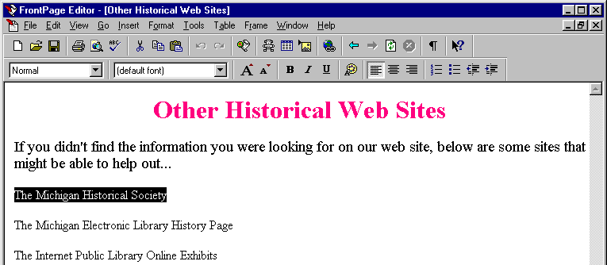
Inserting an External Link
To create a link to the Michigan Historical Center… the address is: http://www.sos.state.mi.us/history/history.html
Highlight the Item that you want to link to…
and click on the link icon...

Slide 42
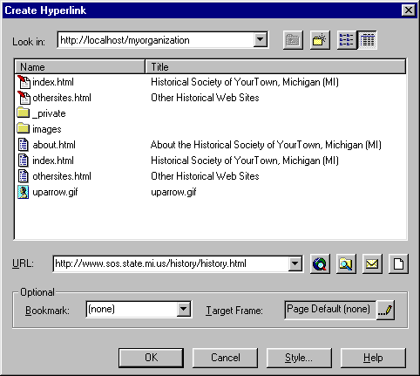
You will see the same window as with an internal link
Put the address for the site in the URL line and click on the OK button.

Slide 43
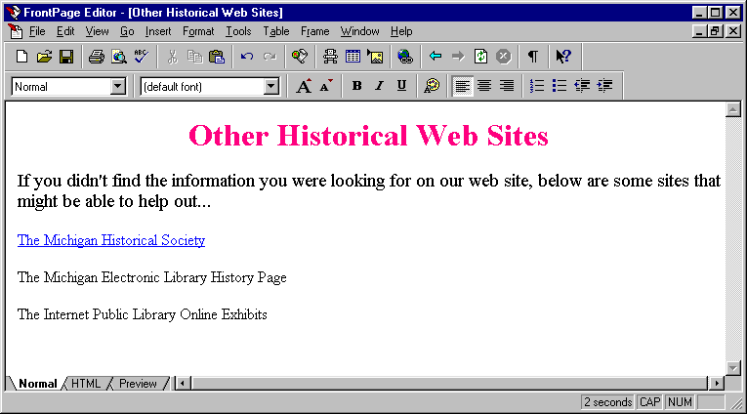
You will now have a link on the page, which (hopefully) goes to the desired address...
Notes:
http://mel.lib.mi.us/michigan/MI-history.html

Slide 44
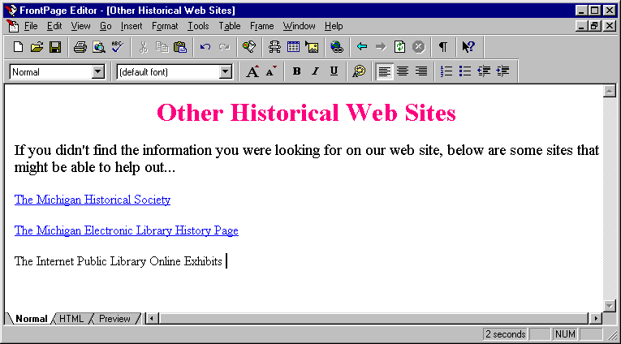
Create a second link to the Michigan Electronic Library History Page using the following address: http://mel.lib.mi.us/michigan/MI-history.html

Slide 45
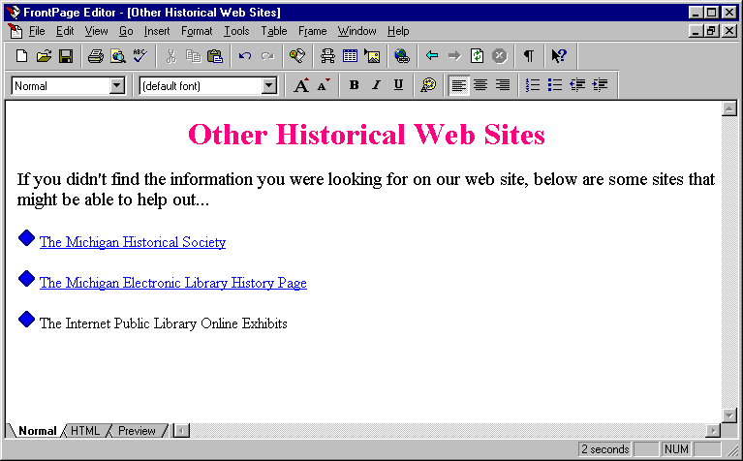
Inserting Images with FrontPage
The end result we’re aiming for with the example document...

Slide 46
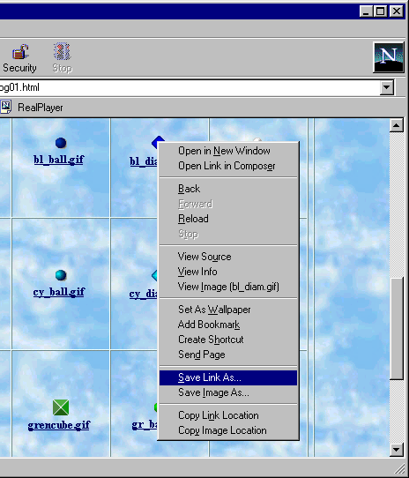
Saving the Image to Your Computer
Click the Right Mouse Button,
Select Save Image As...

Slide 47
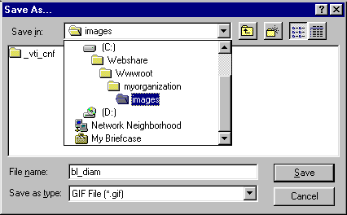
Pick A Location on Your
Computer for the Image
The Location is very important with FrontPage! The path should be like the example image above. The path is as follows:
C:\Webshare\Wwwroot\myorganization\images

Slide 48
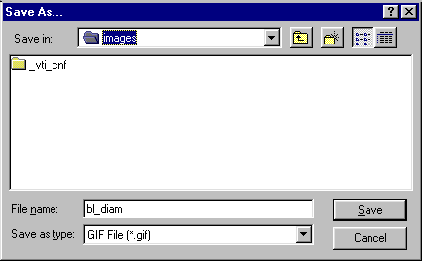
Write Down the File Name!!
In this case, the file name is bl_diam.gif
Don’t forget the extension! (.gif in this case)

Slide 49
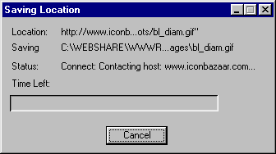
Click on the Save Button...
Very briefly, you will see the Saving Location Window…
The image is now saved on your computer and can be used on your web document.

Slide 50
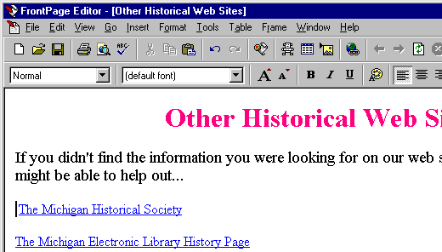
Once you’ve got the image saved, you will need to insert it into the document...
1. Place the cursor where you want the image to appear in your document...
2. Click on the Insert Image Button...

Slide 51
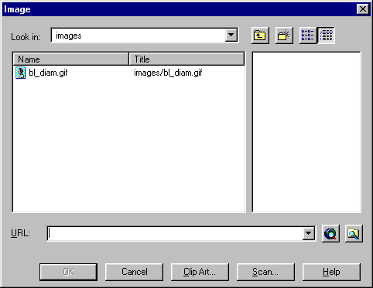
Locate the image on your computer
The location of the image should be exactly the same as where it was save to, as in the example below: C:\Webshare\Wwwroot\myorganization\images
Double click the image to insert it into your document...

Slide 52
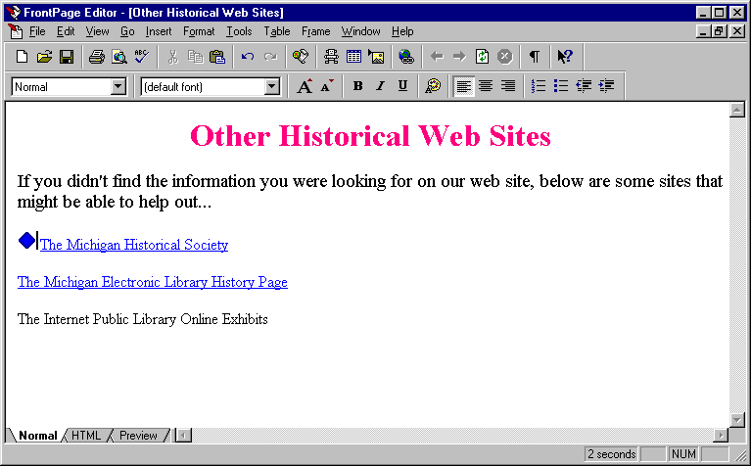
An image should be inserted into your document

Slide 53


Using an Image as a Link

Slide 54

Using an Image as a Link
Insert the address of the web page that you want to link to in the Location line. In the example, the address being used is: http://www.sos.state.mi.us/ history/history.html
Click on the OK button to make the image a link

Slide 55


Using an Image as a Link
Notes:
Using an Image as a Link
When you make an image a link, you’ll notice that the image now has a blue border around it. Most of the time, you won’t want a blue border around your image. To remove the border around the image, you will again need to view the properties of the image again by pointing at the image and clicking the right mouse button.
If the Appearance tab is not to the front, you will need to click on Appearance. This tab allows you to alter the properties affecting the display of the image. There is an item on the Appearance tab is Border Thickness. The Border Thickness controls the size of the border surrounding images. To remove the image border, simply place a value of zero as the Border Thickness and click on the OK button. The image should no longer have a border surrounding it.

Slide 56


Inserting Tables into Your Document

Slide 57

Changing Table Properties

Slide 58


Changing the Size of the Cells

Slide 59



Inserting a Line Break

Slide 60


