Slide 1

Creating HTML Pages:
An Overview
Contributed by
Richard Truxall,
The Library Network
Community
Information
Toolkit
www.mel.org/citoolkit
Copyright © 1999,
Library of Michigan Foundation
Re-use of these materials for non-profit training purposes is allowed without further permission, provided this notice is prominently displayed

Slide 2
Creating Web Pages
Richard Truxall
The Library Network
rtruxall@tln.lib.mi.us
Notes:
Through the use of this document, you will be able to create, from scratch, basic web pages. Overall, you will find that the process of creating web pages is not all that difficult. In fact, with just a little practice, you will become quite proficient and creating and maintaining your information in an online environment. Keep in mind, however, that simply going through this document will not be enough time to make you an expert. You will most definitely need to practice before you will be comfortable with your web pages.

Slide 3
What’s in a Web Document?
WWW documents are just word processing documents
Written in HTML - hypertext markup language
  The HTML language tells a Web Browser how to interpret the document - i.e. where to put text, how big to make the words, where to place pictures, etc.
An example page is available at: http://tln.lib.mi.us/train/sample.html
Notes:
Basically, creating a web page is not more complex than creating a word processing document. In fact, you could create your web pages using any word processor at all - which means that if you own a computer or have access to a computer, you have the basic tools that you need to begin the process of creating your web site.
Most of the Web sites you have ever used have at least one feature in common… they are all created using a special language called HTML (which stands for HyperText Markup Language). The HTML will tell your browser (Netscape or Microsoft’s Internet Explorer) how to interpret the document. If you want some words on your page to be in bold or in a different color, you will need to use HTML to make that result happen.
The easiest way to understand how HTML actually works is to view an example of a document...

Slide 4
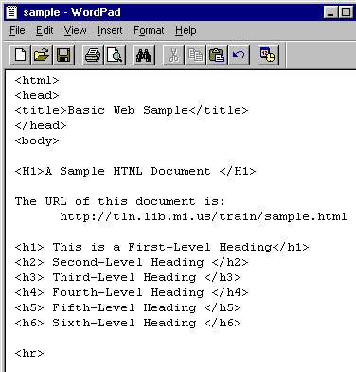
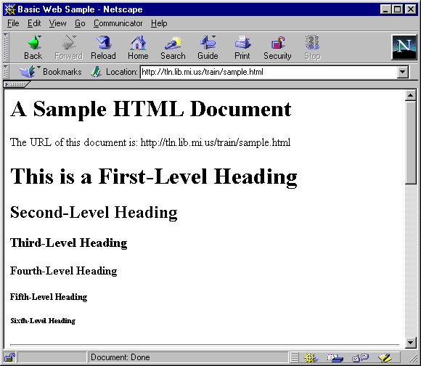
The Same Web Document - The top document viewed with a Word Processor, the bottom document viewed with a web browser
Notes:
The two images in the slide are the exact same document. The only difference between the two documents is the program being used to view the document. The top document is being viewed with WordPad, which is a word processor that comes with Windows95 or Windows98. The bottom document is being viewed with a Web browser (in this case, Netscape). The top document shows you the actual HTML coding which causes the resulting formatting of a document being viewed with a web browser.
To understand HTML and how it works, examine the line of text on the bottom document which reads “A Sample HTML Document.”
Now, find that same line of text on the top document. Notice that the line reads: “<H1>A Sample HTML Document</H1>.” The <H1> before the line of text is an HTML Tag which causes the words to be larger and bolded. The <H1> called a Heading Size One. The tags which occur before a line of text are referred to as beginning tags.
Notice also that there is a slightly different tag after the line of text. That tag, the </H1>, is the stops the text from being slightly larger and bold. Not surprisingly, since the </H1> tag ends the formatting begun by the beginning tag, it is referred to as an ending tag. The primary difference between the two tags is the / which must be present to end a particular tag. Without an ending tag, then all of the text after the beginning <H1> would be slightly larger and bolded.

Slide 5
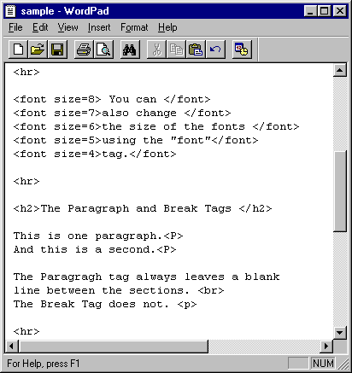
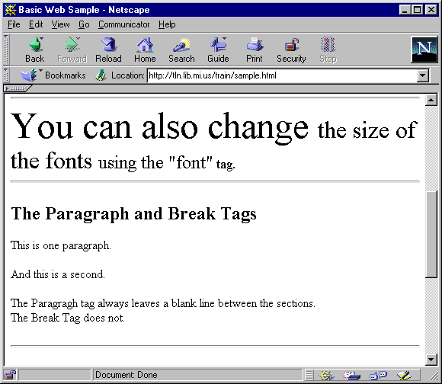
The Same Web Document - The top document viewed with a Word Processor, the bottom document viewed with a web browser
Notes:
To get a better feel for the general concept of using HTML tags to format a document, as well to get an overall view of the wide variety of HTML tags compare the two views of the same document a bit further.
As you scroll down both the top document and the bottom document, notice how the different tags cause a different result in the Web browser (Netscape).

Slide 6
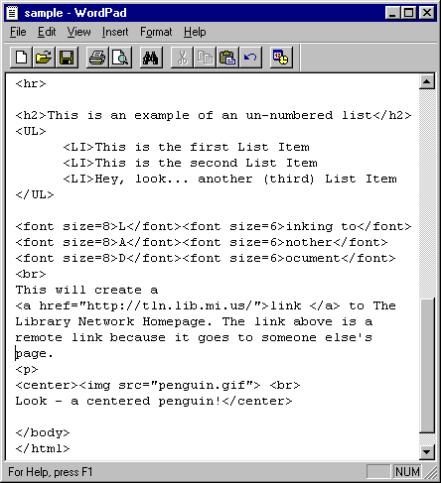
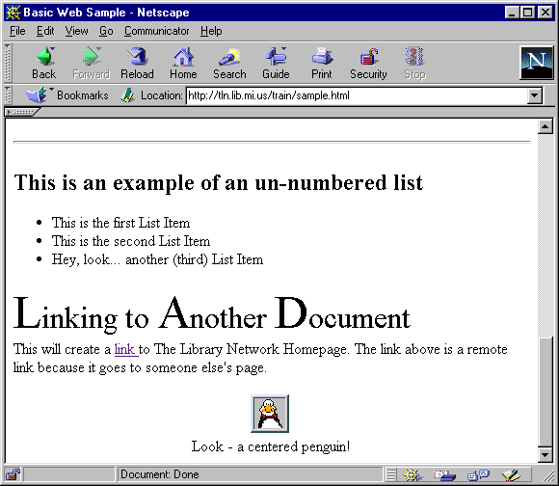
The Same Web Document - The top document viewed with a Word Processor, the bottom document viewed with a web browser
Notes:
As you continue comparing the two documents, you’ll notice the mostly consistent pattern of beginning tags coupled with corresponding ending tags.
The tags shown on this document will be explained in more detail throughout the training.
If you have been using computers for a number of years, you may notice some similarities between HTML tagging and word processing with computers such as the Apple IIe, the Commodore 64 or even older versions of WordPerfect. If you are familiar with other similar programs, then HTML will be a very easy leap for you to make. If you are not familiar with such older programs, don’t worry! HTML is still quite easy to learn.

Slide 7
Starting a Word Processor
Before you can begin, you’ll need to choose a program to use to create your HTML documents
Any word processor will work just fine
WordPad is a good starting point if you’re not sure which program to use
Your Task: Start WordPad
Notes:
Once you understand the general concept of HTML, you are ready to begin your own documents. Before you begin, however, you will need to decide which program you’re going to use to create your documents. Any word processing program will work just fine. If you’re familiar with Microsoft Word, Microsoft Works or WordPerfect, then you could certainly choose to begin your documents with one of those programs. However, since you don’t really need the full functionality of complex programs such as MSWord or WordPerfect, then those programs may not be your best choice. For the remainder of this instruction, we will be using a program called WordPad. WordPad is essentially just a little word processor that doesn’t have the unnecessary features of more complex word processors.
With Windows95, WordPad is (almost) always in the same place. Your first step toward creating a web page is simply starting WordPad.
Your Task: Start WordPad using the Instructions below:
1. Click on the Start button (usually located in the bottom right corner of your screen.
2. Select Programs from the list that appears.
3. Select Accessories
4. You should now see WordPad near the bottom of the list of Accessories
5. Click on WordPad to start the program.

Slide 8
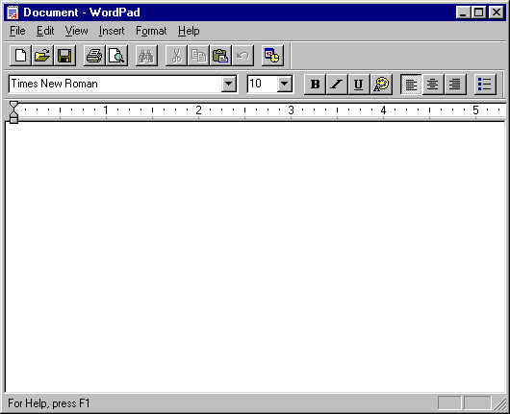
The Empty Word Processing Document- the blank slate to build upon
Notes:
You will now be looking at an empty word processing document, which can be intimidating. From this point you will begin creating your all of your HTML documents following a basic pattern...

Slide 9
All HTML Documents Have the Same Structure
<HTML>
<HEAD>
<TITLE>The Historical Society
of YourTown, Michigan</TITLE>
</HEAD>
<BODY>
This is an HTML document about our
historical society.
</BODY>
</HTML>
The first 5 tags are always the same in basic HTML document.
As are the last two tags of all HTML documents.
Notes:
All basic HTML documents begin with the same basic structure. In fact, the first five tags of most of your basic HTML documents are exactly the same. Those first tags include:
<HTML>
<HEAD>
<TITLE> and </TITLE>
<BODY>
Notice also that the last two tags are the same. All HTML documents end in the same way as well. The last two tags of all of your HTML documents should be:
</BODY>
</HTML>
Knowing that the structure of all HTML documents is the same, you should also then know where you will start your document. Every time you begin a basic HTML document, you will type with those first five tags, in that order.

Slide 10
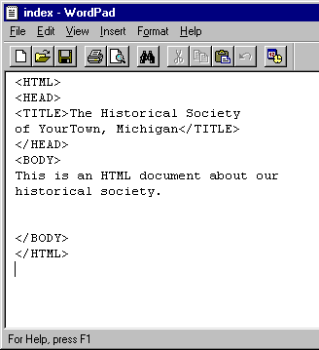
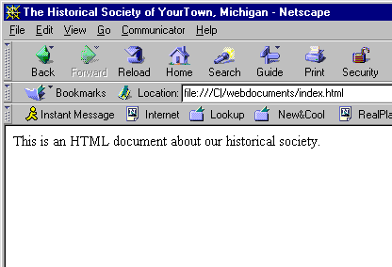
A Basic HTML Document
Notes:
As you now know, the first 5 tags of all HTML documents are the same. A closer explanation of those tags is in order:
<HTML> </HTML>
The <HTML> tag tells the browser that the document being viewed is an HTML document as opposed to some other type of document. All of your HTML documents should start with this tag.
<HEAD> </HEAD>
HTML documents are like letters. They have two parts… the first part is the header and the second part is the body.
<TITLE> </TITLE>
The title tag is deceptive, and easily overlooked as you browse other people’s web sites. The contents of the <TITLE> tag only ever appears in the blue bar along the top of your browser. In the example above, the title of the document is The Historical Society of YourTown, Michigan. A further note about the title tag: If a user bookmarks your web page, what they will see in their bookmark file is whatever words or phrases you included in your <TITLE> tag.
<BODY> </BODY>
Like a letter, the <BODY> of your document is the part that users will see. All of the information that you want to publish must fall between the beginning body tag <BODY> and the end body tag </BODY>. Notice in the example above that the only sentence which appears in the Netscape window is This is an HTML document about out historical society.

Slide 11
Your Task:
Begin a basic HTML document using WordPad.
Notes:
Begin creating your first HTML document using the standard first five tags previously discussed. Your document, should look like the example shown below:
<HTML>
<HEAD>
<TITLE>REPLACE THIS TEXT WITH YOUR TITLE </TITLE>
<BODY>
</BODY>
</HTML>
You are now ready begin adding the actual content to your document...

Slide 12
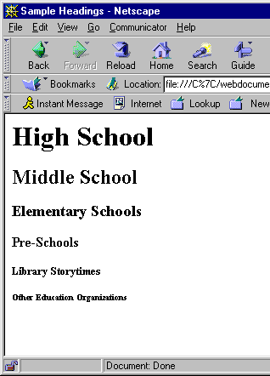
Headings <H1...H6>
<HTML>
<HEAD>
<TITLE>Sample Headings</TITLE>
</HEAD>
<BODY>
<H1>High School</H1>
<H2>Middle School</H2>
<H3>Elementary Schools</H3>
<H4>Pre-Schools</H4>
<H5>Library Storytimes</H5>
<H6>Other Education Organizations</H6>
</BODY>
</HTML>
Notes:
The first tag we will discuss is the Heading tag. Headings are intended to be used exactly as you might guess - as headlines for sections of a single document. There are six levels of headings in HTML. <H1> is the largest size heading and the smallest is <H6>. They are displayed in larger and/or bolder fonts than normal text.
Notice that all headings have beginning and ending tags. For example: </H1> ends the heading size one (<H1>) which precedes high school.
Your Task: Enter in either an <H1> tag or an <H2> tag and what you want the user of your web page to see. Don’t forget the ending tag! (Either a </H1> or a </H2>)
Your results should look something like the example below. Be sure to put in your information! (i.e. use your own <TITLE> tag and your own <H1> tag).
<HTML>
<HEAD>
<TITLE>Historical Society of YourTown, Michigan</TITLE>
<BODY>
<H1>Welcome to the Historical Society of YourTown, Michigan</H1>
</BODY>
</HTML>

Slide 13
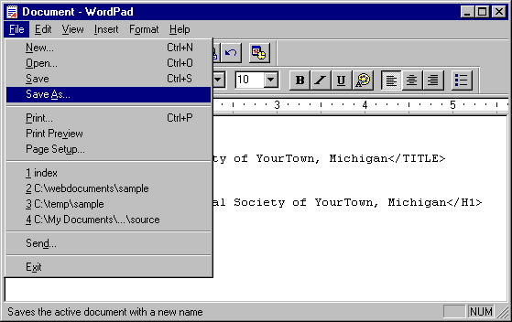
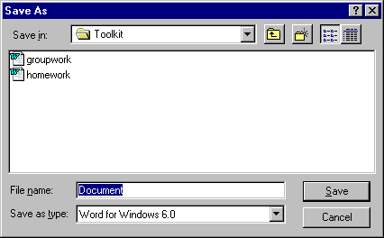
Saving a new HTML Document
1. Pull down the File menu and select Save As
2. You will now see the Save As dialog box, as shown below:
Notes:
At this moment, you should have a very basic HTML document. As you create your web site, it is always valuable to test out the document with your browser to see if you’re happy with the document as you go along the creation process. You most definitely don’t want to spend hours working on a page, only to test it and realize that the result is not at all what you anticipated.
However, you will need to save the document before you can view it with your browser... The steps for saving an HTML document with a word processor are shown below and detailed in the slides above…
1. Pull down the File menu and select Save As.
2. You will now see the Save As dialog box. From here you will need to determine the location that you would like to place the file on your computer. In this case, we will place the file onto the Floppy disk.
3. Once you’ve determined the location for the file, you will need to give the file name. There are some rules of thumb to follow when naming HTML files:
No spaces.
Eight letters or less (not necessary for Win95)
Generally, keep the file names all lower case.
All file names must end with the extension of .htm (Wiin3.1) or .html (Win95)
4. Now that the file has a name, you will need to change the file type to a text document. To do this, simply pull down the Save as Type menu and select Text Document off the list.
This is one of the most important steps!! Do not forget this step!!
5. Click on the Save button and file will be saved onto the Floppy disk.

Slide 14
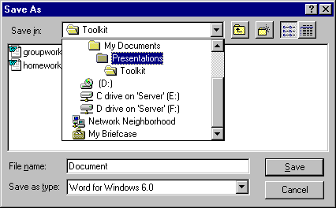
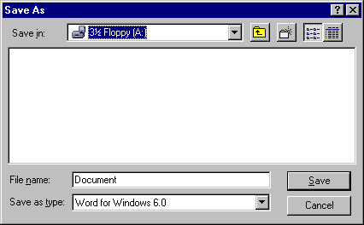
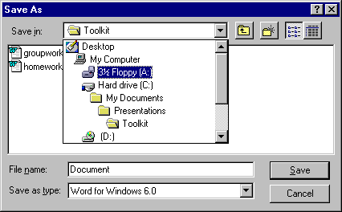
Saving a New HTML Document:
Choosing a Location to Save Your File
2a.
2c.
2b.
Notes:
2. You will now see the Save As dialog box. From here you will need to determine the location that you would like to place the file on your computer. In this case, we will place the file onto the Floppy disk. The steps to changing a Saving Location on your computer are as follows:
a. Pull Down the Save In… menu
b. If you don’t see the folder or drive you’re looking for in the list, you may have to scroll up or down using the scroll buttons for the Save In… menu
c. Once you’ve decided on your location, double check the location shown in the Save In… box to be sure the file is being saved in the correct location.
NOTE: If you are not familiar with saving locations, directories and drives… You should look into finding some Windows95/98 training to help you better understand the process of creating web sites. In fact, if you’ve never been through formal Windows95/98 training, your web site creation experiences will be significantly more useful and enjoyable after taking such training.

Slide 15
Saving a New HTML Document:
Naming the File
3. Once you’ve determined the location for the file, you will need to give the file name. There are some rules of thumb to follow when naming HTML files:
a. No spaces.
    b. Eight letters or less (not necessary for Win95)
    c. Generally, keep the file names all lower case.
    d. All file names must end with the extension of .htm (Wiin3.1) or .html (Win95)
Notes:
3. The file names of HTML Documents are exremely important. A simple, unintended error when naming a file can cause you many needless headaches.
The rules of naming HTML documents are very consistent, which does help keep errors to a minimum once you’ve saved a few document. The four rules of thumb are as follows:
a. No spaces - even if you’re using Windows 95/98, you should not ever put a space in the file name of an HTML document. Using spaces can be deceptive, since file names with spaces will work just fine on your computer. However, as soon as you put that document onto the Internet, it will stop working.
b. Eight letters or less - even though this is not necessary for Win95/98 computers, short file names for HTML documents is always a good recommendation. Keep in mind that the longer you make your filenames, the more a user will have to type when trying to access your document.
c. Generally, keep the file names all lower case - although file names will work just fine if you use uppercase letters, your users will have to type an uppercase in your web address to access the document. This can cause a tremendous amount of frustration on the part of your users, which will cause them to either look at your site negatively or not get to your site at all.
d. All file names must end with the extension of .htm (Wiin3.1) or .html (Win95) - this step is crucial! If you don’t actually type in the file extension of either .htm or .html, then the file will not work easily.

Slide 16
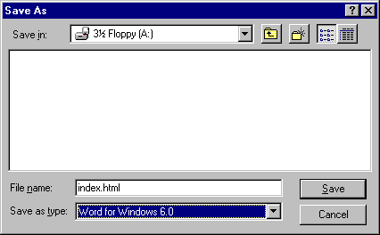
Saving a New HTML Document:
Naming the File
All four naming conventions for naming HTML documents have been followed in the example above.
Notes:
3. All four naming conventions for naming HTML documents have been followed in the example above:
a. No spaces.
b. Eight letters or less (not necessary for Win95)
c. Generally, keep the file names all lower case.
d. All file names must end with the extension of .htm (Wiin3.1) or .html (Win95)
Don’t click on the Save button yet!
There is one more, absolutely vital step to the saving process!
An informational note about the name of your home page:
Your home page (your storefront page) should have a particular name. In the example above, I have named the document index.html With my Internet Service Provider, index.html is an acceptable name for an initial document. This name can vary from provider to provider, so you’ll need to check with your own local company to find out what to name your initial file. The advantage of using a file name specified by an Internet Service Provider is illustrated with the example below:
With a document named index.html, the address for my web site could look like this:
http://tln.lib.mi.us/historical/
The user will still get to the file called index.html without typing it, since that is the file name specified by my Internet Service Provider.
With a document name home.html, the address for my web site would be longer:
http://tln.lib.mi.us/historical/home.html
By using a standardized file name for the home page, my users can use a shorter address when trying to access my web site. This follows the principal of keeping the needs of the user first.

Slide 17
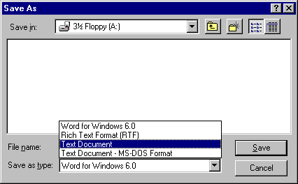

Changing the File Type to Text
4a. Pull Down the Save as Type: menu
4b. Select Text Only or Text Document
Notes:
4. Now that the file has a name, you will need to change the file type to a text document. If you fail to change the type of document being saved, you HTML documents will not work without problems.
To do this, simply pull down the Save as Type menu and select Text Document off the list. Keep in Mind that your Save as Type menu may pull down, not up as the example shows. You may also have to scroll up or down the Save as Type Menu to find the choice of text.
Don’t be fooled by other types of text options… Rich Text Format is not the same as Text Document! Nor will it work!

Slide 18

Review Your Saving Choices before Clicking on the Save Button
Notes:
If all of the information is correct, click on the Save button and your file will be saved onto the floppy disk.

Slide 19
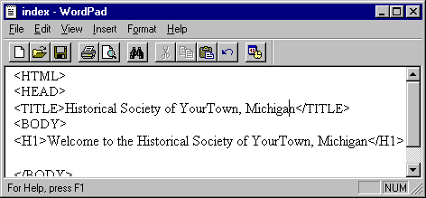
After Saving the Document, you should see the name of the document at the top of your WodPad window
In this case, the file is called index. You will not see the extension of .html and that is to be expected.
Notes:
After Saving the Document, you should see the name of the document at the top of your WodPad window. In the example above, the file name shown is index, not index.html. That is to be expected. WordPad does not show extensions in file names, regardless of which extension is used. As long as you are sure you named the document with the proper extension, then you need not worry about the lack of an extension showing.

Slide 20
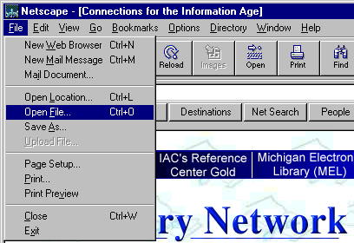
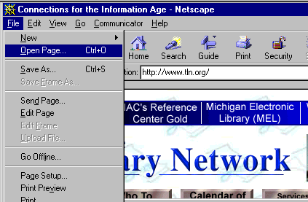
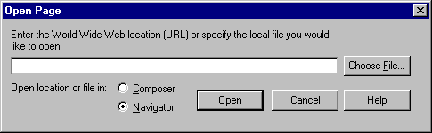
Previewing a Local HTML Document
Netscape 3.x
Netscape 4.x
Netscape 4.x
Notes:
Once you’ve successfully saved your new HTML document, you will need to see what the document looks like in Netscape. Without previewing your document as you go along, it becomes very difficult to create an error free HTML document. So… to preview an HTML document that is saved on your computer involves the following steps:
1. With Netscape 3.x - Pull down the File menu and select Open File
With Netscape 4.x - Pull down the File menu and select Open Page. With Netscape 4.x, you will see a second window which will let you Choose a File located on your computer. To do this click on the Choose File button.
After this one extra window in Netscape 4.x, the rest of the opening process is exactly the same between the different versions of Netscape.

Slide 21
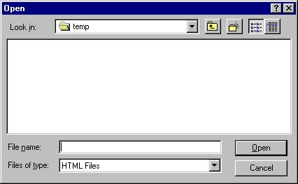
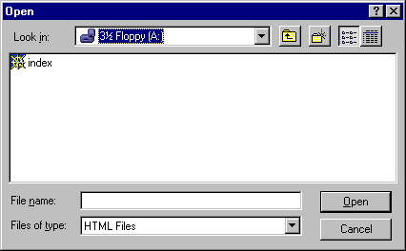
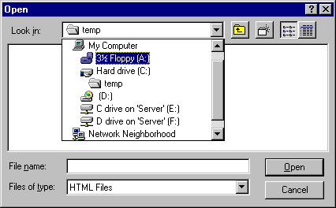
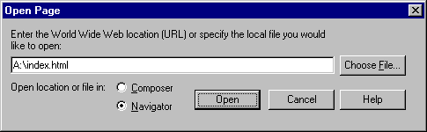
Locating the File on Your Computer
2a.
2c.
2b.
2d. - Netscape 4.x only
Notes:
2. You will need to locate the HTML file on your computer that you wish to preview. In this case the file is on a floppy disk inserted into drive on the computer, so if you do not see your file immediately, you will need to browse your computer for it.
a. To locate the file, use the Look in: menu located near the top of the Open dialog box. This will show you a list of all of the drives and directories that are available on your computer.
b. When you pull down the Look in: menu, you should see the choice for the floppy drive. If you do not see the choice for the floppy drive, you will need to scroll up or down using the scroll buttons located on the right of the Look in: menu. Once you’ve found the choice for the Floppy drive (A:), you will need to highlight it.
c. You should now see your file in the larger white area below the Look in: menu. In the example above, the file name is index. Notice that you don’t see the extension that you typed when saving the document. If the file were not names with an extension of .html, then you would not see the file at all. Common Problem: if you’re on the Floppy Drive, and you don’t see your file, you will need to go back to WordPad and save the file again, being sure to include the .html extension on the file name.
d. If you’re using Netscape 4.x programs, you will see an extra window before seeing your document. All you need to do to actually see your file is click on the Open button.

Slide 22
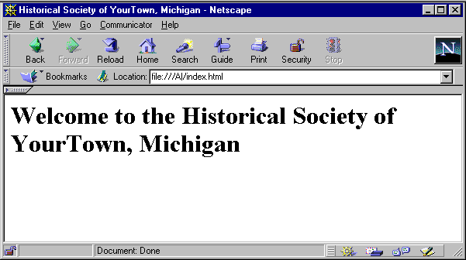
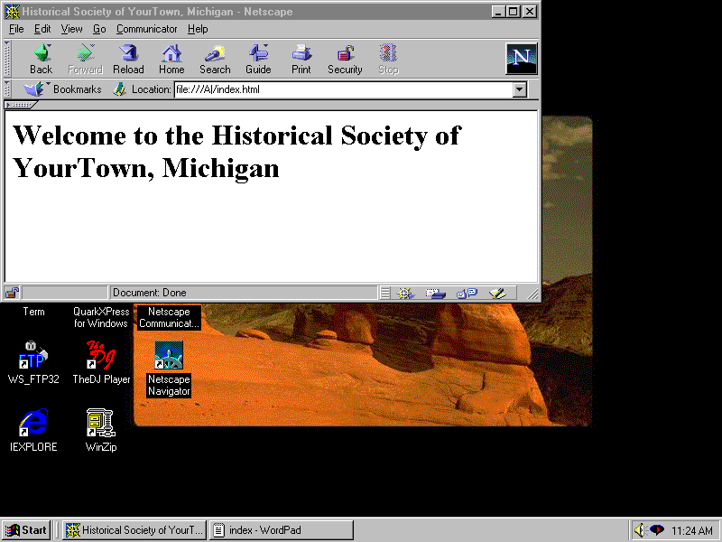
Your Local File Previewed in Netscape
Using the Windows Taskbar to return to WordPad
Notes:
You will now see your basic HTML document as it would appear to a user viewing your document with Netscape. You may not be entirely happy with the current result. You might want the font larger or smaller, or you may want the text centered.
From this point on, you will be making changes to your document, such as centering or increasing the font size. However, before you can make any changes to your document, you must be viewing the HTML coding of your document in WordPad.
Using the Windows Taskbar to return to WordPad
To get back to WordPad, all you’ll need to do is look at the Windows Taskbar at the bottom of your screen. On your Taskbar, you should see an icon for WordPad. By clicking on that icon, you will again see the HTML coding for your document. From this screen you can make changes to the content or the formatting of your document.
From here, we will begin altering your document, adding some information and changing the style of that information.

Slide 23
Character Formatting
<CENTER>Centering</CENTER>
<HTML>
<HEAD>
<TITLE>The Historical Society of YourTown, Michigan</TITLE>
</HEAD>
<BODY>
<CENTER><H1>Welcome to The Historical Society of
YourTown, Michigan</H1></CENTER>
</BODY>
</HTML>
Notes:
Centering Items on Your Document
Your Task:
In order to center items on your document, you will need to use the appropriate HTML tag. The tag for centering is easy enough to remember: <CENTER>…</CENTER>
As in the example above, place a beginning center tag <CENTER> before your <H1> tag and an end center tag </CENTER>after your </H1> tag.
In order to see your changes, you will need to save the document...

Slide 24
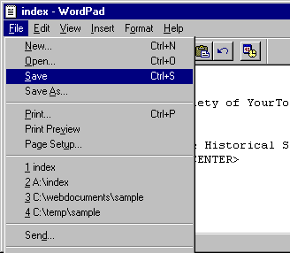
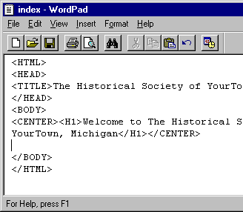
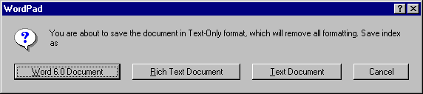
Saving the Document
With the File Menu
With the Save Button
Text Document Formatting - Very Important!
Notes:
After you have made changes to your HTML document, you will need to save the document before you can see the results of that change. Saving an existing HTML document is the same as saving any other Windows document you have ever saved, with one small difference.
To save your document, either:
1. Pull down the File menu and select Save from the choices, OR
2. Click on the Save button on your WordPad toolbar
There is no difference between the two, so use the method that you’re most comfortable with.
You will be prompted with an extremely important question regarding the formatting of the document. The question, is: do you want to save the document as an MSWord document, a Rich Text Document or a Text Document.
HTML documents are always, always, always (!) text documents! If you select a different option, your document will not work! This is true, regardless of the word processor you use to create HTML documents! If you’re using WordPerfect or Microsoft Word, be sure you save your document as text only!

Slide 25
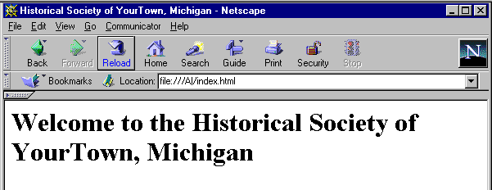
Previewing Your Changes
Pull Up Netscape using the Taskbar
Reload the Document in Netscape to see your Changes
Notes:
To view your new changes, you will first need to use the Taskbar to get back to Netscape. Once you’re back looking at Netscape, you will not instantly see your changes. In order to see you changes you will need to click on the Reload button on your Netscape toolbar. Once you click on the Reload button, you should see your changes.
The process of making changes to your HTML documents will always be the same:
1. Open or View the document in WordPad
2. Make whatever changes you want
3. Save the document in WordPad, being sure to save as a text document
4. Use the Taskbar to Return to Netscape.
5. Open your HTML document using the File menu, or click on the Reload button if you document is already open.
From this point on in this document, we will discuss various HTML tags and their results. To use this document most effectively, you should go through the tags, enter them into your document, save the changes and view the changes as you go.
As errors occur, which is always a possibility, just go back to the HTML coding and look for typos, as that is the cause of most of the troubles in an HTML document.

Slide 26
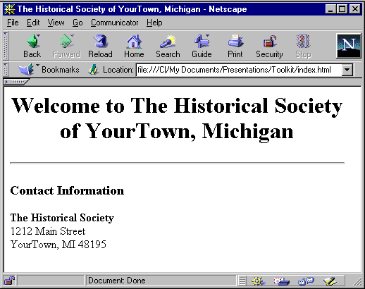
Character Formatting
<B> Bold </B> & <I> Italics </I>
<HR> - The Horizontal Rule
<BR> - The Break Tag
<CENTER><H1>Welcome to The Historical Society of YourTown, Michigan</H1></CENTER>
<HR>
<H3>Contact Information</H3>
<B>The Historical Society</B><BR>
1212 Main Street<BR>
YourTown, MI 48195<BR>
</BODY>
</HTML>
Notes:
<B>Bolds</B> & <I>Italicizes</I>
Certainly, two very common tags used in HTML documents are the bold and italics tags. As you can see, they are fairly obvious tags.
Horizontal Rule <HR>
The Horizontal Rule is the line running across the Netscape window. Horizontal Rules are an easy tool to use to separate parts of HTML documents.
Break Tag <BR>
The Break Tag leaves a single space between lines. Notice that the <BR> falls at the end of the line where you want a break to occur (i.e. after each of the address lines in the example above). Without the <BR>, the address for the Historical Society would have all been on one single line, as shown below:
Your Task: At the bottom of the your pages, add contact information for your organization. It is always recommended to have contact information provided on all of your HTML documents. Presumably, if you’re putting information online, then you will also take responsibility for the quality of that information, and your contact information helps to validate that you’re acting responsibly with your information. Once you’ve entered in your information, save your changes, go to Netscape and reload your document.

Slide 27
Unordered <UL> and Ordered <OL> Lists
<HTML>
<HEAD><TITLE>The Historical Society of YourTown, Michigan</TITLE></HEAD>
<BODY>
<B> Welcome to the Historical Society of YourTown, Michigan</B> <P>
<UL>
<LI>About the Historical Society
<LI>Exhibits at the Museum
<LI>Research Services
<LI>Volunteer Opportunities
</UL><P>
Our goal is to perpetuate the cultural and genealogical studies and histories of our area. To accomplish this goal, the Historical Society:<P>
<OL>
<LI>Publish articles related to the history and current events of a past historical celebration or happening.
<LI>Serve as a clearing house for individuals seeking genealogical connections.
<LI>Provide bi-monthly meetings for members
</OL>
</BODY>
</HTML>
Notes:
Unordered <UL> and Ordered <OL> Lists
Two very commonly used tags are the Unordered and Ordered Lists. Lists are an easy way of listing items, such as services offered, in an easily understandable format. The difference between the <UL> and <OL> tag is quite easy to determine:
Unordered lists <UL> are bulleted and indented
Ordered lists <OL> are numbered and indented.
As you look at the tags and the results of the tags on the next page, you’ll notice that <LI> tag marks items in the list (referred to as List Items). In the Unordered List <UL>, the <LI> makes a bullet. In the Ordered List, the <LI> creates a number. The pattern with both types of lists is always the same… you start the list with either a beginning <UL> or <OL> tag, you enter your list items with the <LI> tag, and lastly you end the list with either an ending </UL> or </OL> tag.
The Paragraph Tag <P>
The Paragraph Tag is a counterpart to the Break Tag <BR>. The only difference is that the Paragraph tag acts as a double space, instead of a single space. Notice on the next page how the <P> after the end of the Unordered List renders.

Slide 28
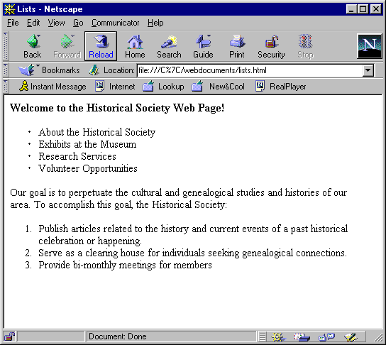
Unordered <UL> & Ordered <OL> Lists
Paragraphs <P>
Notes:
The slide above is how Netscape will show the <UL> and the <OL> tags.
Your Task: Create two lists for your web page - one as an Unordered List <UL> and one as an Ordered List <OL>. Eventually, you will create second (and third) documents to go on your organization’s web site, so as you create your unnumbered list, think about the types of information that you want to provide to your users. Those items should be represented in your lists, as the example above shows. There is a list item for Exhibits at the Museum, but if the users want that information, they will need to click on the link to find out about it. (Obviously, the document about the museum exhibits has not been created yet, but once that happens, you will be able to make a link to that document from within your existing list).

Slide 29
Creating Links: The Anchor Tag
All Anchor Tags have three pieces to them...
<A HREF="name and location of document'>Text that appears as a link</A>
The Beginning Anchor Tag
The text or image(s) that the user would click on
The End Anchor Tag
Notes:
Linking to Other Documents (The Anchor Tag)
Creating links on your web pages is actually a very easy task, once you’ve learned the pattern.
The tag used for creating links is called the Anchor tag. The Anchor Tag consists of three parts:
1. The beginning tag
2. The text or image(s) which appears as a link
3. The ending tag
The beginning Anchor Tag tells the browser what document to open up, regardless of whether that document is a local document (created by you) or a remote document (created by someone else). The anchor tag always begins the same,
Every piece of information on the Web can be described by a URL.
To Link to a remote document, you must know its URL:
http://www.migov.state.mi.us/
http://comnet.org/index.html
http://www.census.gov/ftp/pub/econ/www/servmenu.html
The URL or Uniform Resource Locator gives the location of the information on the Internet.

Slide 30
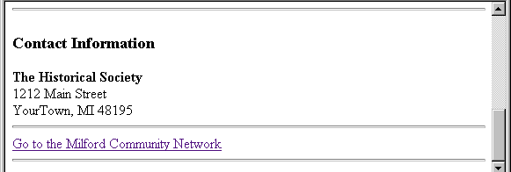
Creating Links to Other Web Sites
<HR>
<H3>Contact Information</H3>
<B>The Historical Society</B><BR>
1212 Main Street<BR>
YourTown, MI 48195<BR>
<HR>
<A HREF="http://milf.tln.lib.mi.us/mcin/comm.htm">Go to the Milford Community Network</a>
</BODY>
</HTML>
Notes:
Creating a Link to Another Web Site
If your sites a part of a larger Community Information Network, you will want to create a link which returns to the Community Information Web site. It is perfectly appropriate to include this type of a link on the bottom of your web pages. In the example above, there is a link which will take the user to the Milford Information Network (this would make sense, assuming that the Historical Society was located in Milford!).
If you examine the tag causing the link to happen (bolded in the example above), you’ll notice the beginning anchor tag contains the EXACT address of the Milford Community Network. If the address is not typed correctly, then the link will not work.
The user, however, does not see the actual address. All the user sees is Milford Community Network, because those are the words which fall between the beginning anchor and the end anchor tags.
Your Task: At the bottom of your page, create a link to the Milford Community Network, using the following address:
http://milf.tln.lib.mi.us/mcin/comm.htm
The key to a successful link relies on following the pattern precisely… notice the use of the quotes in the example above. The most common error when creating a link is to leave off either the beginning or the ending quotes.

Slide 31
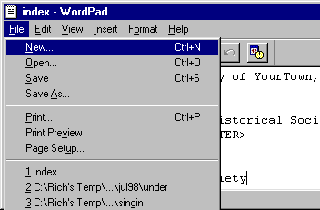
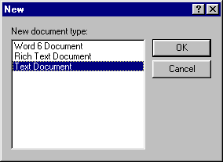
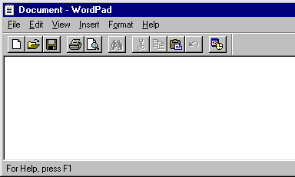
Creating a New HTML Document
1. Pull down the File menu, select New
2. Select Text as the document type
3. A new, empty document
Notes:
Before you can have a link to your own documents, you will need to have another document to link to…
Choose one of the items in your lists that you will make a second document about.
Creating a new HTML document is not any different than creating any other type of document. The steps are as follows:
1. Pull down the File menu and select New.
2. You will be prompted to tell WordPad what type of new document you want to create. Since your document is an HTML document, you will want to select Text Document and then click on the OK button.
3. You will now be looking at a blank screen to create a new HTML document. As you’ll remember, all HTML documents begin with the same five tags.
After those first five tags, the rest of the document can take any shape that you want it to. Keep in mind, as you go through the rest of this document that HTML documents are nothing more than a series of tags that cause the result you’re looking for. Good HTML is nothing more than knowing which tags cause the results you want.
After you’ve created a basic document, follow the steps to saving a new HTML document. Be sure to give the file a different name than the first document and remember to type the extension of .html after the name!

Slide 32
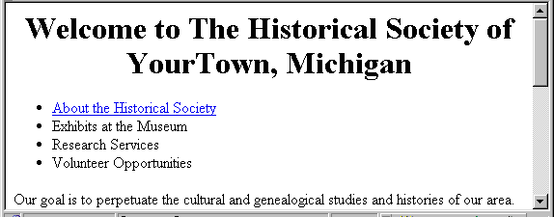
Creating Links to Your Own Documents
<UL>
<LI><A HREF=“about.html”>About the Historical Society</a>
<LI>Exhibits at the Museum
<LI>Research Services
<LI>Volunteer Opportunities
</UL>
Notes:
Creating a Links to Your Own Documents
Creating links between your own documents is essentially not any different than creating links to other documents on the Internet. In the example above, there is an anchor tag, much like the one used to link to the Milford Community Network. The only difference is in the contents of the beginning anchor tag. As in the example above, the beginning tag is:
<A HREF=“about.html”>
The name of the second document I’m linking to is about.html. That is the name assigned to the document when it was first saved (using File --> Save As…). Since the document is a local document, there is no need to include the http:// or the computer name (such as mel.lib.mi.us) in the beginning anchor tag. To link to a local document, however, you must know the directory that the document is in, if it is different than the document . The examples below show the two common possibilities of directory structures for local documents.
Example 1: <A HREF=“about.html">
In the first example, the document being linked to (services.html) is in the same directory as the document which is being linked from. Since the two documents are right next to each other, there is no need for any further directory information. Initially, most of the links to your own documents will follow this example! If you aren’t sure whether your documents are in a different directory or not, likely they are not, so you would want to use the shown in example one for your anchor tag.
Example 2: <A HREF=“/historical/services.html”>
In the second example, the document being linked to (services.html) is in a separate directory than the document which is being linked from. Since that is true, you will need to reflect the directory name(s) in your anchor tag.
If you’re not sure which example to use, then try using the first example without an directory information. Likely, that is the proper pattern for you to follow.
Note: If you’re not sure what a directory is in relation to your documents, then Windows95/98 training is recommended. The more you know about your computer, the easier web site creation will be for you.

Slide 33
Creating Links to Your Own Documents
<UL>
<LI><A HREF=“about.html”>About the Historical Society</a>
<LI>Exhibits at the Museum
<LI>Research Services
<LI>Volunteer Opportunities
</UL>
Notes:
34
Notice in the example above the that the users only see the phrase “About the Historical Society,” as a link. The users do not see the name of the document (about.html) which was included as a part of the beginning anchor tag. Clicking on About the Historical Society will take you to the the document saved as about.html.
Your Task:
Create a link from your first document to your second document, following the appropriate pattern on the previous page.
Note: In order to accomplish this task, you will need to open your first document if you’re still looking at your second document. To accomplish that task, follow the example on the next slide. Don’t forget that your goal is to open the document so that you can place an anchor tag on it!

Slide 34
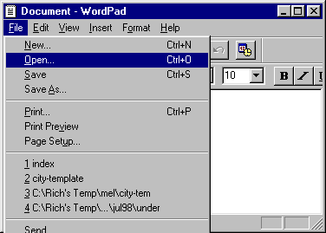
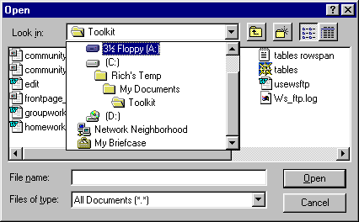
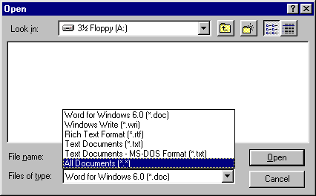
Opening an Existing HTML Document
1. Pull down the File menu and select Open
2. Locate the file you want to open
3. Select All Documents
Very Important!
Notes:
Opening an Existing HTML Document
Opening an HTML document is not significantly different than opening an other Windows based document that you may have opened in the past. There is only one difference, which is in step
1. Pull down the File menu and select Open.
2. Once you pull down the Open menu, you will need to locate the HTML file that you wish to make changes to. In this case the file is on a floppy disk inserted into drive on the computer. To locate the file, use the Location menu located at the top of the Open dialog box. When you pull down the menu, you should see the choice for the floppy drive. Select the Floppy item from the menu.
3. Important Step!!! Once you’ve browsed to the proper location of your files (in the example above, the files are on the Floppy drive) you will not necessarily see your file listed. To see all the files listed on the floppy disk, simply pull down the Files of Type menu and select All Files.

Slide 35
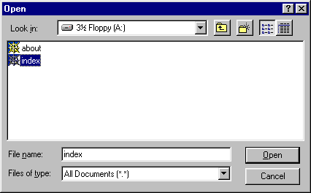
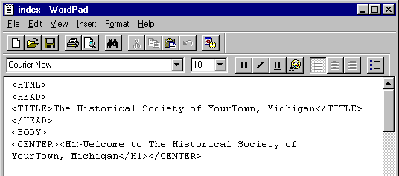
Opening an Existing HTML Document
4. Select your file from the list
5. Your HTML Document, ready for changes
Notes:
5. You should now see a list of all the files on the floppy. To open your file, simply double click file name OR click on the file name once and click on the Open button
6. You should now see the HTML coding document which you opened up. From here you can make an changes or updates to the page and the information
From this point, you can add the anchor tag in your document to create the link

Slide 36
Integrating Images into Your Document
Three steps to including an image in your document:
  Finding/Creating the Image
  Saving the Image
  Placing the Image into your web document
Notes:
Integrating Images into Your Document
There are many free sources of images which can be used to enhance the appearance of web documents. The process of integrating an free image into your web pages will consist of the following three steps:
.Finding the Image
.Saving the Image
.Placing the Image into your web document
Each of these steps is detailed in this document.

Slide 37
Finding Images for Your Web Site
Lots of Free Images for Web pages on the Internet
Some sites to start with are listed below:
  Anthony’s WWW Images – available through The Library Network at: http://tln.lib.mi.us/images/
  Icon Bazaar - http://www.iconbazaar.com/
  A+ Art - http://aplusart.simplenet.com/aplusart/
  The Design Shoppe - http://www.thedesignshoppe.com/
Notes:
Finding Images on the Internet
There are many locations on the Internet that you can use to get free images to use in your web documents. Keep in mind that these are free images, so the quality of images may or may not be a good as you might want in the long run. Certainly free images, however, are a good starting point.
Developing images of your own (or having them developed by graphic professionals) will likely be in your future as your site develops.
Some sites to start with are listed above and on the next page.

Slide 38
Finding Images for Your Web Site
Some sites to start with are listed below:
  Barry's Clip Art Server - http://www.barrysclipart.com/
  Realm Graphics - http://www.ender-design.com/rg
  Animated Icon Browser - http://www.teleport.com/~cooler/MMMM/ index.html

Slide 39
Finding Images for Your Web Site
Searchable Graphics Databases
  Web Places 4-engine Clip Art Searcher - http://www.webplaces.com/search/
  Gif Wizard Image Search - http://www.raspberryhill.com/gifwiz/search.html

Slide 40
A Word on Creating Your Own Images
Can be a difficult process
Possible Programs to use:
  Adobe Illustrator
  Adobe PhotoShop
  Adobe ImageReady
  Microsoft PictureIt
Notes:
A Word on Creating Your Own Images
Creating quality images takes practice and learning. Some basic programs that you could need, include:
Adobe Illustrator
Adobe Photoshop
Adobe ImageReady (designed for creating web images)
Microsoft PictureIt!
If you want to learn to create images, formal training is highly recommended.

Slide 41
Saving Images to Your Computer
Right Mouse Button
Save Image As…
Pick a Location on your computer
Write down the name of the Image
Click on the Save Button
Notes:
Saving Images to Your Computer
The process of saving images that you have found on the Internet is really quite simply, though not necessarily obvious. The five steps are detailed in the following pages.
Your Task:
Find an image to save and place into your web document using one of the addresses given on the previous pages. Once you’ve found the image you want to use, save the image onto your computer using the instructions on the next pages.

Slide 42
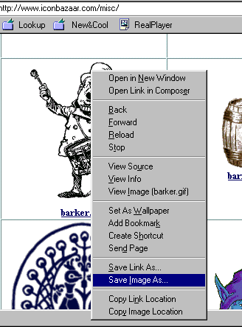
Saving an Image onto Your Computer
1. Click the Right Mouse Button
2. Select Save Image As...
Notes:
Saving an Image onto Your Computer
1. Once you’ve found the image you want to save, place your cursor on the image and click Your RIGHT Mouse. A menu should appear, as shown above.
2. From the menu, select Save Image As...

Slide 43
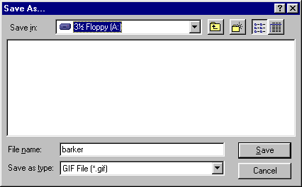
Saving an Image onto Your Computer
3. Pick A Location on Your Computer
4. Write down the file name! In this case, the file name is barker.gif
Notes:
Saving an Image onto Your Computer
3. You should then see a Save As.. dialog box. Decide a location of the image. In the example above, the image will be saved onto the Floppy Drive.
4. Write down the file name! You will need it when you insert the image into your document!!! In the example above, the image name is barker.gif , NOT just barker. The file extension is very important! Without the complete name the image is useless for your web document.
A Note about File Extensions
Extensions tell you the type of data stored in the file you’re looking at. Typically, file extensions consist of a period followed by three letters (for example: .gif). As far as images used on the Internet are concerned, there are primarily two types of images: .gif and .jpg images. The difference is basically in the type of compression used for the file. Typically, .gif images will be smaller, but of a lesser quality than .jpg images.

Slide 44
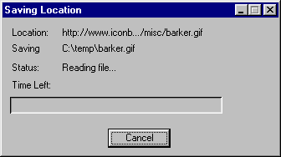
Saving an Image onto Your Computer
5. Click on the Save Button…
Very briefly, you will see the Saving Location Window…
The image will now be saved on your computer and can be used on your web document.
Notes:
Once you’ve determined the location for the image file on your computer and written down the file name, just click on the Save button. The image will be saved onto your computer.

Slide 45
Placing an Image into an HTML Document
<IMG SRC="yahoo.gif” ALT=“Yahoo Logo”>
<p>
<IMG SRC="yahoo.gif” ALT=“Yahoo Logo”><A HREF=“http://www.yahoo.com">Yahoo</A>
<p>
<A HREF="http://www.yahoo.com” ALT=“Yahoo Logo”><IMG SRC="yahoo.gif"></A> Yahoo
Notes:
38
Using a Saved, Created or Scanned Image
The examples above show three different ways of
<IMG SRC=" "> indicates the image source and its location.
This is an example of the tags used to insert graphics into your Web document. In this case, the image file called ”yahoo.gif" is displayed.
Images can also be used as links, as demonstrated in the third example. If you don't want a border around your linked image, add the BORDER=0 tag. (example: <A HREF="http://www.yahoo.com'><IMG SRC="yahoo.gif" BORDER=0></A>)
Use graphics wisely in your Web pages as they can dramatically delay the display at the user end.
There are many Web sites which include freeware graphics and images that you can use to jazz up your Web pages. One of these sites is HTML Goodies at http://www.htmlgoodies.com

Slide 46
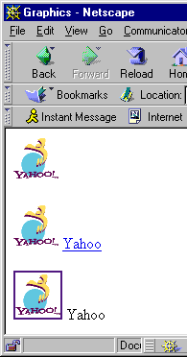
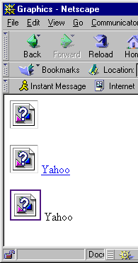
Graphics with and Without Links
Notes:
39
The first time I displayed this html document in Netscape, the images did not appear because the files were not located in the same directory as the html document. Question marks were displayed where the graphics should have appeared.
The bottom example shows the correct output. Notice the differences between the three:
In the first example, the image is displayed, but neither the image or the text is a link.
In the second example, the image and text are displayed, and the text is the link.
In the third example, the image and text are displayed, and the image is the link.

Slide 47
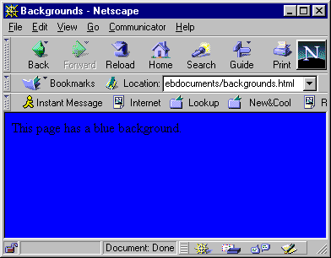
Background Colors
<HTML>
<HEAD>
<TITLE>Backgrounds</TITLE>
</HEAD>
<BODY BGCOLOR="#0000FF">
This page has a blue background.
<P>
</BODY>
</HTML>
Notes:
40
Colored Backgrounds
Colored backgrounds can be created using the following syntax: <BODY BGCOLOR="#RRGGBB"> Where "#RRGGBB" is a hexadecimal red-green-blue triplet used to specify the background color.
Text Attributes
The text attribute is used to control the color of all the normal text in the document (this does not affect link colors). This is necessary because if you change the background to black, you need to change the text color to something other than the default black or else you won’t be able to see it. The syntax for the text color is <BODY TEXT="#RRGGBB">

Slide 48
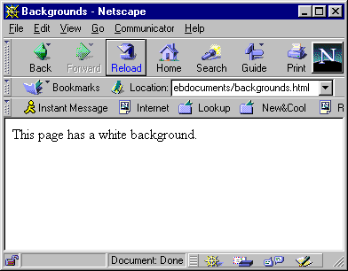
Background Colors
<HTML>
<HEAD>
<TITLE>Backgrounds</TITLE>
</HEAD>
<BODY BGCOLOR="#FFFFFF">
This page has a white background.
<P>
</BODY>
</HTML>
Notes:
41

Slide 49

Background Images
<HTML>
<HEAD>
<TITLE>Background Images</TITLE>
</HEAD>
<BODY BACKGROUND="mi.gif">
This page has the state of Michigan
as a background.
<P>
</BODY>
</HTML>
Notes:
42
Tiled Backgrounds
A tiled background can be created by specifying an image file. This background image is used to tile the full background of the document view area. Ex. <BODY background="image.gif"> Small images are tiled all over the page. If the background image is wide enough to go across the page, it will be tiled from top to bottom. Be careful of background images that are too busy as they distract from the other elements on the page. Loud, distracting backgrounds can make text very hard to read.
You can use search engines to find backgrounds. There are many sites on the web that offer public domain web art, including backgrounds, bullets, lines and other graphic accents to be used on web pages. Keywords for web searches can be images: bullets, images: backgrounds, or just use the word “backgrounds.”
Some URLs for finding backgrounds:
http://phoenixgate.com/backgrounds.html
http://the-tech.mit.edu/KPT/bgs.html
http://www.yahoo.com/Arts/Design_Arts/Graphic_Design/Web_Page_Design_and_Layout/Graphics/Backgrounds/

Slide 50

Basic Tables
<TABLE BORDER>
<TR>
<TD>A</TD>
<TD>B</TD>
<TD>C</TD>
</TR>
<TR>
<TD>D</TD>
<TD>E</TD>
<TD>F</TD>
</TR>
</TABLE>

Slide 51

Tables Using Rowspan
<TABLE BORDER>
<TR>
<TD>Item 1</TD>
<TD ROWSPAN=2>Item 2</TD>
<TD>Item 3</TD>
</TR>
<TR>
<TD>Item 4</TD> <TD>Item 5</TD>
</TR>
</TABLE>

Slide 52

Tables Using Colspan
<TABLE BORDER>
<TR>
<TD>Item 1</TD>
<TD COLSPAN=2>Item 2</TD>
</TR>
<TR>
<TD>Item 3</TD>
<TD>Item 4</TD>
<TD>Item 5</TD>
</TR>
</TABLE>

Slide 53

Tables Using Headers
<TABLE BORDER>
<TR>
<TH>Head1</TH>
<TH>Head2</TH>
<TH>Head3</TH>
</TR>
<TR>
<TD>A</TD>
<TD>B</TD>
<TD>C</TD>
</TR>
<TR>
<TD>D</TD>
<TD>E</TD>
<TD>F</TD>
</TR>
</TABLE>

Slide 54

Table Using Headers, Colspan and Rowspan
<TABLE BORDER>
<TR>
<TD>
<TH ROWSPAN=2></TH>
<TH COLSPAN=2>Average</TH>
</TD>
</TR>
<TR>
<TD>
<TH>Height</TH>
<TH>Weight</TH>
</TD>
</TR>
<TR>
<TH ROWSPAN=2>Gender</TH>
<TH>Males</TH>
<TD>1.9</TD><TD>0.003</TD>
</TR>
<TR>
<TH>Females</TH>
<TD>1.7</TD>
<TD>0.002</TD>
</TR>
</TABLE>

