Slide 1

Updating and Maintaining
Web Pages
Contributed by
Richard Truxall,
The Library Network
Community
Information
Toolkit
www.mel.org/citoolkit
Copyright © 1999,
Library of Michigan Foundation
Re-use of these materials for non-profit training purposes is allowed without further permission, provided this notice is prominently displayed

Slide 2
Updating and Maintaining
Web Pages
Richard Truxall
The Library Network
rtruxall@tln.lib.mi.us

Slide 3
Objectives of the Session
The Server and Your Computer
Using WinFTP to Upload files
Viewing files online as opposed to off a local computer
Directories on the remote computer
Editing Online Files
HTML Editors

Slide 4
The Server and Your Computer
Files created locally are unavailable to Internet users
To make files available, you must transfer them to a server

Slide 5
The Server and Your Computer
The Process of Uploading Files:
  creating or editing your HTML Files locally
  saving the files
  transferring the files to a server using an FTP program
Notes:
http://www.ipswitch.com/Products/WS_FTP

Slide 6
Using WinFTP to Upload Files
There are many different programs
Notes:
http://www.ipswitch.com/Products/WS_FTP/index.html

Slide 7
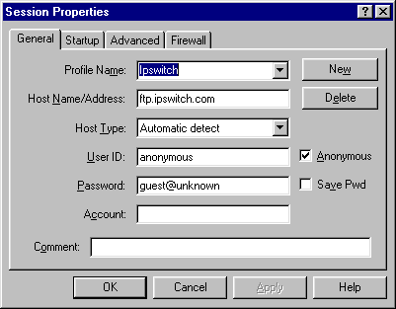

Slide 8
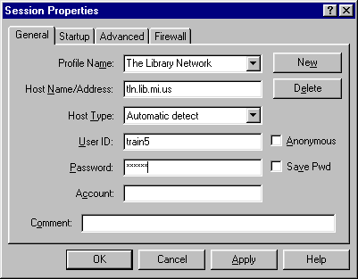

Slide 9
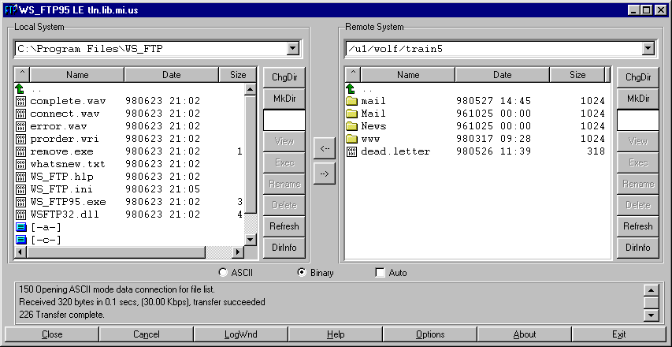

Slide 10
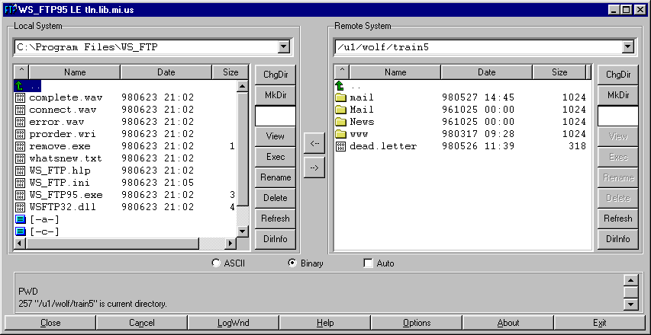

Slide 11
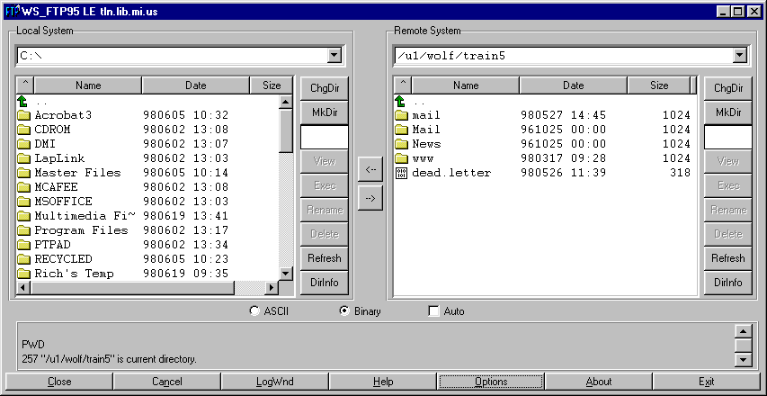

Slide 12
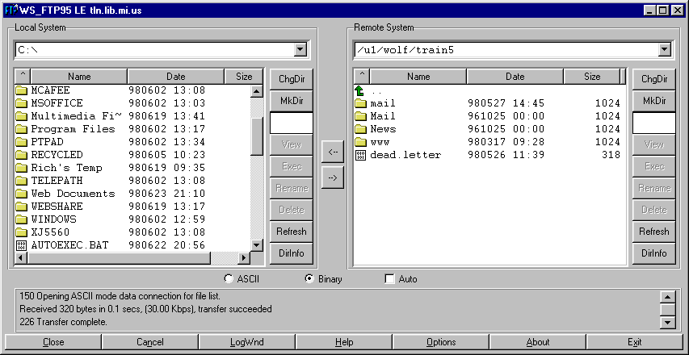

Slide 13
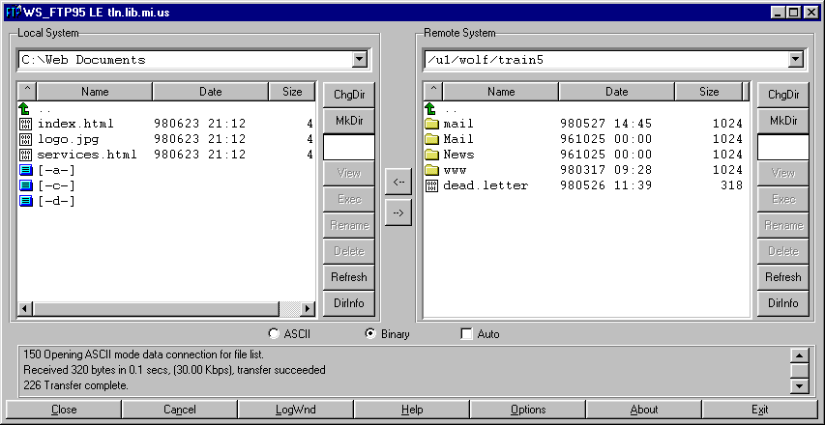

Slide 14
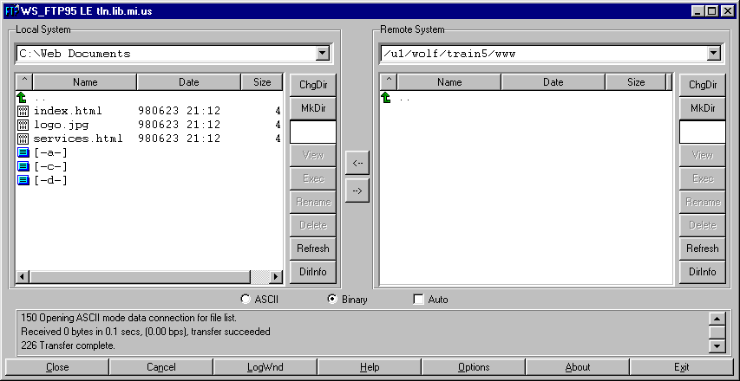

Slide 15
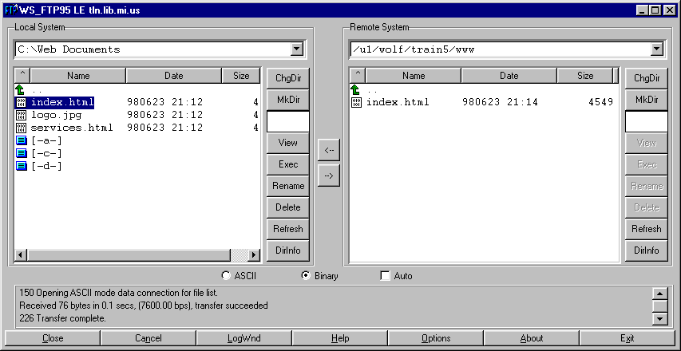

Slide 16
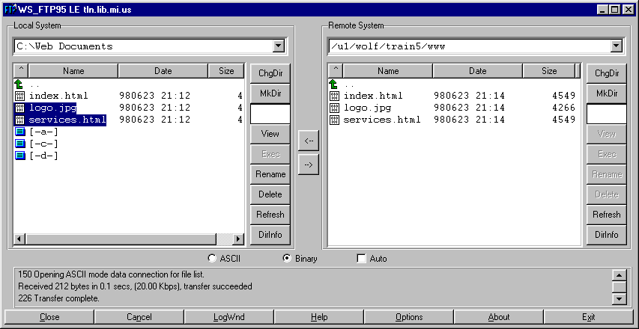

Slide 17
Viewing files online
Knowing Your Address
Keeping track of what you’re looking at…

Slide 18
Directories on the remote computer

Slide 19
Editing Online Files
The Process of Editing Online files is as follows:
  Save the current version of the document onto your computer
  Open the document with your editor
  Make the necessary or desired changes
  Save the updated document
  Transfer the updated document to your server
  Check the online version for errors!

Slide 20
HTML Editors

