Slide 1

Advanced Web Content Choices
Community
Information
Toolkit
Video # 3

Slide 2
Agenda
Advanced Web Content: Beyond Basic HTML
Multimedia Choices
  Animated GIFs, Digital Audio & Video, Shockwave, Streaming Media
Interactivity Choices
  Image Maps, CGI, JavaScript, Java, ActiveX, VRML, Shockwave
Conclusion

Slide 3
Reviewing File Sizes
1 K = 1 kilobyte = 1024 bytes
1 M = 1 megabyte = 1024 kilobytes
1 G = 1 gigabyte = 1024 megabytes
Typical modem handles 28.8 to 56 kilobits per second
  That’s bits, not bytes!
  Think before you offer huge files!

Slide 4
Live Demo of Animated Sites
Www.nemonline.org -- show mouseovers
Www.gabocorp.com
www.vu.msu.edu/egr124
A page with an imagemap
webreference.com/outlook/license

Slide 6
Basic HTML: Your Primary Publishing Medium
HTML is a rich presentation language
HTML plus inline graphics offers many ways to control how your content appears
HTML can be:
  Written on any platform
  ...Using a wide variety of authoring tools
  Delivered by any Web server

Slide 7
Think Before You Leap into Advanced Content
The Internet industry claims your site must be fancy
  You must offer more than pointing and clicking
  You must offer animations, sounds, video
  You must offer sophisticated user interactions
Don’t believe it!

Slide 8
Before You Leap into Multimedia…
Multimedia is natural for some content, but:
Capturing and editing take time and skill
Requires more bandwidth to deliver
You need more capable servers
Your users need the right plugins

Slide 9
Before You Leap into Interactivity
Interactivity is essential for some applications
  Entering a new event on an online calendar
  Registering for a class
  Ordering a print brochure
But:
  It requires programming expertise
  Can require fancier servers

Slide 10

CGI Scripts
Java
Active Server
Pages
Streaming
Media
Shockwave
Image Maps
Animated
GIFs
Static HTML Pages
Basic Web Server

Slide 11
Animated GIFs
A simple way to add visual excitement
Works in ALL browsers -- no plugin!
Banner advertisements you see on commercial sites are often animated GIFs
Really, a simple “movie”
  GIF format allows for multiple separate frames

Slide 12
Building an Animated GIF
Simple tools allow you to:
  Assemble a video frame-by-frame
  Translate from a movie format to animated GIF
    Warning: You usually wouldn’t do that!
  You can simulate motion by moving an object with a frame
  Or, you can make a “slide show”
Example: Ulead’s GIF Animator 2.0

Slide 13
Sounds on Your Web Page
Background sounds
Play automatically when a page is loaded
Can slow down page loading dramatically
Can be frustrating to your users
Often a sign of an amateur personal page

Slide 14
Audio Recording Choices
Compact cassette
  Conventional cassette format
  Professional decks for $300 or less
Digital Audio Tape
  Better than CD quality
  Decks for $800 or so
Minidisc
  Sony’s format, re-introduced
  Decks for $400 or so

Slide 15
Oral History and Other Voice Applications
Sound via the Internet is especially well-suited to voice
Don’t need high quality
You can “sample” at a lower rate
  Don’t need CD quality for voice
Therefore your users can fetch at slower speeds

Slide 16
Microphone Essentials
Audio suffers if you don’t “mike” properly
  Use a good microphone
  Put the mike close to the speaker’s mouth
  Set your levels using a VU meter
    (Some recorders only have “automatic gain”)
  TEST!
    Record a sample tape
    Listen over headphones as you record

Slide 17
Using Digital Audio
You can record onto tape and transfer to your PC
Most PCs (and all Macs) have sound capabilities
  Accept analog inputs
  From analog or digital recording devices
  High end cards accept digital data
Alternative: record directly onto your PC -- even a laptop!

Slide 18
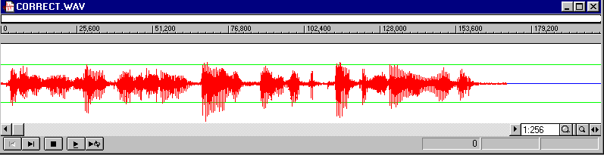
Software for Editing Audio
E.g. Sound Forge XP from Sonic Foundry
Remove coughs, delete unwanted material, re-order material

Slide 19
Audio Formats
.wav files are common on the PC
AIFF files are common on the Mac
RealAudio is dominant format on the Web
  Streaming media
  File begins playing as it downloads
  Far more efficient than having your user download a .wav file

Slide 20
Streaming Media
Real Networks has over 90% of market share with RealAudio and RealVideo
Microsoft Netshow is gaining share
“Encoder” to translate to .RA format is free
Streaming server required
  Free for nonprofits, up to 60 streams free for others
www.real.com

Slide 21
Video on the Web
Much more challenging than audio
  Requires lots of space and bandwidth
  More difficult to edit
Often shown in degraded form
  Presented as 1/4 screen or less
  Only 5 frames per second or so
  Movies and TV have 24 to 30 frames / second

Slide 22
Video Formats
QuickTime
  Developed by Apple
  Available for Mac and PC
AVI
  Microsoft’s Audio/Video Interleaved format
MPEG 2
  International standard

Slide 23
Video on the Web
DEMANDS Streaming
Even in degraded form, a 30 second clip might be 2 megabytes in size
Streaming works reasonably well even over modems
RealVideo encoder lets you pick a modem speed at encoding time

Slide 24
Capturing Digital Video
Sources:
  Analog tape (VHS, Hi-8, etc)
  Digital tape -- new DV format
Video capture cards
  E.g. Targa Truevision, Radius MotoDV
  New option: DV format
    IEEE 1394 “Firewire” allows direct digital transfer -- no analog conversion
Simple PC cameras (e.g. Connectix Quickcam)

Slide 25
Editing Digital Video
Generally requires commercial software such as Adobe Premiere
Requires a high-end computer
  E.g. a 400 MHz PC with 100 megahertz bus
  At least 128M of RAM
  Several gigabytes of hard disk
    FAST hard disk: SCSI or Ultra-ATA

Slide 26
Live Events versus Historical
Most community information sites will feature historical multimedia
Some may wish to try live events
Software from Real Inc. allows encoding and streaming in real time
Be sure you test before the live event
Be sure to record event as you send it out

Slide 27
Test Your Multimedia!
Verify it downloads properly
  Hint: be sure your server has all the right “MIME” types configured
Test on a variety of user setups:
  Modem versus direct connect
  Older sound cards
  Older monitors with fewer colors
  PCs with old CPUs, < 8 megabytes memory

Slide 28
The Benefits of Digital Audio
An interview with Erik Larson
Former webmaster for Michigan State University
Systems Administrator,
ECHO Interactive Music Learning Center,
Chicago Symphony Orchestra

Slide 29
Live Demo of Real Media

Slide 31
Image Maps: Variation on the Hyperlink
Take a photograph or create a graphic
Include on the graphic elements to serve as buttons
Simple tools allow you to mark boundaries of buttons
Coordinates of button are recorded in Web page
User clicks on a button, and the appropriate Web page is delivered

Slide 32
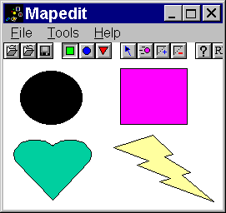
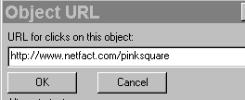

Slide 33
<map name="imagemap">
<area shape="rect" coords="134,5,224,77" href="http://www.netfact.com/pinksquare">
<area shape="circle" coords="57,39,43" nohref>
<area shape="circle" coords="60,34,53" href="http://www.netfact.com/circle.html">
<area shape="rect" coords="2,86,121,169" href="http://www.netfact.com/heart.html">
<area shape="polygon" coords="176,85,129,100,172,118,155,124,186,138,189,151,257,171,227,129,206,108,175,85,175,85" href="http://www.netfact.com/bolt.html">
<area shape="default" nohref>
</map>

Slide 34
Image Map Tips
Make the clickable areas obvious
  What is and isn’t a button to click on?
Embed the <map> tags and content in your page
  Also define in your server config.
Always include an alternative to the image map
  Text mode links at the bottom of the page

Slide 35
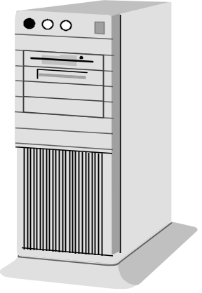
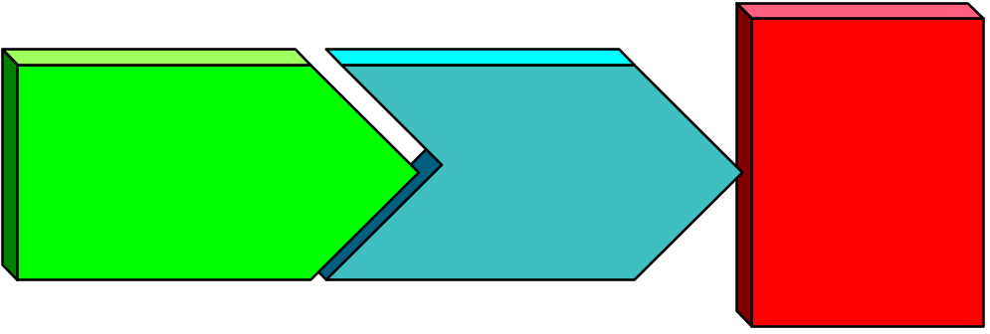
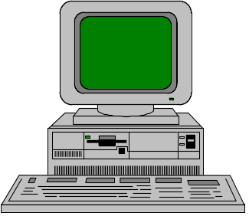
HTTP versus HTML
User’s Web
Browser
Web Server
The Internet
HTTP
session
HTML
docu-
ment
www.smallville.mi.us
user.isp.com

Slide 36

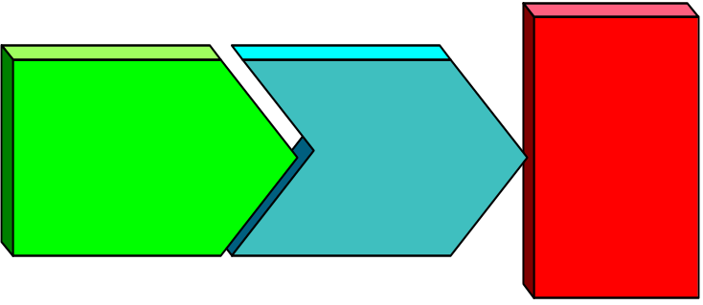
Typical Web Server File Structure
/home/webdata/
index.html
picture1.gif
/topic1/
index.html
picture1.gif
topic1a.html
topic1a.gif
/topic2/
...
Web Server
www.smallville.mi.us

Slide 37
Static HTML
Most sites will mostly serve static HTML
  Prepared offline by hand or using authoring tool
  Posted to Web server each time it is updated
  Posted “by hand” via FTP…
  …or using “one-button publishing”
    FrontPage, Netscape Composer, etc

Slide 38
Alternatives to Static HTML
Common Gateway Interface
Databases
  Cold Fusion
  Microsoft Active Server Pages (ASP)
Java, JavaScript, Shockwave

Slide 39
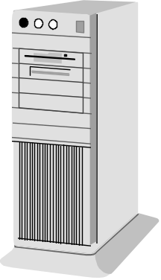
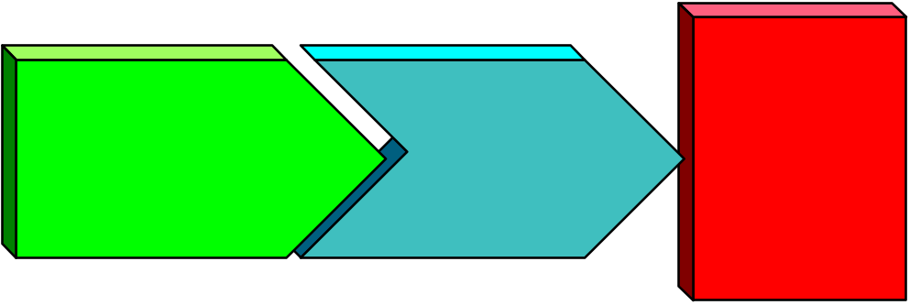
The Common Gateway Interface (CGI)
Web Server
The Internet
CGI
script
CGI
HTTP
session
form.
html
www.smallville.mi.us

Slide 40
Web Middleware Products
Cold Fusion from Allaire Corp
  You write in Cold Fusion Markup Language
  Embed your code in HTML
  You reference a database via embedded code
    E.g. MS-Access, SQL server

Slide 41
Microsoft
Active Server Pages (ASP)
Microsoft solution for connecting your server to a database
Integrated in Microsoft Internet Information server
VB Script language
  Similar to Visual Basic
Easy installation and integration

Slide 42
Java
Programming language from Sun Microsystems
More computer books on Java than any other language
An “applet” is prepared by a developer…
Compiled into a standard “bytecode” file and referenced in a Web page...
...and delivered for “interpretive” execution on the user’s desktop

Slide 43
Java Virtual Machine
Applet
Bytecode Verifier
Class Loader
Java Compiler
Run-time
Interpreter
Bytecodes
Applet Store
Executed Applet
Client
(any platform)
Server

Slide 44
Applet Invocation
HTML <APPLET> tag refers to an applet
Browser opens TCP session to download the applet
  Separate step from download the HTML file
Browser loads applet into client memory
<APPLET> tag defines screen area owned by applet
When user exits referencing Web page, applet execution ceases

Slide 45
Support for Java
First implemented in Sun’s Hot Java browser
Java interpreter built into Netscape Navigator 2.0 and later
Supported in Microsoft Internet Explorer
  But Microsoft pushes ActiveX alternative
Compilers and visual development environments available
  From a few hundred dollars to a few thousand

Slide 46
JavaScript vs. Java
JavaScript is simple language
Actual JavaScript program is embedded in your HTML page
Program is interpreted by the user’s browser
Don’t be fooled by the name!
  Much easier than Java
  Quick payoff for simple applications

Slide 47
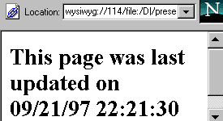
Sample JavaScript Program
<html>
<head> <title>When Was This Page Last Changed?</title> </head>
<body bgcolor=ffffff>
<script language="JavaScript">
<!-- Hide
document.write("<h2>This page was last updated on "
+ document.lastModified + "</h2>")
// -->
</script>
</body> </html>

Slide 48
VRML
Virtual Reality Modeling Language
Developed at Silicon Graphics, elsewhere
A language for defining interactive 3D worlds
Navigate a 3D space as opposed to the 2D world of HTML-based hypermedia
Netscape Navigator supports natively in 3.0, later
Microsoft supports, also extends with “Active VRML”
Relatively obscure technology for most Web sites

Slide 49
Shockwave for Director
Director is a 3D authoring environment
Popular for years in virtual reality community
  Authoring tool for many CD-ROMs
From Macromedia Inc
Shockwave for Director is a plugin for Netscape Navigator (2.0 or later)
Provides ability to “play”, and interact with, a Director animation
Being used by many sites to animate their logos
Also for more extensive applications

Slide 50
Shockwave Flash
Released in 1997
Re-engineered Shockwave for the Web
  Compressed audio
  Streaming playback
  Object-based graphics
Pro: If you want smooth animations and audio, this is the ticket
Con:
  Users need the plugin
  Still slower to load

Slide 51
Software Can Make It Easier
Various authoring packages and specialized tools help with
  GIF animations
  Image maps
Visual Interdev from Microsoft makes ASP much easier
Various Java development environments -- Sun, Borland, etc
Macromedia’s Dreamweaver makes multimedia manageable

Slide 52
A Hardware Store
Full of Tools!
You could spend all your energy picking a tool…
… or learning it
Remember to balance your efforts with real content work
Pick one or two advanced tools…
…or maybe zero!

Slide 53
Build It Once -- and Reuse It!
Build templates for HTML pages
  Copy the template page when you start each new page
Devise simple interactive tools in Javascript
  Reuse those tools throughout your site
Create modules in Java or Active Server Pages
  …for reuse site-wide

Slide 54
CGI Scripts
Java
Active Server
Pages
Streaming
Media
Shockwave
Image Maps
Animated
GIFs
Static HTML Pages
Basic Web Server

