Slide 1

Web Site Maintenance and Administration
Community Information Toolkit
Video # 4

Slide 2
Agenda
Choosing a Home for Your Web Site
  Your own server, or someone else’s?
Organizing and Building Your Site
Running Your Own Server
  Choosing hardware and software
System Administration
  Case Study
Conclusion

Slide 3
Choosing a Home for Your Web Site
Basic choice:
  Run your own server
  Obtain space on someone else’s server
The most critical choice you face in building a Web site!

Slide 4
Reasons NOT to Run Your Own Server
Server hardware costs money
You’ll need lots of expertise
  In operating system maintenance
  In server software maintenance
  In content provider support
    E.g. defining permissions, adding users
You’ll face daily chores such as backup

Slide 5
Alternatives to Running Your Own Server
Make a deal with a partner that already runs a server
  They may offer you space for free
Rent space from a service provider
  Your library cooperative
  A local or national Internet Service Provider (ISP)
  Merit Inc. (statewide service provider in Michigan)

Slide 7
Organizing and Building Your Site
Domain Name System considerations
File System Organization
Databases and integrated publishing environments

Slide 8
Your Own Domain
nasa.gov
msu.edu
merit.edu
aol.com
umich.edu
smallville.mi.us

Slide 9
Obtaining a Domain
Your institution may already have one
For a domain such as smallville.mi.us:
  Contact Merit
For a domain such as smallville.org or smallville.com:
  Visit www.internic.net

Slide 10

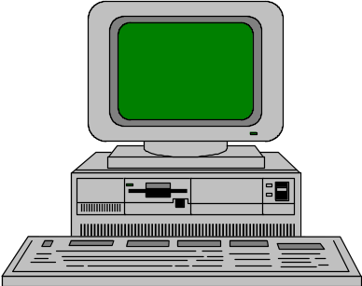
Domain Names vs.
IP Addresses
jpl.nasa.gov
137.78.160.21
nasa.gov
The Internet
dialup.isp.com
198.78.3.92
isp.com

Slide 11
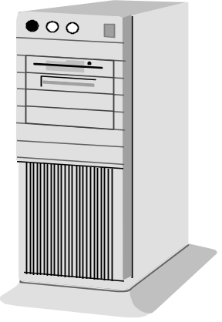
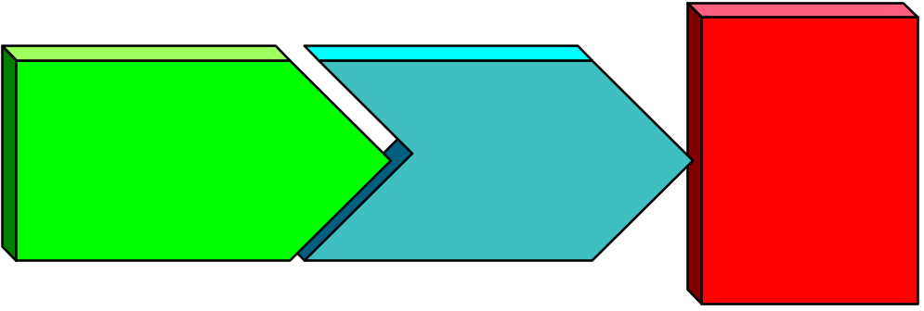
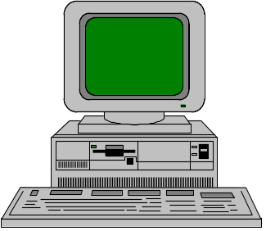
HTTP versus HTML
User’s Web
Browser
Web Server
The Internet
HTTP
session
HTML
docu-
ment
www.smallville.mi.us
user.isp.com

Slide 12

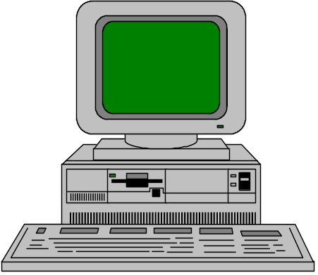
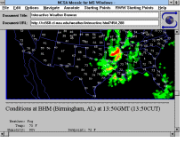
Typical Internet Publishing Scenario
Server Is
Directly
Connected
The Internet
www.ci.smallville.mi.us
User May Be
Dial-up OR
Directly
Connected
aol.com

Slide 13
Virtual Host Concept
A single physical server “owns” multiple domain names
Multiple organizations share one server
Thus smallville.mi.us and bigtown.mi.us could be on one server
Users cannot tell the difference

Slide 14
URL Components
http://www.merit.edu
http://www.ci.east-lansing.mi.us
ftp://ftp.netscape.com
http:// www.smallville.gov /events.html
Protocol
Server
Address
Document

Slide 15

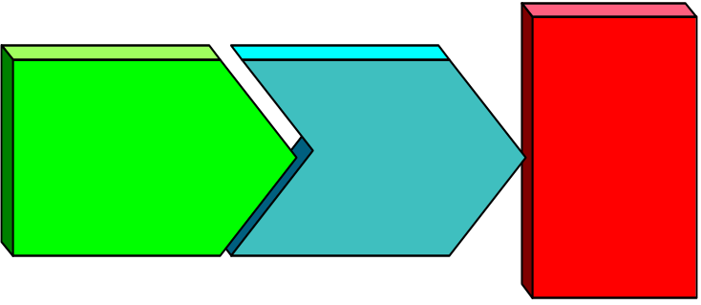
Typical Web Server File Structure
/home/webdata/
index.html
picture1.gif
/topic1/
index.html
picture1.gif
topic1a.html
topic1a.gif
/topic2/
...
Web Server
www.smallville.mi.us

Slide 16
Static HTML
Most sites will mostly serve static HTML
  Prepared offline by hand or using authoring tool
  Posted to Web server each time it is updated
  Posted “by hand” via FTP…
  …or using “one-button publishing”
    Frontpage, Netscape Composer, etc

Slide 17
Alternatives to Static HTML
Common Gateway Interface
Databases
  Cold Fusion
  Other Middleware Products
  Microsoft Active Server Pages (ASP)

Slide 18
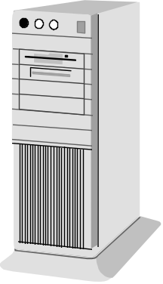
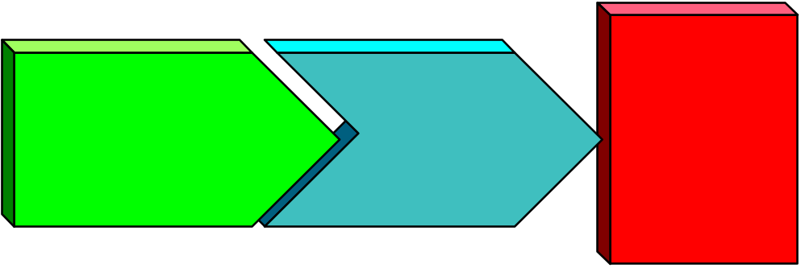
The Common Gateway Interface (CGI)
Web Server
The Internet
CGI
script
CGI
HTTP
session
form.
html
www.smallville.mi.us

Slide 19
Web Middleware Products
Cold Fusion from Allaire Corp
  You write in Cold Fusion Markup Language
  Embed your code in HTML
  You reference a database via embedded code
    E.g. MS-Access, SQL server

Slide 20
Microsoft
Active Server Pages (ASP)
Microsoft solution for connecting your server to a database
Integrated in Microsoft Internet Information server
VB Script language
  Similar to Visual Basic
Easy installation and integration

Slide 22
Running Your
Own Server
Webmaster vs system administrator?
Choosing a hardware platform
Server software choices

Slide 23
Server Administration Roles
Two distinct roles:
  Webmaster: Web content and maintenance
  System Administration: Installation, Networking, Security, Backup
In smaller organizations these roles are often done by the same person

Slide 24
Server System Choices
Traditional Internet server has been a Unix workstation -- server class
Unix server costs about $7500 to $25,000 or more
Vendors: Sun, HP, IBM, DEC, etc
Many hardware vendors bundle Web server software

Slide 25
Low-end Unix Options
  “Wintel” PC can be a great low-cost platform
  Can be far cheaper than proprietary hardware
  Could run a free Unix
    Linux
    FreeBSD
  Commercial Unix for Intel (UnixWare, SCO Unix)

Slide 26
Windows Server Platforms
Windows NT is server-class platform
  Rugged, robust, high performance
  Various Netscape servers, Microsoft, O’Reilly’s Web Site Pro
  Note Microsoft user licensing limit on NT Workstation
Not Windows 95 or 98!
  Good for personal servers -- not institutional

Slide 27
Server Platform: System Options cont’d
Macintosh
  System 7 and later provides multitasking
  Plug-and-play servers (e.g. WebStar)
  Very easy setup and administration
  Little used for high-visibility sites

Slide 28
Server Software Selection
Many sites still use public domain Unix servers
Popular Unix shareware server: Apache
  Majority of sites on Web use Apache
  Good for virtual host option
Now commercial packages dominate for Windows NT applications

Slide 29
Commercial Web Servers
Netscape
  Netscape Commerce Server, Communications Server, and Fasttrack
    Commerce supports secure encryption needed for commerce
Microsoft Internet Information Server (IIS)
    Comes free with Windows NT Server Edition
    Support for Microsoft Active Server Pages
Others

Slide 30
Special Webmaster Duties
Log Analysis
Site Promotion
Managing server-side extensions
  E.g. Frontpage
  Administering users

Slide 31
Log Analysis
Learn About Your Site:
  What pages are most/least popular?
  Are there dead links within your site?
  Who visits your site (from what domains?)
  How do people find your site?
    What links from other sites?
    What search engine keywords?

Slide 32
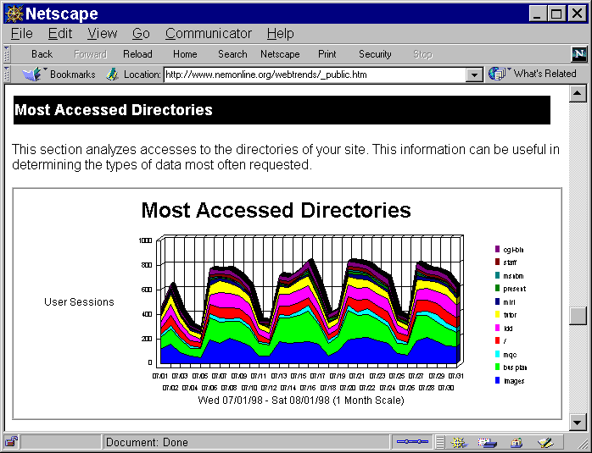

Slide 33
Site Promotion
Learn about and use <META> tags
  Meta Keywords: short words people might type into search engines
  Meta Description: short (< 100 word) description of your site
    This will be displayed by the search engines
Consider a site promotion service
  Submitit.com
  Webpromote.com

Slide 34
Site Doctors
Check your site for broken links
Check your HTML for validity
E.g., Doctor HTML
Go to webreference.com for pointers to such tools

Slide 36
System Administration
Installation
Configuration
Security
Networking
Backup

Slide 37
Installation
If this is a new system it may come with NT 4.0 installed
You still may want to start over from the setup disks for experience
Toolkit shows setp-by-step approach to installation

Slide 38
Installation Challenges
Hardware choices - See NT compatibility guide
Hardware settings
  Interrupt Number (3-15)
  Input address (e.g. 2F0 or 300)
Device drivers - software specific to each piece of hardware

Slide 39
Installation Outline
Boot Floppies
Partition and format the hard disk
Reboot
NT installs from the CD-ROM

Slide 40
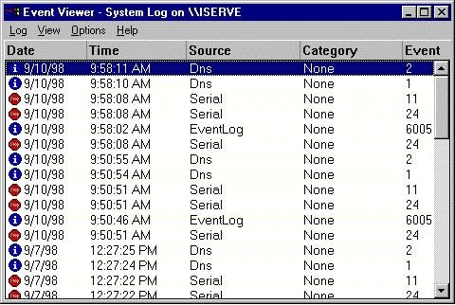
Configuration
Often configuration errors will appear in the event log
Start | Program
Common
Admin Tools |
Event Log

Slide 41
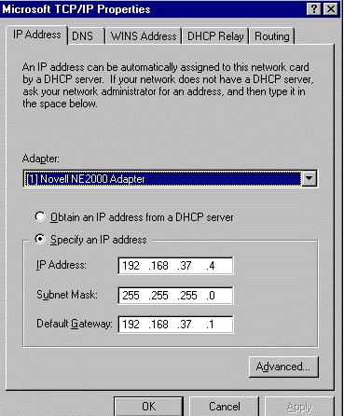
Networking
Once the hardware is configured, you will configure the networking and software
The network settings will be different for each location

Slide 42
Security
Security in such a system is very important
Hackers will be drawn to such a site
General approaches
  Few accounts - log and disallow repeated attempts
  Keep the server simple
  Look at the logs at least weekly

Slide 43
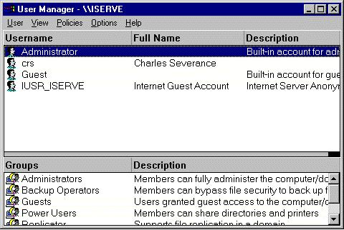
User Accounts
You will create user accounts for various people
Don’t allow
account
sharing
Be “paranoid”

Slide 44
Backup Considerations
Backup is critical
Hard drives will fail!
A single failure can be a catastrophe:
  Loss of months or years of work
  Work by many contributors

Slide 45
Backup Strategies
Daily, weekly, monthly
  Every day, back up any files that changed during the day
  Every week, back up all files on the system
  Every month, back up all files on the system
Establish a pool of tapes for each

Slide 46
Offsite storage
What if a fire destroys your backup tapes
…and your server?
Make arrangements to take full dumps off site
Once a month is a good idea
A safe-deposit box is a good place

Slide 47
Backup Options
Media
  DAT (Digital Audio Tape)
    12/24 holds up to 24 gigabytes
    Costs up to $1500
    Each tape costs $5 or so
  Other tape media
    Travan
      Tape holds up to 8 gigabytes
      Drives cost $300 or so
      Each tape costs $40 or so

Slide 48
Backup Software
NT comes with basic backup software
  Suitable for standalone system backup
If your server is part of a general NT network, you need additional tools
  Many commercial choices
  Provide scheduling, catalogs
  E.g. ARCSERVE product

Slide 49

Community Information Toolkit
Produced for the Library of Michigan

Slide 50
Running Your Own Server:
A Case Study
Rochester Hills Public Library
Demonstration site chosen for Community Information Toolkit Project
  Focus on history of Rochester Hills area
  Historical post cards, other documents
Larry Neal
  Head of Technical Systems for RHPL

Slide 51
In Conclusion
Plan before you leap!
Your own server, or someone else’s?
  What server hardware / software platform?
How will your content providers post their pages?
Static HTML only, or static plus dynamic content?

Slide 52
Crawl Before You Walk!
Content is more important than technology
Choose the simplest technology that accomplishes the task
Don’t embrace technology for its own sake

Slide 53
Community Information Toolkit
Produced for the Library of Michigan

