Slide 1

The True Story of Python Assignment Statements
Charles Severance
online.dr-chuck.com

Slide 2
Slides from the Past…
The following two slides are from Chapter 2 of the the popular “Python for Everybody” course and book available online, in Coursera, and edX. The course has introduced more people to programming (in the millions) than any other course in the world.
www.py4e.com

Slide 3
Slides from the Past…
The following two slides are from Chapter 2 of the the popular “Python for Everybody” course and book available online, in Coursera, and edX. The course has introduced more people to programming (in the millions) than any other course in the world.
At best, these slides are misleading and at worst they are technically 100% wrong.
Let's learn why….
www.py4e.com

Slide 4
Variables
A variable is a named place in the memory where a programmer can store data and later retrieve the data using the variable “name”
Programmers get to choose the names of the variables
You can change the contents of a variable in a later statement
12.2
x = 12.2
y = 14
x
14
y

Slide 5
Variables
A variable is a named place in the memory where a programmer can store data and later retrieve the data using the variable “name”
Programmers get to choose the names of the variables
You can change the contents of a variable in a later statement
12.2
x = 12.2
y = 14
x = 100
x
100
14
y

Slide 6
What *IS* a Python variable?
A Python variable is a symbolic name that is a pointer or reference to an object.
We can examine what a variable is ”pointing to” using the id() function in Python
>>> x = 42
>>> y = x
>>> print(id(x))
4311543376
>>> print(id(y))
4311543376
x
Object
int
42
y
https://realpython.com/python-variables/#object-references

Slide 7
Variables
Objects
>>> print(type(300))
<class 'int'>
>>> x = 300
>>> print(id(x))
4315234800
>>> x = 2000
>>> print(id(x))
4315237200
>>> y = x
>>> print(id(y))
4315237200
x
int
300
free
list
x
int
300
y
int
2000

Slide 8
Variables
Objects
>>> x = list()
>>> print(id(x))
4315241024
>>> x.append('Hello')
>>> print(id(x))
4315241024
>>> y = x
>>> print(id(y))
4315241024
>>> x.append('world')
>>> print(y)
['Hello', 'world']
x
list
Hello
x
list
Hello
y
x
list
Hello
world
y

Slide 9
A ”Copy Constructor”
>>> x = list()
>>> print(id(x))
4315242048
>>> x.append('Hello’)
>>> print(id(x))
4315242048
>>> y = list(x)
>>> print(id(y))
4315242176
>>> x.append('world’)
>>> print(x)
['Hello', 'world']
>>> print(y)
['Hello']
>>>
In many cases, you can create a new object when creating a new variable
If we use the “copy constructor” pattern, the two objects are independent
The two variables are each pointing at their own copy of the list so they can be manipulated independently

Slide 10
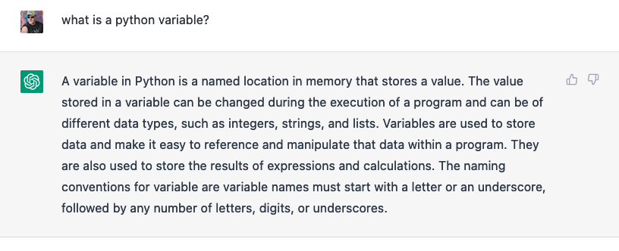
Even ChatGPT believes into the simplification

Slide 11
Conclusion
Sorry to have mislead you back in PY4E ☺
The notion of a variable being a drawer that can contain data is accurate in languages like C and sometimes Java
C supports variables that contain data and variables that point to data stored at a location (a pointer variable)
That is a story for another time (Chapters 5 and 6 from www.cc4e.com)

Slide 12

Acknowledgements / Contributions
These slides are Copyright 2023- Charles R. Severance (online.dr-chuck.com) of the University of Michigan School of Information and made available under a Creative Commons Attribution 4.0 License. Please maintain this last slide in all copies of the document to comply with the attribution requirements of the license. If you make a change, feel free to add your name and organization to the list of contributors on this page as you republish the materials.
Initial Development: Charles Severance, University of Michigan School of Information
… Insert new Contributors and Translators here
Continue…

