Slide 1


Building Web Applications
in Django
A Campus-Linked Open Course
CLOC
First offering begins August 1
$300 • supports instructional staff
This is an experiment to explore feasibility of this course model.
django.dr-chuck.com
django.dr-chuck.com
Notes:
Hi, I’m Dr. Chuck, and I want to tell you about a new way that I’m offering Building Web Applications in Django, beginning August 1. I’m calling it a CLOC: a Campus Linked Open Course.

Slide 2
What is a Campus-Linked Open Course (CLOC)?
A CLOC is tightly linked to an on-campus section of a course which it is being taught
MOOC
open access
large scale
mostly self-directed
no live support
no instructor interaction
often an old copy of an on-campus course
Django CLOC
course calendar / cohort
weekly communications
instructor interaction
weekly live help sessions
open enrollment
low cost / non-credit
certificate/badge
schedule / no late points
no exams /no grades
cohort 15 weeks
self-paced for 360 days
SI357@UMich
course calendar / cohort
weekly communications
instructor interaction
weekly live help sessions
limited enrollment
campus credit cost
real deadlines / late points
exams and grades
course ends after 15 weeks
Django CLOC
course calendar / cohort
weekly communications
instructor interaction
weekly live help sessions
open enrollment
low cost / non-credit
schedule / no late points
no exams /no grades
cohort 15 weeks
self-paced for 360 days
certificate/badge maybe
CLOC is not “MOOC plus.” It is a non-credit online section of a campus course.

Slide 3


Why should you take this course as a CLOC?
I think it is difficult to stay motivated in self-paced online courses…
I think you would learn better and faster with:
a calendar and due dates
office hours and responsive help
human feedback when the course is confusing
a cohort moving through the material together
a sense of a "real college experience"
CLOC lets you learn online at low cost and anywhere in the world (like a MOOC) while providing campus-like vibe, rhythm and support.
django.dr-chuck.com

Slide 4

First CLOC offering
A focused pilot for Building Web Applications in Django.
Cost: $300
Enrollment: August 1 – September 1
August 1 – August 25 is online-only early access (with weekly office hours)
First due date is September 4
Instructional Assistant Sessions start in September
Late Enrollment: September 1 - October 1
Financial Aid – 90% discount – depends on paid enrollment – Decision late August
django.dr-chuck.com
Flexible online learning + campus connection

Slide 5
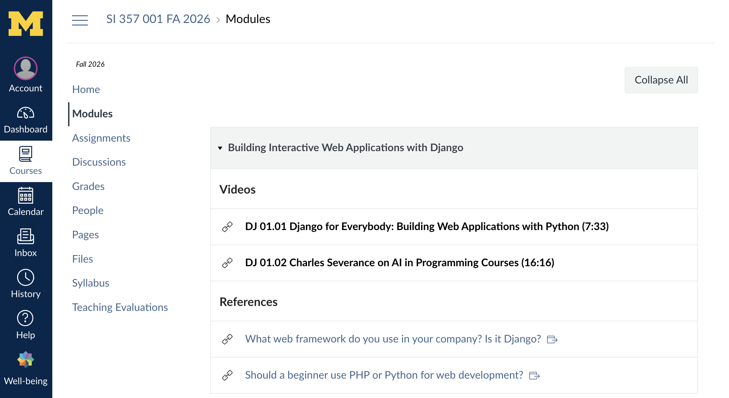
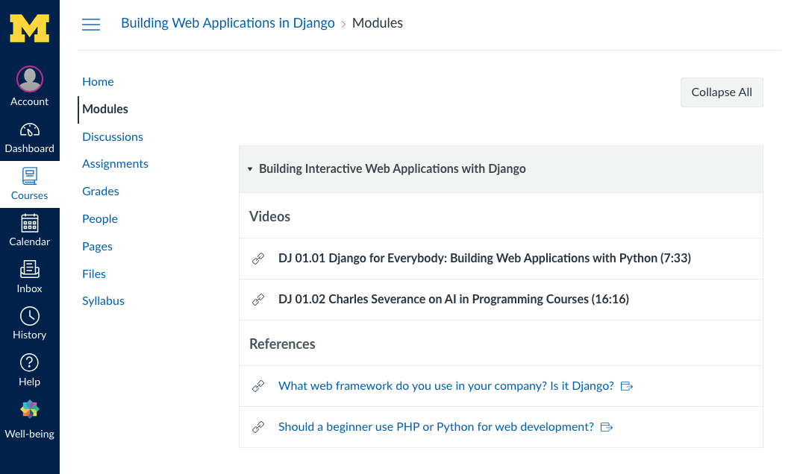
django.dr-chuck.com

Slide 6
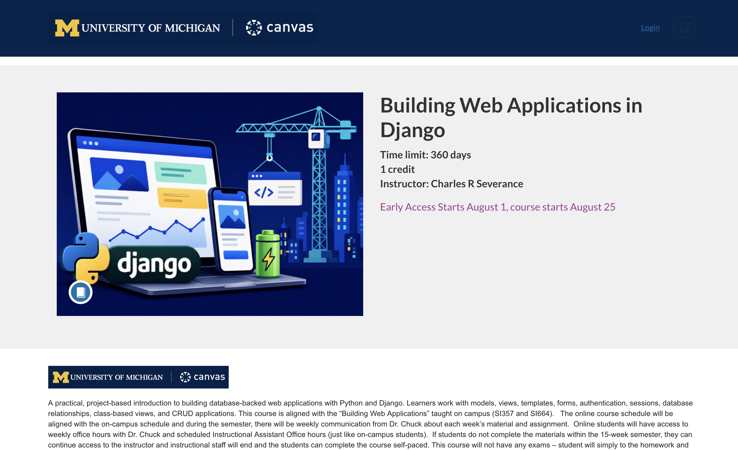
django.dr-chuck.com

Slide 7
This is an experiment (Alternative Learning Initiative – ALI)
Our experience in this first offering will define all future offerings from me and other UMSI Faculty
Listen
Adjust
Improve
•
office-hour feedback
•
clarify instructions
•
future offerings
•
live session questions
•
add examples
•
better interaction
•
email
•
tune sessions
•
stronger online support
•
patterns across assignments
•
create extra material
•
clearer CLOC model
I need to make a report to my fellow faculty throughout the semester.
django.dr-chuck.com
Notes:
This is an experiment, and we will learn from it as we go. Online students will be encouraged to share feedback during office hours, in live sessions, and by email. When several people struggle with the same assignment or explanation, that is useful information. We may add examples, clarify instructions, adjust sessions, or create additional material.

Slide 8
One course.
Campus and open sections.
A shared schedule, a shared instructional community, and a better chance to feel connected to the process of learning.
Please join me in the the world's first CLOC
django.dr-chuck.com
Notes:
I think there is an important space between a completely self-paced online course and formal university enrollment. A Campus-Linked Open Course is meant to occupy that space. One course. Campus and online learners. A shared schedule, a shared instructional community, and a better chance for online learners to feel connected. Welcome to Building Web Applications in Django. Welcome to the experiment. And welcome to the CLOC.

