Slide 1
JavaScript and AJAX
http://www.w3schools.com/js/js_examples.asp

Slide 2
JavaScript
In addition to HTML and CSS...
Browsers have a powerful programming language called JavaScript that runs in the browser
Actually not much like Java - more like C
Very powerful and flexible - we keep “discovering” new power
http://en.wikipedia.org/wiki/JavaScript

Slide 3
Language Syntax
Whitespace does not matter - spaces and new lines
Begin and end of blocks are curly braces
Statements must end in semicolons
function message()
{
alert("This alert box was called with the onload event");
}

Slide 4
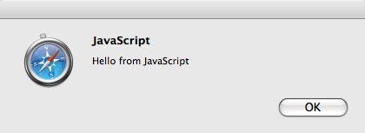
The Most Useful JavaScript
The alert box is often the way we debug simple JavaScript
When it runs - alert makes a pop up box
alert("Hello from JavaScript");

Slide 5
Including JavaScript in a Page
Include a file from a URL specified as an attribute of a "script" tag
Inline code inside a "script" tag
As an attribute on a tag

Slide 6
Including a File from a URL
<html xmlns="http://www.w3.org/1999/xhtml">
<head>
<title>App Engine - HTML</title>
<link href="/static/glike.css" rel="stylesheet" type="text/css" />
<script type="text/javascript" src="/static/js/jquery-1.2.6.min.js"></script>
</head>
<body>
<div id="header">

Slide 7
Inline Javascript
<html>
<head>
</head>
<body>
<h1>Here is my Document</h1>
<script type="text/javascript">
alert("Hello from JavaScript");
</script>
<h1>Here is my second Header</h1>
</body>
</html>
Inline JavaScript. This example runs as the page loads.
inline.htm

Slide 8
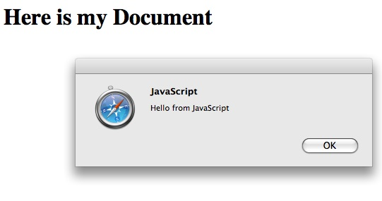

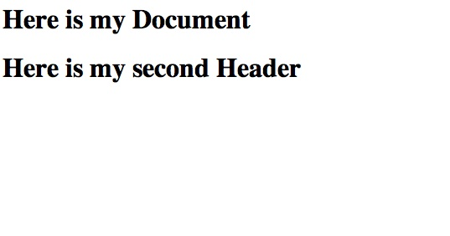
<html>
<head>
</head>
<body>
<h1>Here is my Document</h1>
<script type="text/javascript">
alert("Hello from JavaScript");
</script>
<h1>Here is my second Header</h1>
</body>
</html>

Slide 9
Event Handling
Certain tags can have attributes which contain JavaScript which run when things (events) “happen” to the tag
http://www.w3schools.com/jsref/jsref_events.asp
onchange, onclick, onmousedown, onmouseup, ..
<a href="http://www.umich.edu" onclick="alert('Ouch!')">Plan A</a>

Slide 10
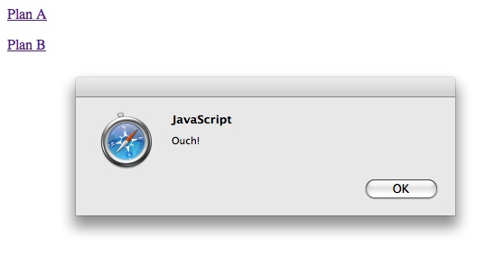
<body>
<p>
<a href="http://www.umich.edu" onclick="alert('Ouch!')">
Plan A</a>
</p><p>
<a href="http://www.umich.edu" onclick="alert('Yow!');return false;">
Plan B</a>
</p>
</body>
Returning false in these events means “don’t do what you were going to do”. In this case, Plan B will not follow the link after the popup.

Slide 11
Another Event
<html>
<head>
<script type="text/javascript">
function message()
{
alert("This alert box was called with the onload event");
}
</script>
</head>
<body onload="message()">
<h1>Hello World</h1>
</body>
</html>
http://www.w3schools.com/js/tryit.asp?filename=tryjs_headsection

Slide 12
<form method="post" action="/apply">
<p>
        <label for="name">Name:</label>
    <input type="text" name="name" id="name"/>
    </p>
<p>
        <label for="account"> Account:</label>
  <input type="text" name="account" id="account"/>
    </p>
<p>
        <label for="password"> Password:</label>
  <input type="password" name="password" id="password"/>
    </p>
<input type="submit" name="Login"/>
<input type="button" onclick="window.location='/'; return false;"
value="Cancel" />
</form>

Slide 13
<input type="button" onclick="window.location='/'; return false;"
value="Cancel" />
When this button is clicked, navigate this window’s location to the “/” URL, and do not submit this form.

Slide 14
Document Object Model
http://en.wikipedia.org/wiki/Document_Object_Model

Slide 15
Document Object Model
JavaScript can manipulate the current HTML docment
The “Document Object Model” tells us the syntax to use to access various “bits” of the current screen to read and/or manipulate
You can even find pieces of the model by id attribute and change them
http://en.wikipedia.org/wiki/Document_Object_Model

Slide 16
<input type="button" onclick="window.location='/'; return false;"
value="Cancel" />
When this button is clicked, go into the document model at window.location and change it to be “/”, and do not submit this form.

Slide 17



Updating the Browser Document
<p>
<a href="#"
onclick="document.getElementById('stuff').innerHTML = 'BACK';">BACK</a>
<a href="#"
onclick="document.getElementById('stuff').innerHTML = 'FORTH';">FORTH</a>
</p>
<p>
Hello <b><span id="stuff">Stuff</span></b> there.
</p>
This is one reason why you can only have one id per document.

Slide 18
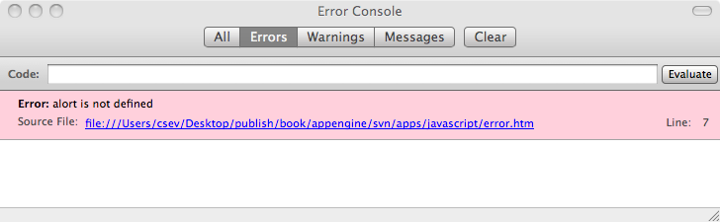
JavaScript Errors
<html>
<head>
</head>
<body>
<h1>Here is my Document</h1>
<script type="text/javascript">
alort("Hello from JavaScript);
</script>
<h1>Here is my second Header</h1>
</body>
</html>
Generally silently ignored by the browser
FireFox: Tools -> Error Console

Slide 19
FireBug - JavaScript / DOM
If you are going to do *any* non-trivial JavaScript and/or DOM manipulation
        Get FireBug for FireFox
        addons.mozila.org
Many Javascript errors are *silent* - FireBug notices the errors

Slide 20
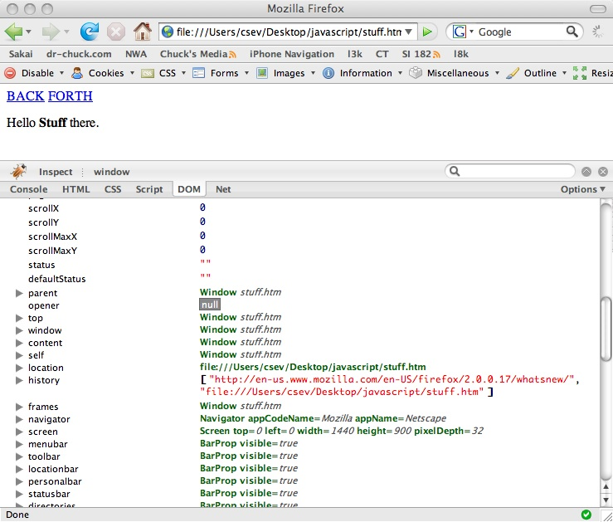

Slide 21
JavaScript Summary
There is a lot of power in JavaScript - we keep “discovering” new uses and capabilities of JavaScript
JavaScript is increasingly being treated as a very serious language - including using it in the server as well as the browser
People now specialize as JavaScript developers
http://www.w3schools.com/js/js_examples.asp

Slide 22
JavaScript “Compilers”
Some languages can be “compiled” into Javascript
        Google Web Tool Kit - Java
        Ruby - Red
        Pyjamas - Python
Google Chrome - Very Fast Javascript

Slide 23
Asynchronous JavaScript and XML (AJAX)
http://en.wikipedia.org/wiki/Ajax_(programming)

Slide 24
In The Good Old Days
A user would take some action like a click on a link or button
The Browser would make a TCP/IP connection to the web server
The browser would send a POST or GET request
The Server would send back a page to display to the user
Repeat the Request-Response Cycle...

Slide 25
Browser
Redraw
Redraw
Redraw
Redraw
Whole
Page
Whole
Page
Whole
Page
Whole
Page
GET
GET
POST
GET
Server

Slide 26
XMLHttpRequest
By 1999, Microsoft wanted to move some of the processing of web pages from the web server to the web browser
The idea was instead of sending whole pages of HTML to the browser, send out the data to be displayed as XML and then produce presentation in JavaScript in the browser
Originally a Microsoft innovation - other browsers soon adopted the idea and it became a defacto standard with a little variation between browsers :)
It soon became clear that this could send *anything* - not just XML back and forth between a browser and client
http://en.wikipedia.org/wiki/XMLHttpRequest

Slide 27
Browser
Redraw
Update
Update
Update
Whole
Page
Fragment
Fragment
Fragment
HTTP
REQ
HTTP
REQ
HTTP
REQ
GET
Server

Slide 28
AJAX Arms Race
The race was on to build better and better web sites that began to replace things like frames and full-screen updates with XmlHttpRequest operations and very selective screen updates.
With clever JavaScript programmers - the impossible became possible - drag and drop, automatic field completion - automatic data saving. It made the web operate much more like the desktop.
Applications like GMail and Google Maps - feel very un-web.

Slide 29
AJAX versus Request/Response
Standard Request/Response
      Each click presents a whole new screen
AJAX
      Each action sends data and receives results in the background.
      The browser typically gets back a fragment of HTML or XML or JSON, which is used to update a portion of the screen using the browser document model

Slide 30
Lots of Flexibility
When you combine the ability to rewrite the Browser document model with the ability to interact with the web server from JavaScript - there is lots of potential fun
Different browsers did things a *little* differently - this led to the rise of AJAX Libraries

Slide 31
AJAX Libraries
Prototype - Basic portability and common functionality
  http://www.prototypejs.org/
Script.aculo.us - Animation and effects
  http://script.aculo.us/
jQuery - General purpose - http://jquery.com/
Google Web Toolkit - http://code.google.com/webtoolkit/

Slide 32

Accessibility with Ajax
It is not perfect
Needs further study
Lots of investment going on
Fluid Project - Univ. Toronto
  http://www.fluidproject.org/

Slide 33
Google App Engine jQuery and Ajax
ae-12-ajax

Slide 34
Topics
Installing jQuery and adding it to _base.htm
Create new HTML fragment of messages at /messages - do not extend _base.htm
Change chat.htm to use JQuery / Javascript and a timer

Slide 35
Ajax Enabled Chat
We will update the list of messages in the background every four seconds
This way we will see messages from other people “appear” on our screen - even if we are typing

Slide 36
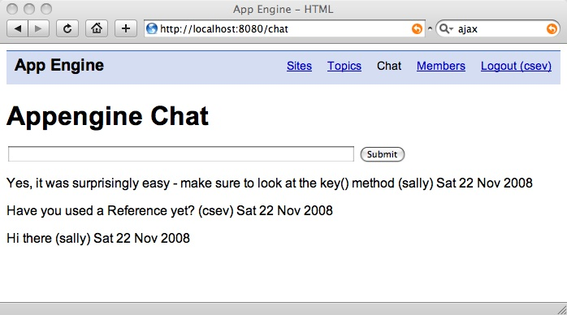
We will put the chat messages in a div and update the div using AJAX.

Slide 37
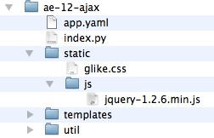
Installing JQuery
Go to jquery.com - download the latest version - source code
Place it in your application under the static folder

Slide 38
Installing jQuery
To use the jQuery library in your HTML, you need to include it
Typically this is done in _base.htm in the <head> area
<head>
<title>App Engine - HTML</title>
<link href="/static/glike.css" rel="stylesheet" type="text/css" />
<script type="text/javascript" src="/static/js/jquery-1.2.6.min.js"></script>
</head>

Slide 39
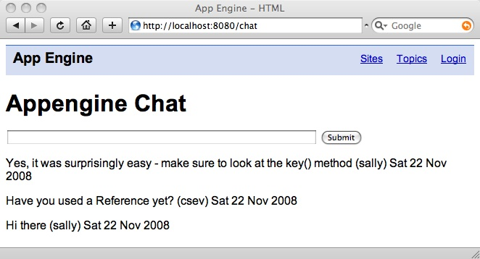
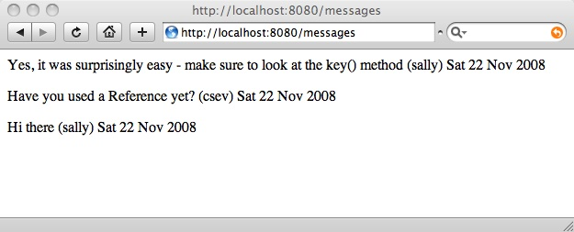
HTML Fragments
We need a page that just gives us message content
No head material - not even a body tag

Slide 40
def main():
application = webapp.WSGIApplication([
('/login', LoginHandler),
('/logout', LogoutHandler),
('/apply', ApplyHandler),
('/members', MembersHandler),
('/chat', ChatHandler),
('/messages', MessagesHandler),
('/.*', MainHandler)],
debug=True)
wsgiref.handlers.CGIHandler().run(application)
New Routing Entry

Slide 41
class MessagesHandler(webapp.RequestHandler):
def get(self):
que = db.Query(ChatMessage).order("-created");
chat_list = que.fetch(limit=10)
doRender(self, 'messagelist.htm', {'chat_list': chat_list})
Retrieve the recent ChatMessage messages and put them in the rendering dictionary for our new messages.htm template.

Slide 42
templates\messagelist.htm
{% for chat in chat_list %}
<p>{{ chat.text }} ({{chat.user.acct}})
{{chat.created|date:"D d M Y"}}</p>
{% endfor %}
Do not extend _base.htm - we do not want the headers. Loop through the messages in the rendering dictionary and print out each message enclosed in a paragraph tag.

Slide 43
templates\messages.htm
{% for chat in chat_list %}
<p>{{ chat.text }} ({{chat.user.acct}})
{{chat.created|date:"D d M Y"}}</p>
{% endfor %}

Slide 44
<div id="chatcontent">
Loading...
</div>
<script>
function updateMsg() {
$.ajax({
url: "/messages",
cache: false,
success: function(html){
$("#chatcontent").html(html);
}
});
setTimeout('updateMsg()', 4000);
}
updateMsg();
</script>
{% endblock %}
{% extends "_base.htm" %}
{% block bodycontent %}
<h1>Appengine Chat</h1>
<p>
<form method="post" action="/chat">
<input type="text" name="message"
size="60"/>
<input type="submit" name="Chat"/>
</form>
</p>
{% ifnotequal error None %}
<p>
{{ error }}
</p>
{% endifnotequal %}
chatscreen.htm

Slide 45
<div id="chatcontent">
Loading...
</div>
<script>
function updateMsg() {
$.ajax({
url: "/messages",
cache: false,
success: function(html){
$("#chatcontent").html(html);
}
});
setTimeout('updateMsg()', 4000);
}
updateMsg();
</script>
{% endblock %}
The chatcontent div is where we will put the messages which we retrieve from the /messages url.
The $.ajax() call is from jQuery. It retrieves a URL and then looks up a named div and replaces its html content.
Then we request that this be done every 4 seconds.

Slide 46
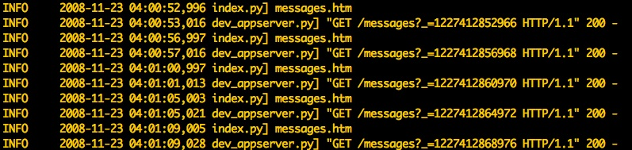
You can watch the log as the Ajax requests come in every 4 seconds.
The timestamp changes to make sure that the pages are not cached.

Slide 47
class ChatHandler(webapp.RequestHandler): def get(self): que = db.Query(ChatMessage).order('-created'); chat_list = que.fetch(limit=10) doRender( self, 'chatscreen.htm', { 'chat_list': chat_list })
The chatscreen.htm no longer needs the list of messages since they comes out in “/messages”.

Slide 48
class ChatHandler(webapp.RequestHandler): def get(self): que = db.Query(ChatMessage).order('-created'); chat_list = que.fetch(limit=10) doRender( self, 'chatscreen.htm')
The chatscreen.htm no longer needs the list of messages since they comes out in “/messages”.

Slide 49
AJAX Summary
This is one of hundreds of AJAX techniques supported by jQuery
It is a very common and useful pattern
http://www.jquery.com/ - much more detail

