Slide 1
JavaScript and AJAX
http://www.w3schools.com/js/js_examples.asp

Slide 2
JavaScript
In addition to HTML and CSS...
Browsers have a powerful programming language called JavaScript that runs in the browser
Actually not much like Java - more like C
Very powerful and flexible - we keep “discovering” new power
http://en.wikipedia.org/wiki/JavaScript

Slide 3










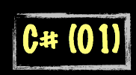

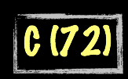
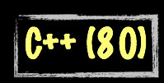









Science Calculations
System
System
bash (79)
C uses curly braces { } for code blocks.
Scripting/
Interpreted
http://en.wikipedia.org/wiki/History_of_programming_languages

Slide 4
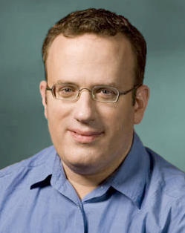
About JavaScript
Introduced in Netscape in 1995
Developed by Brandon Eich
Named to make use of Java market buzz
Standardized today as ECMAScript
http://en.wikipedia.org/wiki/Brendan_Eich

Slide 5
Language Syntax
Whitespace does not matter - spaces and new lines
Begin and end of blocks are curly braces
Statements must end in semicolons
function message()
{
alert("This alert box was called with the onload event");
}

Slide 6
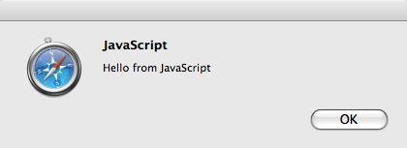
The Most Useful JavaScript
The alert box is often the way we debug simple JavaScript
When it runs - alert makes a pop up box
alert("Hello from JavaScript");

Slide 7
Including JavaScript in a Page
Include a file from a URL specified as an attribute of a "script" tag
Inline code inside a "script" tag
As an attribute on a tag

Slide 8
Including a File from a URL
<html xmlns="http://www.w3.org/1999/xhtml">
<head>
<title>App Engine - HTML</title>
<link href="/static/glike.css" rel="stylesheet" type="text/css" />
<script type="text/javascript" src="/static/js/jquery-1.2.6.min.js"></script>
</head>
<body>
<div id="header">

Slide 9
Inline Javascript
<html>
<head>
</head>
<body>
<h1>Here is my Document</h1>
<script type="text/javascript">
alert("Hello from JavaScript");
</script>
<h1>Here is my second Header</h1>
</body>
</html>
Inline JavaScript. This example runs as the page loads.
inline.htm

Slide 10
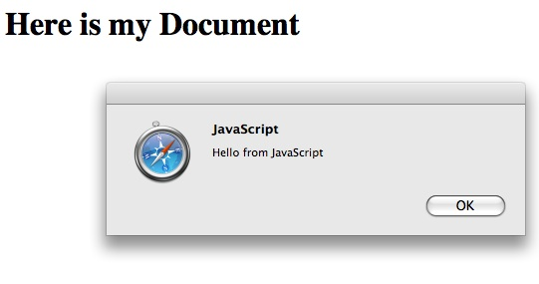

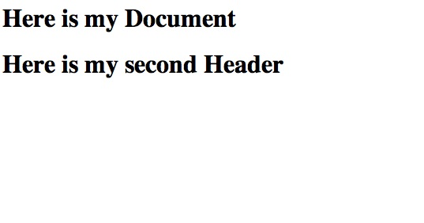
<html>
<head>
</head>
<body>
<h1>Here is my Document</h1>
<script type="text/javascript">
alert("Hello from JavaScript");
</script>
<h1>Here is my second Header</h1>
</body>
</html>

Slide 11
Event Handling
Certain tags can have attributes which contain JavaScript which run when things (events) “happen” to the tag
http://www.w3schools.com/jsref/jsref_events.asp
onchange, onclick, onmousedown, onmouseup, ..
<a href="http://www.umich.edu" onclick="alert('Ouch!')">Plan A</a>

Slide 12
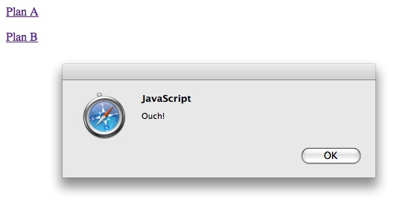
<body>
<p>
<a href="http://www.umich.edu" onclick="alert('Ouch!')">
Plan A</a>
</p><p>
<a href="http://www.umich.edu" onclick="alert('Yow!');return false;">
Plan B</a>
</p>
</body>
Returning false in these events means “don’t do what you were going to do”. In this case, Plan B will not follow the link after the popup.

Slide 13
Another Event
<html>
<head>
<script type="text/javascript">
function message()
{
alert("This alert box was called with the onload event");
}
</script>
</head>
<body onload="message()">
<h1>Hello World</h1>
</body>
</html>
http://www.w3schools.com/js/tryit.asp?filename=tryjs_headsection

Slide 14
<form method="post" action="/apply">
<p>
        <label for="name">Name:</label>
    <input type="text" name="name" id="name"/>
    </p>
<p>
        <label for="account"> Account:</label>
  <input type="text" name="account" id="account"/>
    </p>
<p>
        <label for="password"> Password:</label>
  <input type="password" name="password" id="password"/>
    </p>
<input type="submit" name="Login"/>
<input type="button" onclick="window.location='/'; return false;"
value="Cancel" />
</form>

Slide 15
<input type="button" onclick="window.location='/'; return false;"
value="Cancel" />
When this button is clicked, navigate this window’s location to the “/” URL, and do not submit this form.

Slide 16
Document Object Model
http://en.wikipedia.org/wiki/Document_Object_Model

Slide 17
Document Object Model
JavaScript can manipulate the current HTML docment
The “Document Object Model” tells us the syntax to use to access various “bits” of the current screen to read and/or manipulate
You can even find pieces of the model by id attribute and change them
http://en.wikipedia.org/wiki/Document_Object_Model

Slide 18
<input type="button" onclick="window.location='/'; return false;"
value="Cancel" />
When this button is clicked, go into the document model at window.location and change it to be “/”, and do not submit this form.

Slide 19



Updating the Browser Document
<p>
<a href="#"
onclick="document.getElementById('stuff').innerHTML = 'BACK';">BACK</a>
<a href="#"
onclick="document.getElementById('stuff').innerHTML = 'FORTH';">FORTH</a>
</p>
<p>
Hello <b><span id="stuff">Stuff</span></b> there.
</p>
This is one reason why you can only have one id per document.

Slide 20
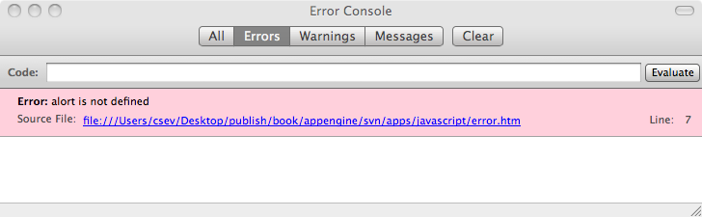
JavaScript Errors
<html>
<head>
</head>
<body>
<h1>Here is my Document</h1>
<script type="text/javascript">
alort("Hello from JavaScript);
</script>
<h1>Here is my second Header</h1>
</body>
</html>
Generally silently ignored by the browser
FireFox: Tools -> Error Console

Slide 21
FireBug - JavaScript / DOM
If you are going to do *any* non-trivial JavaScript and/or DOM manipulation
        Get FireBug for FireFox
        addons.mozila.org
Many Javascript errors are *silent* - FireBug notices the errors

Slide 22
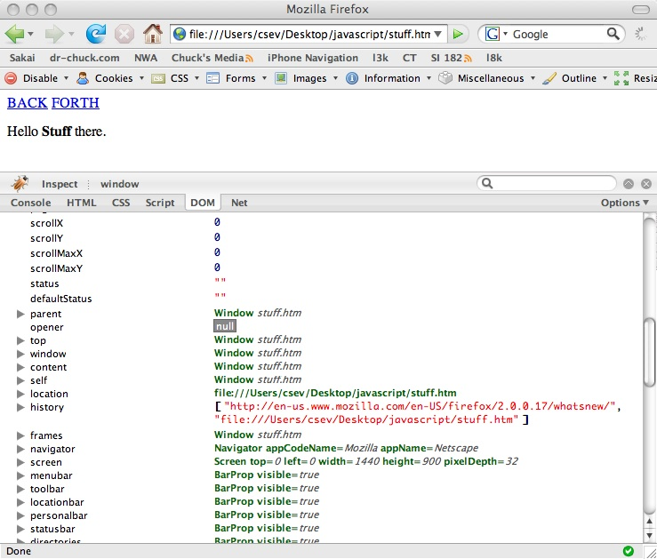

Slide 23
JavaScript Summary
There is a lot of power in JavaScript - we keep “discovering” new uses and capabilities of JavaScript
JavaScript is increasingly being treated as a very serious language - including using it in the server as well as the browser
People now specialize as JavaScript developers
http://www.w3schools.com/js/js_examples.asp

Slide 24
Asynchronous JavaScript and XML (AJAX)
http://en.wikipedia.org/wiki/Ajax_(programming)

Slide 25
In The Good Old Days
A user would take some action like a click on a link or button
The Browser would make a TCP/IP connection to the web server
The browser would send a POST or GET request
The Server would send back a page to display to the user
Repeat the Request-Response Cycle...

Slide 26
Browser
Redraw
Redraw
Redraw
Redraw
Whole
Page
Whole
Page
Whole
Page
Whole
Page
GET
GET
POST
GET
Server

Slide 27
XMLHttpRequest
By 1999, Microsoft wanted to move some of the processing of web pages from the web server to the web browser
The idea was instead of sending whole pages of HTML to the browser, send out the data to be displayed as XML and then produce presentation in JavaScript in the browser
Originally a Microsoft innovation - other browsers soon adopted the idea and it became a defacto standard with a little variation between browsers :)
It soon became clear that this could send *anything* - not just XML back and forth between a browser and client
http://en.wikipedia.org/wiki/XMLHttpRequest

Slide 28
Browser
Redraw
Update
Update
Update
Whole
Page
Fragment
Fragment
Fragment
HTTP
REQ
HTTP
REQ
HTTP
REQ
GET
Server

Slide 29
AJAX Arms Race
The race was on to build better and better web sites that began to replace things like frames and full-screen updates with XmlHttpRequest operations and very selective screen updates.
With clever JavaScript programmers - the impossible became possible - drag and drop, automatic field completion - automatic data saving. It made the web operate much more like the desktop.
Applications like GMail and Google Maps - feel very un-web.

Slide 30
AJAX versus Request/Response
Standard Request/Response
      Each click presents a whole new screen
AJAX
      Each action sends data and receives results in the background.
      The browser typically gets back a fragment of HTML or XML or JSON, which is used to update a portion of the screen using the browser document model

Slide 31
Lots of Flexibility
When you combine the ability to rewrite the Browser document model with the ability to interact with the web server from JavaScript - there is lots of potential fun
Different browsers did things a *little* differently - this led to the rise of AJAX Libraries

