Slide 1

Introduction to Dynamic Web Content
Charles Severance
www.dj4e.com
Notes:
Note from Chuck. If you are using these materials, you can remove my name and URL from this replace it with your own, but please retain the CC-BY logo on the first page as well as retain the entire last page when you remix and republish these slides.

Slide 2
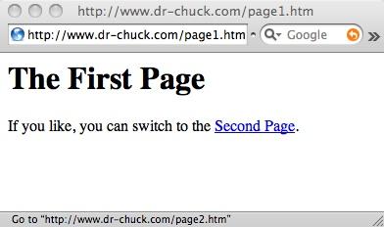

Browser
HTML
CSS
DOM
JavaScript
JQuery
Web Server
DJango / Flask
Sqlite3 / MySQL
http://www.dr-chuck.com/page1.htm

Slide 3
HTTP - Hypertext Transfer Protocol
The dominant Application Layer Protocol on the Internet
Invented for the Web - to retrieve HTML, Images, Documents, etc.
Extended to handle data in addition to documents - RSS, Web Services, etc.
Basic Concept: Make a connection - Request a document - Retrieve the document - Close the connection
http://en.wikipedia.org/wiki/Http

Slide 4
Uniform Resource Locator
http://www.dr-chuck.com/page1.htm
protocol
host
document

Slide 5
Getting Data from the Server
Each time the user clicks on an anchor tag with an href = value to switch to a new page, the browser makes a connection to the web server and issues a “GET” request - to GET the content of the page at the specified URL.
The server returns the HTML document to the browser, which formats and displays the document to the user.

Slide 6
Web Server
80
Browser

Slide 7
Web Server
80
Browser
Click

Slide 8
Request
Web Server
80
GET http://www.dr-chuck.com/page2.htm
Browser
Click

Slide 9
Request
Web Server
Response
80
<h1>The Second Page</h1><p>If you like, you can switch back to the <a href="page1.htm">First Page</a>.</p>
GET http://www.dr-chuck.com/page2.htm
Browser
Click

Slide 10
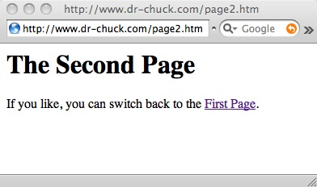
Request
Web Server
Response
80
<h1>The Second Page</h1><p>If you like, you can switch back to the <a href="page1.htm">First Page</a>.</p>
GET http://www.dr-chuck.com/page2.htm
Browser
Click
Parse/
Render

Slide 11
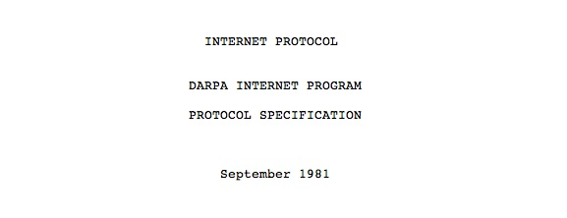
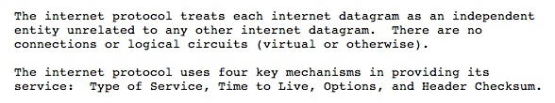
Internet Standards
The standards for all of the Internet protocols (inner workings) are developed by an organization
Internet Engineering Task Force (IETF)
www.ietf.org
Standards are called “RFCs” - “Request for Comments”
Source: http://tools.ietf.org/html/rfc791

Slide 12
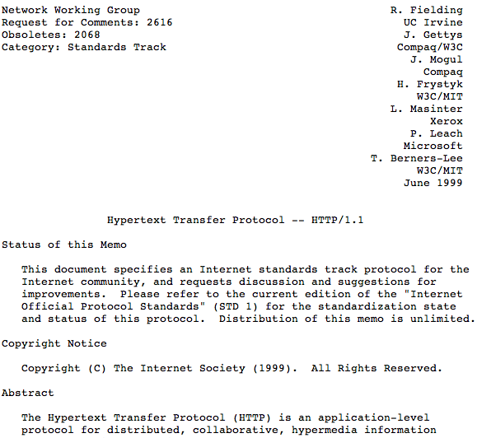
http://www.w3.org/Protocols/rfc2616/rfc2616.txt

Slide 13
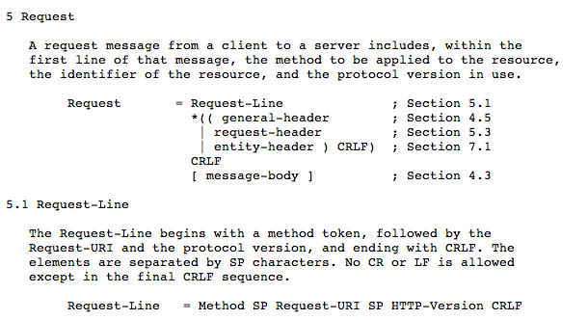

Slide 14
Making an HTTP Request
Connect to the server like www.dr-chuck.com
      - a “handshake”
Request a document (or the default document)
      - GET http://www.dr-chuck.com/page1.htm HTTP/1.0
      - GET http://www.mlive.com/ann-arbor/ HTTP/1.0
      - GET http://www.facebook.com HTTP/1.0

Slide 15
Web Server
$ telnet data.pr4e.org 80
Trying 74.208.28.177...
Connected to data.pr4e.org character is '^]'.
GET http://data.pr4e.org/page1.htm HTTP/1.0
HTTP/1.1 200 OK
Date: Thu, 04 Jan 2018 14:45:10 GMT
Server: Apache/2.4.7 (Ubuntu)
Last-Modified: Mon, 15 May 2017 11:11:47 GMT
Content-Type: text/html
<h1>The First Page</h1>
<p>If you like, you can switch to
the <a href="http://www.dr-chuck.com/page2.htm">Second
Page</a>.</p>
Connection closed by foreign host.
Browser

Slide 16

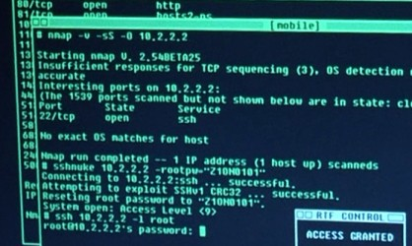
Accurate Hacking in the Movies
Matrix Reloaded
Bourne Ultimatum
Die Hard 4
...
http://nmap.org/movies.html

Slide 17
Getting to Know Our Browsers

Slide 18
Find Developer Mode
Chrome: View > Developer
FireFox: Tools -> Web Developer -> Toggle
Safari: Preferences > Advanced > Show Develop Menu

Slide 19
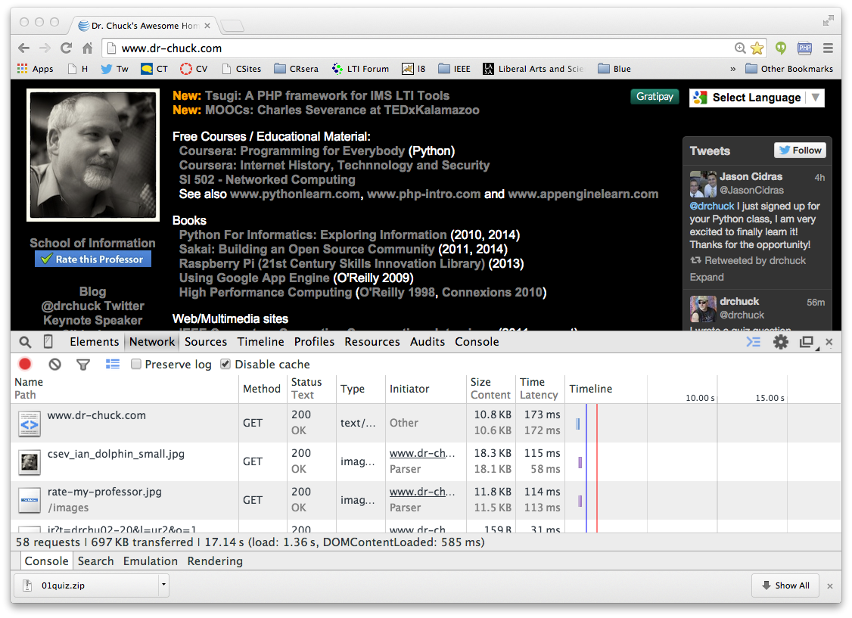
DEMO

Slide 20
Request
Web Server
Response
80
<h1>The Second Page</h1><p>If you like, you can switch back to the <a href="page1.htm">First Page
</a>.</p>
GET http://www.dr-chuck.com/page2.htm
Browser
Click
Parse/
Render

Slide 21
This is Only the Beginning…
In the Browser – HTML, CSS, Document Object Model (the DOM) and JavaScript
In the Web Server – Apache (or similar) web server with a PHP extension installed
In the Database Server running MySQL - PostgreSQL, Oracle, SQL Server, or similar

Slide 22

Time
Browser
Web Server
Database Server
DOM
Python
Database
MySQL
SQLite3
Postgress
DJango
Parse
Response
urls.py
static files
views.py
Templates
JavaScript
Tables
models.py
RRC/HTTP
SQL

Slide 23
Acknowledgements / Contributions
These slides are Copyright 2019- Charles R. Severance (www.dr-chuck.com) as part of www.dj4e.com and made available under a Creative Commons Attribution 4.0 License. Please maintain this last slide in all copies of the document to comply with the attribution requirements of the license. If you make a change, feel free to add your name and organization to the list of contributors on this page as you republish the materials.
Initial Development: Charles Severance, University of Michigan School of Information
Insert new Contributors and Translators here including names and dates
Continue new Contributors and Translators here
Notes:
Note from Chuck. Please retain and maintain this page as you remix and republish these materials. Please add any of your own improvements or contributions.

