Slide 1
Using Basic Internet Tools
Charles Severance
Notes:
In this lecture we explore the basic tools used for working on the Internet.

Slide 2
Basic Tools
Web Browsers
Telnet - log in to a computer - text mode
Electronic mail - elm
Electronic mail - POP
FTP - File transfer
Web Publishing
Notes:
POP = Post Office Protocol

Slide 3
What is a Browser?
Netscape Navigator/MS Explorer
  Netscape includes a POP mail program
Retrieves, Converts, and Displays
It is our view of the Web
It is a program (netscape.exe)
It requires a working network connection (LAN, PPP, etc.)
Notes:
A browser is the program which is used to “view” the contents of the World-Wide-Web.

Slide 4
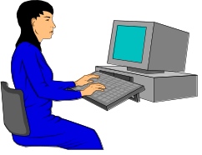




Browsing the Internet
Browsers use
many protocols

Slide 5
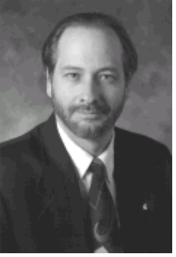
URL - All About Data
How to
Display the
data
Where to
get the data
http://www.egr.msu.edu/~crs/crs.gif
How to
retrieve the
data
What data
to get

Slide 6
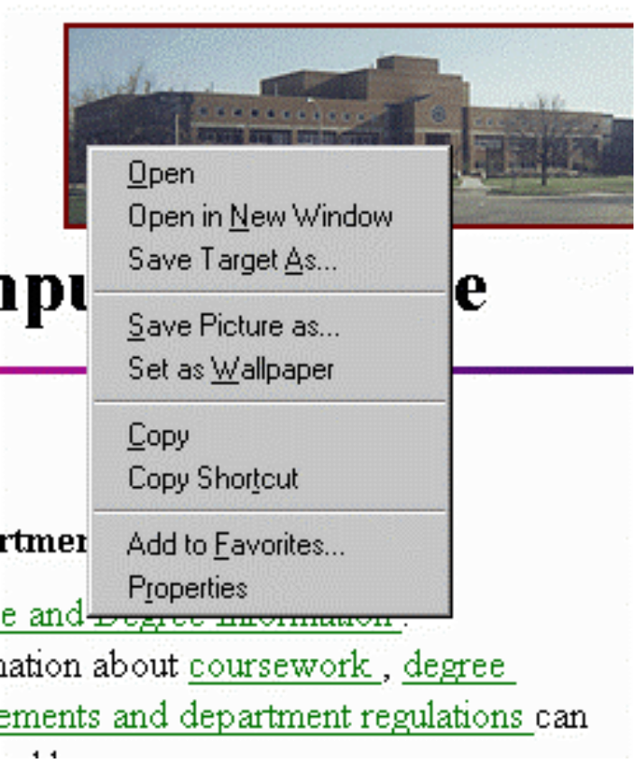
Browser Trick
Learn the “Right
Finger Click” - Allows
you to have flexibility
in what you do with
images or
downloadable
information

Slide 7
Configuring the Browser
Netscape - Options/Preferences
Explorer - View/Options
Change fonts, colors, security, start page, search page, network usage, proxy addresses, helper applications, viewers, screen layout, cache settings, image autoloading, etc..
Configure the POP and NEWS settings
Notes:
You will often have to change the settings in your browser. Other things you can do is set up helper applications, or clear your network cache.
See also
http://www.vu.msu.edu/preview/cps291/faq/plugins/
http://www.vu.msu.edu/preview/cps291/faq/uninstall/
As an exercise, see if you can clear your network cache. In netscape, it is under Options | Network Preferences | Cache
In Microsoft Explorer, it is View | Options | Advanced | Settings | Empty Folder

Slide 8
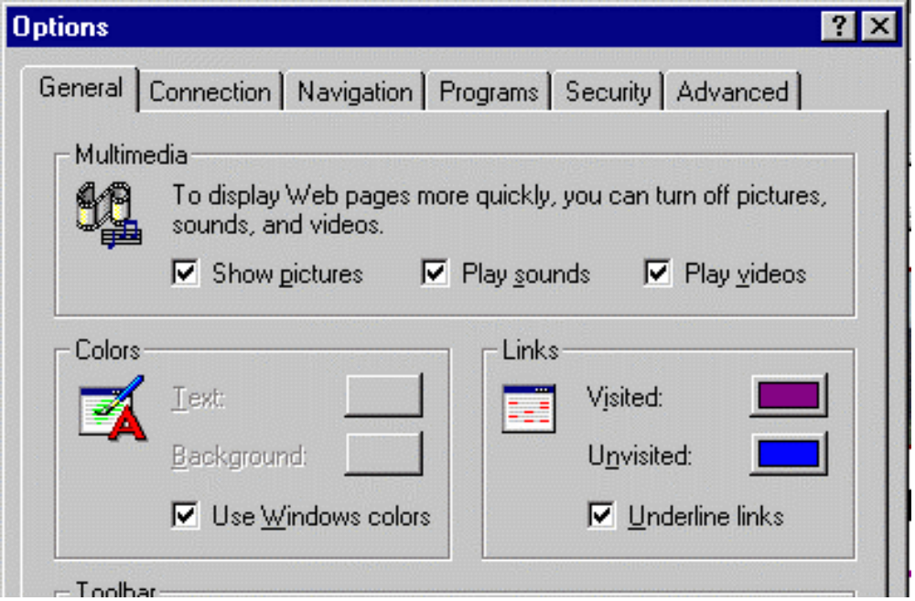
Explorer

Slide 9
Indexing and Searching
The web grew too fast - can’t keep track
  31 million pages, 476,000 servers, 23 million hits/day (Altavista Jan 1997)
Search engines
  Look at references to pages already stored
  Retrieve those pages
  Create keyword index
Search = keyword index + “Intelligence”
Notes:
Search engines are large databases which maintain indexes of which words appear in which web documents.
Lycos was fast and pretty simple
By the time Altavista came around, the problem had gotten out of hand.
People simply pointed their starting page at a search engine

Slide 10
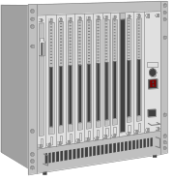
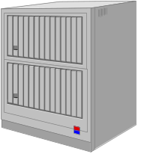
my favorite www.zepplin.com
for the really cool music
The web spiders
come out at night
Blah Blah Blah www.msu.edu blah this and that whatever and still some more stuff
I work at www.egr.msu.edu and like www.tcm.org
I plan to visit www.ncsa.uiuc.edu next month
The users
search
all day
Notes:
The search engines operate in two phases. At night, they act as spiders traversing the web. They retrieve pages, index them and then retrieve the ages that are referenced in each page. Eventually given enough time, they will reach every page that is pointed to in the net.
All of these pages are indexed in a database which is consulted as the uses come in during the day to run searches.

Slide 11
Search Engines
altavista.digital.com
altavista.msu.edu
www.infoseek.com
www.excite.com
www.search.com
www.askjeeves.com
Notes:
Search engines are very popular to the point that they generate significant revenue from advertisements included in the pages.

Slide 12
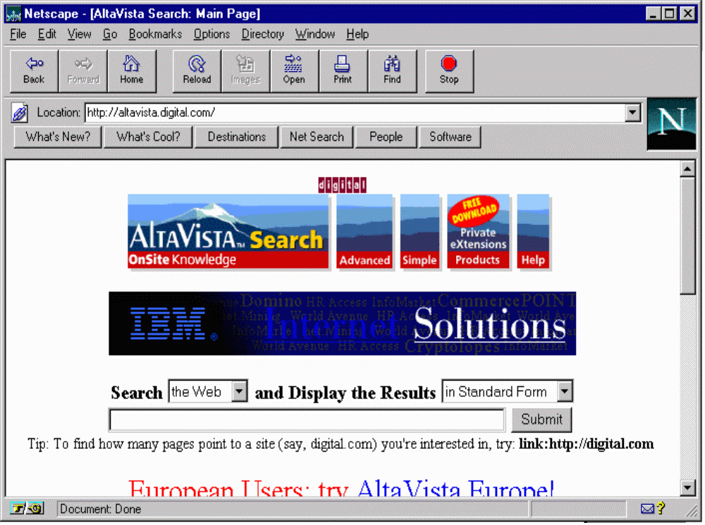

Slide 13
Altavista Tricks
“apple pie”
+karaoke +lansing +michigan
paris = paris, Paris, parIS, or PARIS
host:*.msu.edu
url:*.uk
+”apple pie” +rec*pe -”in the face”
….Many more
Notes:
There is a large number of possible ways to use AltaVista. More detail is available by pressing help at altavista.digital.com. You can also do advanced searches which use Boolean expressions AND, OR, and NOT along with date ranges. Your search expressions can use parenthesis. You can also separate the search criterion from the ranking criterion.
kayak AND "San Juan Islands"
The operator AND ensures that both are present in the resulting documents. The operator AND binds less tightly than juxtaposition.
"Digital Equipment Corporation" OR DEC
The operator OR ensures that at least one is present in the resulting documents. The operator OR binds less tightly than the operator AND.
Louis NEAR Monier
The operator NEAR ensures that both are within ten words of each other in the resulting documents. The operator NEAR binds less tightly than the operator NOT and associates to the left. This query matches Louis Monier, Louis M. Monier and Monier, Louis.
vegetable AND NOT "brussel sprouts"
The operator NOT is used to exclude words or phrases from a query. The operator NOT binds less tightly than the operator OR . This query is equivalent to vegetable and (not "brussel sprouts"). Do not use vegetable NOT "brussel sprouts"; this query is syntactically illegal.

Slide 14
Search .vs. Catalog
Global search engines falling behind
  Give up on “everything” try “useful info”
  Search engines have real trouble determining “useful”
Catalogs - www.yahoo.com
Recent Developments
  Directed Search Engines - Topical
  Localized Search Engines - “Geographical”
Notes:
There are too many URLs to practically index everything. Search engines are beginning to prune their searches. In 1995, the limiting factor was the amount of net they could search in a 24 hour period. Now with 3+ years of searching they have a lot of stuff. They cannot continue to do a complete index so they must rank the information in terms of value. This is pretty difficult to accomplish. Probably the first areas that will get pruned will be user home directories which has some of the most diverse material on the net.
The search engines will have to use metrics to rank the value of the information such as how many links point to the page. Another metric will probably be the length of the URL and how recently the data was updated. The search engines will have to spend a good portion of their time re-verifying their information to minimize the incorrect links.

Slide 15
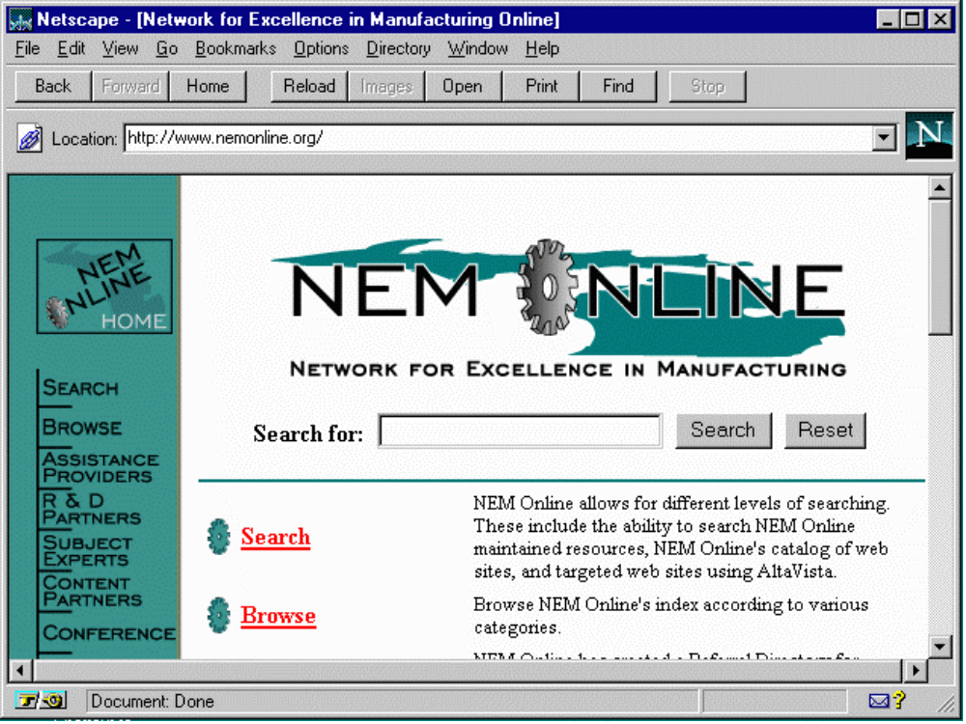

Slide 16
Up Next:
Using Telnet
Using E-Mail
Continue

Slide 17



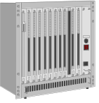
Telnet - Connect Text Mode
Telnet is one of the classic applications
It is a terminal emulator which works over a network connection
TCP/IP Network
RS-232 Cable
VT100 Terminal
Telnet

Slide 18
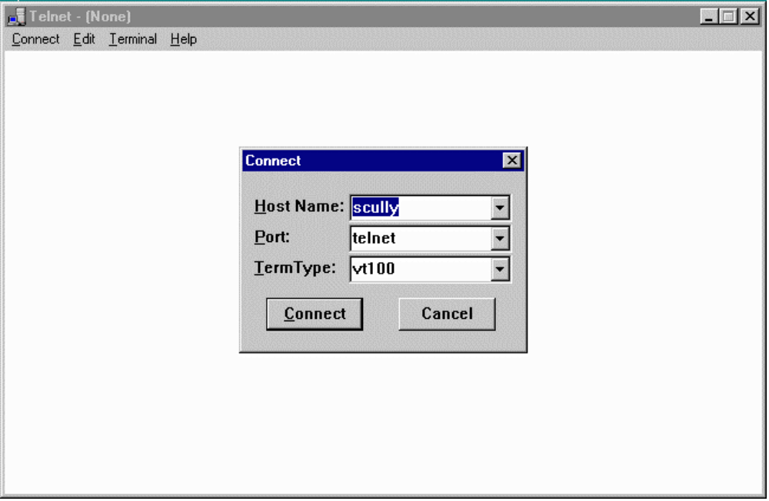
Notes:
To use telnet, you must first start it up. One Windows-95, use Start | Run and then type in telnet. It should bring up a window. Then use Connect | Remote System and then type in the name of the system such as pilot.msu.edu and press Connect.

Slide 19
The UNIX System
Often telnet connects to a UNIX system
Can be in line mode ala MS-DOS
SunOS/scully 3% ls
CSACMailList calendar ed projects tmp
LIST cefile.hang faculty public upload
Mail cps291 manage qqq web
bin download phones school
SunOS/scully 4% date
Tue Feb 4 09:06:55 EST 1997
SunOS/scully 5% uptime
9:07am up 11 day(s), 45 min(s), 17 users, load average: 5.25
SunOS/scully 7% /usr/sbin/ping www.cs.stanford.edu
labrea.Stanford.EDU is alive
SunOS/scully 8% elm

Slide 20
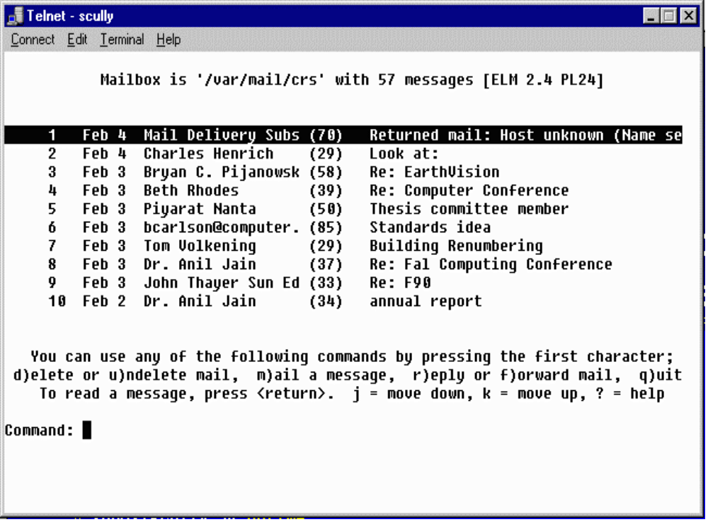
Notes:
In telnet screen mode, programs such as elm, vi or emacs, use cursor positioning sequences to draw text at various locations on the screen and read the keyboard, interpreting cursor and function keys as necessary. This creates the appearance of a “full-screen”.

Slide 21
Electronic Mail
Largest use of Internet for many years
Electronic Mail is very reliable
  Delivered off-line if necessary
  If a connection is down, E-Mail will be stored and retried later
E-Mail only works when it is read regularly
Notes:
The most fundamental form of interpersonal communication over the Internet is E-Mail. Because E-Mail is not instantaneous communication, it can function on low-speed unreliable networks quite effectively. Before the Internet, many users used a network called UUNET for E-Mail. UUNET did not depend on the network being up continuously. Periodically, each system would dial-up its neighbors and transfer any queued mail to the next system. Eventually mail would arrive at its destination, sometimes taking as long as a week.
One the Internet, systems attempt to deliver E-Mail even when there are partial network outages. Since mail messages are relatively small, if a message cannot be immediately transferred to its designation, it is saved on the local system. After some time period (typically 1/2 hour) the transfer is tried again. This makes E-Mail one of the most reliable activities on the Internet.
When E-Mail usage moved form UUNET to the Internet, the Mail was generally delivered directly to the final destination across the Internet.
One observation is that E-Mail is not much use if you have to call someone to tell them to read their mail. However at some point people read E-Mail so often that it is the fastest way to contact them if they don’t pick up the phone. It is often faster than leaving voice mail or a message on an answering machine

Slide 22
E-Mail Addresses
E-Mail addresses consist of a account name and an Internet Domain Name
  crs@egr.msu.edu
E-Mail addresses are like phone numbers - on your business card
Account Name
Domain Name
Notes:
An E-Mail address is a precise way to contact a person. As long as your mail system supports Internet style addresses if someone types that address into their mail program you will get the information. Mail addresses are unique across the Internet. In a sense it is like a pager number.
Often people put their E-Mail addresses on business cards and other forms of correspondence to allow people to contact them easily.
E-Mail addresses are VERY precise - much like phone numbers. crs@egr.msu.edu is not the same as chuck@michigan.state.university or dr.chuck@msu. A single typo nearly always makes the E-Mail addresses incorrect and the resulting mail undeliverable.
Using a technique called “mail forwarding” a user may actually have several working E-Mail addresses:
20095crs@ibm.cl.msu.edu (1987)
crs@cps.msu.edu (1988)
crs@egr.msu.edu (1988)
crs@convex.cl.msu.edu (1989)
crs@msu.edu (1991)
crs@clunix.msu.edu (1992)
As a person moves form computer to computer, they collect addresses.

Slide 23
Reading E-Mail
Terminal-style interfaces
  Read mail on the Internet connected server
  Store folders on the server
  Must use text editor on server to compose messages
Post Office Protocol on PC’s
  Much more convenient - Mouse
  PC’s may be turned off or disconnected
Notes:
Originally, we read mail on an Internet connected server. The mail would be delivered to the server, and then periodically we would log-in and run the mail program. This has a few drawbacks, in that it does not take full advantage of the capability of the PC. A PC has a mouse, can select text, and is relatively easy to learn to write documents.
To take advantage of PC capabilities, the server is used as a post-office to hold the messages until the PC user is ready to read the messages.

Slide 24
E-Mail Settings @ MSU
Pilot - Text based - uses elm
  telnet pilot.msu.edu
Pilot also supports POP access
  POP server: pilot.msu.edu
  SMTP server: pilot.msu.edu
  POP account and password are the same as your pilot ID
Other departments have other systems

Slide 25
Mailbox is '/var/mail/crs' with 57 messages [ELM 2.4 PL24]
1 Jan 18 Castillo Zacatelco (32) Help me ..!!!
2 Jan 18 Mark A. Hunter (38) IEEE/SEM Web Page
3 Jan 18 Marshall D. Hesten (29) Web Version of CPS 291
4 Jan 18 Marshall D. Hesten (34) Zoom Text in 220 Egr
5 Jan 18 Jeff Evans (32) Re: not making the 10:20
6 Jan 17 David J Fitzgerald (90) How to get the money!!??
7 Jan 17 David J Fitzgerald (64) Funding Proposal
8 Jan 17 Alejandro Diaz (144) Computing Services Advisory Committe
9 Jan 17 George.Van_Dusen (25) Engineering Fee
10 Jan 17 Bernie G Holmes (54) APP&R Budget Suggestions
You can use any of the following commands by pressing the first character;
d)elete or u)ndelete mail, m)ail a message, r)eply or f)orward mail, q)uit
To read a message, press <return>. j = move down, k = move up, ? = help
Command: Quit
Folder unchanged.
SunOS/scully 6%
Notes:
This is an example of a screen capture of the program called elm. This program is currently in use in the Pilot project at MSU where 60000+ faculty, staff, and students read E-Mail using UNIX servers.
Another popular text oriented mail reader is called “pine”.
While these types of interfaces are not flashy and can be difficult to learn, they can be used from any type of computer including a handheld computer with a modem.
Often text-based interfaces such as these are very effective for persons with sight limitations.

Slide 26
Post Office Protocol (POP)
With PC’s people like “pointy-clicky”
PC’s are not always ready to receive
POP uses a server to accept mail
When PC starts up, mail is downloaded from the server
Ease of editing
Attaching a binary file
Notes:
Because a PC may be shut off when a person leaves the office or it may not be connected to the Internet when the modem is not dialed, it is not practical to deliver directly to a PC. Typically the mail is delivered to a server permanently attached to the Internet This way, the mail can be delivered the instant the sender completes the message. When the receiver starts their system, it downloads the mail from the server to be read.
This is called the post office protocol because it is very similar to having a Post Office Box. You do not have to be present when the mail is delivered into the box. You stop in at your convenience and pick up the mail which has been placed in the box.

Slide 27
Software which Supports POP
Eudora
Netscape
Microsoft Outlook
Microsoft Outlook Express
Many others...

Slide 28
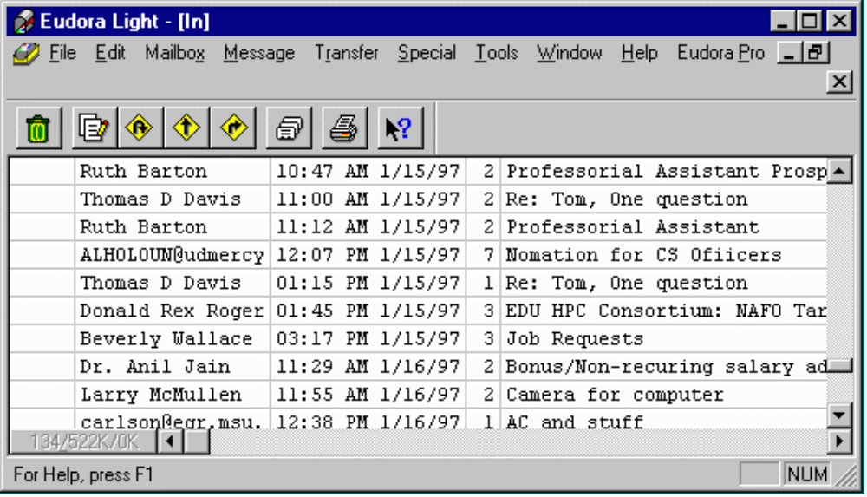
Eudora

Slide 29
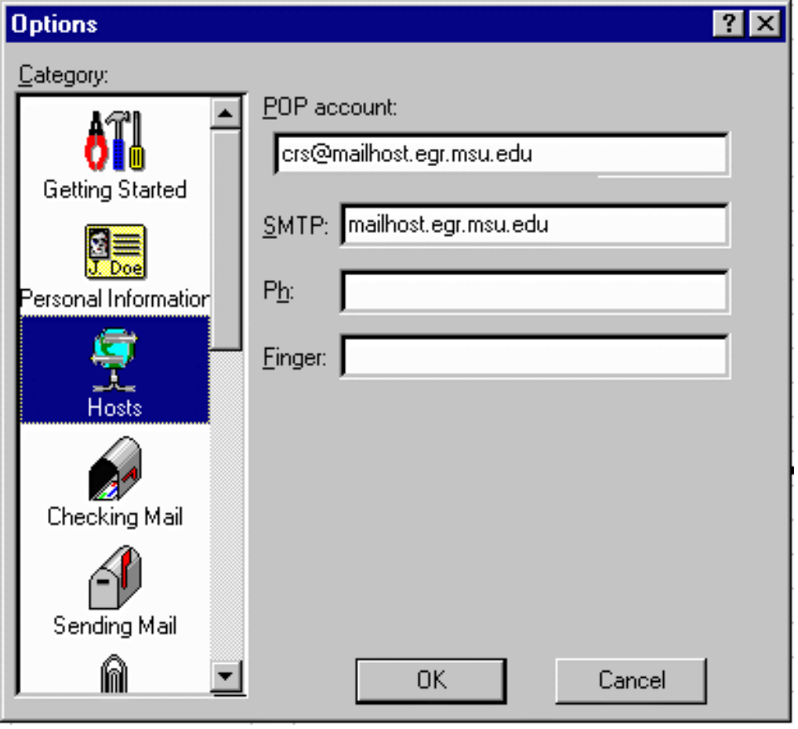
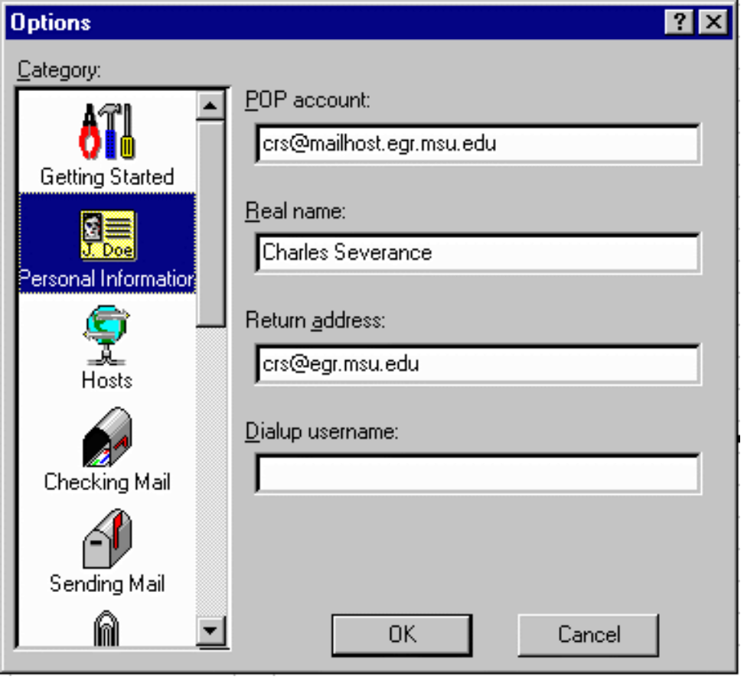
Configuration

Slide 30
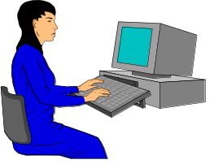

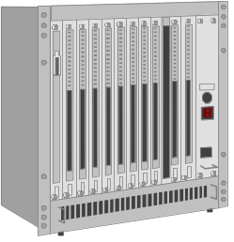
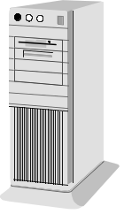

POP Operation
Eudora
Post Office Protocol
“Post Office”
mail.egr.msu.edu
SMTP - Mail Transfer Protocol
elm

Slide 31
Attachments
An advantage of using POP for both sender and receiver
Similar to sending a file on a floppy
MIME - Good for PC - Use when unsure
binhex - Good for Mac
uuencode - Good for UNIX
Can have viruses - JUST like a floppy
Notes:
One of the most convenient capabilities of E-Mail is the capability of sending attachments. With an attachment, you compose a short message like, “Johnm here is the spreadsheet”, then “attach the .XLS file to the mail message. When the message is received, the mail program allows the contents to be saved to disk.
One problem with attachments is that there are too many types. Each mail reader seems to have its favorite type and can read a few of the other types. Unfortunately not all reader programs can read all types.
Saving an attachment is like reading a disk of a floppy. It can contain a virus which would negatively affect the performance of your system. Top end virus checking software automatically checks incoming attachments for viruses.

Slide 32
Problem with POP
Incoming messages
  Copied to Hard Disk - If you use one PC
  Leave on Server - If move from PC to PC
Folders - “All my mail from Wiggins”
  Kept on Hard Disk
A protocol called IMAP keeps both folders and incoming mail on the server
Notes:
POP is a great solution to allowing PC users to read their mail using graphical programs. However a problem occurs when a user often moves from one PC to another regularly. When the user moves, the messages stored on the local disk do not move with the user. One solution is to configure Eudora to leave the messages on the server but that still does not solve the problem of “folders”.
Folders are where a user stores a message for reference. For example, it is common to create a folder for a topic such as “Every message sent to me regarding the cps291 class”. These folders are stored on the hard disk and do not follow a moving user around.
A solution to this problem is a new “post-office” protocol called IMAP. IMAP can store all messages and all folders on the server to allow completely movable users.

Slide 33
Up Next:
Using FTP
Publishing Web Pages
Continue

Slide 34
FTP - File Transfer Protocol
Used to transfer files
Can be used to convert text files
  ASCII <-> EBCDIC (Mainframe)
  Line-Ending - DOS/Mac/UNIX/VMS
Many programs do FTP
  Netscape - downloads - ftp://ftp.msu.edu/
  Win-95 ftp.exe - simple command mode
  WS_FTP32 - Nifty screen mode FTP
Notes:
FTP is the most basic tool for moving bulk data between two systems. You can either use a command mode FTP which comes on UNIX or Windows-95 or a screen mode FTP such as Fetch (for Macs) or WS_FTP32 (for Windows-95). Regardless of the interface, all FTP programs have the same goal of getting data from one system to another by either “uploading” (or “put”ing) or downloading (“get”ing) a file.
FTP handles data conversions for text files and has a binary mode for raw data files such as image files.

Slide 35
FTP Commands
open pilot.msu.edu
cd dir
lcd directory
put localfile [remotefile]
get remotefile [localfile]
ascii (use for .html .txt .c files)
binary (use for .gif .jpg .doc .zip files)
mput *.c
pwd
bye
Notes:
mput stands for “multiple put” and it accepts wildcards. There is also a “delete” command, “rmdir”, and “mdel” command to delete files while connected via FTP.

Slide 36
FTP to Pilot Space
C:\ > ftp pilot.msu.edu
Connected to pilot. msu.edu.
220 pilot.msu.edu FTP server (Version wu-2.1c(17) Fri Jan 21)
Name (pilot:sparty): sparty
331 Password required for sparty.
Password: [Type in your password. It will not be displayed.]
230 User sparty logged in.
ftp> cd web
ftp> put index.htm
200 PORT command successful.
150 Opening ASCII mode for index.htm (9286 bytes).
226 Transfer complete.
9286 bytes transferred in 0.0724 seconds (133.9 Kbytes/s)
ftp> quit
221 Goodbye.
Notes:
It is important to be in the proper “local” directory and the proper “remote” directory “remote” directory before you transfer the files. For example, lets say you saved a picture to “me.gif” in the \temp\photos directory on your hard disk and you wanted to upload it to your main web space in the web subdirectory of your home directory on the server. It would work something like this:
ftp pilot.msu.edu
(log in)
lcd \temp\photos
cd web
binary
put me.gif
quit
Before the put command you moved into the proper directory on the hard disk, the proper directory on the server, and set the mode to binary before actually transferring the data.

Slide 37
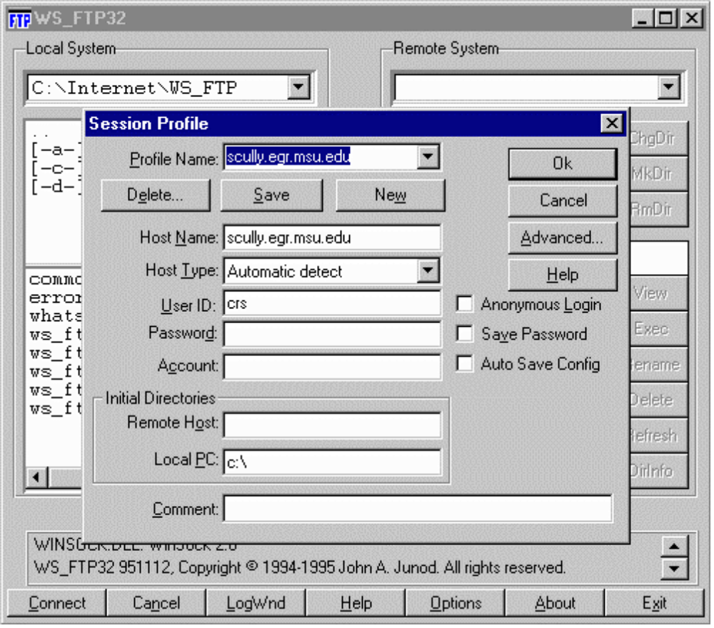
WS_FTP32
Full Screen
Can send
an entire
directory
Very
convenient

Slide 38
Personal Publishing
First Web Servers supported “User Pages”
As many styles of user pages as there are people
  Serious publications
  “My Favorite Stuff”
  My views on whatever
  Family pictures
Notes:
The Web encourages individuals and organizations to put up data on the net
In a sense we have come full circle
We communicate person-to-person
We retrieve data/information from repositories
We ourselves are a repository for the world

Slide 39
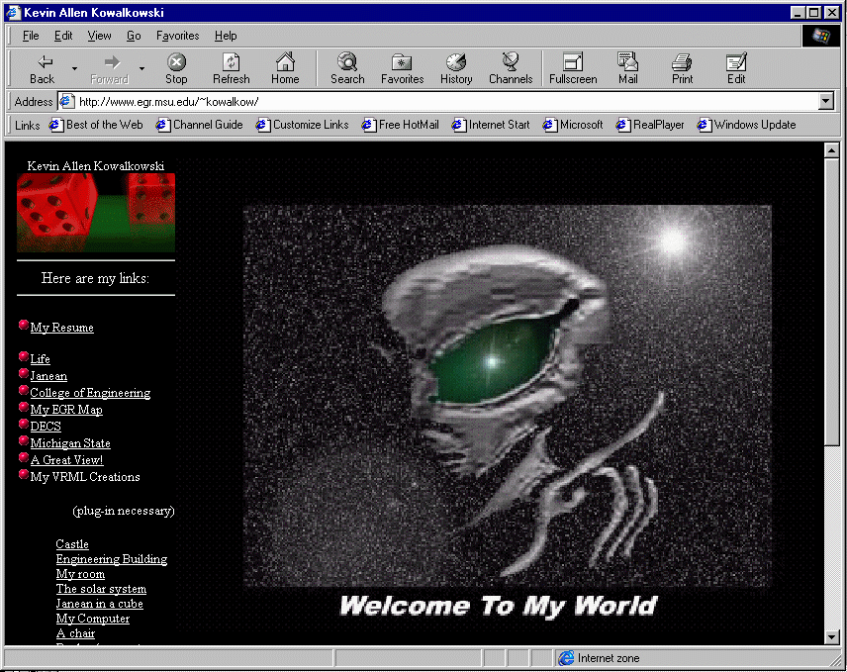

Slide 40
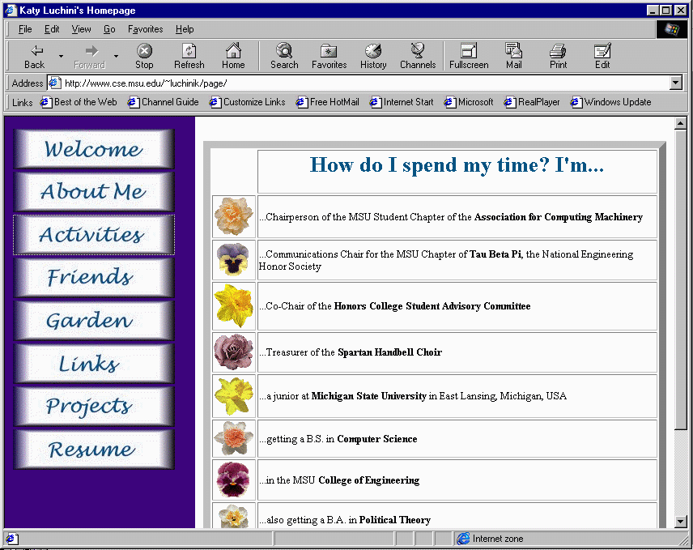

Slide 41
Your First Web Page
Develop your HTML (HyperText Markup Language)
Upload to the web space (use FTP)
Test your web page
There are easier ways to do this but this way will work
Notes:
The site www.windows95.com is an excellent site for graphics editors.

Slide 42
Create index.htm
Type this into a file C:\index.htm
<h1>A Very Simple Home Page</h1>
<p>
Welcome to my home page. This page
is just a test to see if I can actually get
something to upload. Here is
<a href=“http://www.msu.edu/”> MSU! </a>
</p>
<p>This page is under construction</p>

Slide 43
FTP to Pilot Space
Start | Run | ftp pilot.msu.edu | OK
220 pilot.msu.edu FTP server (Version wu-2.1c(17) Fri Jan 21)
Name (pilot:sparty): sparty
331 Password required for sparty.
Password: [Type in your password. It will not be displayed.]
230 User sparty logged in.
ftp> cd web
ftp> put C:\index.htm index.htm
200 PORT command successful.
150 Opening ASCII mode for index.htm (9286 bytes).
226 Transfer complete.
9286 bytes transferred in 0.0724 seconds (133.9 Kbytes/s)
ftp> quit
221 Goodbye.
Notes:
It is important to be in the proper “local” directory and the proper “remote” directory “remote” directory before you transfer the files. For example, lets say you saved a picture to “me.gif” in the \temp\photos directory on your hard disk and you wanted to upload it to your main web space in the web subdirectory of your home directory on the server. It would work something like this:
ftp pilot.msu.edu
(log in)
lcd \temp\photos
cd web
binary
put me.gif
quit
Before the put command you moved into the proper directory on the hard disk, the proper directory on the server, and set the mode to binary before actually transferring the data.

Slide 44
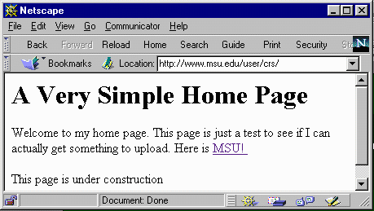
View Your New Page!
Test the page using your browser
  http://www.msu.edu/user/sparty/

Slide 45
<h1>A Very Simple Home Page</h1>
<p>
Welcome to my home page. This page
is just a test to see if I can actually get
something to upload. Here is
<a href=“http://www.msu.edu/”> MSU! </a>
</p>
<p>This page is under construction</p>

Slide 46
Publishing Pages
Your web site will consist of more than just one file
  Multiple html files
  Images (*.jpg, *.gif)
  Subdirectories
We will cover this in more detail

Slide 47
The “web” Subdirectory
Typically you have a home directory on each system for your files
  /afs/msu/user/c/r/crs
  /user/crs
  /home/uo/crs
Unless your account is specially setup for web pages only, there is a subdirectory called “web” which is used to store pages
Notes:
The choice of the subdirectory web is up the the system administrator of each system but the name “web” is commonly used across different systems to eliminate confusion.
You may have to set permissions properly on the web directory. In Pilot the permissions are set properly automatically when your account is created.
The files in the web subdirectory and all of its subdirectories must generally be “world-readable” for them to be served over the web. If you get “Permission denied” when you try to view a web page, it probably means that permissions are not set properly.
On UNIX:
chmod ugo+rx web
chmod ugo+r web/index.htm

Slide 48
Putting a file on the Web
To publish a file, you must get the file into your web directory (typically with FTP)
The name of the file becomes the last part of the URL
/afs/msu/user/c/r/crs/web/crs.gif
http://www. msu.edu/user/crs/crs.gif

Slide 49
Sub-Directories
Below the web subdirectory, you can create your own directory structure. The directory structure is reflected in the URL.
/afs/msu/user/c/r/crs/web/photos/crsgrad.gif
http://www.msu.edu/user/crs/photos/crsgrad.gif

Slide 50
The index.html (or .htm) File
When you specify a directory in the URL, the web server looks for a default file
  index.html or index.htm on Pilot
  index.html on CPS and EGR
  index.htm Windows index.html on UNIX
Added
http://www.msu.edu/user/crs/photos/
/afs/msu/user/c/r/crs/web/photos/index.htm

Slide 51
A Web Structure
/home/uo/crs
/home/uo/crs/web
Legend
web
directory
index.htm
Mail
file
crs.gif
project
photos
todo
school
teresa
index.htm
index.htm
c++
brent
crsgrad.gif
cps291int
secret
mandy

Slide 52
HTML Tools
Converters
  Microsoft Word
  Microsoft PowerPoint
Editors
  Microsoft Frontpage
  Netscape Composer
One-button publishing is possible

Slide 53
Summary
Fundamental Internet tools
  Netscape Navigator/Microsoft Explorer
  telnet
  ftp
  HTML
These tools are a great improvement over the previous tools

