Slide 1
The History of the Internet and World-Wide-Web
Charles Severance
Michigan State University
Notes:
In this lecture we will look at the history of the Internet as a technical and social phenomena. it is important to understand the history of the Internet in order to understand its current capabilities and potential future trends.

Slide 2
Five Phases
Long Distance Networking 1966-1973
Network of Networks “internet” 1974-1985
internet becomes Internet 1985-1990
Internet becomes easier to use 1991-1993
Internet becomes internet.com 1993-now
Notes:
While the Internet appears to have popped up on the technology radar screen in the last year or so, it is over 35 years old. In a sense Universities and research organizations slowly developed the Internet for 30 years in preparation for its formal introduction to mass society in 1992. During the first 30 years the Internet was not viewed as a “product”. There was little thought given to marketing the Internet. The effort was focused on just making the Internet work. However, by 1992, the Internet was a very mature and successful method to tie computers around the country together. All it needed was a little shove into the spotlight and few million dollars worth of high-speed phone line upgrades to become a major social fad and technical revolution.

Slide 3
Long Distance LAN
1956 - Universities Building Computers
1966 - Merit network formed
1968 - BBN Develops IMPs
1969 - ARPANET - UCLA, Stanford, UCSB, Univ. of Utah
1971 - ARPANET - 23 Hosts
1971 - Apple microcomputer
Notes:
Graphing the growth of the Internet is pretty much pointless. The best way to characterize the growth of the Internet by phase. For the first decade, it was a small number of hosts which were participating directly in the development of the protocols. After that time, only very well funded research institutions and supercomputer centers were able to connect.
http://www.msu.edu/staff/rww/netgrow.html

Slide 4
“internet”
1973 - Internet - network of networks
1973 - ARPANET - University of London
1974 - Design of TCP/IP starts
1981 - 213 hosts
1981 - IBM PC (8088) introduced
1983 - TCP/IP is the standard protocol
1984 - Internet - 1000 hosts

Slide 5
Internet
1985 - Many campuses expand their LANs
1986 - NSFNET - 5 supercomputer centers
1987 - 10000 hosts
1987 - Merit manages NSFNET

Slide 6
Tool Building
1989 - World-Wide-Web at CERN
1991 - Gopher developed at Minnesota
1992 - 1 Million hosts
1992 - National Information Infrastructure
1993 - Multimedia PC < $1000
1993 - Very-high-speed-backbone (VBNS)
1993 - Mosaic is written

Slide 7
Commercialization
1995 - 10 Million hosts
1995 - NSFNET is turned over to MCI
1997 - People can view video lectures all over the world on demand
1997 - 100 Universities planning to connect to the VBNS at 155Mb/sec

Slide 8
Computing History
Internet history is driven by the availability computer technology
Networks are useless if network cards cost $5000
Virtual reality would never work on an Intel 8088
Without sound cards - no RealAudio
Notes:
In 1969 there were not even 10 Million Computers in existance. So few people were able to use computers there was no real reason to connect them. The Internet was a pure research project for a long time until cheap computer technology slowly moved it toward the home consumer.
Some important advances in computer technology:
Fast Processors for 3D Graphics
Inexpensive Sound Card
28,800 modems for under $250.00
Complete PC’s for < $1000
Computers fast enough to run windowed environments
Cheap disk space for software and server data

Slide 9
Designing an Internet
Technical Challenges
  Federated Network - No single authority
  Many computer vendors
  Worked over fast local links and slower long-distance links
  Worked over unreliable links
TCP/IP was the result of this effort
Notes:
Initially, the goal was just to make the Internet work. One problem in any cooperative technological activity is who will be in charge. The Internet adopted the idea of a “Federation” of networks rather than a single centrally controlled network. Some of this approach is based on the original concepts of a network which could survive battlefield conditions.
As each site is added to the Internet, It gets a set of IP addresses and a domain name. After this is set up, the site is free to completely administer its own section of the Internet without external intervention. This approach allowed organizations to collaborate without having one organization having to submit to another organization’s control (Imagine if the University of Michigan had to get permission from Michigan State University each time the UM needed to add a new computer!).
From its inception, the Internet did not operate on a single vendor’s equipment. While corporations like IBM and Digital were developing network solutions which were proprietary all the way down to the wiring used, the Internet separated the host computer, the network protocols, and the network wiring. This allowed each technology are to evolve indpenedently. TCP/IP could work equally well over slow long-distange modem lines and high speed local area networks because it dynamicly adaptes to the speed of the network media.

Slide 10
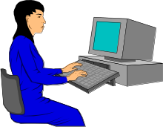
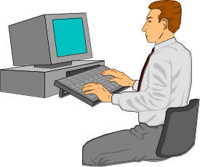
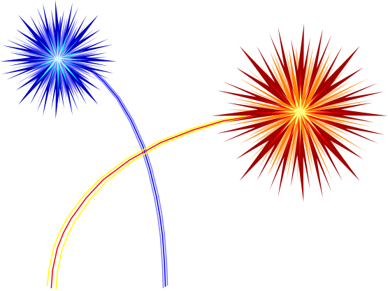
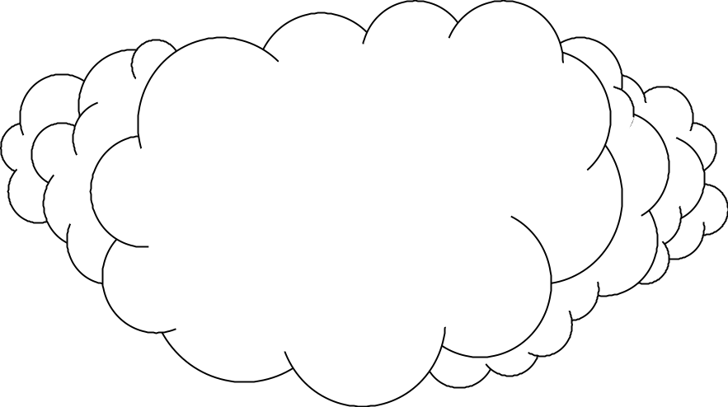
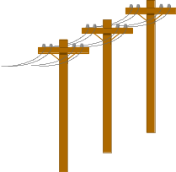
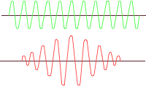


Unreliable Network
Hi There
Hi There
Amanda
Hi There
TCP/IP
Amanda
Notes:
The truly difficult technical challenge is to create reliable “connections” between programs on different computers assuming the intermediate network is unreliable. To accomplish this, data is broken into “Packets”. Each packet is independently routed through the network. If a packet is lost for one reason or another, it must be retransmitted by the original system. The network can detect the lost data, change its configuration to internally route packets to the destination using a redundant path. Because each packet is independent, when data is lost, it is only a small amount of data.

Slide 11
Stone Age User Tools
Stone Age 1966-1990
People had “Terminals” - Usually text
  telnet - remote log in
  FTP - File Transfer
  MAIL - Personal Communication
Tools are primitive but very powerful in the hands of an experienced user
Notes:
Terminasl were primitive - many did not even have cursor keys, function keys, windows or a mouse. Some printed right onto paper. A terminal used in 1975 was a printing terminal which used a roll of paper called a TTY-33 which communicated at 110 bits/second. That is a long way from a 200Mhz Pentium, Windows-95 and a 100,000,000 bits/second Ethernet card.
E-Mail
Nearly Instant - Across the world or across the hall or across time
Sure beats phone tag
Seems “Free”
Predates widespread use of FAX by a long time

Slide 12
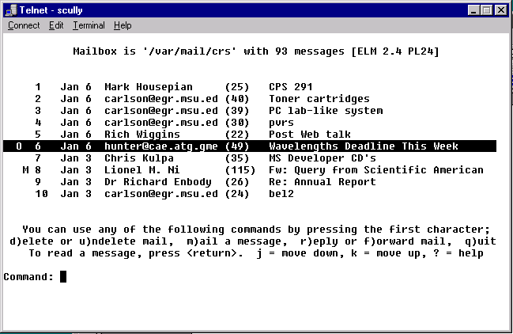
Notes:
This is an example of the telnet program from Windows-95 reading Electronic Mail using a program called “elm” which stands for “ELectronic Mail”. Sometimes today for an advanced user, it is still more convienent to use these simpler tools. Especially when using a slow connection or old computer equipment.

Slide 13
Nerds at Play
Can send something non-work related
  Network News - Worldwide discussion forums
  Talk - On-line instant communication
  Mailing lists
  FTP Servers - Public Domain Software
Notes:
Theory: If you cannot have fun with a technology it has a short life. At the University of Michigan there was a program called Confer which was a text based conferencing program. This program was both used for pleasure and technical discussions. One observation is that the enjoyable discussions served to make the users confortable with the environment so they were able to have excellent technical discussions.
Network News (or Usenet News) started in 1979 now contains over 5000 topic areas with readers all over the world.
The talk program allows instantaneous real-time chat between two users over the Internet..
The FTP program allows filetransfer over a TCP/IP network. Through the use of anonymous (no account require) FTP programmers made a wide variety of software available over the Internet. This public domain software appraoch was often used to develop, deploy, and test a new piece of Internet software.

Slide 14
Newsgroups: sci.math.research
Path:newsflash.concordia.ca!utcsri!utnut!torn!
ux1.cso.uiuc.edu!news.cso.uiuc.edu!dan
From: mckay@alcor.concordia.ca (John McKay)
Subject: Fermat's Last Theorem has been proved
Approved: Daniel Grayson <dan@math.uiuc.edu>
Date: Wed, 23 Jun 1993 11:00:27 GMT
Message-ID: <C92MKs.8F2@newsflash.concordia.ca>
Sender: Daniel Grayson <dan@math.uiuc.edu>
Originator: dan@symcom.math.uiuc.edu
Organization: Concordia University, Montreal, Quebec
Lines: 8
I have heard that an announcement to this effect has
been made in Cambridge by Andrew Wiles today,
June 23rd. 1993.
Notes:
This is an example of a news message announcing the proof of Fermat’s last theorem.
x^{n} = y^{n} = z^{n}
Has no integer solutions except for n=1 and n=2
Fermat was a brilliant mathematician who lived in the 1600’s. After he died, other mathematicians examined his notes and found many brilliant proofs. Before his death he claimed to a colleague, “I have a beautiful and elegant proof to this (the above) theorem”.
Three hundred years after his death, this was the only of Fermat’s theorems which remained unproved (hence the title “Fermat’s Last Theorem”).
http://www.netspace.org/herald/issues/092995/wiles.f.html

Slide 15
The State of the Net - 1988
Very limited access - Universities
Personal communication
Personal data exchanged
Some central repositories
  ftp.uu.net
  wuarchive.wustl.edu
Public domain software evolves
Notes:
In 1988, the Net was both very mature and very immature. For those with access to the Net it was a powerful effective tool. However the only users were those at the top level universities. The Internet was beginning to move from E-Mail as the primary data transferred to FTP data as the largest amount of bandwidth. Most users were very experienced computer users so the Internet did not have to be particularly user friendly.
ftp://ftp.uu.net
ftp://wuarchive.wustl.edu

Slide 16
Anticipating Gopher
The number of information repositories (ftp sites) started to grow
There was a problem keeping track
Simple cataloging tools were created to manage the problem
Disk was becoming cheap and desktop systems were increasing in power
Notes:
In 1989 - $30,000 per Gigabyte of Disk
Having an FTP repository was a great honor

Slide 17
The Age of Gopher
Gopher was the first “net browser”
  University of Minnesota - 1991
Simple user interface
  No cryptic commands - menu driven
  Network details completely hidden
Combines
  Retrieval of information
  Conversion of information
  Viewing of information
Notes:
The Gopher software was not rocket science - could have been written in 1985 - but there was no need - also, graphical computers with sound cards were becoming more common.

Slide 18
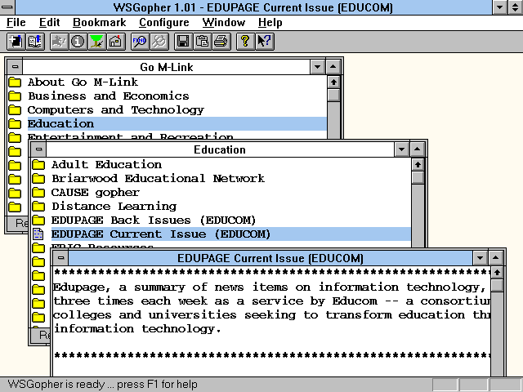
Notes:
Gopher was a hierarchy of menus. You navigated through folders and at some point you came upon a sound, text document, or graphic image. The data was retrieved and then displayed or played automatically. As you selected menu choices, you seamlessly moved from one server to another through “gopher-space”.
Gopher was the first program to integrate indexing, retrieval, conversion, and display of data into a single program.

Slide 19
The Age of Gopher
Gopher made the Internet usable by the masses.
Using Gopher was an adventure - travel the world from an easy chair
Gopher accessed existing information and encouraged the creation of new information
Notes:
At MSU in the early days of gopher we provided a “Public Gopher” with free dial-in - no password - we wanted to share this “internet thing” with many people in the community. Three years later we had to put passwords on our modems because otherwise we would not have been able to support or faculty/staff/students use of the modems.

Slide 20
The Age of Gopher
Gopher server became a matter of pride
Gopher showed that the Internet could be a valuable resource
Gopher still had limitations
  Strict menu interface
  Not a very “Jazzy” interface
Notes:
A fundamental driving force behind the production of gohper materials was institutional pride. While universities typically do not do much advertising or marketing, they are very competitive with each other. The competition to be the first and best on the network drove the creation of many excellent resources.

Slide 21
Gopher Content
Universities
  gopher://gopher.msu.edu/
Federal Government Agencies
  gopher://gopher.nsf.gov/
State Governments
  gopher://gopher.mde.state.mi.us/
No individuals
Notes:
Federal Government agencies in the early 1990’s were under great pressure to demonstrate their value to the taxpayers. Gopher sites with “valuable” information for taxpayers which received a large number of hits were a great way for an agency to spport its claims for value to the taxpayers.
One of the best early gopher examples - Michigan State Department of Education - School District MEAP tests
gopher://gopher.msu.edu/
gopher://gopher.nsf.gov/
gopher://gopher.mde.state.mi.us/

Slide 22
Gopher’s Short Life
University of Minnesota decided to make some money
People spent time rewiting free versions of Gopher
Mosaic and the web arrived
Remember that gopher was what triggered the interest
Notes:
Gopher was rapidly adopted. In a short time, gopher servers, gopher clients, gopher conferences, gopher working groups, and gopher content were developed and deployed. Of course there was no charge for any of the software which feuled this growth. At the peak of gopher popularity, University of Minnesota decided to make some revenue off of Gopher’s success. The resulting confusion meant that when the free web software arrived, gopher was powerless.
Keep this example in mind when we begin to examine Netscape versus Microsoft Explorer.

Slide 23
Government Internet
Technology became political issue in 1992 elections
Al Gore - “Information superhighway”
National Information Infrastructure - Information Infrastructure Task Force
1993 NII = 500 two-way TV channels
1995 Internet = IITF
Notes:
As the Internet was emeging in the early 1990’s there was a national level push to create a “Information Superhighway System” similar to the road system. This was viewed as critical to national leadership in the technology area. In 1993, the national Information Infrastructure vision had a very telephone and cable TV centric perspective. The internet was viewed as an interesting “toy”. However by 1995,the Internet had taken over as the vision for the National Information Infrastructure.
http://iitf.doc.gov/

Slide 24
The Age of Web
Web - Was a “better mousetrap” (or perhaps a gophertrap)
Mixed text and graphics
Hypertext approach - hot links
Focused on pleasing the end-user
Available on MAC, Windows, and UNIX
Notes:
Think of PerfectCalc and Lotus 123 and then Excel - The first example of a new technology is not always the most successful. Mosaic, Netscape, ….?

Slide 25
Web Heritage
HTML - Hypertext Markup Language invented at CERN by Tim Berners-Lee
Mosaic from NCSA - Mark Andreesen
Netscape formed by Mark Andreesen and Jim Clark
Microsoft Explorer developed by Microsoft to compete with Netscape
Notes:
Interestingly, HTML (Hypertext Markup Language) was invented about the same time as Gopher. HTML is the language used to “mark-up” the hypertext aspects of web documents and to interate the multimedia aspects of the documents into the text portions of the documents.
However because there was no free software available to view HTML effectively it was not immediately a hit. HTML was over two years old when Mosaic was developed at NCSA (National Center for Supercomputing Applications) at university of Illinois at Urbana-Champaign in 1993.
Mark Andreesen had an $20,000 SGI on the desk at NCSA - So did everyone else at NCSA - assumed graphics, networking, an multimedia three years before it was commonplace.

Slide 26
Browser Power
User interface was like a CD-ROM
Extremely intuitive - Interactive forms
Web introduced the concept of a URL or “Uniform Resource Locator”
Like an E-Mail address for data
  Completely specified world-wide
  Could be typed into browser
Notes:
With the development of Mosaic and the founding of Netscape Comunications Corporation it became quickly clear that the Web was innnovating much more rapidly than the personal computer market. There quikly became the talk of the web browser changing froma simple program to a program which controlled your enrite desktop and launched other programs as necessary. This threatened existing hardware and operating systems manufacturers. Because netscape ran on multiple computer types (PC, Mac, UNIX) and on multiple operating systems, people might actually be able to choose the best hardware/operating system and casue too much competition.
Microsoft saw this threat to the dominance of their operating system and developed Microsoft Explorer - a competitive web browser. While Netscape has continually tried to make revenue from their browser, Microsoft has given Explorer away for nothing so far. (does this sound familiar???) Microsoft has also added web/internet features across its product line.

Slide 27
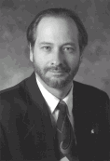
URL - All About Data
How to
Display the
data
Where to
get the data
http://www.egr.msu.edu/~crs/crs.gif
How to
retrieve the
data
What data
to get
Notes:
One of the great contributions of the World-Wide-Web was the concept called the Uniform Resource Locator or (URL). URLs may initially look like gibberish, but they tell the Web Browser a great deal of information.
The first part of the URL specifies a high level network protocol which is needed to retrieve the data. Examines include “http”:, “ftp”:, “news:”. The prefix “http:” indicates to use the Hypertext Transport Protocol to retrieve the data.
The second part of the URL is the host to contact to retrieve the data. Any domain name or numeric IP address can be used in this spot.
The third part of the URL specifies a document to be retrieved from the server.
The suffix on the document also determines how the information is to be displayed. Examples include:
GIF - Picture
JPG - Picture
PS - Postscript File
HTML - Hypertext Markup Language
RA - RealAudio file
MPG - MPEG Animation

Slide 28
Early Web Content
Mostly from organizations
Nifty Collections
  Software
  Art Museums
Proof of Concept - Look what I can do!
  http://wxweb.msu.edu/weather/
  http://www.hcc.hawaii.edu/
Folks would say, “look what I found!”
Notes:
Hawaii Community College - First MPEG Video
Fish Cam
Audio was already popular in Gopher - Became more common on the web
One assumed that the Web was going to become the large world-wide electronic library
For a while one could keep up - Then the growth got out of hand
http://wxweb.msu.edu/weather/
http://www.hcc.hawaii.edu/

Slide 29
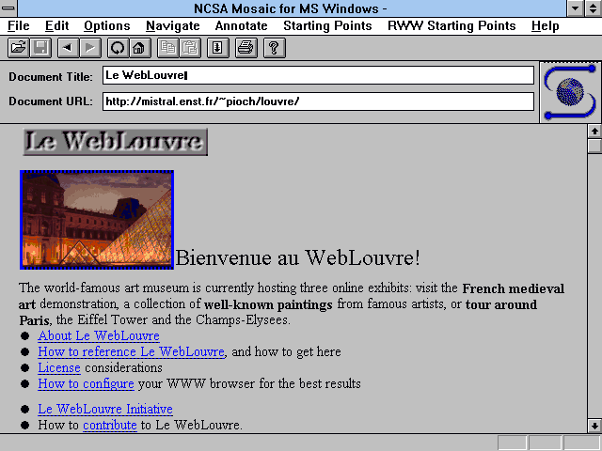
Notes:
This is an early example of Web content. this site was an early demontration of how the web could be used to deliver material with graphical content integrated into text pages. This site for the Louvre Museum from Paris was converted from a Gopher version on the information.

Slide 30
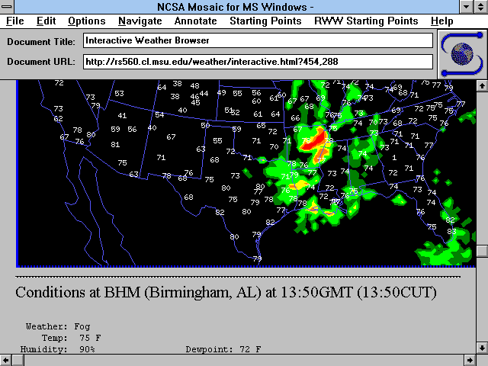
Notes:
The weather site at MSU was one of the first weather sites with real-time weather animation. For the first few years of the web revolution this was one of the top-10 sites in most lists. This site was developed by an undergraduate student at MSU called Charles Henrich After about four years, this site was retired in April 1997 after hundreds of millions of hits. So this slide is now an antique in the Internet sense.

Slide 31
Personal Publishing
First Web Servers supported “User Pages”
As many styles of user pages as there are people
  Serious publications
  “My Favorite Stuff”
  My views on whatever
  Family pictures
Notes:
The Web encourages individuals and organizations to put up data on the net
In a sense we have come full circle
We communicate person-to-person
We retrieve data/information from repositories
We ourself are a repository for the world, soon from our own desktop or dorm room!

Slide 32
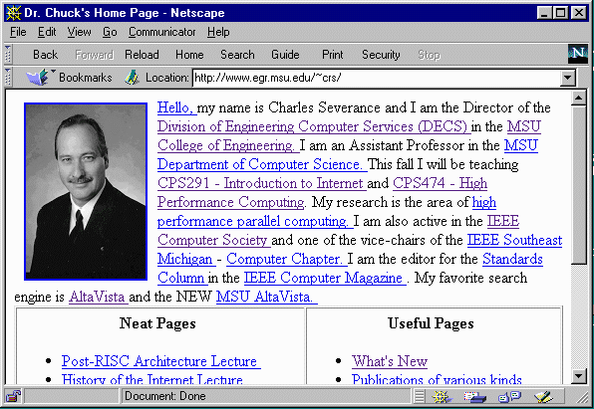
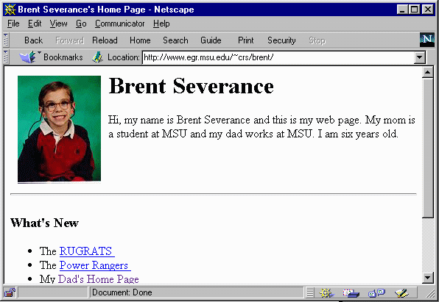
Notes:
This is Chuck Severance’s home page - It is a large but unexciting page including
Class notes
Papers
Family Pictures
Essays and Columns
Talks and Presentations
This page is designed to be my personal start page. The links I use the most are near the top.
For some other some home pages, see http://www.egr.msu.edu/~crs/school/cps291int/students.html

Slide 33
Internet Rush
People want to get on to “consume”
Some become producers
  Governments - Federal/State/Local
  Businesses
More producers make Internet more desirable - more consumers ...
URLs on TV fuels curiosity
Notes:
The Internet has become an essential element of modern companies marketing strategy. The ability of a company to taylor a message and have two-way interactions with their customers at a very low cost makes the Internet a valuable tool in a martketing strategy.
Today there are Internet sections in the paper yellow pages.

Slide 34
Internet As a Medium
The Internet has quickly evolved
  Experiment
  Gee-Whiz - It works
  CD-ROM Database
  A Publishing Medium
Many newspapers have E-Editions
  www.nando.com
  www.detnews.com
Notes:
Some good example newspaper sites:
www.nando.com
www.detnews.com

Slide 35
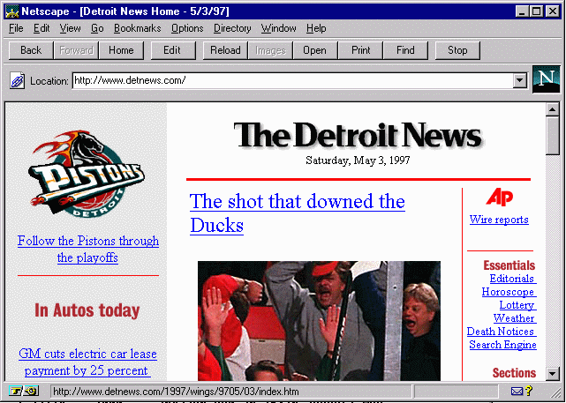
Notes:
For example:
http://www.detnews.com/

Slide 36
Java Programming
Most dramatic adoption of language in history - developed by SUN
JAVA is an evolutionary language - Similar to C++ with multimedia and network extensions
JAVA has the potential to be the most portable language in computing history - hardware vendors hate this
Notes:
JAVA was introduced in 1994 - It has been termed - “The most important Technology event after the Internet”. By 1994, journalists had all reported all about the “new internet” and gotten over it. In 1994, they were looking for the next story and JAVA popped up. It got a lot of hype and less than a year after its introduction, hundreds of books were written, colleges were teaching JAVA classes. A little over 500 days later, there were products which were based on this new language/operating environment.
http://java.sun.com/nav/whatis/index.html
While many are excited that JAVA is the language of the Internet, its greatest contribution might bethe fact that it is operating system independent. It is possible to write complete applications in JAVA - See
www.corel.com
For a JAVA word-processor which should run on any system.
Because of the fact that JAVA does not depend on the operating system, some computer vendors are concerned that they might lose market share. Expect to see competing products to JAVA to be developed to protect these market segments.

Slide 37
Browser Battles
Microsoft realized that the browser with JAVA could eventually make the operating system irrelevant
Software could run on any computer - not just computers which ran Microsoft operating systems
Microsoft Explorer - ActiveX
Notes:
While Netscape was a threat to the desktop interface, Netyscape+JAVA threatens all of the Microsoft product line. microsoft has added JAVA to microsoft Explorer, ext5ended JAVA and proposed ActiveX as another way to deliver network applications.

Slide 38
Summary
The current Internet trend is based on years of preparation
The Internet has the potential to have a large impact on our technology
The Internet would never have existed without Universities and research funding from Government

