Slide 1
HTML Overview
Material developed by Richard Wiggins
  http://www.msu.edu/staff/rww/
Presentation by Charles Severance
  http://www.msu.edu/~crs/

Slide 2
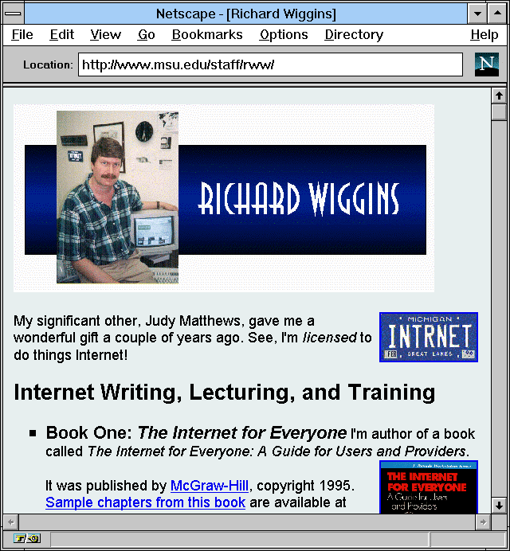
Personal Pages via the Web
Photos, resumes, papers, voices delivered on demand

Slide 3
Definitions
URL = text string that specifies a unique document
“Home Page” = beginning of a particular Web document or collection of documents
Web browser = a client program for navigating the Web, e.g.:
  Netscape
  Microsoft Internet Explorer
HTML = the language used to compose documents for Web delivery
HTTP = the protocol used by Web servers to deliver requested documents to Web browsers

Slide 4



HTTP versus HTML
HTTP governs how files move over the Web
HTML defines structure of Web documents
Web Server
User’s Web
Browser
The Internet
HTTP
session
HTML
docu-
ment
www.info.org
user.podunk.edu

Slide 5
HTML = Text plus “Markup”
Notes:
“Markup” is simply a specialized set of code words, or tags, that HTML authors use in preparing documents for the Web.

Slide 6
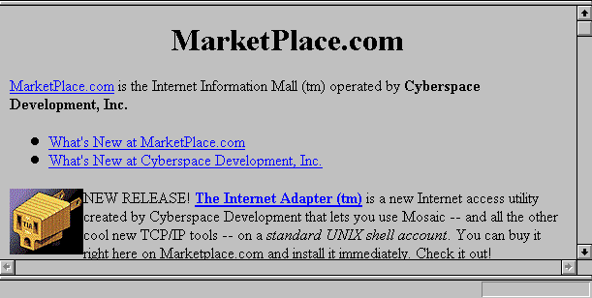
<H1><center>MarketPlace.com</center></H1>
<A HREF="http://marketplace.com:80/csd/development.html">
MarketPlace.com</A> is the Internet Information
Mall (tm) operated by <b>Cyberspace Development, Inc.</b>
<IMG ALIGN=LEFT ALT="" SRC="http://marketplace.com:80/
tia/TIA.1x1.4bit.COLOR.gif"> NEW RELEASE!

Slide 7
Preparing HTML Documents
Simple option: Edit documents by hand
  Use a text editor to manually edit your text and markup and save/upload
  Use Netscape (or other browser) to check your work as you go click “Reload”
“Authoring Tools” becoming popular
  Netscape
  Microsoft Word/PowerPoint/FrontPage
  Adobe PageMill
  Many Others
Notes:
See http://www.commtechlab.msu.edu/mig/Followups/webpub.html

Slide 8
HTML Layout: Some control, not total
You “mark” the logical elements of a document
  Paragraphs
  Headings
  Etc
Your user controls exact presentation by specifying browser options
When the user resizes windows, text is re-wrapped
How much control should be given to author?
  The <CENTER> tag
  Relative font tags
  The <BLINK> tag

Slide 9
Template Tags
<HTML>
<HEAD>
<TITLE>A Sample Document</TITLE>
</HEAD>
<BODY>
Document body
</BODY>
</HTML>

Slide 10
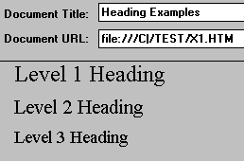
HTML Tags: Headings
<h1>Level 1 Heading</h1>
<h2>Level 2 Heading</h2>
<h3>Level 3 Heading</h3>

Slide 11
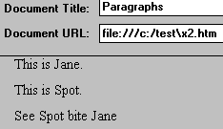
HTML Tags: Paragraphs
This is Jane.
<p> This is Spot.
<p> See Spot bite Jane </p>
Correct

Slide 12
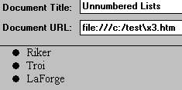
HTML Tags: Lists (Unnumbered)
<ul>
<li>Riker
<li>Troi
<li>LaForge
</ul>

Slide 13
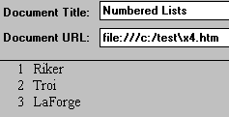
HTML Tags: Lists (Numbered)
<ol>
<li>Riker
<li>Troi
<li>LaForge
</ol>

Slide 14
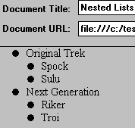
HTML Tags: Lists (Nested)
<ul>
<li> Original Trek
<ul> <li>Spock
<li>Sulu
</ul>
<li> Next Generation
<ul> <li>Riker
<li>Troi
</ul>
</ul>

Slide 15
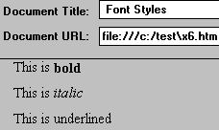
HTML Tags: Font Styles
This is <b>bold</b> <p>
This is <i>italic</i> <p>
This is <u>underlined</u> <p>

Slide 16

HTML Tags: Inline Images
<IMG ALIGN=LEFT
SRC="http://marketplace.com:80/tia/TIA.1x1.4bit.COLOR.gif">
NEW RELEASE!

Slide 17
Image Attributes
HEIGHT=n, WIDTH=n
  Allows browser to preallocate space for the image
  Speeds downloading
  Modem friendly
  Use with caution
ALT=txt
  Useful for blind users with “talkers”
  Also useful for slow modem users
ALIGN= [TOP, BOTTOM, RIGHT, MIDDLE]

Slide 18

HTML Tags: Links to Other Documents
generally known as Anchors
<A HREF="http://marketplace.com:80/csd/development.html">
MarketPlace.com</A>
is the Internet Information
Mall (tm) operated by
<b>Cyberspace Development, Inc.</b>

Slide 19
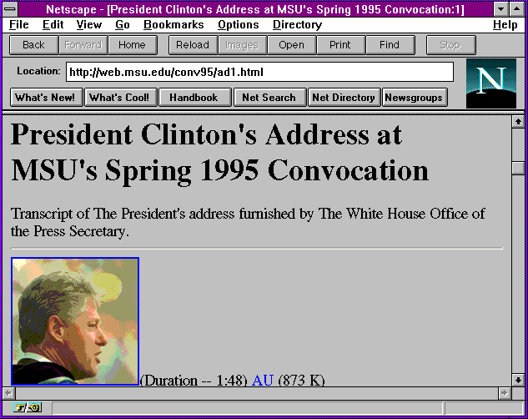
HTML Tags: Inline Images as Anchors
<a href="clinton1.gif">
<img src="clin_sm1.gif">
</a>

Slide 20

HTML Tags: <HR>
Following this line is a horizontal rule.
<hr>
Preceding this line is a horizontal rule.

Slide 21

HTML Tags: <ADDRESS>
<ADDRESS>
Rich Wiggins <br>
wiggins@msu.edu
</ADDRESS>

Slide 22

HTML Tags: <mailto:>
Would you like to send some e-mail
to <a href="mailto:wiggins@msu.edu">
Rich Wiggins</a>? Do so now!

Slide 23
HTML Tags: Comments
<!-- Sometimes you want to
insert comments inside a document. -->

Slide 24
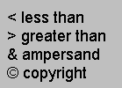
HTML Tags: Escape Characters
&lt less than <br>
&gt greater than <br>
&amp ampersand <br>
&copy copyright <br>

Slide 25
Background Colors
<body bgcolor="#E5E9EE">
Component
colors specified
as hexadecimal
numbers, 2 digits
for each color...
Red
Blue
Green
<body bgcolor="#FFFFFF"> = white background

Slide 26
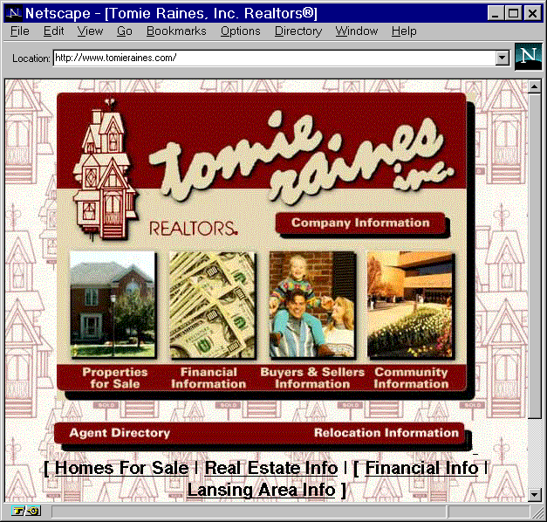
Background Images
<BODY background=
"/images/paper.jpg"
bgcolor="#FFFFFF"
text="#000000" >
Meaning:
White background
with black text
and with the image
stored as “paper.jpg”
as a repeating
background
element...

Slide 27
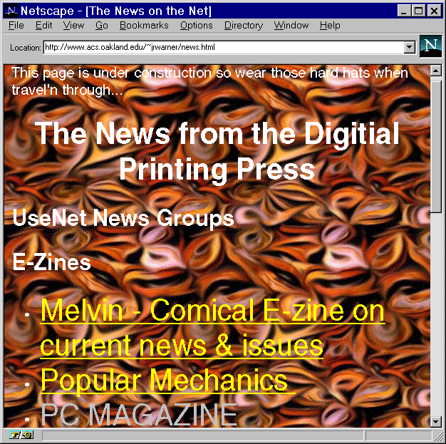
Beware of Hideous Backgrounds

Slide 28
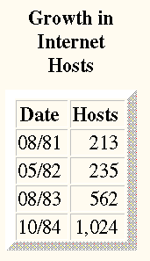
HTML Tags: <TABLE>
<html>
<body>
<table border=10 >
<caption><b>Growth in Internet Hosts</b></caption>
<tr> <th> Date </th> <th> Hosts </th> </tr>
<tr align=right> <td> 08/81 </td> <td> 213 </td> </tr>
<tr align=right> <td> 05/82 </td> <td> 235 </td> </tr>
<tr align=right> <td> 08/83 </td> <td> 562 </td> </tr>
<tr align=right> <td> 10/84 </td> <td> 1,024 </td> </tr>
</table>

Slide 29
Meta Tags - Redirect
<HEAD> <TITLE>Dr. Chuck's Other Home Page</TITLE>
<META HTTP-EQUIV="refresh” CONTENT="5;URL=http://www.egr.msu.edu/~crs/">
</HEAD>
<body bgcolor="#FFFFFF">
<H1>Charles Severance's <br> Other Home Page</h1>
Hello, you have arrived at one of my "other" home pages.
My real home page is at
<a href=http://www.egr.msu.edu/~crs/>
http://www.egr.msu.edu/~crs/</a>
and if things work well you will be sent there in
five seconds 5... 4... 3... 2... 1...
</body>

Slide 30
More Meta
You can control how a page is indexed using META
  <META name="description"
  content="We specialize in grooming pink poodles.">
  <META name="keywords" content="pet grooming,
  Palo Alto, dog">
Notes:
http://searchenginewatch.com/fchart.htm
http://searchenginewatch.com/ekg1.htm

Slide 31
Building an HTML Document
Use all of these possible elements
And others...
To build your documents according to your style
It’s much easier than it may appear at first

Slide 32
HTML Preparation Tips
Tip: Find documents that are similar to the ones you want to put online
... then use View Source to save the other document as a template
Tip: Edit your document in one window;
  Use “Reload” option
Be sure to view your document on multiple platforms:
  Different video cards
  Different Web browsers

Slide 33
HTML Tips (Cont’d)
Consider low-bandwidth users
  Use thumbnail images that link to larger images
  Give file sizes on links to large documents
  Minimize number of separate inline images in a document
Consider Lynx users:
  Use the ALT construct:
  <IMG SRC=“flower.gif” ALT=“[Yellow Rose]”>
  Offer menus as an alternative to any image maps

Slide 34
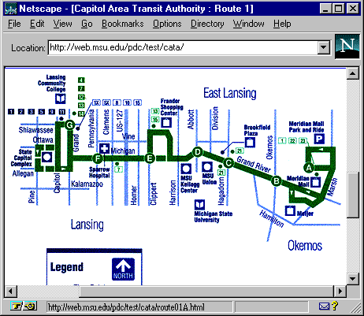
Image Map Example
<map name="r1">
<AREA SHAPE="RECT"
COORDS="367,90 432,134" HREF="route01A.html">
<AREA SHAPE="RECT"
COORDS="327,113 366,175" HREF="route01B.html">
<AREA SHAPE="RECT"
COORDS="273,96 305,146" HREF="route01C.html">
...
</map>

Slide 35
Design Issues
People expect high quality graphics
.... but beware of glitz
Don’t forget the user on older quipment...
...or slow modems
Avoid designing for the machine on your desktop
Beware of designing pages that only work with the latest version of Netscape
Avoid excessive use of harsh color, complex backgrounds

Slide 36
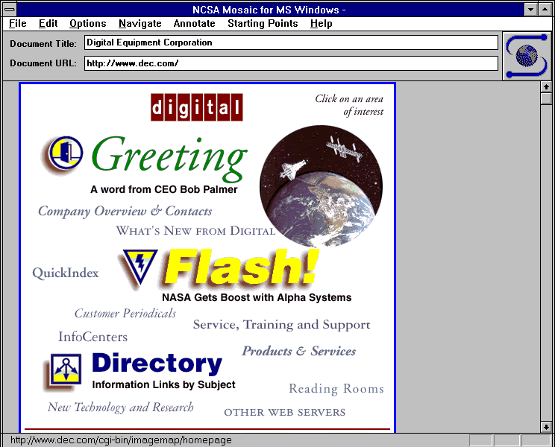
Content vs Glitzy Presentation

Slide 37
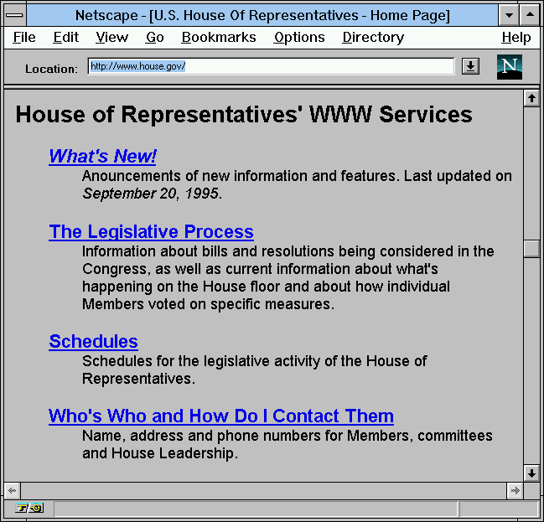
The Courage to Avoid Glitz

Slide 38
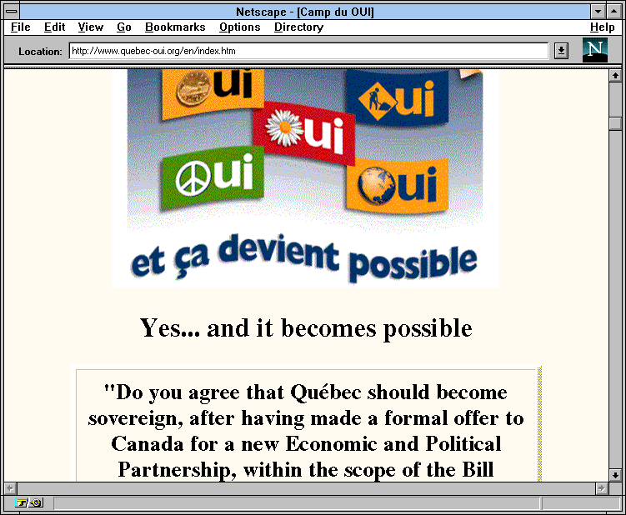
Carry a Theme Through Your Pages

Slide 39
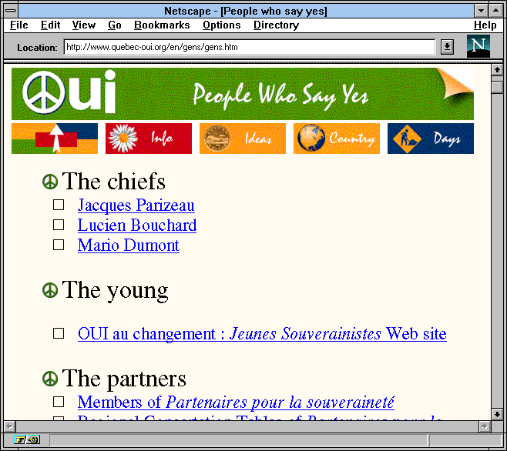
...Consistent Themes Help Provide Context

Slide 40
Style: To Link or Not To Link
Don’t add a link every time a common phrase appears
Your pages will look like Christmas trees...
... and will be impossible to read
Consider a “Return to Home Page” link on every page
Avoid internal links within a single page
  Very confusing to readers
  Is it a link to a new page, or to part of this page? Hard to tell..

Slide 41
Style: Label Links Naturally
Explore our Online Photo Gallery
Read about today’s ski conditions
...not...
If you want to see today’s ski conditions, click here

Slide 42
Style: Don’t Force HTML
Don’t use the <BR> tag excessively
  And don’t use it to simulate word wrap!
  Your video setup is not the same as your readers!
Go easy on the <HR> tag
Be judicious in use of Netscape font extensions
  If at all
Don’t <BLINK>

Slide 43
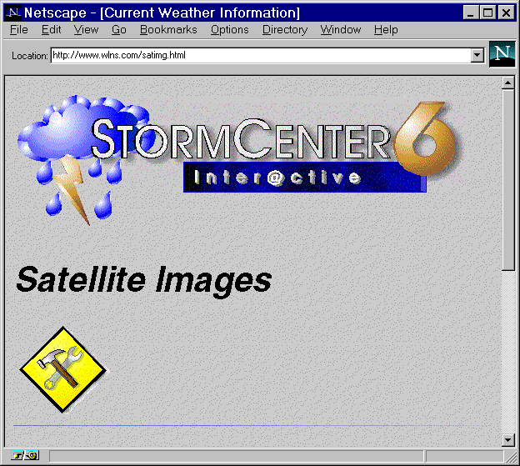
Style: No Dead Ends!
Don’t add a link if the document doesn’t exist!
The whole Web is under construction; why bother labeling your service as such?

Slide 44
Style: Keep Inline Logos Simple
Consider very small logos
Try to keep logos < 500 or so pixels wide
Excellent examples:
  Lycos
  Yahoo
  Netscape
  UCLA

Slide 45
Style: Don’t Design for Your Desktop
Try viewing your pages with other browsers...
  Older Netscapes
  Mosaic
  AOL, Prodigy
  Lynx
  Turn off Images
... At other screen capabilities:
  640 X 480 instead of 1024 X 768
  256 (or even 16) colors instead of 16-bit

Slide 46
Style: Be Modem Friendly
Use small inline images
Provide thumbnails that point to larger images
Keep number of inline images on a page small
  Consider image maps instead of multiple images
Label your links that point to large files
  E.g. Clinton Speech (1400K .wav file)

