Slide 1
Images
Dr. Charles Severance
(portions adapted from Richard Wiggins’ materials)

Slide 2
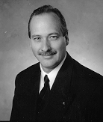

Images in Computers
To store images in computers they are broken into Pixels - Picture Elements
The “size” of a pixel
is determined when
the image is created
An example of
pixel size would be
75 “dots-per-inch”

Slide 3
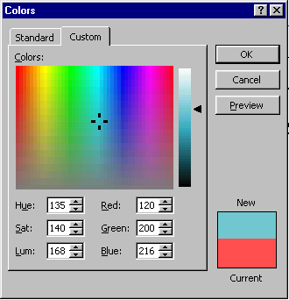
Red, Green, and Blue
By varying levels of Red, Green and Blue, each pixel can have a wide range of colors
Play with the color selector
in a word-processor
In this example, each color
is represented by a number
from 0-255

Slide 4
Image Compression
When files are sent across the network, file size is important
Because images have a lot or repetitive, redundant or unnecessary information, they can be compressed using several techniques

Slide 5
Image File Formats
There are a number of popular image formats
  TIF - Tagged Image File Format
  JPG - Joint Photographic Experts Group
  GIF - Graphics Interchange Format
  BMP - Bit MaP - Windows format

Slide 6
Tagged Image File Format
This is generally a raw, uncompressed format
24 bits of data are used for each pixel
Each pixel is stored separately
A full screen image (640x480) would be 1 Megabyte - It would fill a floppy disk and take several minutes to download over a modem
Often produced by scanners

Slide 7
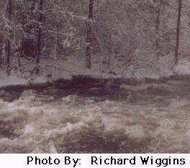
Joint Picture Experts Group
JPG (or JPEG) is designed to compress photographic material
Photographs often have many colors which are very similar
JPEG can highly compress
an image by discarding
detail which is “not visible”
Can introduce “artifacts”
in high-contrast material

Slide 8
Graphics Interchange Format
Developed (and patented) by Compuserve/Unisys
Designed for computer graphics
256 Distinct Colors
Compression uses “Run-Length-Encoding”
10
4
6

Slide 9
GIF Features to Explore
Transparency
  Pick a color in your image to render as transparent
    E.g. the wall behind a human subject
  The picture will blend into the Web page
Animation
  This is how banner ads work
  Very easy to set up
Many image editors can handle transparency and animation

Slide 10
Up Next:
Getting Images
Continue

Slide 11
Getting Images
From the web or from a library
  Right click trick
Create them in a draw program
Input a digital image
  Digital cameras
  Scanners
  Photo Floppies or Photo CD
  Develop to the Web

Slide 12
A Word About Copyright
Most content on the Web is copyrighted
The copyright symbol © is not required
It is generally not acceptable to republish text and images from Web sites -- nor from books, magazines, etc.
  Even if your use is non-profit
Civil and criminal penalties apply
Get permission, or don’t do it!
Note: This slide is Copyright 1998, 1999 Richard Wiggins, used with permission :)

Slide 13
Working With Images
Get a good image editor
  Paint Shop Pro (shareware)
  Lview Pro (shareware)
  Adobe Photoshop
  Adobe Photodeluxe
    A stripped-down version of Photoshop
    With many user-friendly features and effects
    Included with many scanners
  Corel PhotoPaint

Slide 14
What Image Editors Can Do
Convert among various formats
Rotate images
Resize or crop images
  Standard video monitor is at least 640 X 480 pixels
Adjust contrast, brightness, number of colors
Add text, even combine images
Apply a variety of special effects

Slide 15
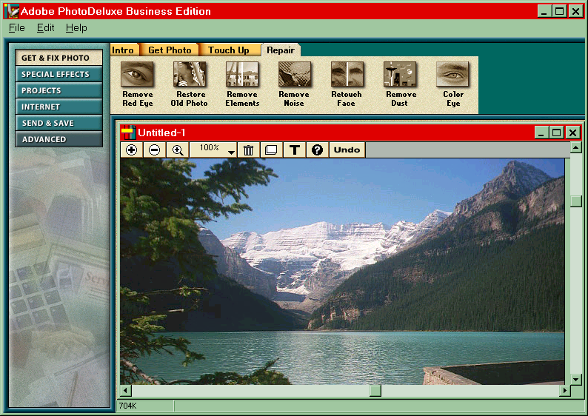
Adobe PhotoDeluxe Example
Note: This slide is Copyright 1998, 1999 Richard Wiggins, used with permission :)

Slide 16
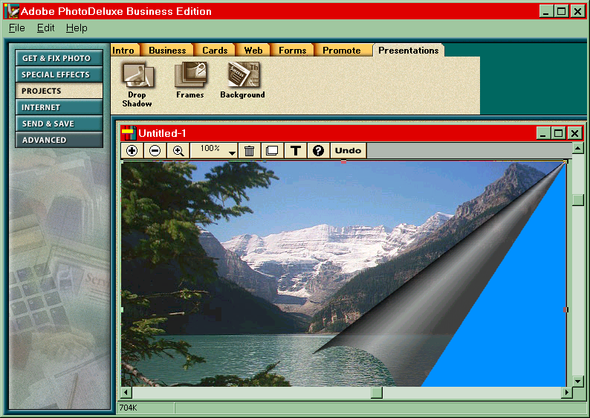
PhotoDeluxe Effects
Note: This slide is Copyright 1998, 1999 Richard Wiggins, used with permission :)

Slide 17
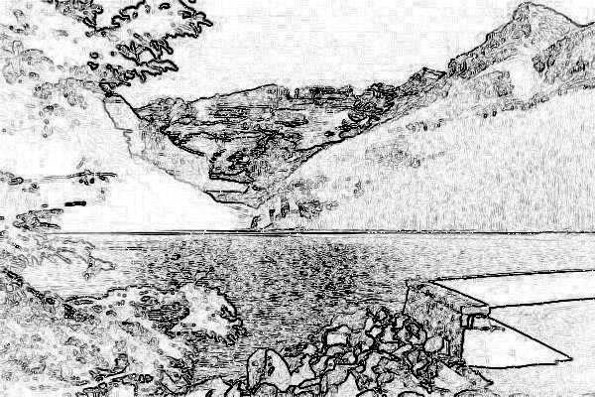
PhotoDeluxe "Sketch" Effect
Note: This slide is Copyright 1998, 1999 Richard Wiggins, used with permission :)

Slide 18
Image Size Matters
Reduce your image to the minimum possible to convey your meaning
  A 100 kilobyte image is too large!!!
  Reduce size of image
  Reduce number of colors in image
  Use a GIF optimizer in image editor
Use thumbnails instead of full-size images
  Thumbnail is small, points to larger image

Slide 19
Up Next:
Putting Images into Web Pages
Continue

Slide 20
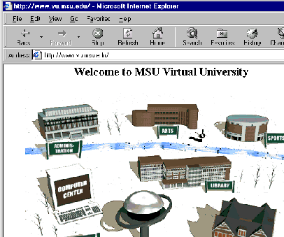
The IMG Tag
We use the IMG tag to include images into our web pages
In this example, we use a relative link so the image must be in the
same directory as the
HTML file
Welcome to MSU Virtual University
<P>
<img src="win_day.gif" >

Slide 21
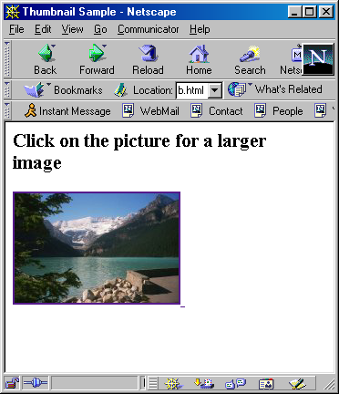
"Thumbnail" Concept
You can use an image as an HREF in an anchor <A …> tag
You can use the image as
as the “clickable” element
in an anchor TAG
This can be used to show
a “thumbnail” of an image
in the main page
Click on the picture for a larger image <p>
<a href=“large.jpg”>
<img src=“small.jpg”>
</a>

Slide 22
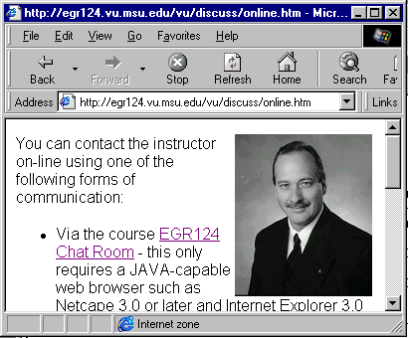
More IMG tag Stuff
Border=0 removes the line around the image when it is in an anchor tag (i.e. Clickable)
Align=Left or Align=Right allows the text to flow around the image
<a href=http://www. msu.edu/~crs/>
<img src=crs.gif align=right border=0>
</a>
You can contact the instructor on-line using …..

Slide 23
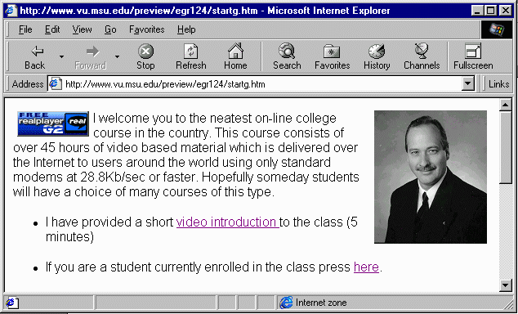
Images, Align, and
HREFs (Oh My!)
<a href=“http://www.real.com/”>
<img src=“freeplayer_g2.gif” align=left
hspace=5 border=0
alt="RealVideo Enabled!">
</a>
<a href=“http://www.egr.msu.edu/~crs/”>
<img src="crs.gif" align=right alt="Dr. Chuck”
hspace=5 border=0>
</a>
<p>
I welcome you to
the neatest on-line
college course in
the country. ...

Slide 24
More Options on IMG
HEIGHT and WIDTH
  Speed the display of the page
  Can stretch or shrink the image for display if they do not match the actual height and width of image
USEMAP
  Specifies the client side image-map to be used to create clickable areas within an image
ALT
  text to be displayed if images are not loaded or while an image is loading

Slide 25
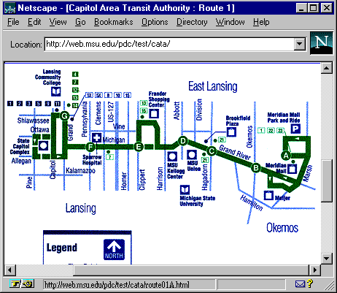
Image Map
Example
<map name="r1">
<AREA SHAPE="RECT"
COORDS="367,90 432,134" HREF="route01A.html">
<AREA SHAPE="RECT"
COORDS="327,113 366,175" HREF="route01B.html">
<AREA SHAPE="RECT"
COORDS="273,96 305,146" HREF="route01C.html">
...
</map>

Slide 26
Summary
Images are what makes the “World-Wide-Web go around”
Working with images can be a lot of fun
It is pretty easy to get started
You can develop skills to a point where you work with digital images and software for a living as a graphic artist

