Slide 1
Using Basic Internet Tools
Charles Severance
Notes:
In this lecture we explore the basic tools used for working on the Internet.

Slide 2
Basic Tools
Telnet - log in to a computer - text mode
Electronic mail - elm
Electronic mail - POP
FTP - File transfer
Web Browsers
Web Publishing
Notes:
POP = Post Office Protocol

Slide 3

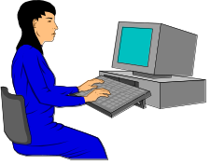

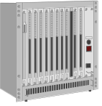
Telnet - Connect Text Mode
Telnet is one of the classic applications
It is a terminal emulator which works over a network connection
TCP/IP Network
RS-232 Cable
VT100 Terminal
Telnet
Notes:
In this lecture we explore the basic tools used for working on the Internet.

Slide 4
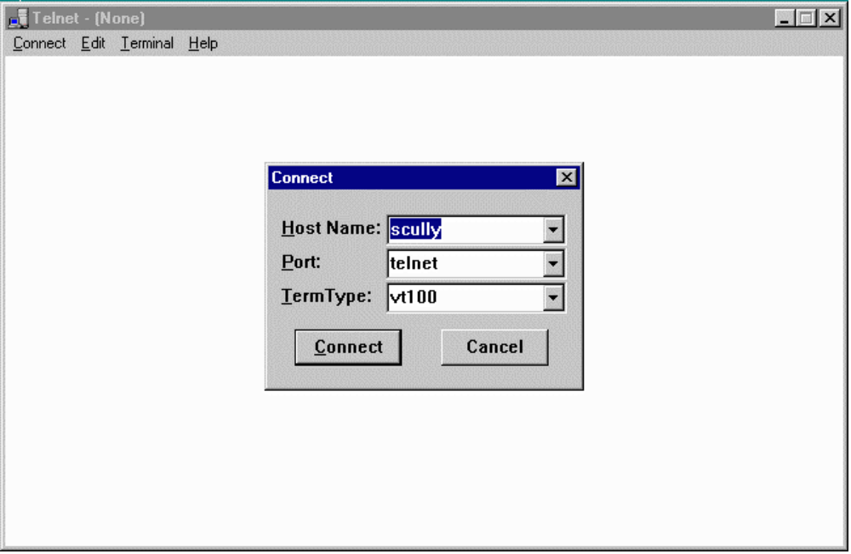
Notes:
To use telnet, you must first start it up. One Windows-95, use Start | Run and then type in telnet. It should bring up a window. Then use Connect | Remote System and then type in the name of the system such as pilot.msu.edu and press Connect.

Slide 5
The UNIX System
Often telnet connects to a UNIX system
Can be in line mode ala MS-DOS
SunOS/scully 3% ls
CSACMailList calendar ed projects tmp
LIST cefile.hang faculty public upload
Mail cps291 manage qqq web
bin download phones school
SunOS/scully 4% date
Tue Feb 4 09:06:55 EST 1997
SunOS/scully 5% uptime
9:07am up 11 day(s), 45 min(s), 17 users, load average: 5.25
SunOS/scully 7% /usr/sbin/ping www.cs.stanford.edu
labrea.Stanford.EDU is alive
SunOS/scully 8% elm
Notes:
In this lecture we explore the basic tools used for working on the Internet.

Slide 6
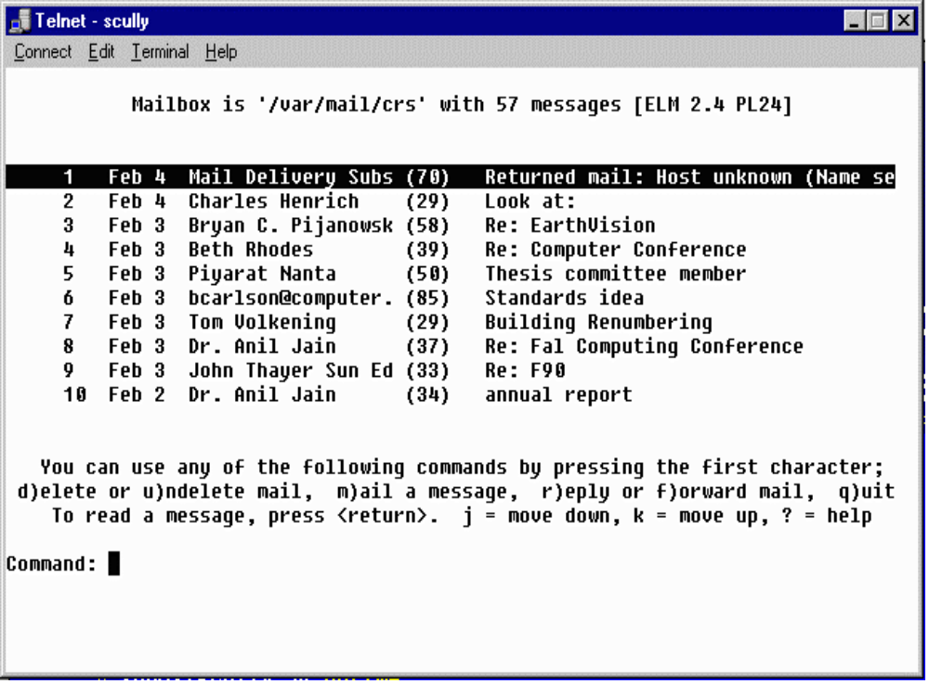
Notes:
In telnet screen mode, programs such as elm, vi or emacs, use cursor positioning sequences to draw text at various locations on the screen and read the keyboard, interpreting cursor and function keys as necessary. This creates the appearance of a “full-screen”.

Slide 7
Electronic Mail
Largest use of Internet for many years
Electronic Mail is very reliable
  Delivered off-line if necessary
  If a connection is down, E-Mail will be stored and retried later
E-Mail only works when it is read regularly
Notes:
The most fundamental form of interpersonal communication over the Internet is E-Mail. Because E-Mail is not instantaneous communication, it can function on low-speed unreliable networks quite effectively. Before the Internet, many users used a network called UUNET for E-Mail. UUNET did not depend on the network being up continuously. Periodically, each system would dial-up its neighbors and transfer any queued mail to the next system. Eventually mail would arrive at its destination, sometimes taking as long as a week.
One the Internet, systems attempt to deliver E-Mail even when there are partial network outages. Since mail messages are relatively small, if a message cannot be immediately transferred to its designation, it is saved on the local system. After some time period (typically 1/2 hour) the transfer is tried again. This makes E-Mail one of the most reliable activities on the Internet.
When E-Mail usage moved form UUNET to the Internet, the Mail was generally delivered directly to the final destination across the Internet.
One observation is that E-Mail is not much use if you have to call someone to tell them to read their mail. However at some point people read E-Mail so often that it is the fastest way to contact them if they don’t pick up the phone. It is often faster than leaving voice mail or a message on an answering machine

Slide 8
E-Mail Addresses
E-Mail addresses consist of a account name and an Internet Domain Name
  crs@egr.msu.edu
E-Mail addresses are like phone numbers - on your business card
Account Name
Domain Name
Notes:
An E-Mail address is a precise way to contact a person. As long as your mail system supports Internet style addresses if someone types that address into their mail program you will get the information. Mail addresses are unique across the Internet. In a sense it is like a pager number.
Often people put their E-Mail addresses on business cards and other forms of correspondence to allow people to contact them easily.
E-Mail addresses are VERY precise - much like phone numbers. crs@egr.msu.edu is not the same as chuck@michigan.state.university or dr.chuck@msu. A single typo nearly always makes the E-Mail addresses incorrect and the resulting mail undeliverable.
Using a technique called “mail forwarding” a user may actually have several working E-Mail addresses:
20095crs@ibm.cl.msu.edu (1987)
crs@cps.msu.edu (1988)
crs@egr.msu.edu (1988)
crs@convex.cl.msu.edu (1989)
crs@msu.edu (1991)
crs@clunix.msu.edu (1992)
As a person moves form computer to computer, they collect addresses.

Slide 9
Reading E-Mail
Terminal-style interfaces
  Read mail on the Internet connected server
  Store folders on the server
  Must use text editor on server to compose messages
Post Office Protocol on PC’s
  Much more convenient - Mouse
  PC’s may be turned off or disconnected
Notes:
Originally, we read mail on an Internet connected server. The mail would be delivered to the server, and then periodically we would log-in and run the mail program. This has a few drawbacks, in that it does not take full advantage of the capability of the PC. A PC has a mouse, can select text, and is relatively easy to learn to write documents.
To take advantage of PC capabilities, the server is used as a post-office to hold the messages until the PC user is ready to read the messages.

Slide 10
E-Mail Settings @ MSU
Pilot - Text based - uses elm
  telnet pilot.msu.edu
Pilot also supports POP access
  POP server: pilot.msu.edu
  SMTP server: pilot.msu.edu
  POP account and password are the same as your pilot ID
Other departments have other systems

Slide 11
Mailbox is '/var/mail/crs' with 57 messages [ELM 2.4 PL24]
1 Jan 18 Castillo Zacatelco (32) Help me ..!!!
2 Jan 18 Mark A. Hunter (38) IEEE/SEM Web Page
3 Jan 18 Marshall D. Hesten (29) Web Version of CPS 291
4 Jan 18 Marshall D. Hesten (34) Zoom Text in 220 Egr
5 Jan 18 Jeff Evans (32) Re: not making the 10:20
6 Jan 17 David J Fitzgerald (90) How to get the money!!??
7 Jan 17 David J Fitzgerald (64) Funding Proposal
8 Jan 17 Alejandro Diaz (144) Computing Services Advisory Committe
9 Jan 17 George.Van_Dusen (25) Engineering Fee
10 Jan 17 Bernie G Holmes (54) APP&R Budget Suggestions
You can use any of the following commands by pressing the first character;
d)elete or u)ndelete mail, m)ail a message, r)eply or f)orward mail, q)uit
To read a message, press <return>. j = move down, k = move up, ? = help
Command: Quit
Folder unchanged.
SunOS/scully 6%
Notes:
This is an example of a screen capture of the program called elm. This program is currently in use in the Pilot project at MSU where 60000+ faculty, staff, and students read E-Mail using UNIX servers.
Another popular text oriented mail reader is called “pine”.
While these types of interfaces are not flashy and can be difficult to learn, they can be used from any type of computer including a handheld computer with a modem.
Often text-based interfaces such as these are very effective for persons with sight limitations.

Slide 12
Post Office Protocol (POP)
With PC’s people like “pointy-clicky”
PC’s are not always ready to receive
POP uses a server to accept mail
When PC starts up, mail is downloaded from the server
Ease of editing
Attaching a binary file
Notes:
Because a PC may be shut off when a person leaves the office or it may not be connected to the Internet when the modem is not dialed, it is not practical to deliver directly to a PC. Typically the mail is delivered to a server permanently attached to the Internet This way, the mail can be delivered the instant the sender completes the message. When the receiver starts their system, it downloads the mail from the server to be read.
This is called the post office protocol because it is very similar to having a Post Office Box. You do not have to be present when the mail is delivered into the box. You stop in at your convenience and pick up the mail which has been placed in the box.

Slide 13
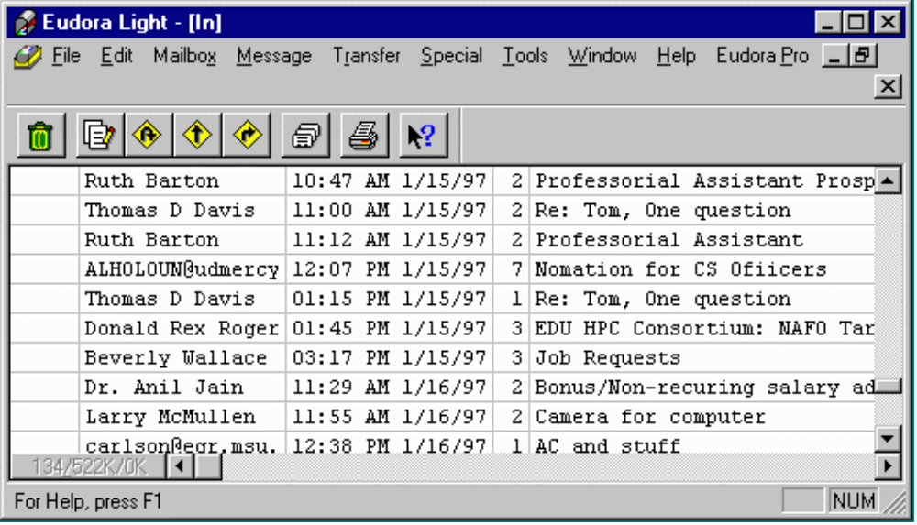
Eudora
Notes:
In this lecture we explore the basic tools used for working on the Internet.

Slide 14
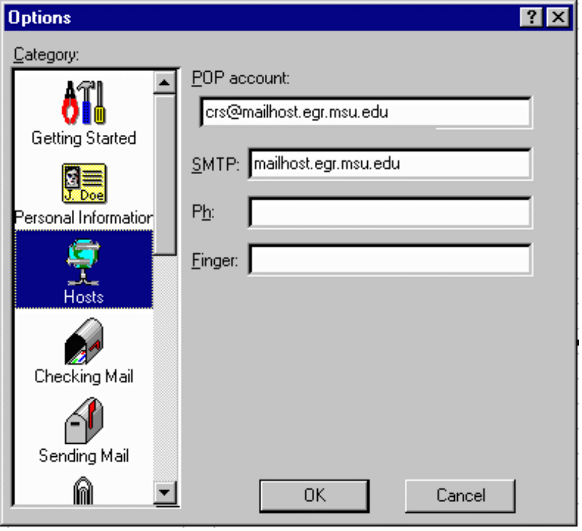
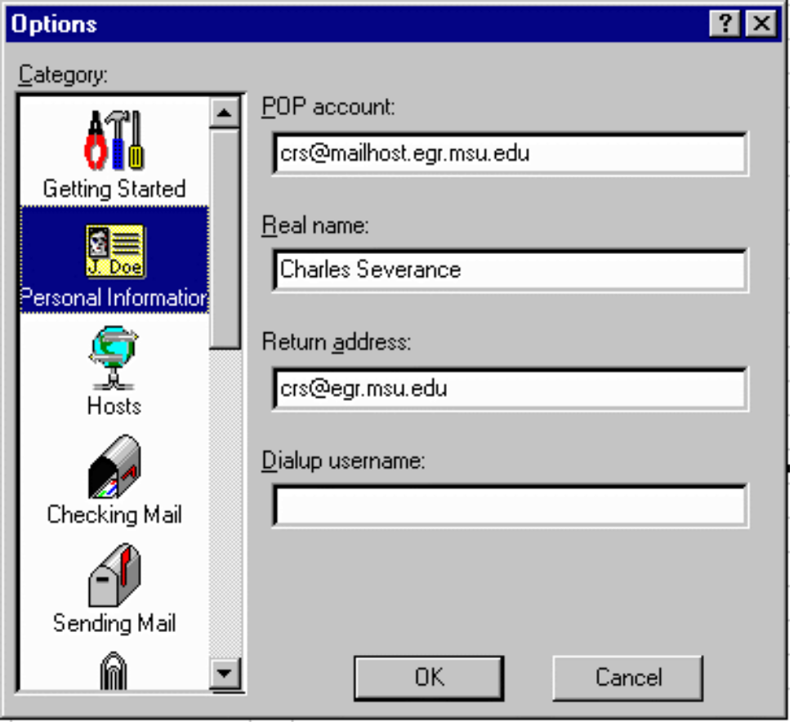
Configuration
Notes:
In this lecture we explore the basic tools used for working on the Internet.

Slide 15
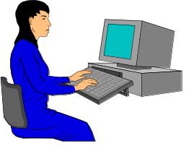

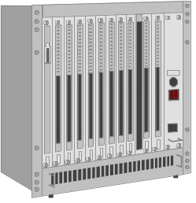
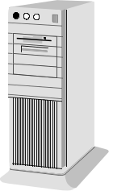

POP Operation
Eudora
Post Office Protocol
“Post Office”
mail.egr.msu.edu
SMTP - Mail Transfer Protocol
elm
Notes:
In this lecture we explore the basic tools used for working on the Internet.

Slide 16
Attachments
An advantage of using POP for both sender and receiver
Similar to sending a file on a floppy
MIME - Good for PC - Use when unsure
binhex - Good for Mac
uuencode - Good for UNIX
Can have viruses - JUST like a floppy
Notes:
One of the most convenient capabilities of E-Mail is the capability of sending attachments. With an attachment, you compose a short message like, “Johnm here is the spreadsheet”, then “attach the .XLS file to the mail message. When the message is received, the mail program allows the contents to be saved to disk.
One problem with attachments is that there are too many types. Each mail reader seems to have its favorite type and can read a few of the other types. Unfortunately not all reader programs can read all types.
Saving an attachment is like reading a disk of a floppy. It can contain a virus which would negatively affect the performance of your system. Top end virus checking software automatically checks incoming attachments for viruses.

Slide 17
Problem with POP
Incoming messages
  Copied to Hard Disk - If you use one PC
  Leave on Server - If move from PC to PC
Folders - “All my mail from Wiggins”
  Kept on Hard Disk
A protocol called IMAP keeps both folders and incoming mail on the server
Notes:
POP is a great solution to allowing PC users to read their mail using graphical programs. However a problem occurs when a user often moves from one PC to another regularly. When the user moves, the messages stored on the local disk do not move with the user. One solution is to configure Eudora to leave the messages on the server but that still does not solve the problem of “folders”.
Folders are where a user stores a message for reference. For example, it is common to create a folder for a topic such as “Every message sent to me regarding the cps291 class”. These folders are stored on the hard disk and do not follow a moving user around.
A solution to this problem is a new “post-office” protocol called IMAP. IMAP can store all messages and all folders on the server to allow completely movable users.

Slide 18
FTP - File Transfer Protocol
Used to transfer files
Can be used to convert text files
  ASCII <-> EBCDIC (Mainframe)
  Line-Ending - DOS/Mac/UNIX/VMS
Many programs do FTP
  Netscape - downloads - ftp://ftp.msu.edu/
  Win-95 ftp.exe - simple command mode
  WS_FTP32 - Nifty screen mode FTP
Notes:
FTP is the most basic tool for moving bulk data between two systems. You can either use a command mode FTP which comes on UNIX or Windows-95 or a screen mode FTP such as Fetch (for Macs) or WS_FTP32 (for Windows-95). Regardless of the interface, all FTP programs have the same goal of getting data from one system to another by either “uploading” (or “put”ing) or downloading (“get”ing) a file.
FTP handles data conversions for text files and has a binary mode for raw data files such as image files.

Slide 19
Command Mode FTP
open pilot.msu.edu
cd dir
lcd directory
put localfile [remotefile]
get remotefile [localfile]
ascii (use for .html .txt .c files)
binary (use for .gif .jpg .doc .zip files)
mput *.c
pwd
bye
Notes:
mput stands for “multiple put” and it accepts wildcards. There is also a “delete” command, “rmdir”, and “mdel” command to delete files while connected via FTP.

Slide 20
FTP to Pilot Space
C:\CLASS > ftp pilot.msu.edu
Connected to pilot.cl.msu.edu.
220 pilot.msu.edu FTP server (Version wu-2.1c(17) Fri Jan 21)
Name (pilot:sparty): sparty
331 Password required for sparty.
Password: [Type in your password. It will not be displayed.]
230 User sparty logged in.
ftp> cd web
ftp> put index.htm
200 PORT command successful.
150 Opening ASCII mode for index.htm (9286 bytes).
226 Transfer complete.
9286 bytes transferred in 0.0724 seconds (133.9 Kbytes/s)
ftp> quit
221 Goodbye.
Notes:
It is important to be in the proper “local” directory and the proper “remote” directory “remote” directory before you transfer the files. For example, lets say you saved a picture to “me.gif” in the \temp\photos directory on your hard disk and you wanted to upload it to your main web space in the web subdirectory of your home directory on the server. It would work something like this:
ftp pilot.msu.edu
(log in)
lcd \temp\photos
cd web
binary
put me.gif
quit
Before the put command you moved into the proper directory on the hard disk, the proper directory on the server, and set the mode to binary before actually transferring the data.

Slide 21
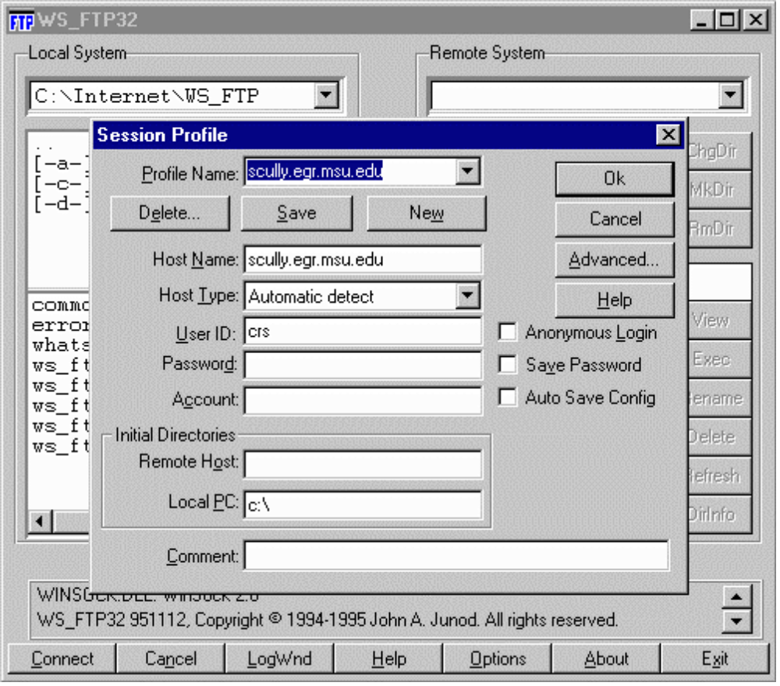
WS_FTP32
Full Screen
Can send
an entire
directory
Very
convenient
Notes:
In this lecture we explore the basic tools used for working on the Internet.

Slide 22
What is a Browser?
Netscape Navigator/MS Explorer
  Netscape includes a POP mail program
Retrieves, Converts, and Displays
It is our view of the Web
It is a program (netscape.exe)
It requires a working network connection (LAN, PPP, etc.)
Notes:
A browser is the program which is used to “view” the contents of the World-Wide-Web.

Slide 23





Browsing the Internet
Browsers use
many protocols
Notes:
In this lecture we explore the basic tools used for working on the Internet.

Slide 24
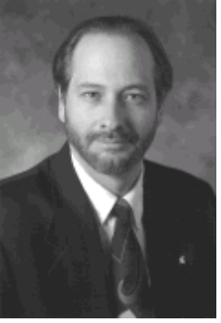
URL - All About Data
How to
Display the
data
Where to
get the data
http://www.egr.msu.edu/~crs/crs.gif
How to
retrieve the
data
What data
to get
Notes:
In this lecture we explore the basic tools used for working on the Internet.

Slide 25
Which Browser?
http://www.webtrends.com/ - Jan 1997
  Netscape 65.89
  Microsoft Internet Explorer 31.24
  The Rest 2.87
http://www.cen.uiuc.edu/~ejk/bryl/951109.html
  Netscape (Windows) 54.5
  Netscape (Macintosh) 17.4
  Netscape (X11) 5.5
  Lynx 4.7
  Microsoft Explorer 3.6
Notes:
There has been a continuous battle to determine the best browser. At the end of 1995, Netscape was the king of browsers but there were about 30 other browsers which people were actively using. By the beginning of 1997, the competition had whittled down to Netscape and Microsoft Explorer with all of the remaining systems totaling less than 4%. In 1995 nearly 5% of the users were using a text-based browser called Lynx.

Slide 26
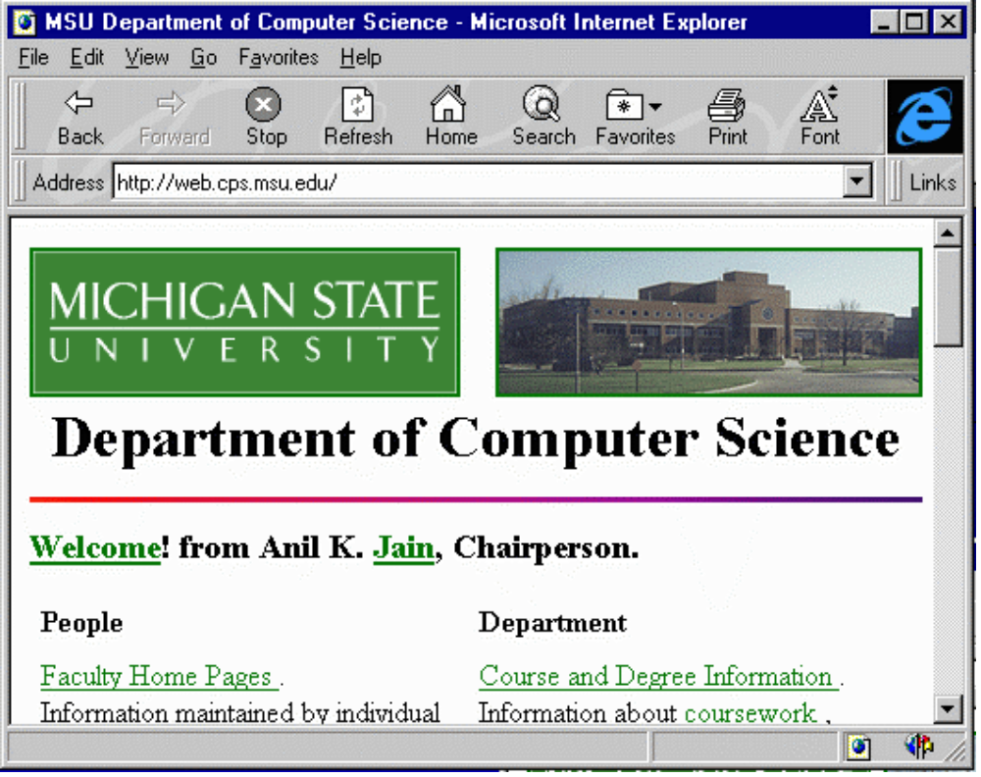
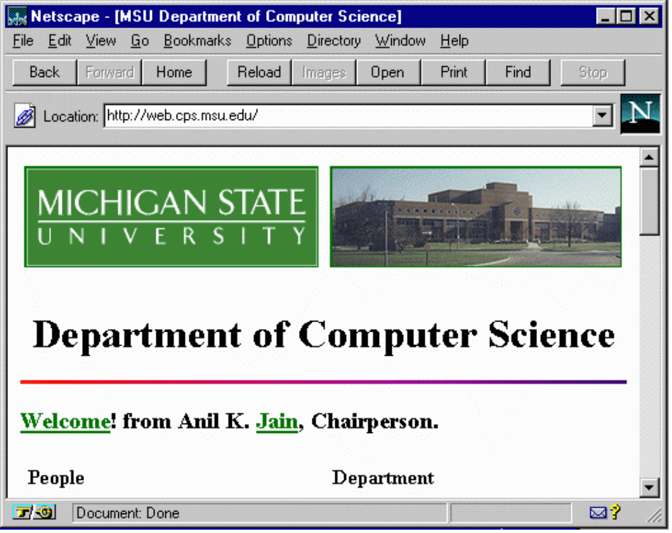
Browser .vs. Browser
Notes:
In this lecture we explore the basic tools used for working on the Internet.

Slide 27
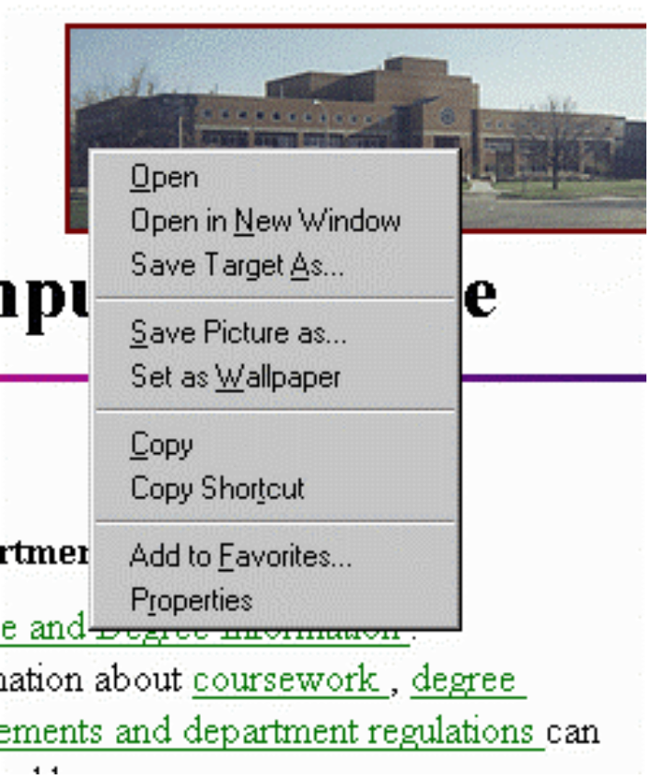
Browser Trick
Learn the “Right
Finger Click” - Allows
you to have flexibility
in what you do with
images or
downloadable
information
Notes:
In this lecture we explore the basic tools used for working on the Internet.

Slide 28
Configuring the Browser
Netscape - Options/Preferences
Explorer - View/Options
Change fonts, colors, security, start page, search page, network usage, proxy addresses, helper applications, viewers, screen layout, cache settings, image autoloading, etc..
Configure the POP and NEWS settings
Notes:
You will often have to change the settings in your browser. Other things you can do is set up helper applications, or clear your network cache.
See also
http://www.vu.msu.edu/preview/cps291/faq/plugins/
http://www.vu.msu.edu/preview/cps291/faq/uninstall/
As an exercise, see if you can clear your network cache. In netscape, it is under Options | Network Preferences | Cache
In Microsoft Explorer, it is View | Options | Advanced | Settings | Empty Folder

Slide 29
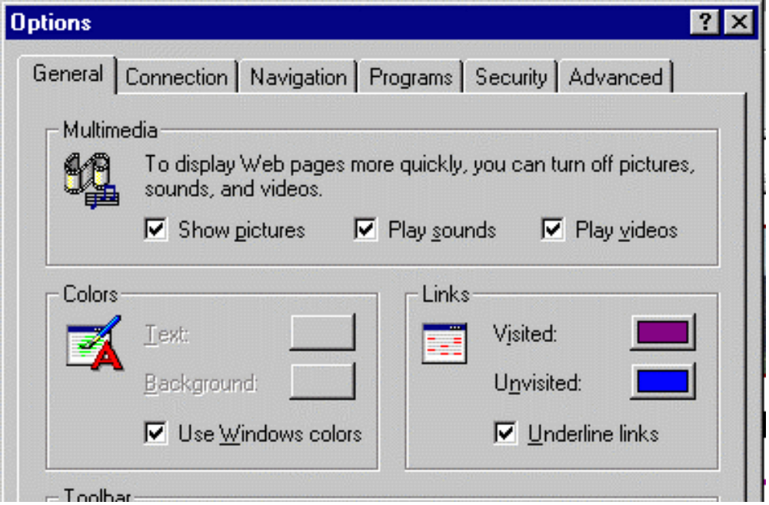
Explorer
Notes:
In this lecture we explore the basic tools used for working on the Internet.

Slide 30
Indexing and Searching
The web grew too fast - can’t keep track
  31 million pages, 476,000 servers, 23 million hits/day (Altavista Jan 1997)
Search engines
  Look at references to pages already stored
  Retrieve those pages
  Create keyword index
Search = keyword index + “Intelligence”
Notes:
Search engines are large databases which maintain indexes of which words appear in which web documents.
Lycos was fast and pretty simple
By the time Altavista came around, the problem had gotten out of hand.
People simply pointed their starting page at a search engine

Slide 31
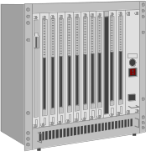
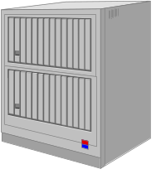
my favorite www.zepplin.com
for the really cool music
The web spiders
come out at night
Blah Blah Blah www.msu.edu blah this and that whatever and still some more stuff
I work at www.egr.msu.edu and like www.tcm.org
I plan to visit www.ncsa.uiuc.edu next month
The users
search
all day
Notes:
The search engines operate in two phases. At night, they act as spiders traversing the web. They retrieve pages, index them and then retrieve the ages that are referenced in each page. Eventually given enough time, they will reach every page that is pointed to in the net.
All of these pages are indexed in a database which is consulted as the uses come in during the day to run searches.

Slide 32
Search Engines
altavista.digital.com
altavista.msu.edu
www.lycos.com
www.infoseek.com
www.excite.com
www.search.com
webcrawler.com
Notes:
Search engines are very popular to the point that they generate significant revenue from advertisements included in the pages.

Slide 33
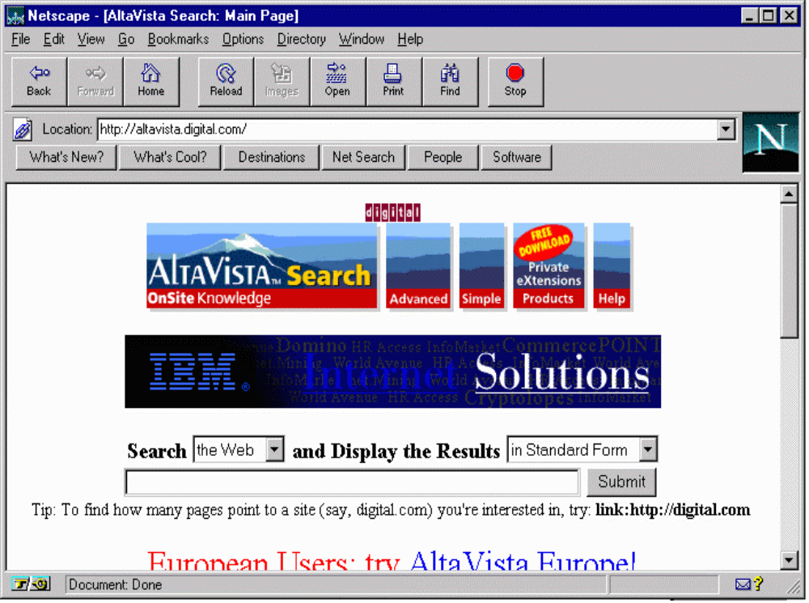
Notes:
In this lecture we explore the basic tools used for working on the Internet.

Slide 34
Altavista Tricks
“apple pie”
+karaoke +lansing +michigan
paris = paris, Paris, parIS, or PARIS
host:*.msu.edu
url:*.uk
+”apple pie” +rec*pe -”in the face”
….Many more
Notes:
There is a large number of possible ways to use AltaVista. More detail is available by pressing help at altavista.digital.com. You can also do advanced searches which use Boolean expressions AND, OR, and NOT along with date ranges. Your search expressions can use parenthesis. You can also separate the search criterion from the ranking criterion.
kayak AND "San Juan Islands"
The operator AND ensures that both are present in the resulting documents. The operator AND binds less tightly than juxtaposition.
"Digital Equipment Corporation" OR DEC
The operator OR ensures that at least one is present in the resulting documents. The operator OR binds less tightly than the operator AND.
Louis NEAR Monier
The operator NEAR ensures that both are within ten words of each other in the resulting documents. The operator NEAR binds less tightly than the operator NOT and associates to the left. This query matches Louis Monier, Louis M. Monier and Monier, Louis.
vegetable AND NOT "brussel sprouts"
The operator NOT is used to exclude words or phrases from a query. The operator NOT binds less tightly than the operator OR . This query is equivalent to vegetable and (not "brussel sprouts"). Do not use vegetable NOT "brussel sprouts"; this query is syntactically illegal.

Slide 35
Search .vs. Catalog
Global search engines falling behind
  Give up on “everything” try “useful info”
  Search engines have real trouble determining “useful”
Catalogs - www.yahoo.com
Recent Developments
  Directed Search Engines - Topical
  Localized Search Engines - “Geographical”
Notes:
There are too many URLs to practically index everything. Search engines are beginning to prune their searches. In 1995, the limiting factor was the amount of net they could search in a 24 hour period. Now with 3+ years of searching they have a lot of stuff. They cannot continue to do a complete index so they must rank the information in terms of value. This is pretty difficult to accomplish. Probably the first areas that will get pruned will be user home directories which has some of the most diverse material on the net.
The search engines will have to use metrics to rank the value of the information such as how many links point to the page. Another metric will probably be the length of the URL and how recently the data was updated. The search engines will have to spend a good portion of their time re-verifying their information to minimize the incorrect links.

Slide 36
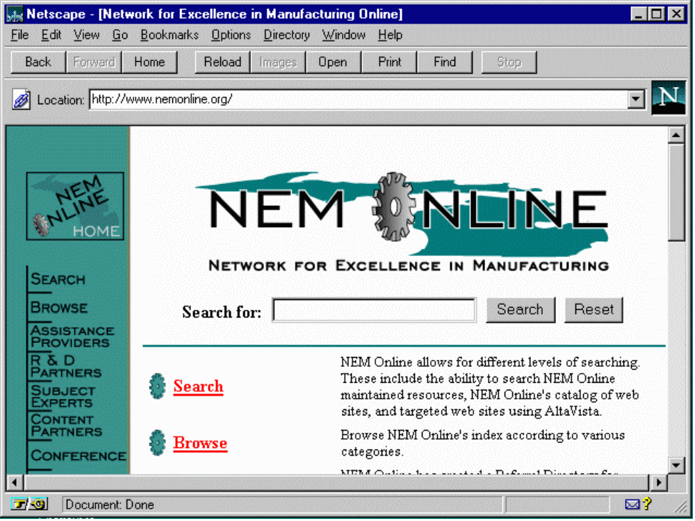
Notes:
In this lecture we explore the basic tools used for working on the Internet.

Slide 37
Personal Publishing
First Web Servers supported “User Pages”
As many styles of user pages as there are people
  Serious publications
  “My Favorite Stuff”
  My views on whatever
  Family pictures
Notes:
The Web encourages individuals and organizations to put up data on the net
In a sense we have come full circle
We communicate person-to-person
We retrieve data/information from repositories
We ourselves are a repository for the world

Slide 38
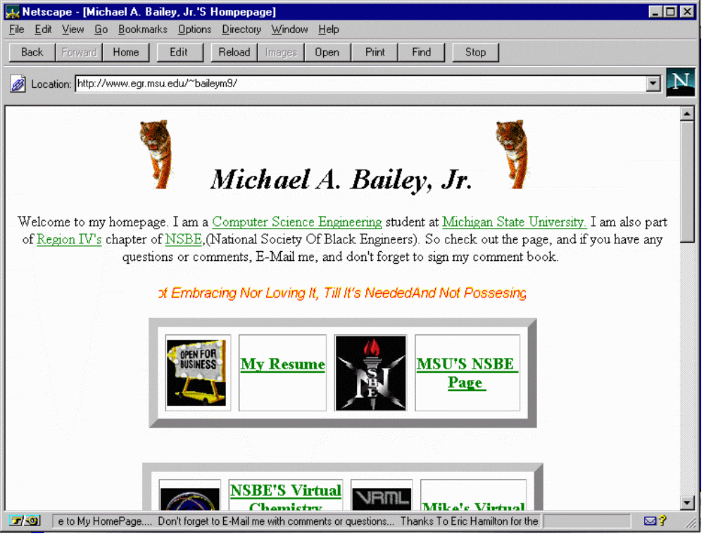
Notes:
In this lecture we explore the basic tools used for working on the Internet.

Slide 39
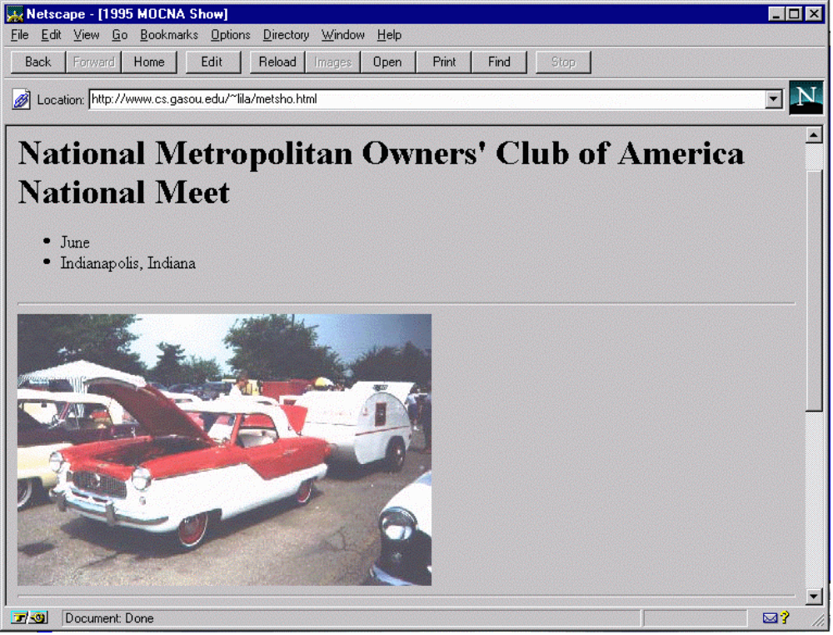
Notes:
In this lecture we explore the basic tools used for working on the Internet.

Slide 40
Publishing Your Home Page
Develop your HTML
Upload to the web space (use FTP)
There are many web servers on campus
  pilot.msu.edu
  www.egr.msu.edu
  www.cps.msu.edu
Notes:
The site www.windows95.com is an excellent site for graphics editors.

Slide 41
Getting Images
Images come from several sources
  Scanner
  Screen shot (LviewPro or Paint Shop Pro)
  Off the net (use the right click trick)
  From a video capture (i.e. Snappy)
  From a camera - (i.e. Connectix)
  Some film developers send you a URL!

Slide 42
The “web” Subdirectory
Typically you have a home directory on each system for your files
  /afs/msu/user/c/r/crs
  /user/crs
  /home/uo/crs
Unless your account is specially setup for web pages only, there is a subdirectory called “web” which is used to store pages
Notes:
The choice of the subdirectory web is up the the system administrator of each system but the name “web” is commonly used across different systems to eliminate confusion.
You may have to set permissions properly on the web directory. In Pilot the permissions are set properly automatically when your account is created.
The files in the web subdirectory and all of its subdirectories must generally be “world-readable” for them to be served over the web. If you get “Permission denied” when you try to view a web page, it probably means that permissions are not set properly.
On UNIX:
chmod ugo+rx web
chmod ugo+r web/index.htm

Slide 43
Putting a file on the Web
To publish a file, you must get the file into your web directory (typically with FTP)
The name of the file becomes the last part of the URL
/afs/msu/user/c/r/crs/web/crs.gif
http://www. msu.edu/user/crs/crs.gif
Notes:
In this lecture we explore the basic tools used for working on the Internet.

Slide 44
Sub-Directories
Below the web subdirectory, you can create your own directory structure. The directory structure is reflected in the URL.
/afs/msu/user/c/r/crs/web/photos/crsgrad.gif
http://www.msu.edu/user/crs/photos/crsgrad.gif
Notes:
In this lecture we explore the basic tools used for working on the Internet.

Slide 45
The index.html (or .htm) File
When you specify a directory in the URL, the web server looks for a default file
  index.html or index.htm on Pilot
  index.html on CPS and EGR
  index.htm Windows index.html on UNIX
Added
http://www.msu.edu/user/crs/photos/
/afs/msu/user/c/r/crs/web/photos/index.htm
Notes:
In this lecture we explore the basic tools used for working on the Internet.

Slide 46
A Web Structure
/home/uo/crs
/home/uo/crs/web
Legend
web
directory
index.htm
Mail
file
crs.gif
project
photos
todo
school
teresa
index.htm
index.htm
c++
brent
crsgrad.gif
cps291int
secret
mandy
Notes:
In this lecture we explore the basic tools used for working on the Internet.

Slide 47
Steps to a Pilot Page
On PC, create file index.htm (see notes)
Use FTP to pilot.msu.edu
  Log-in with id/password
  cd web
  put index.htm
Test the page using your browser
  http://www.msu.edu/user/sparty Your Pilot ID
Notes:
If you don’t know HTML (coming up in a later lecture) you can use this as a sample index.htm to upload. Use a simple editor like Notepad to create the file. You should be able to cut and paste it right in to notepad.
<title>This is Jane Spartan’s Home Page</title>
<h1>A Very Simple Home Page</h1>
<p>
Welcome to my home page. This page
is just a test to see if I can actually get something to upload.
If you don’t like this page, it is the fault of my instructor in
<a href=“http://www.vu.msu.edu/preview/cps291/”>
CPS291.
</a>
</p>
<p>This page is under construction</p>

Slide 48
Navigator Gold 3.0
Navigator Gold 3.0 has an HTML Editor built in - get from www.netscape.com
To edit a page
  Browse to the page
  Edit the page (saves to local disk first)
  Re-publish the page
Must configure destination for upload
  ftp://pilot.msu.edu/msu/user/s/p/sparty/web
Pilot ID
Notes:
In this lecture we explore the basic tools used for working on the Internet.

Slide 49
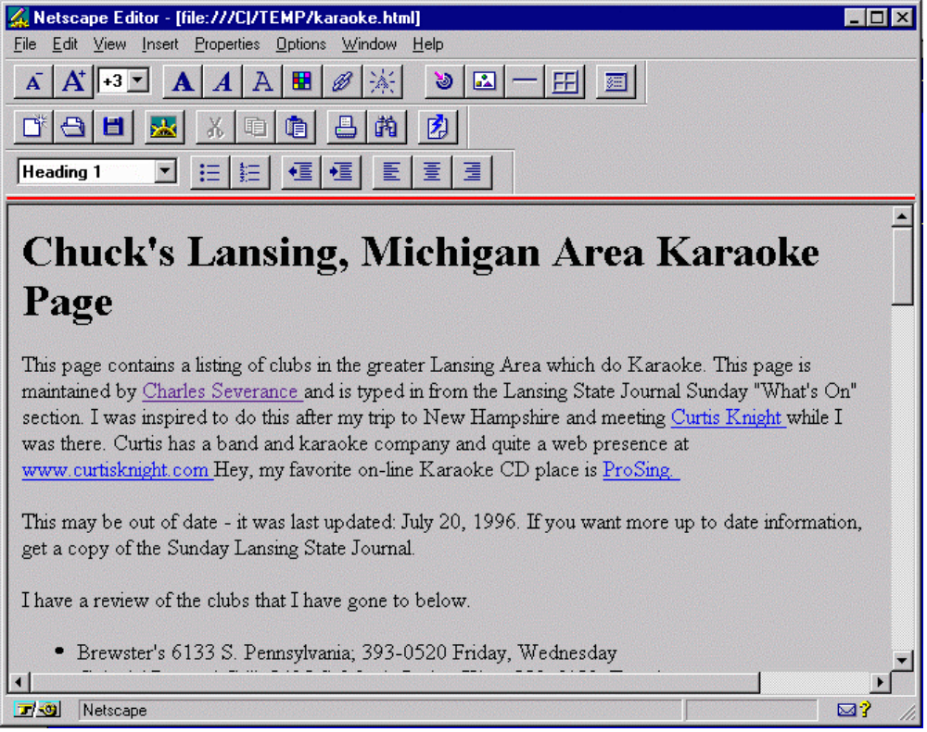
Navigator Editing
Notes:
In this lecture we explore the basic tools used for working on the Internet.

Slide 50
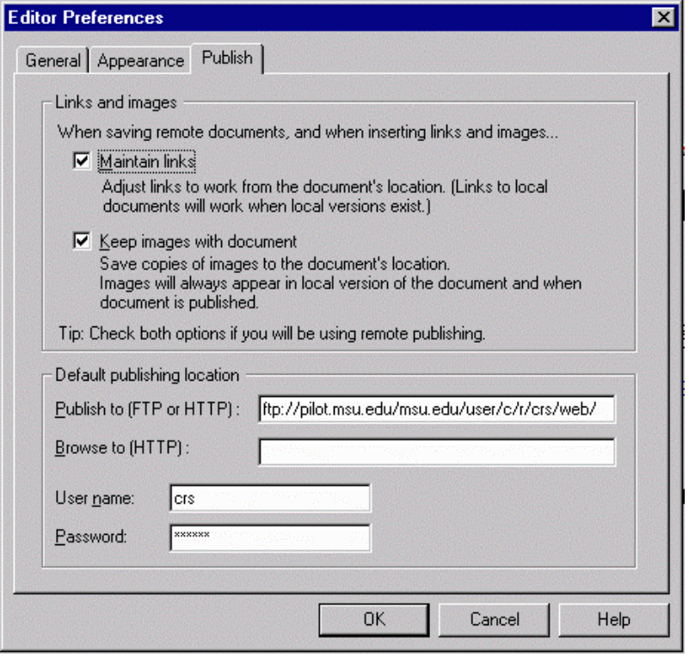

Editor Preferences at MSU
ftp://pilot.msu.edu/msu/user/c/r/crs/web/
Account and Password
Then Press
Notes:
In this lecture we explore the basic tools used for working on the Internet.

Slide 51
To find the proper location to use when setting Editor Preferences for your system, use ftp as if you were going to manually upload a file to the web space as follows:
ftp cps.msu.edu
  Connected to cps.msu.edu.
  220 arctic FTP server (UNIX(r) System V Release 4.0) ready.
  Name (cps.msu.edu:crs): crs
  331 Password required for crs.
  Password:
  230 User crs logged in.
  ftp> cd web (or whatever directory is appropriate)
  250 CWD command successful.
  ftp> pwd
  257 "/user/crs/web" is current directory.
  ftp> bye
  221 Goodbye.
The setting in preferences would be:
ftp://cps.msu.edu/user/crs/web/
Notes:
In this lecture we explore the basic tools used for working on the Internet.

Slide 52
What is CGI?
CGI is a Web Interface where a program generates the web data dynamically each time the page is accessed
Used with fill in the blank forms
  Available on Computer Science and Engineering
  No CGI on pilot.msu.edu

Slide 53
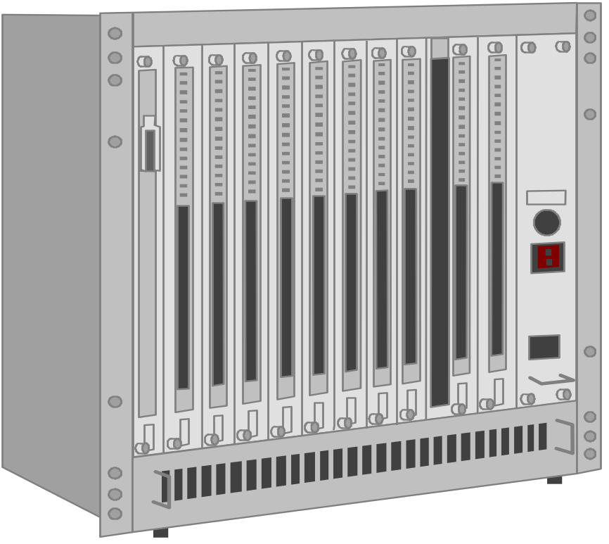


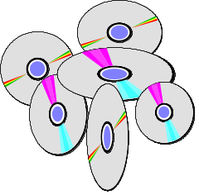
Web
Server
CGI
Program
1. Form is downloaded
2. Form is filled out and sent
3. Web Server calls CGI program
4. CGI program does “whatever”
5. CGI program passes results to web server
6. Results are sent to the browser as HTML
Notes:
In this lecture we explore the basic tools used for working on the Internet.

Slide 54
CGI Scripts
CGI Programs are typically written in
  Perl
  UNIX - Shell Language
  C or C++
May access databases or other networks
Often used for tracking (ads) and to customize an interface for each user
CGI works very well - all on the server
Notes:
Take a look at:
http://www.cps.msu.edu/cgi-user/crs/scncweb_ping
http://www.cps.msu.edu/cgi-user/crs/scncweb_traceroute
http://www.cps.msu.edu/cgi-user/crs/scncweb_dnsquery
In CPS, see
http://web.cps.msu.edu/facility/cgi.html

Slide 55
Summary
Fundamental Internet tools
  telnet
  Netscape Navigator/Microsoft Explorer
  ftp
  HTML Editor
These tools are a great improvement over the previous tools and the next generation is even better

