Slide 1
Business on the Internet
Charles Severance

Slide 2
Business Networking
Business priorities are different
  Productivity of employees
  Development of employees
  Protection of proprietary data
  Maintaining its image
  Computer support costs
Notes:
Business Computing and Networking is somewhat different than home or university computing. Businesses need extremely efficient communication within the company but not necessarily so much communication between every single company in the world. Simply adding Internet to the desks of all employees is generally viewed as a way to reduce employee productivity.
However, having a well-connected company internally can have a tremendous benefit to employee productivity and morale. In business, there is often an overriding need to protect proprietary data and universal internet access provides a challenge to the security requirements.

Slide 3

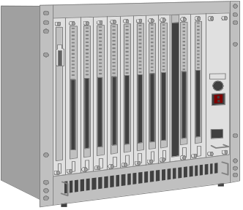

Early Computing

Slide 4

Early Networking

Slide 5


Adding PC’s

Slide 6

PC Networks

Slide 7




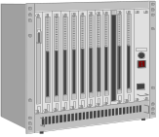




PC Networks Rule

Slide 8


“The Network IS the Computer”
“NET”

Slide 9

Add the Internet
“NET”
“Internet”

Slide 10

After a While...
“Intra-NET”
“Internet”

Slide 11
Network Compters vs PC
One of the goals of business is to minimize costs of technology
A big cost is people/support
The network can help in this area
  Remote update of computers
  Sharing of Printers
Recently, network computers were introduced to save $$

Slide 12
Network Computer
No local software - downloaded across the network (JAVA)
No local configuration - retrieved from the net at boot time
Low cost ($300-$1000)
When one breaks, simply replace it

Slide 13
PC
Local hard disk with software, configuration and data
Must be backed up
To replace failed PC, must restore the data (assuming it was backed up)
Less dependent on the network
$1000-$5000

Slide 14
The Debate
Network Computers
  depend on a fast reliable network
  few applications
PC
  Higher support cost (being worked on)
  Still require fast reliable network
For a while Netputers will stay in speaialized applications

Slide 15
With Network Computers
Does this look
familiar?
“Intra-NET”
“Internet”

Slide 16
Early Computing

Slide 17
Intranet Ideas
Web-Browser becoming standard
Internal Communication
  Daily Newsletter
  On-Line Forms
  Policy Statements / Procedures
  Departmental Publishing
  Web Search Engines - Find Resources

Slide 18
Business Networking
Much of the networking details for business are the same
  Network Cable, Bridges
  Phone Lines, Routers
The biggest challenge is to allow desktops to do the approved activities without unlimited access

Slide 19
Adding a Firewall
The purpose of a gateway router is to connect a LAN to the Internet
A firewall is a router which controls and monitors access to the Internet
  Who can use the Internet
  What types of access
  Log all transfers
Companies may use two or more

Slide 20


“Internet”
“Internet”
Log
Config
“Intranet”
“Internet”

Slide 21
Firewall Operation
Firewalls start allowing no access
Then the desired access is added
  E-Mail
  Corporate Web Server
Access through firewalls
  Proxy access
  Transparent forwarding

Slide 22
Proxy Access
In Proxy Access, the client uses a special proxy protocol to the firewall
  Client requests firewall to retrieve page
  Firewall decides if the page is OK
  Firewall might send back a cached copy
  Firewall gets page across Internet
  Adds log entry - perhaps caches page
  Returns page to client

Slide 23

Config
Log
(2) IS blah.com
OK for Chuck?
(5) Chuck got blah.com
(1) GET blah.com
(3) GET blah.com
“Internet”
(7) Here is
(4) Here is
(6) Store on Disk

Slide 24
Transparent Forwarding
In transparent forwarding, the client uses its normal protocols, but each connection is still intercepted, authorized, and possibly logged in the firewall
“Internet”

Slide 25
Internet Commerce
Internet Commerce is a broad topic
  Secure Sockets Layer SSL - Encrypts connection from client to server
  Encrypting connection is not only problem
    Keyboard viruses
    Security breaches on the server
  Digital Cash
  Micropayments

Slide 26
Home Access to Business
Home access for employees
  Modems “behind” the firewall
    Requires “long-distance” out-of-town
    Clean solution -security
    Company must support services
  Use the Internet
    Requires additional security
    Provides employees with Internet Access

Slide 27





“Intranet”
“Internet”
Requires Additional
Security

Slide 28
Business Web Sites
Becoming a necessity
On-site or off-site server?
  On-site server is a BIG responsibility
  Off-site servers are a bargain often
Content is the key
  Must have graphic artists and designers
  In addition to motivated geeks

Slide 29
Evolution of a Business Site
Name, Phone Number and Picture
On-line press releases and other info
Lookup Static Information
Some connection to corporate database
Full catalog - better than paper
“Wired”
Notes:
In addition to personal publishing, organizations publish as well. The information published by an organization can range from simple to extremely complex. A web presence can be integrated into the data processing of a large organization.

Slide 30
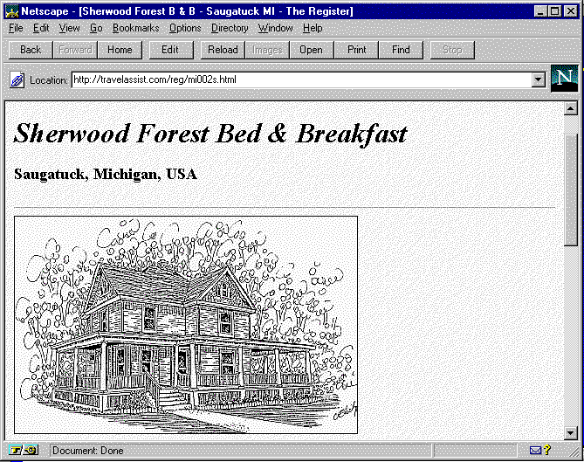
http://travelassist.com/reg/mi002s.html

Slide 31
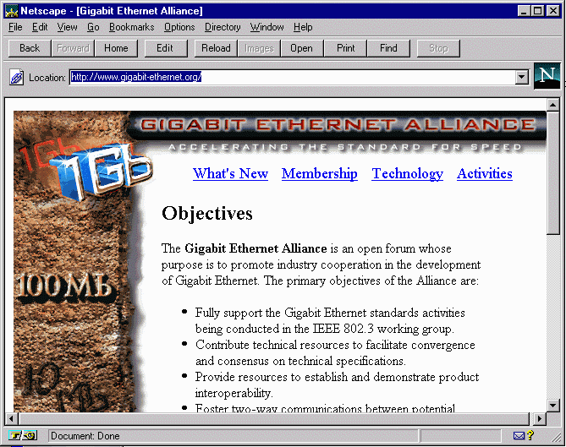
http://www.gigabit-ethernet.org/

Slide 32
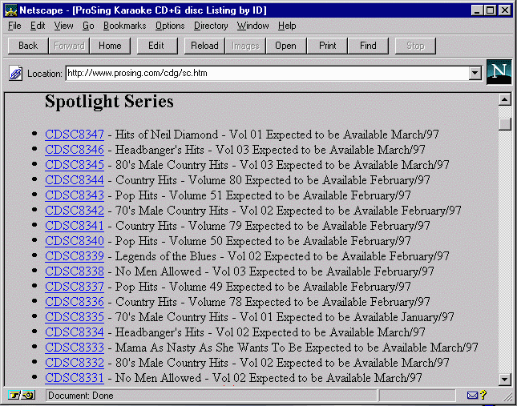
http://www.prosing.com/

Slide 33
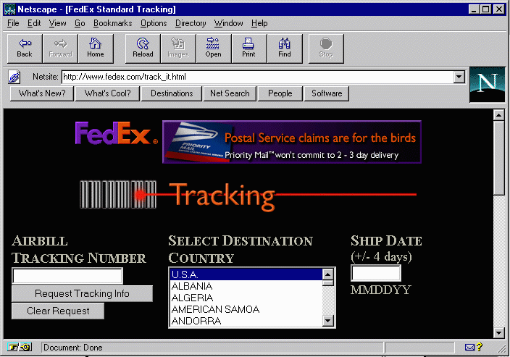
www.fedex.com

Slide 34
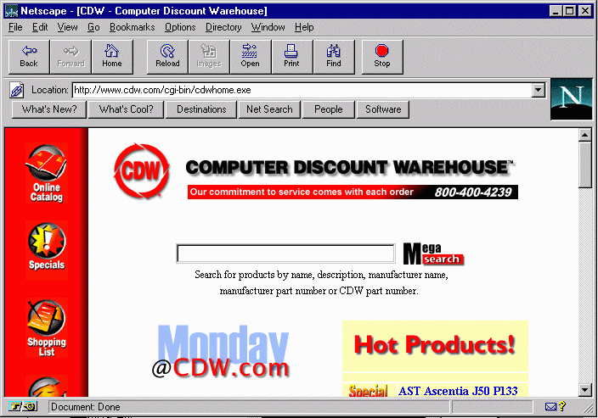
www.cdw.com

Slide 35
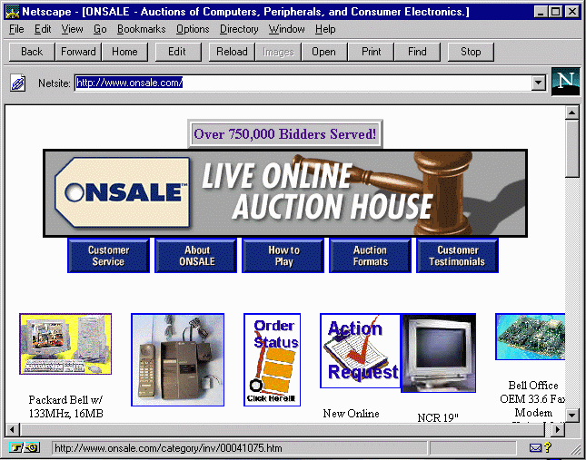
www.onsale.com

Slide 36
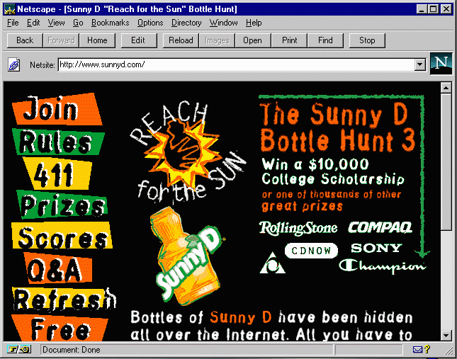
www.sunnyd.com

Slide 37
Web Presence Choices
In-House
    Forces 24x7 support
    May force larger connection
    Only for large organizations
Virtual host
    Higher reliability - leave it to the “pros”
    Faster connection
    Small/Medium organizations

Slide 38
Web Design Choices
In House
  Cost of content is lower - easy update
  Can access in-house databases
Contracted Work
  Visually pleasing - technically sound
  Engineers are seldom graphic artists
Tough to develop “top quality” site without a combination

Slide 39
Other Business Issues
E-Mail Privacy
Free Speech
Personal Use .vs. Business Use
Fair-Use
Copyright

Slide 40
Summary
While universities have had the Internet for 10+ years, many businesses are just getting started.
Businesses need to answer several questions regarding the Internet: Why do we need it? Who needs the Internet? What will they do? How will it save or make money?

