Slide 1
What is Cable Modem?

Slide 2
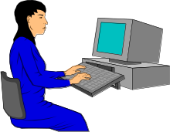



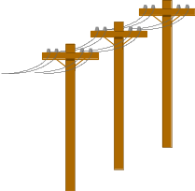
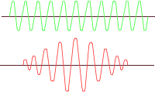





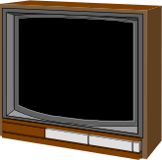

What IS a cable modem?
X
X
Y
Internet
X=“Cable Modem”

Slide 3
What IS a Cable Modem?
Uses channels in two-way cable plant to move digital data
Makes CATV/Fiber look like a Local Area Network
Challenging Problem

Slide 4
Challenges
Digital Problems
  TCP/IP - Routing, Window Size
  Snooping, Spoofing
  Source Redirect
Analog Problems
  Signal/Noise
  Changes in temperature
  Frequency agility

Slide 5



One-Way Cable Plant
Head End

Slide 6



“Two Way” Cable Plant
Head End

Slide 7
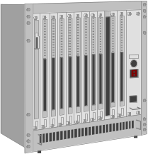
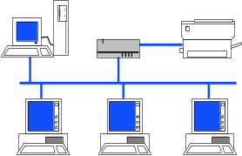
Cable-Modem Two-Way Plant
X
X
X
X

Slide 8
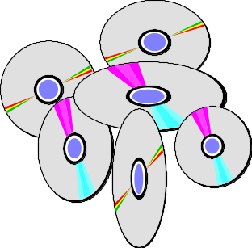

How Cable Modems Work
Receive Frequency
Send Frequency
X
X
Translator
Digital
Networking
Internet
Other Services

