Slide 1
HTML Overview
Material developed by Richard Wiggins
  http://www.msu.edu/staff/rww/
Presentation by Charles Severance
  http://www.msu.edu/~crs/

Slide 2
Personal Publishing
First Web Servers supported “User Pages”
As many styles of user pages as there are people
  Serious publications
  “My Favorite Stuff”
  My views on whatever
  Family pictures
Notes:
The Web encourages individuals and organizations to put up data on the net
In a sense we have come full circle
We communicate person-to-person
We retrieve data/information from repositories
We ourselves are a repository for the world

Slide 3
Publishing Your Home Page
Develop your HTML
Upload to the web space (use FTP)
There are many web servers on campus
  pilot.msu.edu
  www.egr.msu.edu
  www.cps.msu.edu
Notes:
The site www.windows95.com is an excellent site for graphics editors.

Slide 4
Definitions
URL = text string that specifies a unique document
“Home Page” = beginning of a particular Web document or collection of documents
Web browser = a client program for navigating the Web, e.g.:
  Netscape
  Microsoft Internet Explorer
HTML = the language used to compose documents for Web delivery
HTTP = the protocol used by Web servers to deliver requested documents to Web browsers

Slide 5
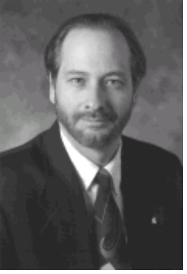
URL - All About Data
How to
Display the
data
Where to
get the data
http://www.egr.msu.edu/~crs/crs.gif
How to
retrieve the
data
What data
to get
Notes:
One of the great contributions of the World-Wide-Web was the concept called the Uniform Resource Locator or (URL). URLs may initially look like gibberish, but they tell the Web Browser a great deal of information.
The first part of the URL specifies a high level network protocol which is needed to retrieve the data. Examines include http:, ftp:, news:
The second part of the URL is the most to contact to retrieve the data. Any domain name or numeric IP address can be used in this spot.
The third part of the URL specifies a document to be retrieved from the serves.
The suffix on the document also determines how the information is to be displayed. Examples include:
GIF - Picture
JPG - Picture
PS - Postscript File
HTML - Hypertext Markup Language
RA - RealAudio file
MPG - MPEG Animation

Slide 6



HTTP versus HTML
HTTP governs how files move over the Web
HTML defines structure of Web documents
Web Server
User’s Web
Browser
The Internet
HTTP
session
HTML
docu-
ment
www.info.org
user.podunk.edu

Slide 7
HTML = Text plus “Markup”
<title>This is Jane Spartan’s Home Page</title>
<h1>A Very Simple Home Page</h1>
<p>
Welcome to my home page. This page
is just a test to see if I can actually get something to upload.
If you don’t like this page, it is the fault of my instructor in
<a href=“http://www.vu.msu.edu/preview/egr124/”>
EGR124.
</a>
</p>
<p>This page is under construction</p>
Notes:
“Markup” is simply a specialized set of code words, or tags, that HTML authors use in preparing documents for the Web.

Slide 8
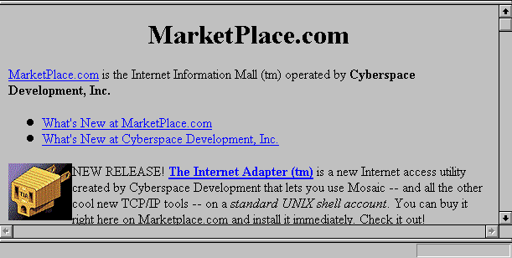
<H1><center>MarketPlace.com</center></H1>
<A HREF="http://marketplace.com:80/csd/development.html">
MarketPlace.com</A> is the Internet Information
Mall (tm) operated by <b>Cyberspace Development, Inc.</b>
<IMG ALIGN=LEFT ALT="" SRC="http://marketplace.com:80/
tia/TIA.1x1.4bit.COLOR.gif"> NEW RELEASE!

Slide 9
Preparing HTML Documents
Simple option: Edit documents by hand
  Use a text editor to manually edit your text and markup and save/upload
  Use Netscape (or other browser) to check your work as you go click “Reload”
“Authoring Tools” becoming popular
  Netscape
  Microsoft Word/PowerPoint/FrontPage
  Adobe PageMill
  Many Others
Notes:
See http://www.commtechlab.msu.edu/mig/Followups/webpub.html

Slide 10
HTML Layout: Some control, not total
You “mark” the logical elements of a document
  Paragraphs
  Headings
  Etc
Your user controls exact presentation by specifying browser options
When the user resizes windows, text is re-wrapped
How much control should be given to author?
  The <CENTER> tag
  Relative font tags
  The <BLINK> tag

Slide 11
Steps to a Pilot Page
On PC, create file index.htm (see notes)
Use FTP to pilot.msu.edu
  Log-in with id/password
  cd web
  put index.htm
Test the page using your browser
  http://www.msu.edu/user/sparty Your Pilot ID
Notes:
If you don’t know HTML (coming up in a later lecture) you can use this as a sample index.htm to upload. Use a simple editor like Notepad to create the file. You should be able to cut and paste it right in to notepad.
<title>This is Jane Spartan’s Home Page</title>
<h1>A Very Simple Home Page</h1>
<p>
Welcome to my home page. This page
is just a test to see if I can actually get something to upload.
If you don’t like this page, it is the fault of my instructor in
<a href=“http://www.vu.msu.edu/preview/cps291/”>
CPS291.
</a>
</p>
<p>This page is under construction</p>

Slide 12
Steps to an Engineering Page
On PC, create file index.htm (see notes)
Use FTP to scully.egr.msu.edu
  Log-in with id/password
  cd web
  put index.html
Test the page using your browser
  http://www.egr.msu.edu/~sparty Your Account
Notes:
If you don’t know HTML (coming up in a later lecture) you can use this as a sample index.htm to upload. Use a simple editor like Notepad to create the file. You should be able to cut and paste it right in to notepad.
<title>This is Jane Spartan’s Home Page</title>
<h1>A Very Simple Home Page</h1>
<p>
Welcome to my home page. This page
is just a test to see if I can actually get something to upload.
If you don’t like this page, it is the fault of my instructor in
<a href=“http://www.vu.msu.edu/preview/cps291/”>
CPS291.
</a>
</p>
<p>This page is under construction</p>

Slide 13
The “web” Subdirectory
Typically you have a home directory on each system for your files
  /afs/msu.edu/user/c/r/crs
  /user/crs
  /home/uo/crs
Unless your account is specially setup for web pages only, there is a subdirectory called “web” which is used to store pages
Notes:
The choice of the subdirectory web is up the the system administrator of each system but the name “web” is commonly used across different systems to eliminate confusion.
You may have to set permissions properly on the web directory. In Pilot the permissions are set properly automatically when your account is created.
The files in the web subdirectory and all of its subdirectories must generally be “world-readable” for them to be served over the web. If you get “Permission denied” when you try to view a web page, it probably means that permissions are not set properly.
On Engineering or CPS or any UNIX system:
chmod ugo+rx web
chmod ugo+r web/index.htm
Permissions are already set properly on the web subdirectories on Pilot.

Slide 14
Putting a file on the Web
To publish a file, you must get the file into your web directory (typically with FTP)
The name of the file becomes the last part of the URL
/home/d3/crs/web/crs.gif
http://www.egr.msu.edu/~crs/crs.gif

Slide 15
A Web Structure
/home/uo/crs
/home/uo/crs/web
Legend
web
dir
index.htm
Mail
file
crs.gif
project
photos
todo
school
teresa
index.htm
index.htm
c++
brent
crsgrad.gif
cps291int
secret
mandy

Slide 16
FTP to Web Space
C:\CLASS > ftp scully.msu.edu
Connected to pilot.cl.msu.edu.
220 scully.msu.edu FTP server (Version wu-2.1c(17) Fri Jan 21)
Name (scully:sparty): sparty
331 Password required for sparty.
Password: [Type in your password. It will not be displayed.]
230 User sparty logged in.
ftp> cd web
ftp> put index.htm
200 PORT command successful.
150 Opening ASCII mode for index.htm (9286 bytes).
226 Transfer complete.
9286 bytes transferred in 0.0724 seconds (133.9 Kbytes/s)
ftp> quit
221 Goodbye.
Notes:
It is important to be in the proper “local” directory and the proper “remote” directory “remote” directory before you transfer the files. For example, lets say you saved a picture to “me.gif” in the \temp\photos directory on your hard disk and you wanted to upload it to your main web space in the web subdirectory of your home directory on the server. It would work something like this:
ftp pilot.msu.edu
(log in)
lcd \temp\photos
cd web
binary
put me.gif
quit
Before the put command you moved into the proper directory on the hard disk, the proper directory on the server, and set the mode to binary before actually transferring the data.

Slide 17
Sub-Directories
Below the web subdirectory, you can create your own directory structure. The directory structure is reflected in the URL.
/home/d3/crs/web/photos/crsgrad.gif
http://www.egr.msu.edu/~crs/photos/crsgrad.gif

Slide 18
FTP to a Sub-Directory
C:\CLASS > ftp scully.msu.edu
Connected to pilot.cl.msu.edu.
220 pilot.msu.edu FTP server (Version wu-2.1c(17) Fri Jan 21)
Name (scully:sparty): sparty
331 Password required for scully.
Password: [Type in your password. It will not be displayed.]
230 User sparty logged in.
ftp> cd web
ftp> mkdir photos
ftp> cd photos
ftp> binary
ftp> put me.gif
200 PORT command successful.
150 Opening BINARY mode for me.gif (9286 bytes).
226 Transfer complete.
9286 bytes transferred in 0.0724 seconds (133.9 Kbytes/s)
ftp> quit
221 Goodbye.
Notes:
You can use mkdir in FTP to create a new subdirectory.

Slide 19
Navigator Gold 3.0
Navigator Gold 3.0 has an HTML Editor built in - get from www.netscape.com
To edit a page
  Browse to the page
  Edit the page (saves to local disk first)
  Re-publish the page - auto-FTP
Must configure destination for upload
  ftp://pilot.msu.edu/msu/user/s/p/sparty/web
  ftp://scully.egr.msu.edu/home/d3/decs1/web
Notes:
Even with navigator Gold, images must be done using a separate program such as LviewPro or Paint Shop Pro.
You may need to specify a subdirectory in the destination too. These paths can get pretty long.

Slide 20
Finding your Home Directory
To find the proper location to use when setting Editor Preferences for your system, use ftp as if you were going to manually upload a file to the web space as follows:
ftp cps.msu.edu
  Connected to cps.msu.edu.
  220 arctic FTP server (UNIX(r) System V Release 4.0) ready.
  Name (cps.msu.edu:crs): crs
  331 Password required for crs.
  Password:
  230 User crs logged in.
  ftp> cd web (or whatever directory is appropriate)
  250 CWD command successful.
  ftp> pwd
  257 "/user/crs/web" is current directory.
  ftp> bye
  221 Goodbye.
The setting in preferences would be:
ftp://cps.msu.edu/user/crs/web/
Notes:
Note: In most systems, web pages are stored in the web subdirectory of your home directory. Your system administrator will have detail s on where to start your web hierarchy.

Slide 21
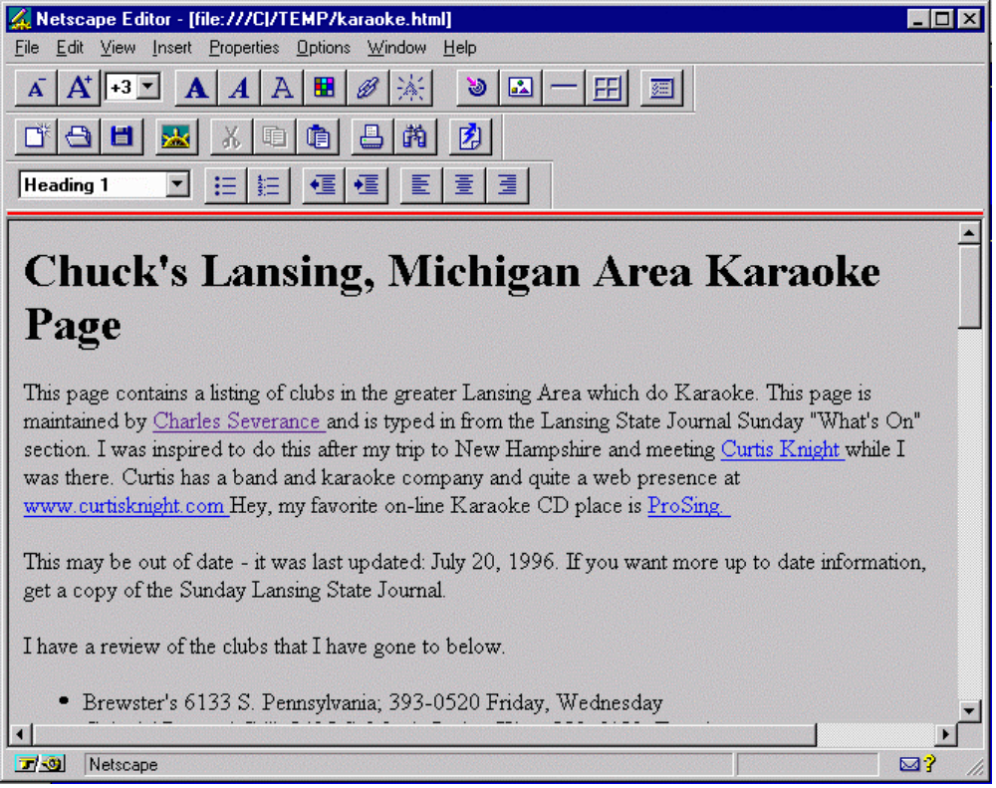
Navigator Editing
Notes:
Once you click the “EDIT” button, Navigator will bring up an editor - but first the file will be saved to your local disk.

Slide 22
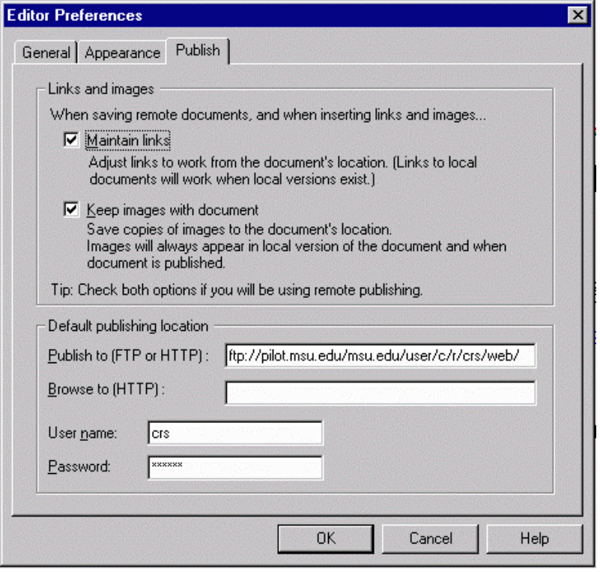

Editor Preferences at MSU (3.0)
ftp://pilot.msu.edu/msu/user/c/r/crs/web/
Account and Password
Then Press

Slide 23
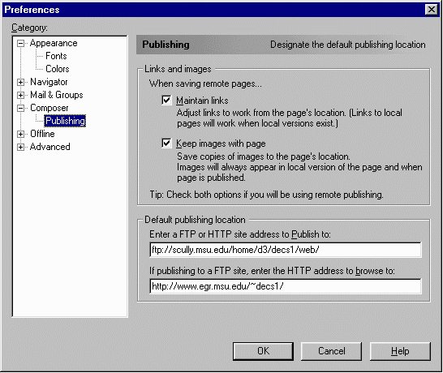
Editor Preferences (Communicator)

Slide 24
The index.html (or .htm) File
When you specify a directory in the URL, the web server looks for a default file
  index.html or index.htm on Pilot
  index.html on CPS and EGR
  index.htm Windows index.html on UNIX
http://www.egr.msu.edu/~crs/photos/
Added
/home/uo/crs/web/photos/index.htm

Slide 25
Template Tags
<HTML>
<HEAD>
<TITLE>A Sample Document</TITLE>
</HEAD>
<BODY>
Document body
</BODY>
</HTML>

Slide 26
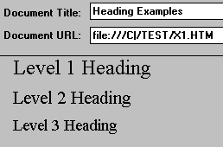
HTML Tags: Headings
<h1>Level 1 Heading</h1>
<h2>Level 2 Heading</h2>
<h3>Level 3 Heading</h3>

Slide 27
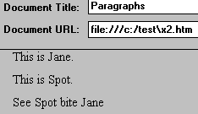
HTML Tags: Paragraphs
This is Jane.
<p> This is Spot.
<p> See Spot bite Jane </p>
Correct

Slide 28
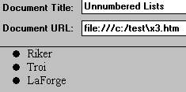
HTML Tags: Lists (Unnumbered)
<ul>
<li>Riker
<li>Troi
<li>LaForge
</ul>

Slide 29
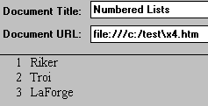
HTML Tags: Lists (Numbered)
<ol>
<li>Riker
<li>Troi
<li>LaForge
</ol>

Slide 30
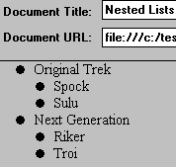
HTML Tags: Lists (Nested)
<ul>
<li> Original Trek
<ul> <li>Spock
<li>Sulu
</ul>
<li> Next Generation
<ul> <li>Riker
<li>Troi
</ul>
</ul>

Slide 31
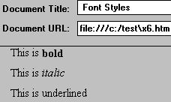
HTML Tags: Font Styles
This is <b>bold</b> <p>
This is <i>italic</i> <p>
This is <u>underlined</u> <p>

Slide 32

HTML Tags: Inline Images
<IMG ALIGN=LEFT
SRC="http://marketplace.com:80/tia/TIA.1x1.4bit.COLOR.gif">
NEW RELEASE!

Slide 33
Getting Images
Images come from several sources
  Scanner
  Screen shot (LviewPro or Paint Shop Pro)
  Off the net (use the right click trick)
  From a video capture (i.e. Snappy)
  From a camera - (i.e. Connectix)
  Some film developers send you a URL!

Slide 34
Image Attributes
HEIGHT=n, WIDTH=n
  Allows browser to preallocate space for the image
  Speeds downloading
  Modem friendly
  Use with caution
ALT=txt
  Useful for blind users with “talkers”
  Also useful for slow modem users
ALIGN= [TOP, BOTTOM, RIGHT, MIDDLE]

Slide 35

HTML Tags: Links to Other Documents
generally known as Anchors
<A HREF="http://marketplace.com:80/csd/development.html">
MarketPlace.com</A>
is the Internet Information
Mall (tm) operated by
<b>Cyberspace Development, Inc.</b>

Slide 36
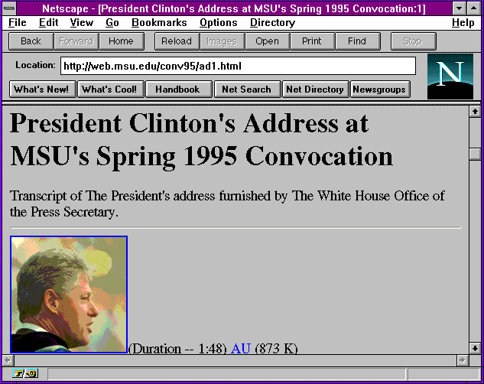
HTML Tags: Inline Images as Anchors
<a href="clinton1.gif">
<img src="clin_sm1.gif">
</a>

Slide 37

HTML Tags: <HR>
Following this line is a horizontal rule.
<hr>
Preceding this line is a horizontal rule.

Slide 38

HTML Tags: <ADDRESS>
<ADDRESS>
Rich Wiggins <br>
wiggins@msu.edu
</ADDRESS>

Slide 39

HTML Tags: <mailto:>
Would you like to send some e-mail
to <a href="mailto:wiggins@msu.edu">
Rich Wiggins</a>? Do so now!

Slide 40
HTML Tags: Comments
<!-- Sometimes you want to
insert comments inside a document. -->

Slide 41

HTML Tags: Escape Characters
&lt less than <br>
&gt greater than <br>
&amp ampersand <br>
&copy copyright <br>

Slide 42
Background Colors
<body bgcolor="#E5E9EE">
Component
colors specified
as hexadecimal
numbers, 2 digits
for each color...
Red
Blue
Green
<body bgcolor="#FFFFFF"> = white background

Slide 43
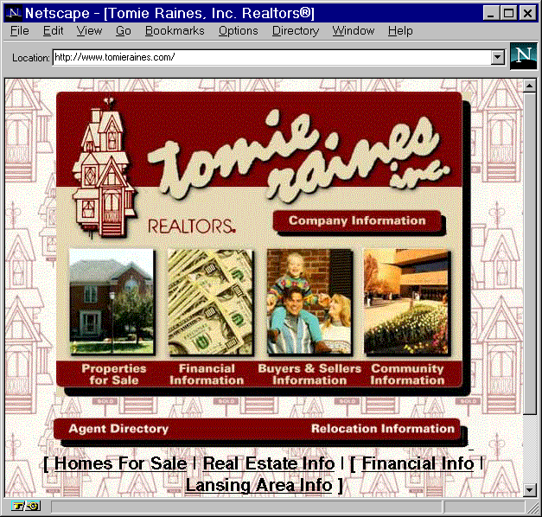
Background Images
<BODY background=
"/images/paper.jpg"
bgcolor="#FFFFFF"
text="#000000" >
Meaning:
White background
with black text
and with the image
stored as “paper.jpg”
as a repeating
background
element...

Slide 44
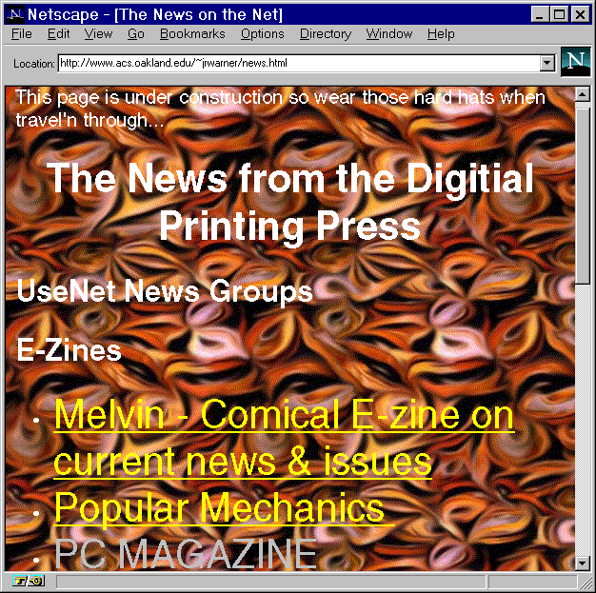
Beware of Hideous Backgrounds

Slide 45
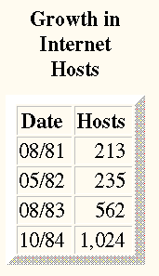
HTML Tags: <TABLE>
<html>
<body>
<table border=10 >
<caption><b>Growth in Internet Hosts</b></caption>
<tr> <th> Date </th> <th> Hosts </th> </tr>
<tr align=right> <td> 08/81 </td> <td> 213 </td> </tr>
<tr align=right> <td> 05/82 </td> <td> 235 </td> </tr>
<tr align=right> <td> 08/83 </td> <td> 562 </td> </tr>
<tr align=right> <td> 10/84 </td> <td> 1,024 </td> </tr>
</table>

Slide 46
Meta Tags - Redirect
<HEAD> <TITLE>Dr. Chuck's Other Home Page</TITLE>
<META HTTP-EQUIV="refresh” CONTENT="5;URL=http://www.egr.msu.edu/~crs/">
</HEAD>
<body bgcolor="#FFFFFF">
<H1>Charles Severance's <br> Other Home Page</h1>
Hello, you have arrived at one of my "other" home pages.
My real home page is at
<a href=http://www.egr.msu.edu/~crs/>
http://www.egr.msu.edu/~crs/</a>
and if things work well you will be sent there in
five seconds 5... 4... 3... 2... 1...
</body>

Slide 47
More Meta
You can control how a page is indexed using META
  <META name="description"
  content="We specialize in grooming pink poodles.">
  <META name="keywords" content="pet grooming,
  Palo Alto, dog">
Notes:
http://searchenginewatch.com/fchart.htm
http://searchenginewatch.com/ekg1.htm

Slide 48
Building an HTML Document
Use all of these possible elements
And others...
To build your documents according to your style
It’s much easier than it may appear at first

Slide 49
HTML Preparation Tips
Tip: Find documents that are similar to the ones you want to put online
... then use View Source to save the other document as a template
Tip: Edit your document in one window;
  Use “Reload” option
Be sure to view your document on multiple platforms:
  Different video cards
  Different Web browsers

Slide 50
HTML Tips (Cont’d)
Consider low-bandwidth users
  Use thumbnail images that link to larger images
  Give file sizes on links to large documents
  Minimize number of separate inline images in a document
Consider Lynx users:
  Use the ALT construct:
  <IMG SRC=“flower.gif” ALT=“[Yellow Rose]”>
  Offer menus as an alternative to any image maps

Slide 51
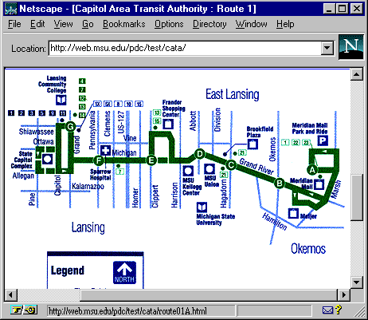
Image Map Example
<map name="r1">
<AREA SHAPE="RECT"
COORDS="367,90 432,134" HREF="route01A.html">
<AREA SHAPE="RECT"
COORDS="327,113 366,175" HREF="route01B.html">
<AREA SHAPE="RECT"
COORDS="273,96 305,146" HREF="route01C.html">
...
</map>

Slide 52
Design Issues
People expect high quality graphics
.... but beware of glitz
Don’t forget the user on older quipment...
...or slow modems
Avoid designing for the machine on your desktop
Beware of designing pages that only work with the latest version of Netscape
Avoid excessive use of harsh color, complex backgrounds

Slide 53
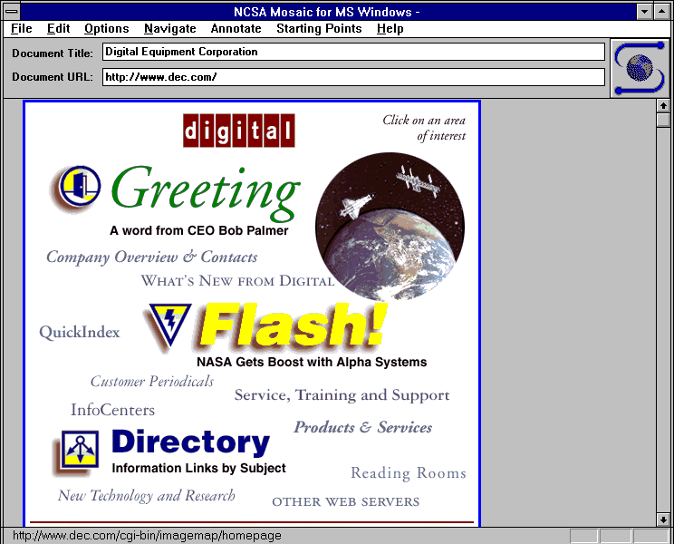
Content vs Glitzy Presentation

Slide 54
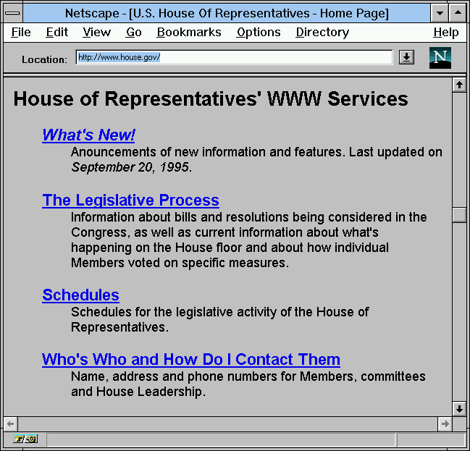
The Courage to Avoid Glitz

Slide 55
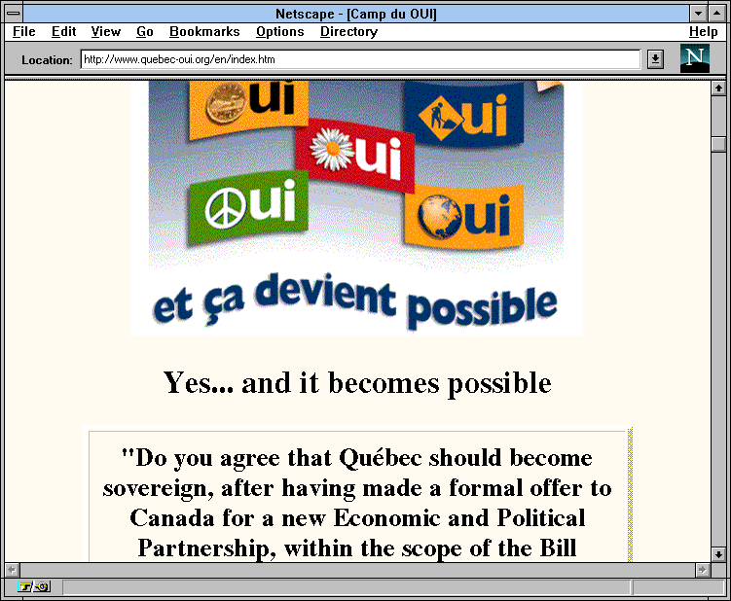
Carry a Theme Through Your Pages

Slide 56
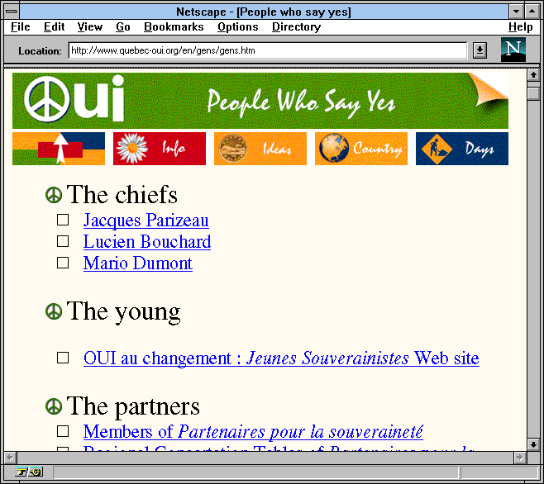
...Consistent Themes Help Provide Context

Slide 57
Style: To Link or Not To Link
Don’t add a link every time a common phrase appears
Your pages will look like Christmas trees...
... and will be impossible to read
Consider a “Return to Home Page” link on every page
Avoid internal links within a single page
  Very confusing to readers
  Is it a link to a new page, or to part of this page? Hard to tell..

Slide 58
Style: Label Links Naturally
Explore our Online Photo Gallery
Read about today’s ski conditions
...not...
If you want to see today’s ski conditions, click here

Slide 59
Style: Don’t Force HTML
Don’t use the <BR> tag excessively
  And don’t use it to simulate word wrap!
  Your video setup is not the same as your readers!
Go easy on the <HR> tag
Be judicious in use of Netscape font extensions
  If at all
Don’t <BLINK>

Slide 60
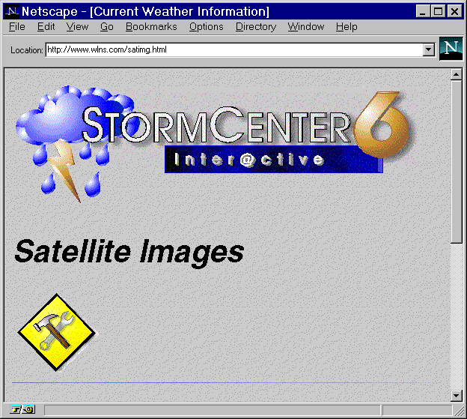
Style: No Dead Ends!
Don’t add a link if the document doesn’t exist!
The whole Web is under construction; why bother labeling your service as such?

Slide 61
Style: Keep Inline Logos Simple
Consider very small logos
Try to keep logos < 500 or so pixels wide
Excellent examples:
  Lycos
  Yahoo
  Netscape
  UCLA

Slide 62
Style: Don’t Design for Your Desktop
Try viewing your pages with other browsers...
  Older Netscapes
  Mosaic
  AOL, Prodigy
  Lynx
  Turn off Images
... At other screen capabilities:
  640 X 480 instead of 1024 X 768
  256 (or even 16) colors instead of 16-bit

Slide 63
Style: Be Modem Friendly
Use small inline images
Provide thumbnails that point to larger images
Keep number of inline images on a page small
  Consider image maps instead of multiple images
Label your links that point to large files
  E.g. Clinton Speech (1400K .wav file)

Slide 64
What is CGI?
CGI is a Web Interface where a program generates the web data dynamically each time the page is accessed
Used with fill in the blank forms
  Supported on www.cps.msu.edu
  Supported on www.egr.msu.edu
  No CGI on pilot.msu.edu
Also Server Side Includes - Odometers
Notes:
In a CGI page, the page is generated by a program rather than being read off disk. CGI is a “security hole” so not all users are allowed to use CGI. On some systems approval is needed.
Server Side Includes (SSI) are used to include the odometers and other dynamic elements in a web page.

Slide 65




Web
Server
CGI
Program
1. GGI Program runs produces the form as output
2. Form is downloaded
3. Form is filled out and sent
4. Web Server calls CGI program passing in data
5. CGI program executes “whatever”
6. CGI program passes results to web server
7. Results are sent to the browser as HTML
Notes:
#! /bin/csh
cat << EOF
Content-type: text/html
<HTML><HEAD>
<TITLE>Sudent On-line Directory</TITLE>
</HEAD><BODY>
EOF
if ( $QUERY_STRING == "" ) then
cd /home/cps291/cgi-bin/students
set folks = ( * )
echo "You can update your directory information - "
echo "<a href=http://cps291.vu.msu.edu/cgi-bin/stupage/> update </a>"
echo "<ul>"
foreach i ( $folks )
set name=`cat $i | grep ^name: | awk -F: '{print $2}'`
echo "<li><a href=http://cps291.vu.msu.edu/cgi-bin/stulist?$i>"
echo "$name</a>"
end
echo "</ul>"
else
cat /home/cps291/cgi-bin/students/$QUERY_STRING
endif
done:
echo "</HTML>"

Slide 66
CGI Scripts
CGI Programs are typically written in
  Perl
  UNIX - Shell Language
  C or C++
May access databases or other networks
Often used for tracking (ads) and to customize an interface for each user
CGI works very well - all on the server
Notes:
In CPS, see
http://web.cps.msu.edu/facility/cgi.html

