Slide 1
A Short Internet Film
Dr. Charles Severance
Michigan State University
http://www.egr.msu.edu/~crs/

Slide 2

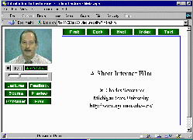
A New Form of Lecture Delivery
The idea: Lecture + Overhead projector on the Internet

Slide 3
The “Overhead”
Shows the lecture slides
Students can “surf”
A new slide will appear when necessary

Slide 4
How does it Work?
Develop PowerPoint
Tape the lecture in the Studio
Digitize Video and Audio
Merge Video/Audio/PowerPoint
  Special Software
  Synchronized Events

Slide 5
On the Internet
Put it up on the Web for delivery
Streaming Audio and Video
  Real Video www.realaudio.com
Web Server
  www.vu.msu.edu

Slide 6
Conclusion
Please let me know what you think!
http://www.egr.msu.edu/~crs
crs@egr.msu.edu
Thanks for listening!
Free Internet Lectures: http://www.vu.msu.edu/preview/egr124/

