Slide 1
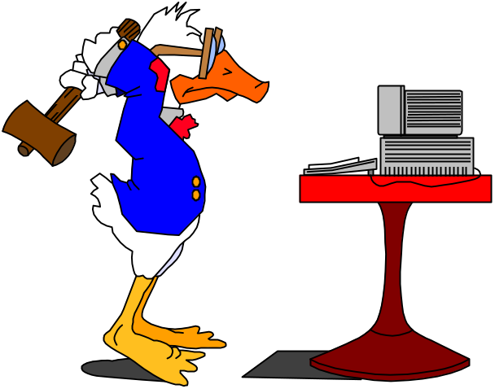
EGR124 - Gauntlet
Will You solve the Puzzle?
If not, you will be dropped from EGR124 - Good Luck

Slide 2
Hello!
If this slide is flipping automatically as the Audio or video plays - Great.
Hold on - The clue will be arriving soon!
RealVideo Rules!

Slide 3

The Next Hurdle...
Getting your Pilot ID and Password
Once you have the Pilot ID adding you to the course Authentication
Otherwise you won’t be able to get into http://egr124.vu.msu.edu/
We're Goin' Virtual...

Slide 4
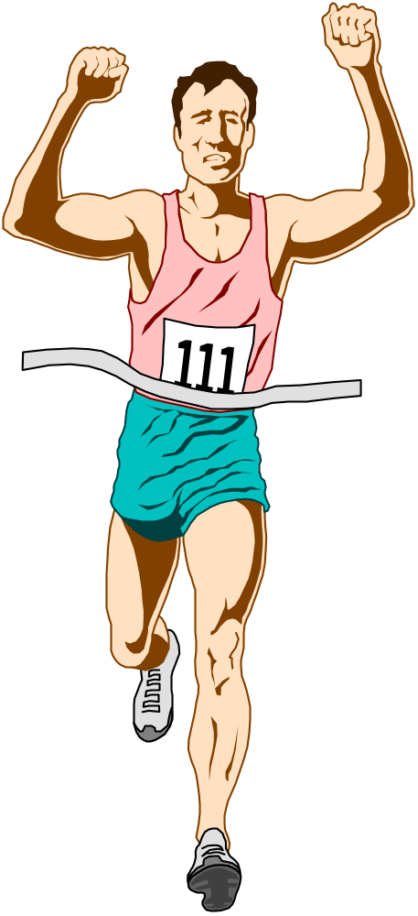


LISTEN for the CLUE!!!
You Can't Have Too Much ClipArt!

Slide 5
You Should Now Have the Clue
It is a single word
It has two syllables
It is a adjective
It has two vowels
If you don’t have it go back and listen again!

