Slide 2

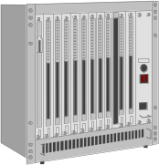






Internet = Communication
Notes:
The Internet is simply a way for 10 Million Computers worldwide to communicate and exchange information. The real question is how do people, companies, and organizations use this capability. In a sense, the Internet does nothing new, it simply allows us to do it better, faster, and easier. But like any significant new technology, such as telephone or automobiles it will have an impact at some point on our society.

Slide 3
Communications
Person to person
  Electronic Mail
Person to data (who published the data?)
  Searching
  Downloading
Organization to person
  Viewing
Notes:
At first glance it seems that the primary purpose of the Internet is to interact with information and entertainment. However the at its core, the Internet allows people to communicate with one another. Even if you are browsing a brochure from Ford motor company, at some point there is a person/organization trying to sell you an automobiles. The Internet is simply a very efficient form of delivery of that type of information.

Slide 4
Learn

Slide 5
Entertain

Slide 6
Netscape

Slide 7
Value of Intellectual Property
Online databases traditionally are extremely expensive
Electronic rights to journals also expensive
Freely-available Web documents will drive down prices of vendor databases
Paying for search time will wane; index searches will become free
Pay by-the-article, campus subscriptions, advertising

Slide 8
Java
Most dramatic adoption of a language in history of computing
JAVA is an evolutionary language - Similar to C++ with multimedia and network extensions
JAVA has the potential to be the most portable language in computing history - hardware vendors hate this
Notes:
Vendors may not be able to kill JAVA

Slide 9
Evolution of a Business Site
Name, Phone Number and Picture
On-line press releases and other info
Lookup Static Information
Some connection to corporate database
Full catalog - better than the paper copy
“Wired”
Notes:
In addition to personal publishing, organizations publish as well. The information published by an organization can range from simple to extremely complex. A web presence can be integrated into the data processing of a large organization.

Slide 10
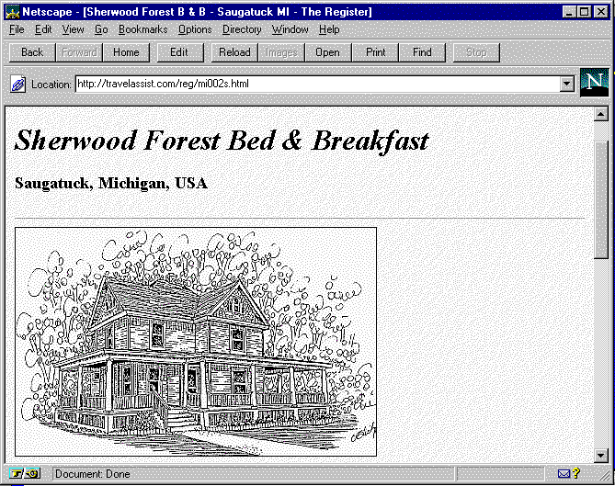
http://travelassist.com/reg/mi002s.html
Notes:
This is a bed-and-breakfast in Saugatuck, MI - This web page is the electronic equivalent of a guidebook entry. It has a name, picture, phone number and costs about $35.00 per year. A much better media buy for a five room B&B than a 30 second spot on the superbowl.

Slide 11
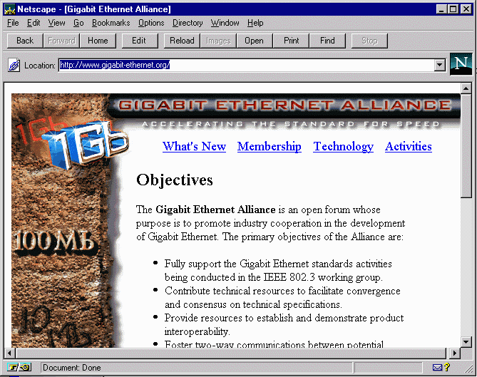
http://www.gigabit-ethernet.org/
Notes:
This is a trade association representing 90 companies participating no the Gigabit Ethernet development. They have about 30 pages (nicely done) but are not very interested.

Slide 12
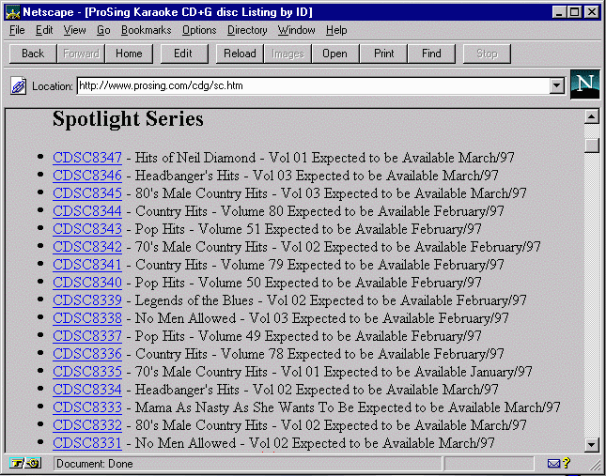
http://www.prosing.com/
Notes:
This is the ProSing catalog. This web site is not interactive at all but a good substitute for the paper catalog. Even better in some ways because you can use the search feature of your browser to scan quickly. You still have to order over the phone. But the phone number is prominently featured on every page. The advantage of this type of site is that it can drum up business but can be updated every month or even less often.

Slide 13
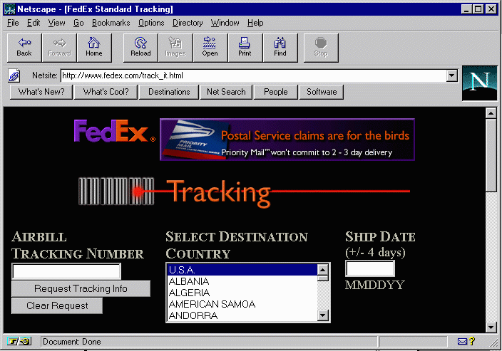
www.fedex.com
Notes:
This is an excellent example of linking to a corporate database. Federal Express took advantage of the web to deploy a package tracking system leveraging the Internet infrastructure and software. UPS on the other hand created their own infrastructure using custom software and their own dedicated modems which enjoyed far less desktop penetration.
This shows how the Web can be used to perform data processing functions both on an Intranet and on an Internet.
Another nifty example of this is www.nwa.com - Pretty good substitute for a phone call.

Slide 14
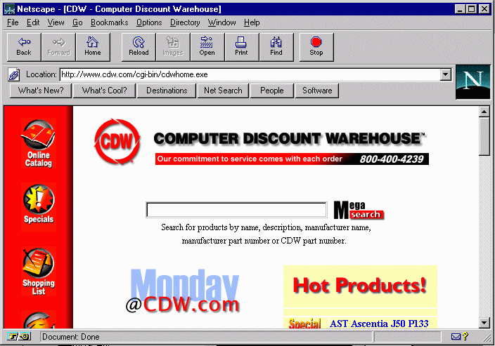
www.cdw.com
Notes:
Computer Discount Warehouse on-line is better than a paper catalog - it allows you to look at different models and do direct price comparison. Also it gives much more detail than limited paper ad space.
You can shop and buy on-line.

Slide 15
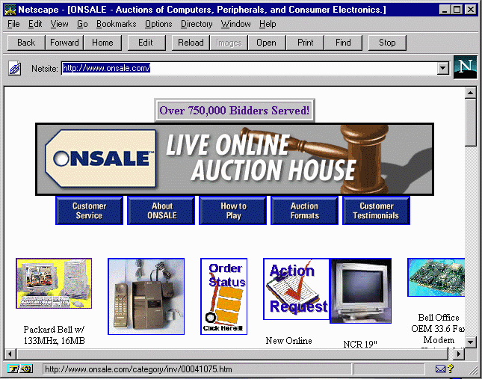
www.onsale.com
Notes:
The www.onsale.com page begins to border on the “wired” approach. This is only something that could happen on the Internet. People bid against each other (after entering their credit card) on a time clock - the top 50 bids get to buy the system at the price they bid when the time expires. At all times, you can see who is bidding and what they bid - You can even add a comment to plead with or threaten other potential bidders. The following is an example bidding frenzy on a Pentium 166 without monitor:
1. JA of Byron, GA, Mon Feb 3, 8:59 pm ($625.00, 1) : "I WANT THIS"
2. DS of Chadbourn, NC, Mon Feb 3, 8:20 pm ($600.00, 1)
3. DL of Fife, WA, Mon Feb 3, 9:35 pm ($600.00, 1)
4. KP of Cleveland, TN, Mon Feb 3, 8:52 pm ($550.00, 1) : "Remanufactured! Monitor not
included!"
5. MP of Porterville, CA, Mon Feb 3, 9:26 pm ($550.00, 1)
6. CB of St. Paul, MN, Mon Feb 3, 8:15 pm ($525.00, 1)
7. EF of Woodhaven, MI, Mon Feb 3, 8:33 pm ($525.00, 1)
8. RH of Brownstown, IN, Mon Feb 3, 6:34 pm ($500.00, 1)
9. PI of Tulsa, OK, Mon Feb 3, 6:41 pm ($500.00, 1)
18. GN of Trenton, NJ, Mon Feb 3, 9:51 pm ($500.00, 1) : ""BID LOW...SOME MORE
UNITs COMING..."

Slide 16
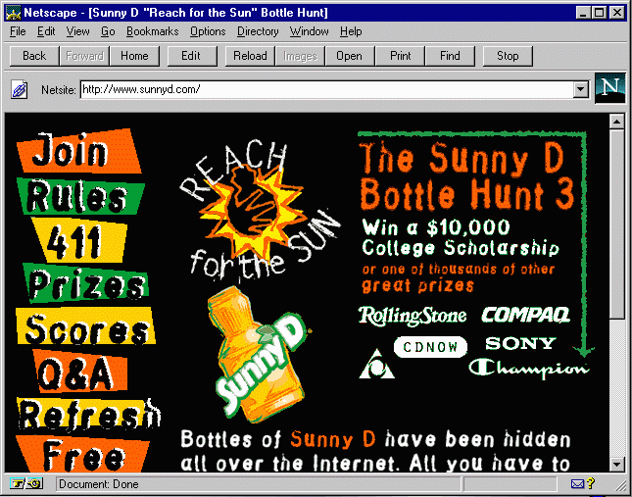
www.sunnyd.com
Notes:
The www.sunnyd.com page crosses the “wired” barrier from useful to pure art. Of course this is not a bad thing - SunnyD is trying to out-hip products like Mountain Dew, Dr. Pepper, and Frutopia. You can’t even buy SunnyD over the Internet - but you can search for pictures of SunnyD on the Internet and enter a scavenger hunt with a prize worth $10,000.

Slide 17
Summary
Communicating and publishing on the internet take many forms
A skilled user must learn a number of tools
While these tools seem clunky, they are a great improvement over the previous tools and the next generation is even better

