Slide 1
Intellectual Property Rights and the Internet
Presented by Richard Wiggins
  System Architect, NEM Online
    Service of Michigan State University
  Author, The Internet for Everyone: A Guide for Users and Providers (McGraw-Hill, 1995)
  Co-Host, Nothing But Net Television Show
  wiggins@msu.edu

Slide 2
Outline
Case Studies to Consider
Copyright Issues
The Ethics of Search Engines
Trademark Issues
Copyright Protection Technologies
Concept of “Superdistribution”
Case Studies Continued -- One Law Professor’s Answers

Slide 3
Disclaimer and Overview
Today’s lecturer is not an attorney
Don’t take today’s lecture as legal advice
In general:
  Be creative….
  …but be careful
  When in doubt
    Ask permission
    Or don’t do it

Slide 4
Case Study 1: Photos for a Sports Web Site
Major radio station in a big city has a sports talk show
Host runs a Web site covering major sports stories
Host includes photos of recent events (e.g. Tyson biting ear)
Obtains photos from ESPN’s Sportzone site
Does not think he needs permission because the photos are small thumbnails

Slide 5
Case Study 2: Dilbert Cartoon Archive on an Intranet
A fan of Dilbert works for a major international company
Puts up a collection of 200 favorite cartoons she’s collected over time
Publishes on her personal home page, accessible only to company’s intranet
Company has 250,000 employees
She believes this is fair use because
  Access is limited
  “It’s just like putting copies up outside my cubicle”

Slide 6
Case Study 3: Wall Street Journal for Virtual Course Pack
A professor of management likes to use real case studies
Has built a Web site of case studies from the news
  Clips articles from the Wall Street Journal and scans them
  More recently, takes articles from the Journal’s Web site
Has over 200 articles in the virtual course pack
Access limited to students in class

Slide 7
Copyright, Trademarks, Patents
All seek to protect intellectual property rights
Copyright: protects a particular expression of an idea (article, book, song, poem, painting, music video, movie)
Trademark: protects words or symbols that provide identity or brand for a company (or other entity)
Patent: protects inventions (whether physical devices, or industrial processes, or even computer algorithms)

Slide 8
Why Protect Intellectual Property?
Copyright
  Reward creativity, originality
  Promote many kinds of works: fiction, scholarly writing, newspapers, plays, music -- even TV and films
Patents
  Reward invention
  New devices, industrial processes, even genetically engineered forms of life
Trademarks
  Allow businesses to build brands
  Allow consumers to choose favored brands

Slide 9
Copyright: A Balancing Act
Creators and Publishers
Authors
Screenwriters and studios
Musicians and record labels
Publishing houses
Consumers
Readers
Moviegoers
Listeners (radio, home stereo)
Libraries

Slide 10
Copyright Basics
Under current copyright law any original work is copyrighted
Copyright now lasts the life of the author plus 50 years
  75 years for non-individual (eg corporate) creators
Registration is a way of establishing that the work existed in a particular form
  Registration is not required for protection
  May be necessary to recover damages
Ie you can violate someone’s copyright even if no copyright notice and/or unregistered

Slide 11
Assignment and Licensing
Authors/creators can “assign” copyright to another party
  Typically a publisher (or movie studio or TV network…)
  At that time, the copyright belongs to the assignee
Copyright can be licensed to others for limited purposes
  Implicitly (you have a right to read the book you bought)
  Explicitly (contract allows a movie theater to show a film)

Slide 12
Plagiarism vs Copyright Violation
Somewhat similar concepts, actually very different
Copyright violation is a legal concept
  The particular expression of an idea is protected
  Subject to civil or criminal sanctions spelled out in law
Plagiarism is a moral concept
  Stealing the work of another (research, term paper)
  May be theft of words, in some cases theft of new ideas
    E.g. Sue does research in cloning, and Wally publishes a paper based on her lab notes
    It’s still plagiarism even if the words are different

Slide 13
Concept of “Fair Use”
Allows limited copying without permission for
  Personal use
  Educational purposes
  Reviews
Educational example: Article in today’s newspaper is relevant to a class you’re teaching
  It’s fair use to hand out copies; there’d be no time to seek and obtain permission
Review examples:
  Quoting a few lines from a new pop song in a review
  Printing a thumbnail (tiny) replica of a photograph

Slide 14
Don’t Assume Too Much
Attribution does not equate to permission
  Good academic practice encourages attribution
  Gives credit where due, adds weight to your argument
  That’s how scholarship works
  But a citation doesn’t give you the right to reuse
Silence is not assent
  If you ask and the copyright holder fails to answer, you don’t have permission
Fair use is often stretched beyond the limit

Slide 15
Copyright Violations: Civil versus Criminal
Copyright violator may be subject to both civil and criminal sanctions
Civil:
  Copyright holder sues you for lost revenue
Criminal:
  Government prosecutes you for criminal violations
  E.g. you set up a factory making pirated music CDs
  Note that current law makes it a felony to sell more than 10 copies of copyrighted work w/out permission

Slide 16
Break

Slide 17
Copyright Case Study: Far Side
Suppose you are a fan of The Far Side cartoon
Suppose you scan in a copy of your favorite Far Side
You put the image on your Web page
You clearly label the cartoon as Gary Larson’s work
Have you violated the copyright of Gary Larson and his syndicate?

Slide 18
Gary Larson’s Opinion
Larson is retired as a cartoonist
The “back file” or archive of his work is his major source of income now
Old cartoons recycled into calendars, paperback books, etc
Thus Internet archives of Larson’s work could do him great financial harm
Sent a letter to news groups imploring people not to put up scanned images

Slide 19
Copyright and the Web: Special Issues
Incorporation without permission is generally agreed to be a violation of copyright
Ie you cannot download an image (or audio or video clip) and reload it on your own server for distribution
But the hyperlink itself presents new and interesting cases…
Only litigation and new legislation will resolve

Slide 20
The Ticketmaster vs Microsoft Dispute
Microsoft’s “Seattle Sidewalk” site on the Web
Includes concert, sporting event calendars
…and hyperlinks to Ticketmaster’s site to purchase those tickets
Ticketmaster objects, claiming a right to control how people enter their Web site
If visitors don’t see the front page, they don’t see all the ads
If Ticketmaster prevails, ominous implications for search engines

Slide 21
Search Engines: Ethical and Copyright Concerns
Search engines based on spiders that crawl Web sites and index every word
In essence, they build a “concordance” of the Web
But a search engine allows a user to skip the “front matter” of a site
... where sites have their own banner ads
Consumer gets the content without seeing the ads
Is the search engine in effect violating the rights of the copyright holder?

Slide 22
Meta-crawlers and Copyright
Meta-crawlers are search engines that do one search against multiple engines
E.g. www.askjeeves.com
Now, it’s the search engine sites whose banner ads are skipped
Can a search engine company complain, since they do the same thing to content sites?

Slide 23
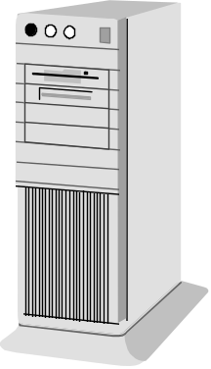
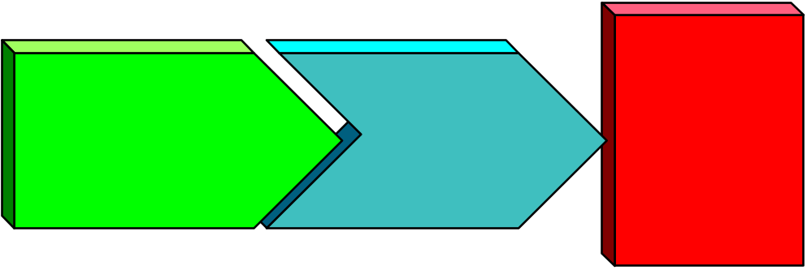
How to Violate Copyright without Ever Copying the Data Yourself
HTTP
session
<h1>My personal cartoon character </h1>
<img src=“http://
www.disney.com/mickey.gif>
...
www.disney.com
The Internet
HTTP
session
index.
html
www.ripoff.com

Slide 24
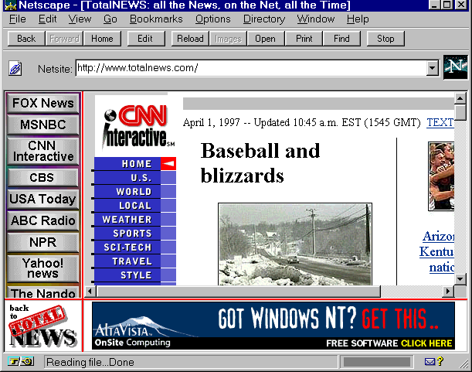
www.totalnews.com

Slide 25
The WebTV Controversy
WebTV is a dial-up (telephone) Internet service
Your TV serves as a display monitor
WebTV tries to present an integrated and coherent view of the Net
Also inserts advertisements on screen while waiting for Web sites you choose to download
Several prominent content providers object
  Note that TV stations have inserted ads in movies for years
  … but they license the movies for broadcast

Slide 26
The Web Channel Case
Suppose a cable TV station wants to show the Web
They develop software that robitically visits a set of Web sites
Weather Channel, NANDO News, Detroit News, etc
All these sites are freely available on the Net
If the Web Channel proceeds without permission, are they violating copyright?

Slide 27
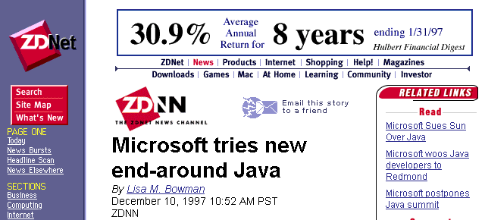

License to E-mail, Not to Steal

Slide 28
Internet Domain Names and Trademark Disputes
msu.edu
nasa.gov
cbs.com
nemonline.org
aol.com
ibm.com
voyager.net

Slide 29
Trademark Case: Kaplan vs Princeton Review
Kaplan and Princeton Review are two test prep services
Kaplan makes it to the Internet first
Also registers princeton.com
Later Princeton Review tries to register its address; finds it taken
Will Princeton Review get its name back?

Slide 30
Trademark Case: Roadrunner.com
A small Internet Service Provider (ISP) starts in Albuquerque
Firm starts doing business in 1993
They name the firm after the state bird: roadrunner.com
1996: Warner Brothers studios starts to register all its cartoon characters
eg wileycoyote.com
Warner Brothers threatens to sue Roadrunner
Will Warners prevail? Should they?

Slide 31
Internet Trademark Disputes
Internic Registration Services managed by Network Solutions Inc (NSI)
Conflicts in use of domain names inevitable
  Policies favor those with registered trademarks in case of disputes
  Even though they would not necessarily win in litigation
One to think about: clue.com (ISP versus game manufacturer)
One reason for the IAHC plan for new top-level domains (e.g. .web, .firm, .store)
  Open up name space to satisfy more players

Slide 32
Break

Slide 33
Internet Intellectual Property Protection Technologies
Tools to help prevent and detect violations
Degraded content: give away samples that are not worth stealing
Tracking tools: watermarks
Secure container tools: Cryptolopes

Slide 34
Degraded Content
Give away samples, make people buy the real thing
Still images: lower the resolution and/or image size
Audio (esp music): lower the resolution, limit the duration of a clip
Software: limited functionality, or stops functioning after a trial period

Slide 35
Digital Watermarks
Tracking mechanism
A visible mark (trademark, seal) is applied to image
Cannot be easily removed with digital image editors (e.g. Photoshop)
Mark is obvious when you look for it, but does not impede scholarly uses

Slide 36
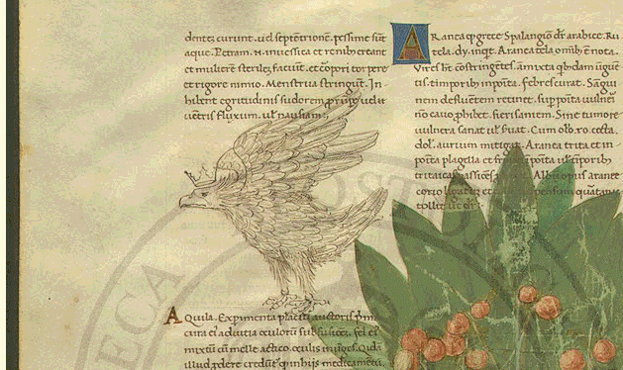
Vatican Archive Watermark Example

Slide 37
Invisible Watermarks
“Metadata” is digitally embedded in the image file
Strewn throughout the file in a way that’s hard to remove
Image looks the same to the naked eye
But a program can determine that a given file is protected

Slide 38
Digimarc’s Marcspider
All content is watermarked
The MarcSpider crawls the Web, looking for watermarked content
Reports given to content owners, detailing what sites have your content
You find offenders, and send “cease and desist” letters -- or sue
Playboy Enterprises = early adopter
May become routine throughout Web publishing

Slide 39
Audio Watermarks
Liquid Audio is a pioneer
Inherently must be inaudible
Otherwise music would become unusable
N2K records = Internet-only record label
Sells by mail order
Also sells singles and full-length CDs via the Net
  Can burn your own CD if you have a CD-R device
Content you download is watermarked, therefore protected

Slide 40
Fingerprints versus Watermarks
Could store specific information about a transaction with each copy
  Who bought it
  When transaction took place
  What the authorized uses are
Now, if redistributed, can identify who did the redistribution

Slide 41
Persistence of Watermarks
Digital files undergo compression/decompression
Images can be printed and scanned back in
Audio could be converted to analog and back
Watermarking vendors claim their schemes survive these transformations
... unless you’ve degraded the quality so much as to render useless

Slide 42
Secure Containers
Content is digitally encrypted for distribution
Metadata -- info about the content -- is in clear text
To open the container, a transaction takes place over the Net
You must supply correct password (or credit card info, etc) to view
Secure viewers prevent cut/copy/paste operations
IBM’s Cryptolopes -- main example

Slide 43
Superdistribution
With secure containers, you don’t really care how widely your content is distributed
Every new reader/viewer/listener must become authorized
So you encourage widespread copying
  On Web sites
  On Usenet
  On CD-ROMs
  Via streaming media
Copying and authorization for access are decoupled

Slide 44
Break

Slide 45
Case Studies: One Set of Opinions
Thanks to Mark Lemley, Assistant Professor, University of Texas Law School
…for his comments on these hypothetical cases
Note that these are not legal opinions
If you need legal advice, talk to an attorney

Slide 46
Case Study 1: Photos for a Sports Web Site
Extremely unlikely to be considered fair use
Use is commercial, entire photo is taken
Assuming ESPN holds copyright, radio host is infringing
He should ask permission or get permission from some other site

Slide 47
Case Study 2: Dilbert Cartoon Archive on an Intranet
Unquestionably an infringement of copyright holder’s rights to copy, distribute, and display Dilbert cartoons
Fan’s claim of fair use is weak
  Extensive copying
  Widespread distribution
  Undercuts United Media’s traffic on their Web site
Note: United Media aggressively protects their intellectual property

Slide 48
Case Study 3: Wall Street Journal for Virtual Course Pack
Sixth Circuit Court recently held that copying for a paper course pack is not fair use
That case is controversial:
  Rested on the for-profit nature of the copy company
If upheld, presumably Internet-based course packs would also require permission
Fact that this is educational, and access is limited, may suffice for fair use claim
Safest bet for the professor is to ask permission from Wall Street Journal

Slide 49
Do You Understand Your Copyright Responsibilities?
“There is an extraordinary amount of naivete about copyright out there, and universities can be the worst offenders. They give students unlimited Internet access and let them publish Web pages for free, but they don’t educate them about the copyright law as they should.”
  -- Eileen Kent, Vice President for New Media, Playboy Enterprises

Slide 50
Intellectual Property Rights on the Internet
Presented by Richard Wiggins
  System Architect, Network for Excellence in Manufacturing Online
    Service of Michigan State University
  Author, The Internet for Everyone: A Guide for Users and Providers (McGraw-Hill, 1995)
  Co-Host, Nothing But Net Television Show
  wiggins@msu.edu

