Slide 1
Using Web At Michigan State University
Charles Severance

Slide 2
Personal Publishing
First Web Servers supported “User Pages”
As many styles of user pages as there are people
  Serious publications
  “My Favorite Stuff”
  My views on whatever
  Family pictures
Notes:
The Web encourages individuals and organizations to put up data on the net
In a sense we have come full circle
We communicate person-to-person
We retrieve data/information from repositories
We ourselves are a repository for the world

Slide 3
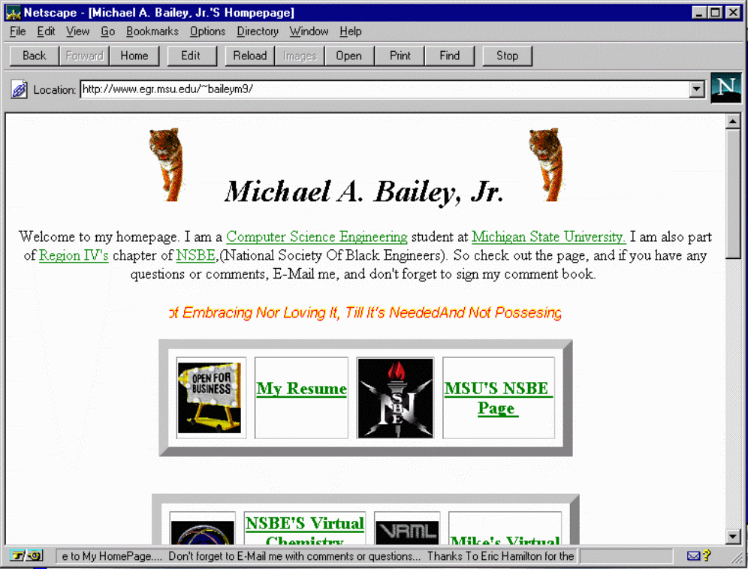

Slide 4
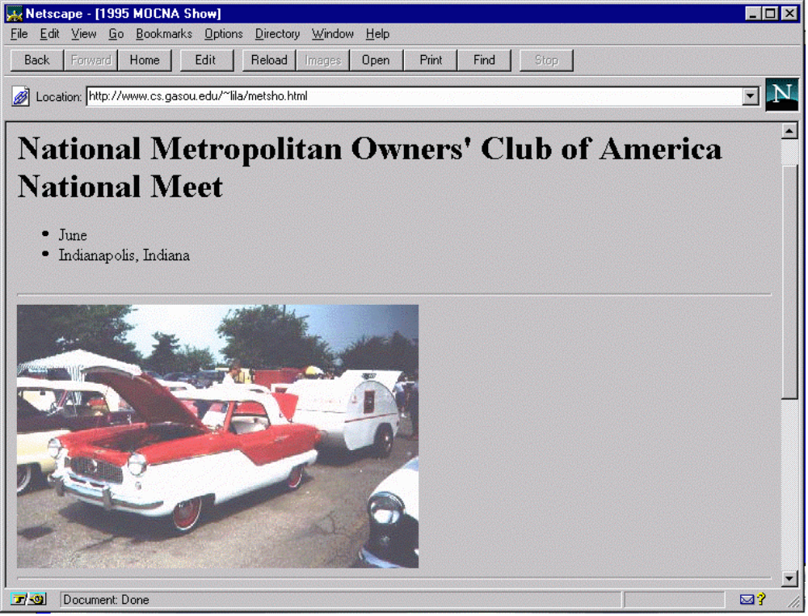

Slide 5
Publishing Your Home Page
Develop your HTML
Upload to the web space (use FTP)
There are many web servers on campus
  pilot.msu.edu
  www.egr.msu.edu
  www.cps.msu.edu
Notes:
The site www.windows95.com is an excellent site for graphics editors.

Slide 6
Getting Images
Images come from several sources
  Scanner
  Screen shot (LviewPro or Paint Shop Pro)
  Off the net (use the right click trick)
  From a video capture (i.e. Snappy)
  From a camera - (i.e. Connectix)
  Some film developers send you a URL!

Slide 7
Steps to a Pilot Page
On PC, create file index.htm (see notes)
Use FTP to pilot.msu.edu
  Log-in with id/password
  cd web
  put index.htm
Test the page using your browser
  http://www.msu.edu/user/sparty Your Pilot ID
Notes:
If you don’t know HTML (coming up in a later lecture) you can use this as a sample index.htm to upload. Use a simple editor like Notepad to create the file. You should be able to cut and paste it right in to notepad.
<title>This is Jane Spartan’s Home Page</title>
<h1>A Very Simple Home Page</h1>
<p>
Welcome to my home page. This page
is just a test to see if I can actually get something to upload.
If you don’t like this page, it is the fault of my instructor in
<a href=“http://www.vu.msu.edu/preview/cps291/”>
CPS291.
</a>
</p>
<p>This page is under construction</p>

Slide 8
The “web” Subdirectory
Typically you have a home directory on each system for your files
  /afs/msu.edu/user/c/r/crs
  /user/crs
  /home/uo/crs
Unless your account is specially setup for web pages only, there is a subdirectory called “web” which is used to store pages
Notes:
The choice of the subdirectory web is up the the system administrator of each system but the name “web” is commonly used across different systems to eliminate confusion.
You may have to set permissions properly on the web directory. In Pilot the permissions are set properly automatically when your account is created.
The files in the web subdirectory and all of its subdirectories must generally be “world-readable” for them to be served over the web. If you get “Permission denied” when you try to view a web page, it probably means that permissions are not set properly.
On Engineering or CPS or any UNIX system:
chmod ugo+rx web
chmod ugo+r web/index.htm
Permissions are already set properly on the web subdirectories on Pilot.

Slide 9
Putting a file on the Web
To publish a file, you must get the file into your web directory (typically with FTP)
The name of the file becomes the last part of the URL
/home/uo/crs/web/crs.gif
http://www.egr.msu.edu/~crs/crs.gif

Slide 10
FTP to Pilot Space
C:\CLASS > ftp pilot.msu.edu
Connected to pilot.cl.msu.edu.
220 pilot.msu.edu FTP server (Version wu-2.1c(17) Fri Jan 21)
Name (pilot:sparty): sparty
331 Password required for sparty.
Password: [Type in your password. It will not be displayed.]
230 User sparty logged in.
ftp> cd web
ftp> put index.htm
200 PORT command successful.
150 Opening ASCII mode for index.htm (9286 bytes).
226 Transfer complete.
9286 bytes transferred in 0.0724 seconds (133.9 Kbytes/s)
ftp> quit
221 Goodbye.
Notes:
It is important to be in the proper “local” directory and the proper “remote” directory “remote” directory before you transfer the files. For example, lets say you saved a picture to “me.gif” in the \temp\photos directory on your hard disk and you wanted to upload it to your main web space in the web subdirectory of your home directory on the server. It would work something like this:
ftp pilot.msu.edu
(log in)
lcd \temp\photos
cd web
binary
put me.gif
quit
Before the put command you moved into the proper directory on the hard disk, the proper directory on the server, and set the mode to binary before actually transferring the data.

Slide 11
Sub-Directories
Below the web subdirectory, you can create your own directory structure. The directory structure is reflected in the URL.
/home/uo/crs/web/photos/crsgrad.gif
http://www.egr.msu.edu/~crs/photos/crsgrad.gif

Slide 12
A Web Structure
/home/uo/crs
/home/uo/crs/web
Legend
web
dir
index.htm
Mail
file
crs.gif
project
photos
todo
school
teresa
index.htm
index.htm
c++
brent
crsgrad.gif
cps291int
secret
mandy

Slide 13
FTP to a Sub-Directory
C:\CLASS > ftp pilot.msu.edu
Connected to pilot.cl.msu.edu.
220 pilot.msu.edu FTP server (Version wu-2.1c(17) Fri Jan 21)
Name (pilot:sparty): sparty
331 Password required for sparty.
Password: [Type in your password. It will not be displayed.]
230 User sparty logged in.
ftp> cd web
ftp> mkdir photos
ftp> cd photos
ftp> binary
ftp> put me.gif
200 PORT command successful.
150 Opening BINARY mode for me.gif (9286 bytes).
226 Transfer complete.
9286 bytes transferred in 0.0724 seconds (133.9 Kbytes/s)
ftp> quit
221 Goodbye.
Notes:
You can use mkdir in FTP to create a new subdirectory.

Slide 14
Navigator Gold 3.0
Navigator Gold 3.0 has an HTML Editor built in - get from www.netscape.com
To edit a page
  Browse to the page
  Edit the page (saves to local disk first)
  Re-publish the page - auto-FTP
Must configure destination for upload
  ftp://pilot.msu.edu/msu/user/s/p/sparty/web
Pilot ID
Notes:
Even with navigator Gold, images must be done using a separate program such as LviewPro or Paint Shop Pro.
You may need to specify a subdirectory in the destination too. These paths can get pretty long.

Slide 15
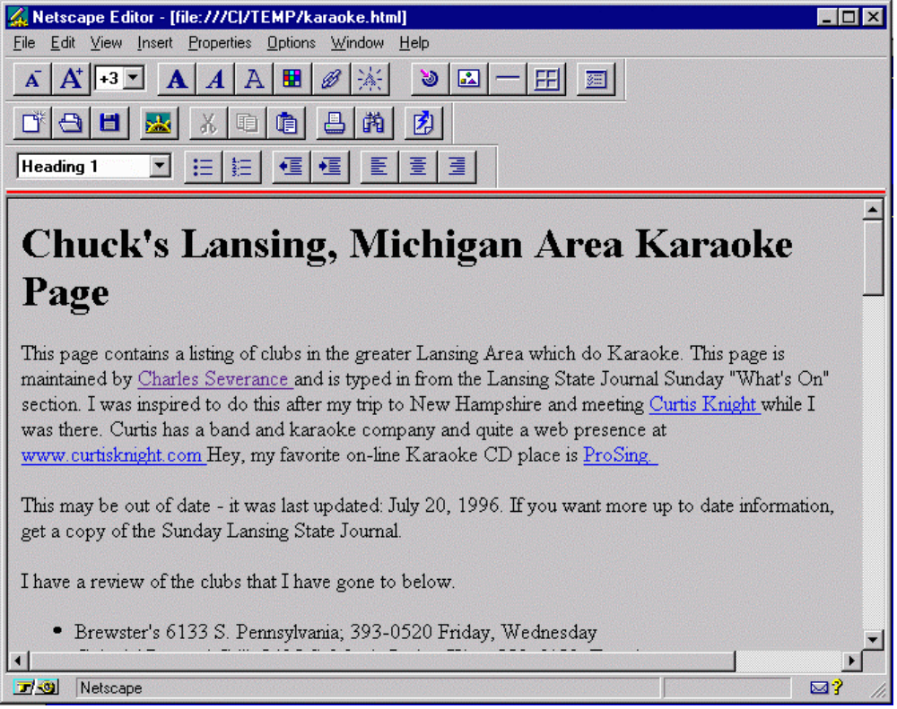
Navigator Editing
Notes:
Once you click the “EDIT” button, Navigator will bring up an editor - but first the file will be saved to your local disk.

Slide 16
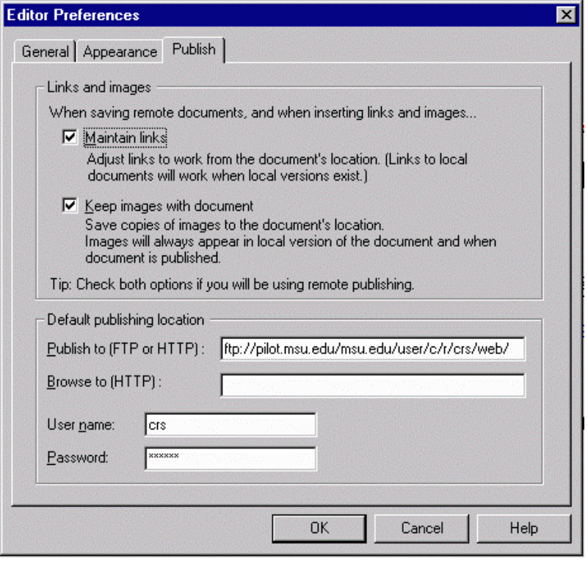

Editor Preferences at MSU
ftp://pilot.msu.edu/msu/user/c/r/crs/web/
Account and Password
Then Press

Slide 17
To find the proper location to use when setting Editor Preferences for your system, use ftp as if you were going to manually upload a file to the web space as follows:
ftp cps.msu.edu
  Connected to cps.msu.edu.
  220 arctic FTP server (UNIX(r) System V Release 4.0) ready.
  Name (cps.msu.edu:crs): crs
  331 Password required for crs.
  Password:
  230 User crs logged in.
  ftp> cd web (or whatever directory is appropriate)
  250 CWD command successful.
  ftp> pwd
  257 "/user/crs/web" is current directory.
  ftp> bye
  221 Goodbye.
The setting in preferences would be:
ftp://cps.msu.edu/user/crs/web/
Notes:
Note: In most systems, web pages are stored in the web subdirectory of your home directory. Your system administrator will have detail s on where to start your web hierarchy.

Slide 18
The index.html (or .htm) File
When you specify a directory in the URL, the web server looks for a default file
  index.html or index.htm on Pilot
  index.html on CPS and EGR
  index.htm Windows index.html on UNIX
http://www.egr.msu.edu/~crs/photos/
Added
/home/uo/crs/web/photos/index.htm

Slide 19
What is CGI?
CGI is a Web Interface where a program generates the web data dynamically each time the page is accessed
Used with fill in the blank forms
  Supported on www.cps.msu.edu
  Supported on www.egr.msu.edu
  No CGI on pilot.msu.edu
Also Server Side Includes - Odometers
Notes:
In a CGI page, the page is generated by a program rather than being read off disk. CGI is a “security hole” so not all users are allowed to use CGI. On some systems approval is needed.
Server Side Includes (SSI) are used to include the odometers and other dynamic elements in a web page.

Slide 20
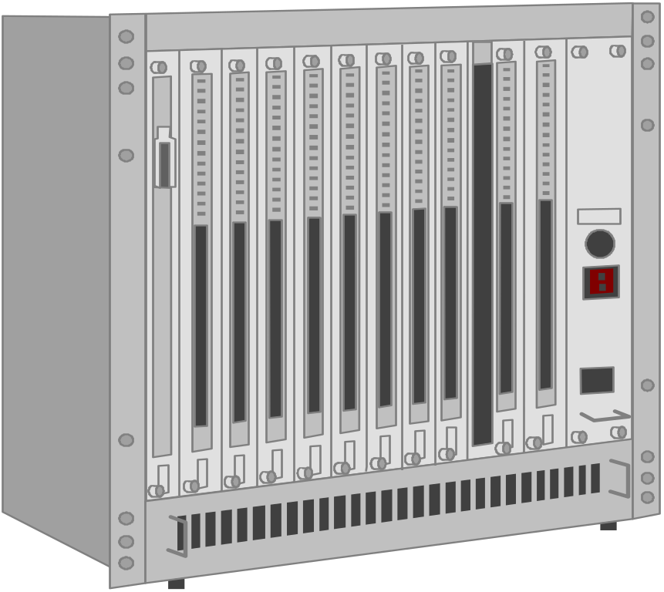



Web
Server
CGI
Program
1. GGI Program runs produces the form as output
2. Form is downloaded
3. Form is filled out and sent
4. Web Server calls CGI program passing in data
5. CGI program executes “whatever”
6. CGI program passes results to web server
7. Results are sent to the browser as HTML
Notes:
#! /bin/csh
cat << EOF
Content-type: text/html
<HTML><HEAD>
<TITLE>Sudent On-line Directory</TITLE>
</HEAD><BODY>
EOF
if ( $QUERY_STRING == "" ) then
cd /home/cps291/cgi-bin/students
set folks = ( * )
echo "You can update your directory information - "
echo "<a href=http://cps291.vu.msu.edu/cgi-bin/stupage/> update </a>"
echo "<ul>"
foreach i ( $folks )
set name=`cat $i | grep ^name: | awk -F: '{print $2}'`
echo "<li><a href=http://cps291.vu.msu.edu/cgi-bin/stulist?$i>"
echo "$name</a>"
end
echo "</ul>"
else
cat /home/cps291/cgi-bin/students/$QUERY_STRING
endif
done:
echo "</HTML>"

Slide 21
CGI Scripts
CGI Programs are typically written in
  Perl
  UNIX - Shell Language
  C or C++
May access databases or other networks
Often used for tracking (ads) and to customize an interface for each user
CGI works very well - all on the server
Notes:
In CPS, see
http://web.cps.msu.edu/facility/cgi.html

