Slide 1
Netscape Plugins
Some forms of media are built into Netscape/Explorer
  gif, html, jpg, ...
Others require a “Plug-in” or helper application
  Download the installation package
  Exit Netscape/Explorer, Install application, and Re-start Netscape
Notes:
Currently getting the necessary plug-ins can be a long process. This document describes a number of plug-ins, each of which are 700K - 3M of data which needs to be downloaded and installed on your computer. Each extends Netscape in its own way. At some point, you get so many plug ins and elper applications that you might find that your Netscape reliability might be reduced.
As time passes, more of the plug-ins are integrated into Netscae and Microsoft Explorer.

Slide 2
Types of Media
RealPlayer - www.real.com
Shockwave - www.macromedia.com
Acrobat PDF Viewer - www.adobe.com
PostScript Viewer - ghostview or rops
www.windows95.com
www.tucows.com

Slide 3
Steps for RealPlayer
In your browser, go to
  www.real.com/products/player/index.html
Fill out the forms and select the proper version
Download should take 10-30 minutes on a modem

Slide 4
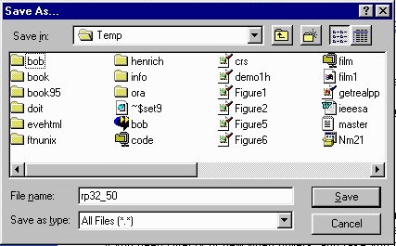
Where to Save?
When download starts, you are asked where to save the material.
I use C:\Temp\ for all my downloads
You must
remember where
you put it and
what its name was
(rp32_50 here)

Slide 5
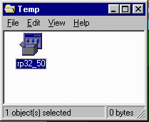
Download Completed
Exit all browsers
My Computer | C:
Navigate to where you stored the file
Click on the file
And follow instructions
Just say “yes” or “Next”

Slide 6
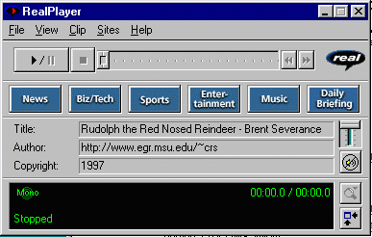
If All Goes Well
Restart Netscape/Explorer
Go back to the page
You should be
able to view the
media

