Slide 1

A Tale of Two Classes
(To nerd or not to nerd - that is the question )
Charles Severance
Michigan State University
Engineering Computing Services
and
Department of Computer Science

Slide 2
Two Classes - Summer97
CPS291 - Introduction to Internet
  Push deployable technology to the max
  Worry about details later
  20 students - one-half hoe for the summer
CPS131 - Technical Computing
  Traditional Lecture/Lab Format
  Five weeks - “triple” speed
During overlap - Direct comparison

Slide 3
CPS291 - Internet
History of the Internet
What is the Internet
Basic Internet Tools
HTML Overview
Business use of the Internet
Technical Overview of the Internet

Slide 4
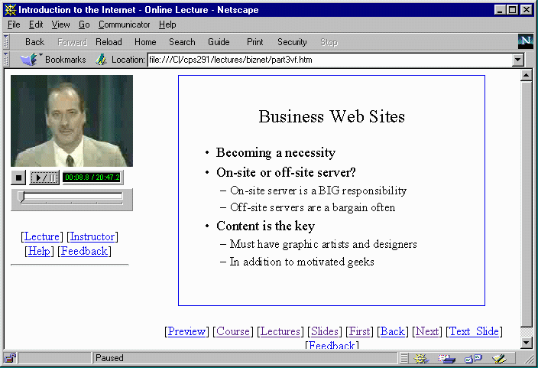
CPS291 - Web Lectures

Slide 5
CPS291 - Technology
Part of MSU Virtual University
RealAudio/RealVideo
Streaming Server
Synchronized multi-media

Slide 6
CPS291 - More Technology
Can download entire lecture -20-50MB
On-line homework and testing
  CAPA - Computer Assisted Personalized Approach - MSU Software used around the country
  NO, I didn’t do digital signatures, retina scans, proctors, virtual reality, or quickcam monitoring of the students

Slide 7
Still More Technology
Webtalk - CGI based web conferencing - developed at MSU
EWGIE - Kevin Hughes of EIT JAVA based real-time chat environment
PowerPoint-97 - Exports HTML/GIF
  Notes pages supported
  Image maps automatic

Slide 8
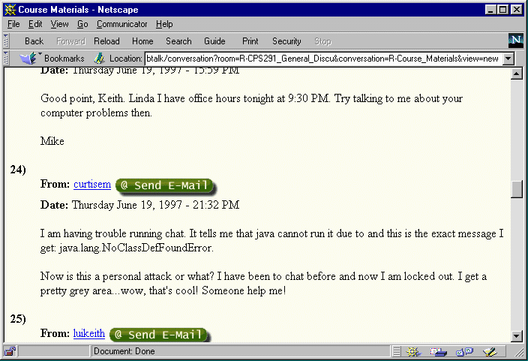
WebTalk

Slide 9
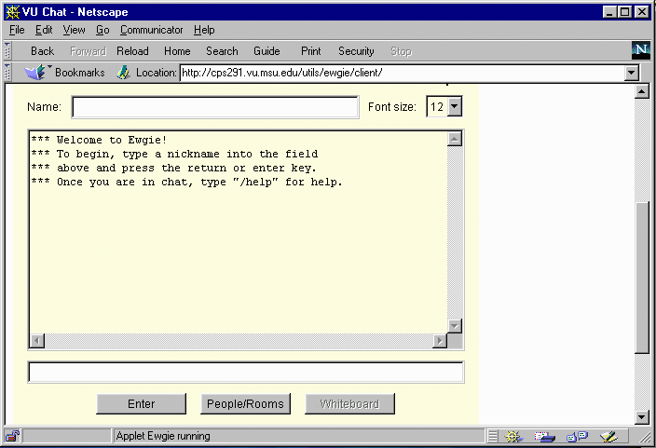
EWGIE

Slide 10
Making Web Lectures
Lecture 1 - history
  Two computers
    Quickcam -> RealVideo
    Microphone -> RealAudio
  In my office
  Wrote slideconvert v1.0
  Built web pages and event files by hand
100 hours total

Slide 11
Making Content
Lecture 2 - What is the Internet
  MSU ITV bought video capture card
  Video Camera in my office
  I digitized audio then video at ITV
  Hand-built the HTML and event files
30 hours

Slide 12
Making Progress...
Lecture 3 - Basic Internet Tools
  Recorded in a studio - Ahhhh.
  Digitized by ITV - Ahhhh.
  Bruce mentioned “frames might be nice”
  slideconvert 1.2
    Powerpoint-97
    Frames
20 Hours

Slide 13
CPS131 Starts...
Lecture 4 - Overview of HTML
  Taped in the studio
    Experiment with the best camera shot
    Show the slide for 5 seconds on video
    ITV writes timing for events (audio person)
  Improve the automatic generation of HTML
2 hours

Slide 14
This is more like it
Lecture 5 - Business on the Net
  ITV is an old hand
  No new software … for now
45 minutes
Thanks Bruce!

Slide 15
Web Page Design
Guest lecturer: Sue Davidsen
  UM/Merit Network
  Michigan Electronic Library
Studio 2.5 hours
Lecture ready and on the internet in two days

Slide 16
What is SlideConvert?
PowerPoint-97 exports HTML
  Formats are UGLY
  Each slide is img010.gif and sld010.htm
SlideConvert creates new sld010.htm
  Based on a user-template
  Extract notes, image map, and heading from PowerPoint exports
Bad C++

Slide 17
RealAudio RealVideo
Streaming Formats
  Audio 8kb/sec Video 12kb/sec
  Uses 50-70% of 28.8 modem
  Audio works best
Video only works on a Pentium or Mac
486 - RealAudio 2.0 only

Slide 18
.. Perchance to stream
Streaming - Costs $1000 +
  Special UDP protocol client <-> server
  Adapts to load
  Allows random jumps
Pseudo-Streaming - Any web server
  Uses TCP - Plays once it has a sufficient head start
  Random is difficult - may wait 10 minutes

Slide 19
Synchronized Multimedia
Adds web events to Audio/Video
Causes browser to be slaved to player
Begs for software
  Timeit 1.0
  Llamatime 1.0 coming… :)
u 00:00:00 00:01:33 http://www.vu.msu.edu/cps291/sld001.htm
u 00:01:33 00:03:25 http://www.vu.msu.edu/cps291/sld002.htm
u 00:03:25 00:05:15 http://www.vu.msu.edu/cps291/sld003.htm

Slide 20
Current State of CPS291
Week 13
  Five lectures - Five Homeworks
  Two midterms
  Positive feedback from students
  Except
    Technical difficulties make them miss deadline
    I am slow returning E-Mail
  Office hours from U-C, Ill and Baltimore

Slide 21
CPS131 - Technical Computing
Word/Excel/Matlab/Visual Basic
Competency class focused on needed skills on real tools
Freshman level
Twelve hands-on labs - theme of the class
Five weeks - three credits - “3X speed”

Slide 22
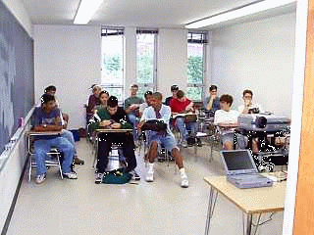
Not a Virtual Lecture

Slide 23
CPS131
15 A.P. High School Students
Instructor / TA
8:1 Instructor to student ratio
Weekly - six hours lecture six hours lab
Lectures
  Skill Oriented - “teach MATLAB”
  Background oriented - Math/Physics

Slide 24
Details, details
Text book - Addison Wesley Engineering modules (Great book)
Paper handouts - Minimal web page
Minimal E-Mail (30% of day in class)
TA was like “mother hen”
Hand-grade everything
CPS291 Final exam - July 22 - Whew!

Slide 25
Observations
Neither my TA nor I knew knew MATLAB or Visual Basic in May
He got to attend CPS131 in June
Two-way learning me <-> students
Lectures would trigger questions which would cause me to alter the next lecture - JAVA Unit Circle

Slide 26
More Observations
I worried less whether or not students got their money’s or credits worth
I could walk by a lab and get a sense of accomplishment
I decided to gather a little data…
the day before yesterday

Slide 27
Assessment - for both classes
Skill increase
Time spent
Learning value
Instructor contact style
Number of questions
Question media
Class interest
Worst topic
Best topic
New topic
Home computer
Technical problems with class
Improvements
Comments

Slide 28
Gross Speeds and Feeds
Study outside lecture / lab - 2.83 hr/wk
Contribution to learning
  Lecture 37% Lab 43% Self 20%
No appreciable difference for students with different incoming skill levels
Will be interesting to compare w/CPS291 -- Journal Article ?? :)

Slide 29
Comparing the classes
When time got short - CPS131 won
CPS291 students are honest in E-Mail
I felt more vulnerable “on the web”
I am lousy at making real office hours but worse making on-line office hours

Slide 30
Questions
Did normal (non-geek) students get benefit from CPS291? How much? One credit? “Self accreditation”
What about teaming and collaboration - the web seems to encourage study separated in space and time

Slide 31
Lessons Learned - Summer 97
I need a TA for the web course
Conferencing/BBS is a waste
Chat is bad except for scheduled events
E-Mail is very good - every 2-3 days
Get an AOL account for testing
A streaming server makes a difference
Technology gets in the way

Slide 32
CPS291 - Fall 1997
Additions
  Teaching Assistants (2 Undergrad)
  Office hours become “meetings”
  Class directory - class E-Mail
  Recent activity - active pages
  Regular E-Mail
  High School/Adult Ed
College of Ed. Help - SeJin Chung

Slide 33
EGR124 - Winter
ENG124 Internet and Technology
  New Topics - 2 Credits
    Advanced Internet Tools
    Web Page Design
    Copyright/Intellectual Property
  Video for beginners - Modem/Software
  Get organized re: High Schools
  WILL have my lab for viewing

Slide 34
Crazy Ideas
EGR124 3 credits
  CGI/JAVA/JAVASCRIPT
  Make textbook/video series/CD-ROM
CPS131 + Precalculus (5 credits)
  Skill Building (MATLAB, Visual Basic)
  Math Understanding (Alg, Trig, Calc)
  Team Skills - Programming project
  Web for background skills and review

Slide 35
Software Plans
Timeit - Complete 9/1/97
  Creates RealAudio/RealVideo event files easily - Visual Basic
DOIT - replaces Slideconvert
  Point/click
  Preferences
  Multiple styles
Goal: ITV does the whole lecture

Slide 36
Conclusion to Date
Get HELP - Instructional Television
  Build infrastructure - pays off quick
Frames are useful for something
Web lectures have good potential when the hardware/software environment is stable.
Students really like my on-line lectures - a fun topic helps

