Slide 1

Experiences Teaching over the Web in a Virtual University
Charles Severance
Michigan State University
Engineering Computing Services
and
Department of Computer Science

Slide 2
MSU Game Plan
High tech push
Build on distance education
Certificates and degrees will evolve
Provide technical infrastructure/people
  Faculty focus on teaching

Slide 3
Fall 1996
MSU Virtual University Established
  Five courses
Michigan Virtual Automotive College
  “Internets, Intranets, and Firewalls”
  Approved among the first 23 courses
  Who knew when the call would come?

Slide 4
CPS291 - Internet (aka EGR124)
History of the Internet
What is the Internet
Basic Internet Tools
HTML Overview
Business use of the Internet
Technical Overview of the Internet

Slide 5
CPS291 - Spring 1997
Television lecture - one hour per week
All honors college students because course was created at the last minute
Used clips from Internet:TCI
Great class - lots of fun - 26 students
Oral Final Exam - Live on Lansing area cable TV

Slide 6
Summer 1997
Technology was the problem for me
  100 hours for the first lecture
  Locked in the studio all night long
25 students - most left for summer

Slide 7
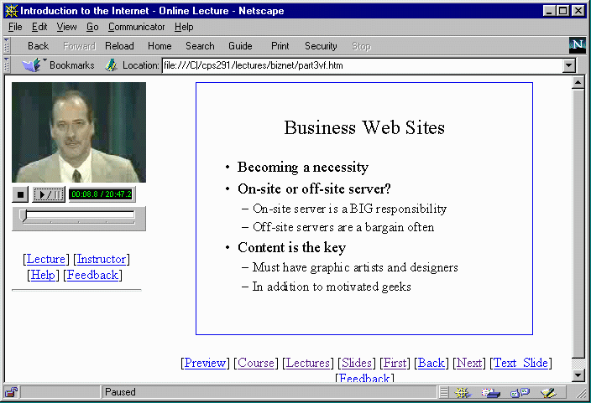
CPS291 - Web Lectures

Slide 8
CPS291 - Technology
Part of MSU Virtual University
RealAudio/RealVideo
  Audio 8kb/sec Video 12kb/sec
  Uses 50-70% of 28.8 modem
Streaming Server
Synchronized multi-media

Slide 9
CPS291 - More Technology
On-line homework and testing
  CAPA - Computer Assisted Personalized Approach - MSU Software used around the country
  NO, I didn’t do digital signatures, retina scans, proctors, virtual reality, or quickcam monitoring of the students

Slide 10
Still More Technology
Webtalk - CGI based web conferencing - developed at MSU
EWGIE - Kevin Hughes of EIT JAVA based real-time chat environment
PowerPoint-97 - Exports HTML/GIF
  Notes pages supported
  Image maps automatic

Slide 11
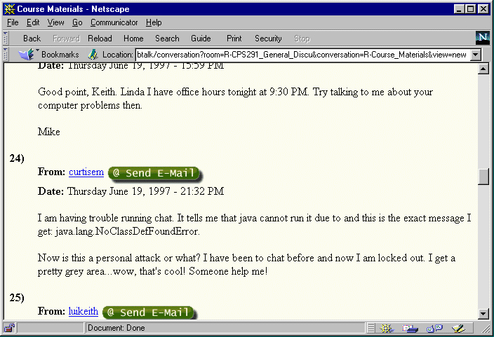
WebTalk

Slide 12
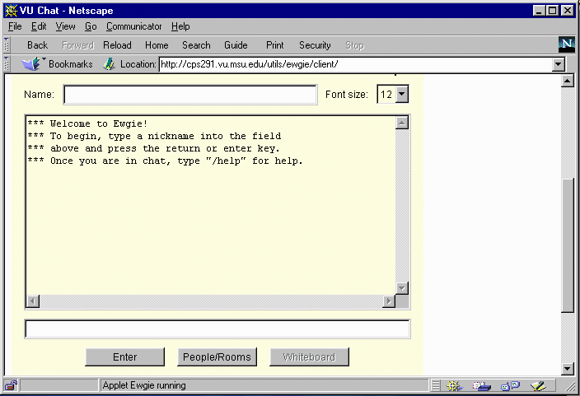
EWGIE

Slide 13
Lessons Learned - Summer 97
I needed a TA for the web course
Conferencing/BBS is a waste
Chat is bad except for scheduled events
E-Mail is very good - every 2-3 days
Technology gets in the way

Slide 14
CPS291 - Fall 1997
Additions
  Teaching Assistants
  Office hours become “meetings”
  Class directory - class E-Mail
  Recent activity - active pages
  Regular E-Mail
  High School/Adult Ed
I was distracted - CPS474 and my book

Slide 15
Lessons Learned - Fall 1997
It worked pretty well for MSU students who already had Internet Access
Needed to really focus on technology problems at the beginning - high school students got really lost

Slide 16
EGR124 - Spring 1998
ENG124 Internet and Technology
  New Topics - 2 Credits
    Web Page Design
    Copyright/Intellectual Property
  Video for beginners - Modem/Software
  Gauntlet - 2.5 weeks - Fail = Dropped
  Group Projects
  41 Students 4 High School

Slide 17
Crazy Ideas
EGR124 3 credits
  JAVA/JAVASCRIPT/Active Server Pages
  Make textbook/video series/CD-ROM
  Need to make more difficult
    Papers Projects and Technical Assignments

Slide 18
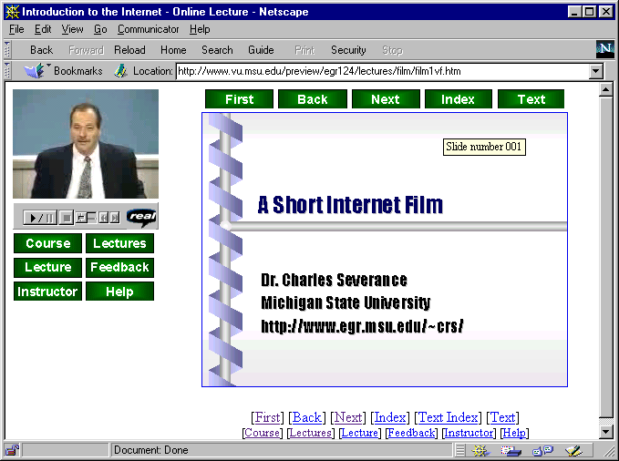

The Sync-O-Matic-3000
Audio
Video
Sync-O-Matic
Slide Timing
PowerPoint
Style Files

Slide 19
Production Modes
Office Mode
  Do it all on your personal computer
  Capture/Digitize
Studio Mode
  Will professionally produce show to tape - then digitize
First we will discuss the techniques in the office

Slide 20
Purpose
Sync-O-Matic is a tool which can improve the ability to deploy on-line lecture content
  Faculty can tape a lecture in a studio and studio staff can produce high quality on-line lecture within hours
  Faculty can use their own personal computer to produce lecture content with minimum of effort

Slide 21
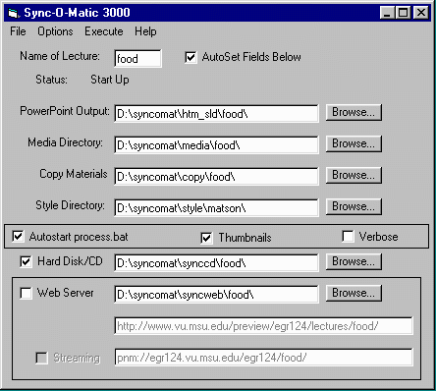
User Interface

Slide 22
High Tech Friends
Cost Rollup - Robert L. Chiodo - University of Wisconsin Stout
Math 2342 - Statistics for the Sciences - Ed Jones, Texas A&M Corpus Christie
Teaching on the Net and Privacy from Roger Bullis at University of Wisconsin at Stevens Point
Micro-Economics James Reese - University of South Carolina Spartanburg

Slide 23
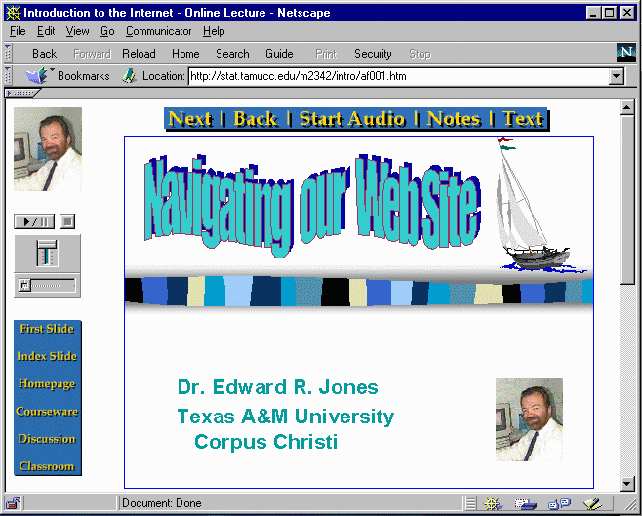

Slide 24
More Instructors at MSU
Instructional Television will do it all
  Walk in with PowerPoint
  Lecture to Camera
  Minutes later the lecture is up on an ITV web server
  Video digitizing hardware in every ITV studio
EC201, PHY231, CPS230, CPS131

Slide 25
CPS474 - Fall 1998
High Performance Computing
I wrote the current edition of textbook
Make a lecture for each chapter
Time will be spent interacting with students
I expect it to be a weird experience
This is my model for a future class

Slide 26
Conclusion to Date
Get HELP - Instructional Television
  Build infrastructure - pays off quick
Web lectures have good potential when the hardware/software environment is stable.
Students really like my on-line lectures - a fun topic helps

Slide 27
Thanks
Bruce Spike, Katie Hicks, Susi Dahl - MSU Instructional Television Staff
Raymond Laurin - MSU Undergraduate Student
Ed Jones, Texas A&M

Slide 28
URLS
http://www.vu.msu.edu/preview/egr124/
http://www.egr.msu.edu/~crs/
http://www.egr.msu.edu/~crs/projects/syncomat

