Slide 1

Experiences Teaching over the Web in a Virtual University
Charles Severance
Michigan State University
Engineering Computing Services
and
Department of Computer Science

Slide 2
MSU VU Game Plan
High tech push
Build on distance education
Certificates and degrees will evolve
Provide technical infrastructure/people
  Faculty focus on teaching
  Instructional TV and VU staff is free
Faculty “volunteer”

Slide 3
Fall 1996
MSU Virtual University Established
  Five courses
Michigan Virtual Automotive College
  “Internets, Intranets, and Firewalls”
  Approved among the first 23 courses
  Who knew when the call would come?

Slide 4
CPS291 - Internet (aka EGR124)
To prepare MVAC materials...
  History of the Internet
  What is the Internet
  Basic Internet Tools
  HTML Overview
  Business use of the Internet
  Technical Overview of the Internet

Slide 5
CPS291 - Spring 1997
Television lecture - one hour per week
All honors college students because course was created at the last minute
Used clips from Internet:TCI
Great class - lots of fun - 26 students
Oral final exam - Live on Lansing area cable TV

Slide 6
Summer 1997
“Go home and still earn a credit over the web”!
  25 Students
  On-campus, out-state, Germany, China
Technology was the problem for me
  100 hours for the first lecture
  Locked in the studio all night long

Slide 7
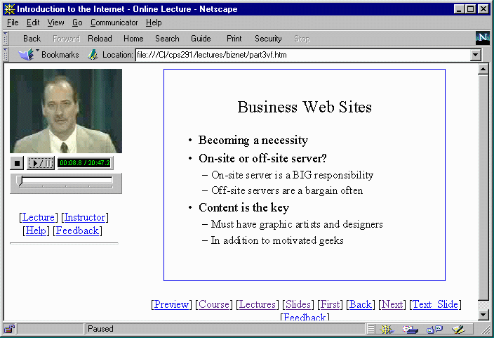
CPS291 - Web Lectures

Slide 8
CPS291 - Technology
RealAudio/RealVideo - Modem delivered - synchronized multi-media
On-line homework and testing
Webtalk - CGI based web conferencing - developed at MSU
EWGIE - Kevin Hughes of EIT JAVA based real-time chat environment

Slide 9
Lessons Learned - Summer 97
Technology gets in the way of the teacher and student
I needed a TA for the web course
Students were not comfortable with Conferencing/BBS
Students were comfortable with E-Mail
Live chat is bad except for scheduled events

Slide 10
CPS291 - Fall 1997
Additions
  Volunteer Teaching Assistants
  Office hours become “meetings”
  Recent activity - active pages
  Regular broadcast E-Mail
  High School/Adult Ed
I was distracted - CPS474 and my book

Slide 11
Lessons Learned - Fall 1997
It worked pretty well for MSU students who already had Internet Access
Needed to really focus on technology problems at the beginning - high school students got really lost

Slide 12
EGR124 - Spring 1998
EGR124 Internet and Technology
  New topics - Copyright and Web Design
  Video for beginners - Modem/Software
  Gauntlet - 2.5 weeks - Fail = Course 0.0
  Group Projects - Make a lecture
  41 Students 4 High School
First “succcessful semester”

Slide 13
Summer 1998
Getting very close
  Large group project - Learn to discuss
  Small Group Project - Create a lecture
  Individual project - Slick web pages
  Faster pace - New topics Javascript and Advanced Multimedia
  NetMeeting Instant Message and ICQ
20 Students 2 High School

Slide 14
Fall 1998
Production - Target 100 students
2-3 Paid TA’s
Topics should be stable
May adjust projects/papers
Future: 3 Credits
  JAVA/Active Server Pages
  Make textbook/video series/CD-ROM

Slide 15
Sync-O-Matic 3000
Driven by the need to save faculty time
  Include the professionals from ITV
  Today at MSU, a faculty can walk into a studio with PowerPoint on a floppy, give their lecture to the camera and by the time they have returned to their office, the lecture will be up on the web.
Currently in use at several other locations

Slide 16
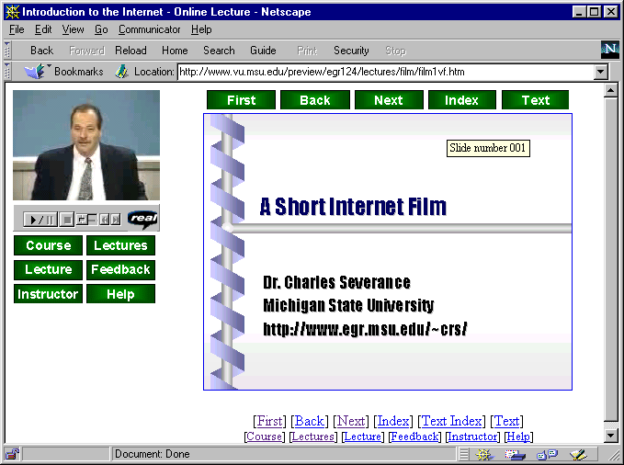

The Process
Audio
Video
Sync-O-Matic
Slide Timing
PowerPoint
Style Files

Slide 17
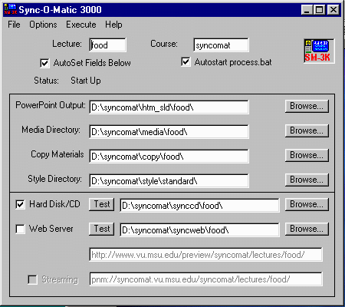
User Interface

Slide 18
High Tech Friends
Cost Rollup - Robert L. Chiodo - University of Wisconsin Stout
Math 2342 - Statistics for the Sciences - Ed Jones, Texas A&M Corpus Christie
Micro-Economics James Reese - University of South Carolina Spartanburg
MSU CPS230 (C++), EC201 (Micro), PHY231 (Intro), CPS474(HPC

Slide 19
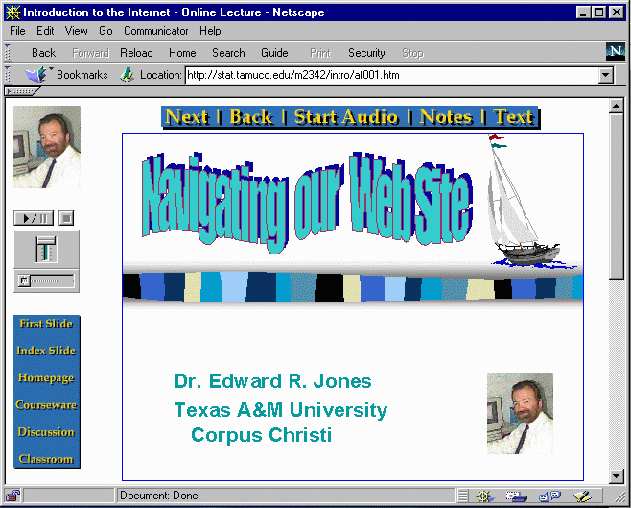

Slide 20
CPS474 - Fall 1998
High Performance Computing
I wrote the current edition of textbook
Make a lecture for each chapter
Time will be spent interacting with students
I expect it to be a weird experience
This is my model for a future class

Slide 21
Observations
Based on my feedback so far, students like, enjoy, and learn from the class
Much easier and fun than a CD-ROM
I suffer from burn-out
I don’t get as much out of teaching this class as I do teaching in a classroom
I need interactions during which I learn

Slide 22
Conclusion to Date
Get HELP - Instructional Television
  Build infrastructure - pays off quick
Web lectures have good potential when the hardware/software environment is stable.
Students really like my on-line lectures - a fun topic helps

Slide 23
Summary
This course demonstrates potential to deliver education at a distance which may actually be enjoyable
Many educators seem to feel that the Internet is a good way to eliminate the educator - I feel the Internet ultimately be used to strengthen the educator.
Work still needs to be done

Slide 24
Thanks
Bruce Spike, Katie Hicks, Susi Dahl - MSU Instructional Television Staff
Raymond Laurin - MSU Undergraduate Student
Ed Jones, Texas A&M

Slide 25
URLS
http://www.vu.msu.edu/preview/egr124/
http://www.egr.msu.edu/~crs/
http://www.egr.msu.edu/~crs/projects/syncomat

