Slide 1
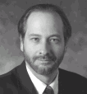


CPS291 Introduction to Internet
MSU Virtual University
Instructor
Welcome to CPS291. This page is for students for CPS291 during Summer 1997 as part of the Virtual University. This class will indeed be completely done using the Web, RealAudio, and CAPA for the homework and exams. Office hours will be on the phone and the Internet. The class is available to regular students, lifelong education students, and may also be given as a non-credit course. Note: Students enrolled in CPS291must have their pilot account activated and regularly read mail sent to their Pilot account. Official communications regarding the course will be done through Pilot.
The course will be an abbreviated version of my two credit Spring 1997 CPS291 Course. In essense, CPS291 Summer will be the "best of" CPS291 Spring.
If you have any questions or comments, please let me know. My E-Mail is crs@egr.msu.edu and my phone is 517-353-2268.
http://www.egr.msu.edu/~crs/school/cps291int/summer97.html
About
Lectures
Homework
Conference
Chat
Reference
Feedback

Slide 2
Instructor
About
Next
Back
Lectures
Homework
Conference
Chat
Reference
Feedback

Slide 3
First
Back
Next
Index
Text
Course
Lectures
Lecture
Feedback
Instructor
Help

Slide 4
CPS291 Introduction to Internet
MSU Virtual University
Course Page
Lecture Material
This is the page which allows you to access the CPS291 lectures. Each lecture consists of Audio, Slides, notes, animations, followed by an on-line homework.
Each of the buttons takes to you to one of the topics in the class. If you need assistance getting any of the software to work, press here.
You will have a two week period to finish the homework associated with any lecture.
Blah Blah Blah.
History
What Is It?
Basic Tools
HTML
Business
Technical

Slide 5
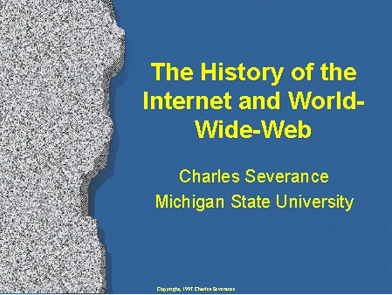
Course Page
Lectures
Index
First
Back
Next
Last
Help

