Slide 1
Getting Started in the
Michigan State University Virtual University www.vu.msu.edu

Slide 2
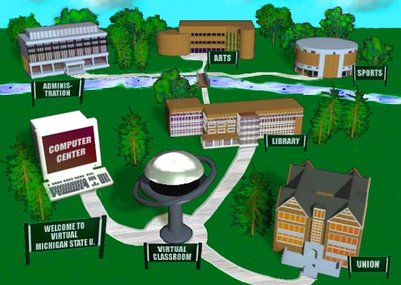

Slide 3
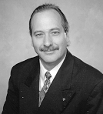
with
Dr. Charles Severance

Slide 4
Many Steps
Get accepted and registered
Get your home/school/work computer working
Get authorized to use MSU computers
Get E-Mail working
Get a web page up

Slide 5
Outline
Your PID, PAN, Pilot ID and Password
Configuring Windows-95 Software
Setting up a Pilot ID over your modem
Setting Up TCP/IP over a modem
Using telnet and pilot

Slide 6
More Outline
Installing the RealPlayer plug-in
Accessing a Virtual University course
Debugging Plug-Ins
Creating a web page
Uploading a web page
Modem Installation

Slide 7
Info
Hotline
Nationwide 1-800-500-1554
East Lansing 355-2345
Virtual University web address
http://www.vu.msu.edu/

Slide 8
Other Resources
MSU Regional Offices
  Computer labs and other resources
  Oakland County: (248) 645-5410
  Grand Rapids: (616) 458-6805
  Traverse City: (616) 929-3902
  Marquette: (906) 228-4830
East Lansing campus computer labs

Slide 9
What We Cover
Windows-95 - This video
Windows 3.1 / Macintosh
  Concepts are similar
  Precise steps are different
Users already connected may want to skip first few segments - to “Using Pilot”

Slide 10
Welcome
Hopefully you have been admitted to Michigan State University
PID (Personal ID Number) A12345678 and PAN (Four-digit Personal Access Number)
PIDS can also start with a V - these are V-PIDs (Virtual Personal ID Numbers)

Slide 11
How do you use a PID/PAN?
These identify you as a university student for the purpose of enrollment
  Computer enrollment
  Telephone enrollment
  Also used to create your Pilot ID!
Protect this - It IS your identification

Slide 12
What is a Pilot ID for?
State-wide unlimited Internet access
Electronic mail
  telnet pilot.msu.edu
  POP Mail Host: pilot.msu.edu
Web Pages
Microcomputer laboratory usage
Virtual university classes

Slide 13
Comments or Questions
This needs to serve your needs
Please let us know how it can be improved
Hotline - 1-800-500-1554
Contact me directly: crs@msu.edu

Slide 14
Up Next
Getting Connected...

Slide 15
Communication Software
If you are already on the net - Skip this
Assume modem is installed, we need:
  Dial-Up Networking
  Hyperterminal
  TCP/IP
Make sure you have your Windows-95 CD or floppies ready before starting

Slide 16
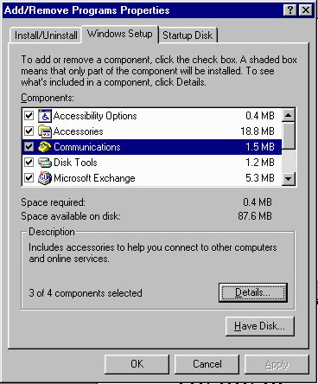
Dial-Up Networking
Start | Settings | Control Panel | Add/Remove Programs | Windows Setup
Click once on “Communications” and press “Details”

Slide 17
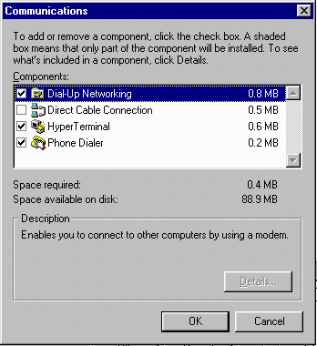
Dial-Up Networking
Make sure that Dial-UpNetworking and HyperTerminal are selected then press OK
You will then be prompted for your CD-ROM

Slide 18
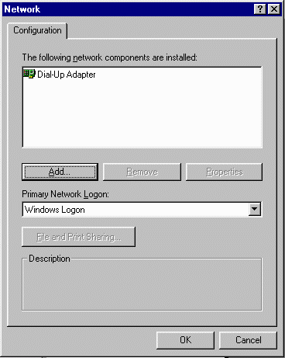
Installing TCP/IP
Start | Settings | Control Panel | Network
You should see your modem adapter if not, go to “Add New Hardware”
Press “Add”

Slide 19
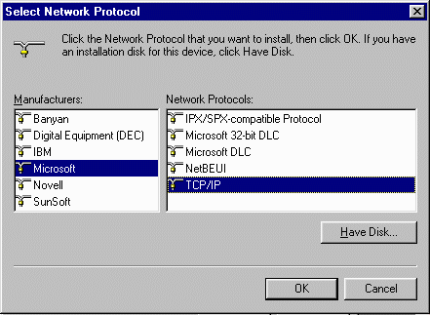
Installing TCP/IP
“Protocol” and press “Add”
The manufacturer is “Microsoft” and the Protocol is “TCP/IP”
Press OK, and be ready to insert your CD-ROM

Slide 20
Up Next
Your First Connection...

Slide 21
Connecting and Activating
You must activate your Pilot ID before you can use the MichNet Network for your Internet access
If you already have Internet access:
  “Start | Run | telnet pilot.msu.edu” | OK
  This substitutes for Hyperterminal
  Skip to “Activating Pilot” in this segment

Slide 22
Finding the Phone Number
The Merit network provides dial-up phone access across the state of Michigan
You need to find your access number
  http://www.merit.edu/michnet/
  how.to.get.connected/michnet.nos
  Hot-line 1-800-500-1554
Can setup long distance 517-353-3500

Slide 23
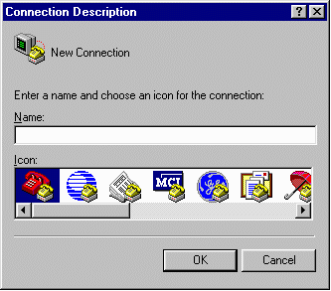
Getting Connected
Start | Programs | Accessories | Hyperterminal | Hypertrm
Name your connection “Bob” (or anything else) and press “OK”

Slide 24
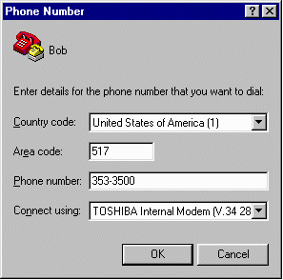
Hyperterm
Put in the phone number including area code
On the next screen, make sure to set Dialing Properties

Slide 25
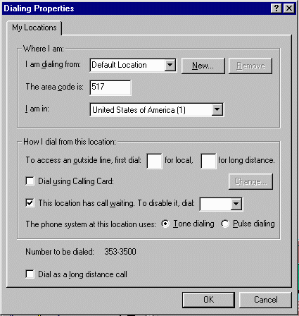
Dialing Properties
Set area code
Set other options as necessary
At the bottom it shows the phone number it will dial
Press OK

Slide 26
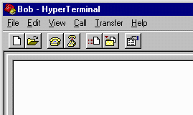
Connecting
When done, press “Dial”
of the big “Phone” icon
The little “hanging up” phone is to disconnect in case something goes wrong
If all goes well, you will hear the squealing noises and will be connected

Slide 27
Logging In
Once the connection is established you will log-in
Connecting to certain hosts, you can use the guest account
host: pilot.msu.edu
login: guest@msu.edu
Password: bob (nothing cares)

Slide 28
Activating Pilot
Next you will be faced with a login prompt from the pilot system
This is the system which you will eventually use for E-Mail and web but for now you are activating your account
login: pilot
Password: bob (nothing cares)

Slide 29
Now for the PID and PAN
Now you will be prompted for your PID and PAN to activate your Pilot Account
It will tell you what your Pilot ID is during this process so make sure to write it down

Slide 30
Pilot Password
Once you have entered a valid PID/PAN combination it will set your Pilot password - Remember this
After you set your password, it will let you try to log-in - this is a good test
login: slenia17
Password: notbob (your password)

Slide 31
Logged In Successfully
Once you have logged in successfully, press q to exit
Our next step is to get re-connected using the Internet

Slide 32
Up Next
Dial-up internet connection...

Slide 33
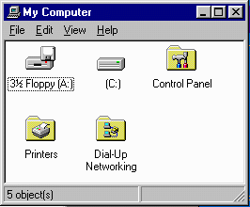
Activating Internet
If you are connected already - skip this
Go to My Computer |
Dial-up Networking
If you have not installed
the software as described
earlier, “Dial-up Networking”
will not be there

Slide 34
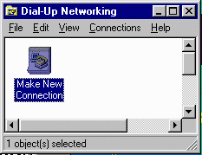
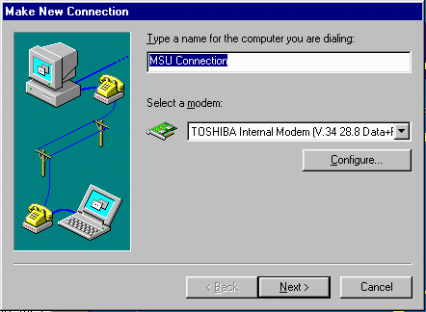
Dial-Up Networking
Click on “Make New Connection”
Name your
connection
Make sure
the right
modem is
selected

Slide 35
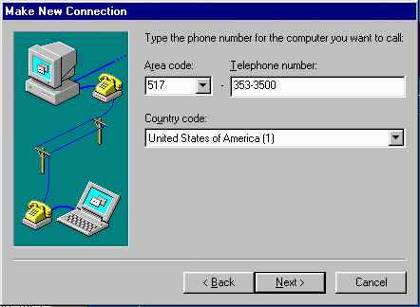
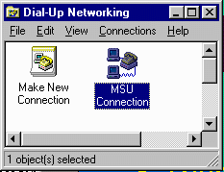
More Internet
Enter the phone number and press Next
Then “finish”
You will see a
new icon

Slide 36
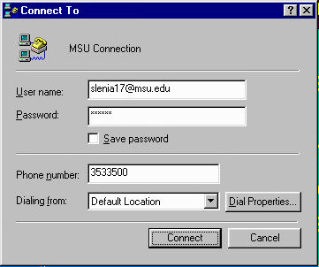
Making the Connection
Click on the new Icon
User Name is
slenia17@msu.edu
Password is your
Pilot Password
which you just
have created
Connect

Slide 37
Success!
It will tell you when it is connected
To test it,
Start | Run | telnet pilot.msu.edu | OK
If you get the log-in prompt, you are on the Internet - Congratulations
In case this does not work, go back and review/re-do the steps again

Slide 38
Up Next
Using Pilot E-Mail...

Slide 39
Activating Pilot
Before you use Pilot, you must “activate” your Pilot ID.
This only needs to be done once
Start | Run | telnet pilot.msu.edu | OK
login: pilot
Password: bob (nothing cares)

Slide 40
Now for the PID and PAN
Now you will be prompted for your PID and PAN to activate your Pilot Account
It will tell you what your Pilot ID is during this process so make sure to write it down

Slide 41
Pilot Password
Once you have entered a valid PID/PAN combination it will set your Pilot password - Remember this
After you set your password, it will let you try to log-in - this is a good test
login: slenia17
Password: notbob (your password)

Slide 42
Using Pilot
Start | Run | telnet pilot.msu.edu | OK
telnet (pilot009)
Welcome to Pilot.
If you need to setup your account, enter 'pilot'.
login: crs
crs's Password:

Slide 43
[MAIN MENU] PILOT E-mail System
Charles Severance
crs@pilot.msu.edu
m - Mail
d - Directory search
p - Password change
u - Usage statistics
a - Advanced features
h - Help
q - Quit

Slide 44
Mailbox is '/var/mail/crs' with 57 messages [ELM 2.4 PL24]
1 Jan 18 Castillo Zacatelco (32) Help me ..!!!
2 Jan 18 Mark A. Hunter (38) IEEE/SEM Web Page
3 Jan 18 Marshall D. Hesten (29) Web Version of CPS 291
4 Jan 18 Marshall D. Hesten (34) Zoom Text in 220 Egr
5 Jan 18 Jeff Evans (32) Re: not making the 10:20
6 Jan 17 David J Fitzgerald (90) How to get the money!!??
7 Jan 17 David J Fitzgerald (64) Funding Proposal
8 Jan 17 Alejandro Diaz (144) Computing Services Advisory Committe
9 Jan 17 George.Van_Dusen (25) Engineering Fee
10 Jan 17 Bernie G Holmes (54) APP&R Budget Suggestions
You can use any of the following commands by pressing the first character;
d)elete or u)ndelete mail, m)ail a message, r)eply or f)orward mail, q)uit
To read a message, press <return>. j = move down, k = move up, ? = help
Command:
Folder unchanged
Notes:
This is an example of a screen capture of the program called elm. This program is currently in use in the Pilot project at MSU where 60000+ faculty, staff, and students read E-Mail using UNIX servers.
Another popular text oriented mail reader is called “pine”.
While these types of interfaces are not flashy and can be difficult to learn, they can be used from any type of computer including a handheld computer with a modem.
Often text-based interfaces such as these are very effective for persons with sight limitations.

Slide 45
Sending Mail
At Pilot mail menu, press ‘m’
Enter e-mail address (get it right)
Enter Subject
Command: Mail
Send the message to: rchurch@pilot.msu.edu
Command: Mail To: rchurch@pilot.msu.edu
Subject of message: What do you think of the Video?

Slide 46
Sending...
Add E-Mail addresses for carbon copies
Edit Message
  ESC 1 means Exit and Save
  ESC h means help
Command: Mail To: rchurch@pilot.msu.edu
Subject of message: What do you think of the Video?
Copies: [nothing typed here - just Enter]

Slide 47
E-Mail Addresses
E-Mail addresses consist of a account name and an Internet Domain Name
  crs@pilot.msu.edu
E-Mail addresses are like phone numbers - don’t mess them up
Account Name
Domain Name
Notes:
An E-Mail address is a precise way to contact a person. As long as your mail system supports Internet style addresses if someone types that address into their mail program you will get the information. Mail addresses are unique across the Internet. In a sense it is like a pager number.
Often people put their E-Mail addresses on business cards and other forms of correspondence to allow people to contact them easily.
E-Mail addresses are VERY precise - much like phone numbers. crs@egr.msu.edu is not the same as chuck@michigan.state.university or dr.chuck@msu. A single typo nearly always makes the E-Mail addresses incorrect and the resulting mail undeliverable.
Using a technique called “mail forwarding” a user may actually have several working E-Mail addresses:
20095crs@ibm.cl.msu.edu (1987)
crs@cps.msu.edu (1988)
crs@egr.msu.edu (1988)
crs@convex.cl.msu.edu (1989)
crs@msu.edu (1991)
crs@clunix.msu.edu (1992)
As a person moves form computer to computer, they collect addresses.

Slide 48
Reading E-Mail
Text-style interfaces
  Read mail on the Internet connected server
  Store folders on the server
  Must use simply text editor to compose
  But it works everywhere!
Post Office Protocol on PC’s
  Much more convenient - Mouse
  PC’s may be turned off or disconnected
Notes:
Originally, we read mail on an Internet connected server. The mail would be delivered to the server, and then periodically we would log-in and run the mail program. This has a few drawbacks, in that it does not take full advantage of the capability of the PC. A PC has a mouse, can select text, and is relatively easy to learn to write documents.
To take advantage of PC capabilities, the server is used as a post-office to hold the messages until the PC user is ready to read the messages.

Slide 49
Post Office Protocol (POP)
With PC’s people like “pointy-clicky”
While you are not connected, pilot gathers your mail
When you reconnect, your mail program starts up and mail is downloaded
Ease of editing and composing
Attaching a files
Notes:
Because a PC may be shut off when a person leaves the office or it may not be connected to the Internet when the modem is not dialed, it is not practical to deliver directly to a PC. Typically the mail is delivered to a server permanently attached to the Internet This way, the mail can be delivered the instant the sender completes the message. When the receiver starts their system, it downloads the mail from the server to be read.
This is called the post office protocol because it is very similar to having a Post Office Box. You do not have to be present when the mail is delivered into the box. You stop in at your convenience and pick up the mail which has been placed in the box.

Slide 50
POP Settings @ Pilot
Pilot also supports POP access
  POP server: pilot.msu.edu
  SMTP server: pilot.msu.edu
  POP account and password are the same as your pilot ID (no @msu.edu)
Software
  Eudora, Netscape, Outlook, Pegasus

Slide 51
Up Next
Installing the RealPlayer...

Slide 52
Installing a Plug-In
Some virtual university classes use audio or video
This needs additional software to extend Netscape/Explorer/AOL
These are called “Plug-Ins”
We need the RealPlayer plug-in
If you are slower than 486-66 call the hotline for special instructions

Slide 53
Steps
In your browser, go to
  www.real.com/products/player/index.html
Fill out the forms and select the proper version
Download should take 10-30 minutes on a modem

Slide 54
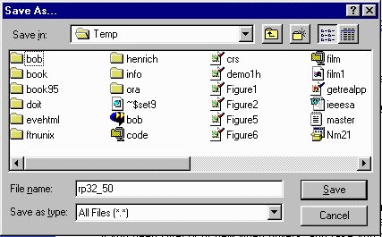
Where to Save?
When download starts, you are asked where to save the material.
I use C:\Temp\ for all my downloads
You must
remember where
you put it and
what its name was
(rp32_50 here)

Slide 55
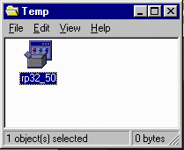
Download Completed
Exit all browsers
My Computer | C:
Navigate to where you stored the file
Click on the file
And follow instructions
Just say “yes” or “Next”

Slide 56
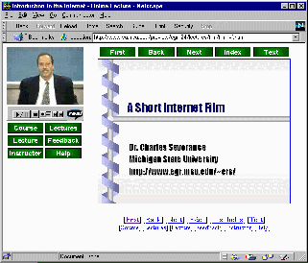
If All Goes Well
www.vu.msu.edu/preview/egr124/
You should be
able to see audio
and video
Any problems,
call the hotline

Slide 57
Up Next
Accessing a Virtual University class...

Slide 58
Virtual University Classes
Many different approaches
  Completely web based
  Live distance education with web-aspects
  Taped distance education with web-aspects
Will need account to have full access to the web sites

Slide 59
Web Sites
Preview pages
  Sample materials
  http://www.vu.msu.edu/preview/egr124/
Authenticated Course Pages
  Course materials
  Chat rooms / Bulliten boards
  http://egr124.vu.msu.edu/

Slide 60
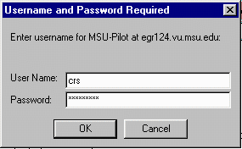
Logging In on the Web
You need your Pilot ID and Password
Pilot ID does NOT have @msu.edu

Slide 61
Problems Getting into Class
Check your ID and password by logging into Pilot
It may take a little while if you late register
Don’t wait too long - contact the hot-line and/or your instructor

Slide 62
Up Next
Your first web page...

Slide 63
Publishing Your Home Page
Develop your HTML (HyperText Markup Language)
Upload to the web space (use FTP)
Test your web page
There are easier ways to do this but this way will work
Notes:
The site www.windows95.com is an excellent site for graphics editors.

Slide 64
Create index.htm
Type this into a file C:\index.htm
<h1>A Very Simple Home Page</h1>
<p>
Welcome to my home page. This page
is just a test to see if I can actually get
something to upload. Here is
<a href=“http://www.msu.edu/”> MSU! </a>
</p>
<p>This page is under construction</p>

Slide 65
FTP to Pilot Space
Start | Run | ftp pilot.msu.edu | OK
220 pilot.msu.edu FTP server (Version wu-2.1c(17) Fri Jan 21)
Name (pilot:sparty): sparty
331 Password required for sparty.
Password: [Type in your password. It will not be displayed.]
230 User sparty logged in.
ftp> cd web
ftp> put C:\index.htm index.htm
200 PORT command successful.
150 Opening ASCII mode for index.htm (9286 bytes).
226 Transfer complete.
9286 bytes transferred in 0.0724 seconds (133.9 Kbytes/s)
ftp> quit
221 Goodbye.
Notes:
It is important to be in the proper “local” directory and the proper “remote” directory “remote” directory before you transfer the files. For example, lets say you saved a picture to “me.gif” in the \temp\photos directory on your hard disk and you wanted to upload it to your main web space in the web subdirectory of your home directory on the server. It would work something like this:
ftp pilot.msu.edu
(log in)
lcd \temp\photos
cd web
binary
put me.gif
quit
Before the put command you moved into the proper directory on the hard disk, the proper directory on the server, and set the mode to binary before actually transferring the data.

Slide 66
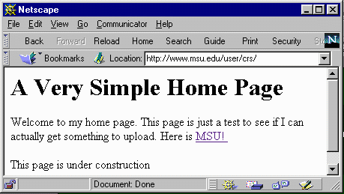
View Your New Page!
Test the page using your browser
  http://www.msu.edu/user/sparty/

Slide 67
<h1>A Very Simple Home Page</h1>
<p>
Welcome to my home page. This page
is just a test to see if I can actually get
something to upload. Here is
<a href=“http://www.msu.edu/”> MSU! </a>
</p>
<p>This page is under construction</p>

Slide 68
Up Next
Installing A Modem...

Slide 69
Installing a Modem
If you are already on the net - Skip this
Communication Ports
Internal and External Modems
Disabling Factory-Installed Modem

Slide 70
Communication Ports
You can have up to four connections to “serial” communication equipment
  COM1 - COM4
  COM1 and COM2 are most typical
  Many computers recently purchased already have internal modem at COM1 or COM2

Slide 71
External Modem
Connects to existing port
  COM1 - COM4 - look at system documentation or just start trying
Needs a cable - usually 9-pin to 25-pin

Slide 72
Internal Modem
Installed inside computer case
May need switch settings - in the book
Plug-and-Play - “Windows-95”
  No switches necessary
  Most modems in the last two years

Slide 73
Existing Internal Modem
Sometimes you have a modem already
In an expansion slot - remove it
Built-in - can be disabled in “SETUP”
Look for a message early during boot
  Press <F2> to Enter SETUP
  Press it and follow instructions
Goal is to “disable” internal modem

Slide 74
Connecting Phone Lines
Generally most modems have two connections
  “Line” - from the wall jack
  “Phone” - to a phone (optional)
There are several wiring choices
  Split the line with an adapter
  Insert computer between wall outlet and the phone - use “Line” on modem

Slide 75

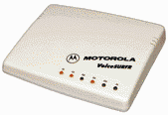
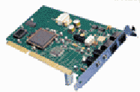
W
A
L
L
Connect to the modem and then the phone
Split the line between the modem and the phone
Phone
Line
Line

Slide 76
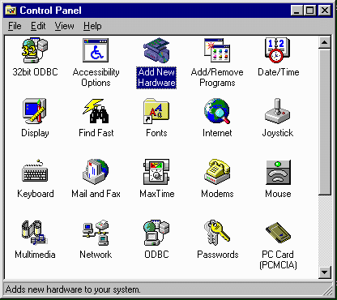
After Modem is Installed
Need to add software to support the modem
Start | Settings | Control Panel | Add New Hardware

Slide 77
Add New Hardware
Allow Windows-95 to automatically detect the new modem
  It takes a long time (3-4 minutes)
  Be patient
You will probably be prompted for your Windows-95 CD-ROM or Floppies
The system may need to be rebooted

Slide 78
In Summary
Thanks for listening
Hope it has been helpful
Please let us know how it can be improved
Hotline - 1-800-500-1554
Contact me directly: crs@msu.edu

