Slide 1
What IS the Internet?
Charles Severance
http://www.egr.msu.edu/user/crs/

Slide 2
Internet in 1996
A really really big slow multimedia CD-ROM which keeps getting better and keeps your phone line busy.
“New media, tend to encapsulate all older media” - Marshall McLuhan, "Understanding Media: The Extensions of Man"
Notes:
From Kevin Hughes ( http://www.eit.com/~kevinh/ ):
Marshall McLuhan wrote that new media tend to encapsulate older media. That is, old media can be represented within the space of new media. The alphabet as a medium was encapsulated by print; radio as a medium was encapsulated by television. I can send a radio broadcast via television and could even use my television solely as a radio if I felt like it (although it may not be practical). What many people have failed to understand is that the computer as a medium has the potential to encapsulate all prior media. Therefore, the interface and working environment of the future will be able to handle or simulate all of the various forms of media.

Slide 3
Internet as a Media
Music Videos
Magazines
Catalogs
Home Shopping Club
Phone Company
  Long Distance Videophone
  Phone Number Directory
Maps
Software Store
Cable TV
  Weather Channel
  Discovery Channel
  ESPN
  COURTTV
Radio - RealAudio
The Library
The Newspaper
FAX Machine

Slide 4
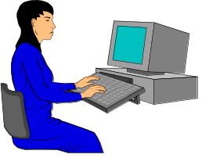
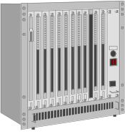



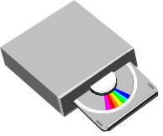
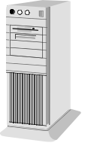


What is it?
ftp.cdrom.com
www.ford.com
www.whitehouse.gov
www.weather.com
www.msu.edu

Slide 5
Things the go “bump” in the Net
In the Internet we generally interact with three types of things - and we need to know their names
  Computers - Have an address and name
  People - Have one or more E-Mail addresses
  Documents - Have Uniform Resource Locators
Notes:
At its most fundamental, the Internet is like a really slick multi-media telephone/computer. Much like before you use the phone effectively you need to understand phone numbers, area codes, long distance access codes, PINs, etc.. We too need to know some of the naming conventions in the Internet. We will talk with people, computers, and documents.

Slide 6
Connecting to Computers
Each computer connected to the Internet must have an IP address
  35.8.2.41
This address is assigned by the organization connected to the Internet
Even dial-up conections are given an address when they dial-up
Notes:
The numeric addresses assigned to each computer contain “geographical” information, much like a zip code. For example, zip codes starting with “0” such as 09876 are on the East Coast in the US, while zip codes such as 96552 are on the west cost and zip codes like 48824 are in the middle of the country.
In the above address, the 35 means somewhere in the state of Michigan and the 8 means a particular network segment at Michigan State University. The .2.41 portion of the address can also include some “routing” information
Because these addresses depend in where the computer is physically located, they may need to be changed periodically as computers are moved about. Because of this it is a bad practice to use these numeric addresses. however they work just as well as the text style addresses such as scully.egr.msu.edu. The net is beginning to run out of system numbers. There is an effort called IP Next Generation which you can take a look at http://playground.sun.com/pub/ipng/html/ipng-main.html
With IP-Next Generation we can have up to 2128 Computers on the net!

Slide 7
Domain Names for Computers
Numeric addresses can change as an organization reorganizes its network
Each computer may also have a Domain Name
  scully.egr.msu.edu
It is named
“scully”
This computer belongs to the
MSU College of Engineering

Slide 8
E-Mail - Contacting People
E-Mail addresses consist of a account name and an Internet Domain Name
  crs@egr.msu.edu
E-Mail addresses are like phone numbers - on your business card
Account Name
Domain Name

Slide 9

URL - All About Data
How to
Display the
data
Where to
get the data
http://www.egr.msu.edu/~crs/crs.gif
How to
retrieve the
data
What data
to get

Slide 10
How does the Internet Work?
The Internet is a hierarchy
National and International Service Providers
Regional Service Providers
Local Service Providers
Notes:
The worldwide Internet is a hierarchy of cooperating networks with each network selling services to the lower levels of the hierarchy. While I have shown three levels of the hierarchy, it is much more complicated. For example, a national provider such as Sprint or MCI can and does provide what we would call “local service”. There are a number of national service providers - all the national service providers are interconnected at critical points around the world to make the Internet appear to be seamless. These access points are called NAPs or Network Access Points. A regional level service provider is roughly the size of a state although some are a portion of a state and others are made up of several states. Local service providers are companies who sell Internet access to the end-customers.
http://www.iw.com/1996/10/howitworks.html
http://www.sprintlink.net/SPLK/HB21.html
http://www.vbns.net/
http://www.isu.edu/departments/comcom/internet/backbone.html

Slide 11
Who is in Charge?
Internic (http://rs.internic.net/)
  Domain name registry
  Network numbers (IP Address Ranges)
Internet Engineering Task Force (www.ietf.org)
  Internet protocols
  Internet technical details
Notes:
The Internet does not require a great deal of administrative oversight. It was designed to allow each organization ot control much of their internet configuration. However there are a few areas which there must be some cooperation.
The Internet numbers (35.8.2.41) and domain names ( www.msu.edu ) are managed by an organization called the Internic. The internic gives these numbers (35.8.*.*) and addresses (*.msu.edu) in large groups and allows each organization to manage their own numbers and names.
The Internet Engineering Task Force (IETF) is the organization which develops technical standards (called Request for Comments) which govern how the Internet works. Typically engineers from companies producing Internet hardware and software participate in the IETF.

Slide 12
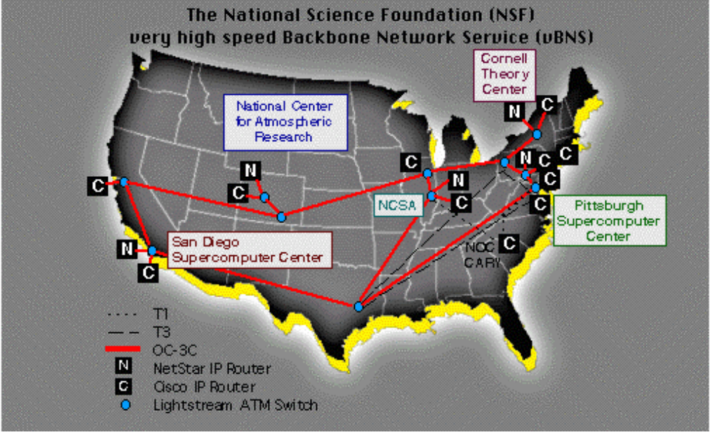
Top Level Service Providers
Use Long-Distance dedicated lines
45Mb/Sec -> 1GB/Sec (fiber)
Often phone
companies
Interact at 5
NAPs (Net
Access Points)

Slide 13
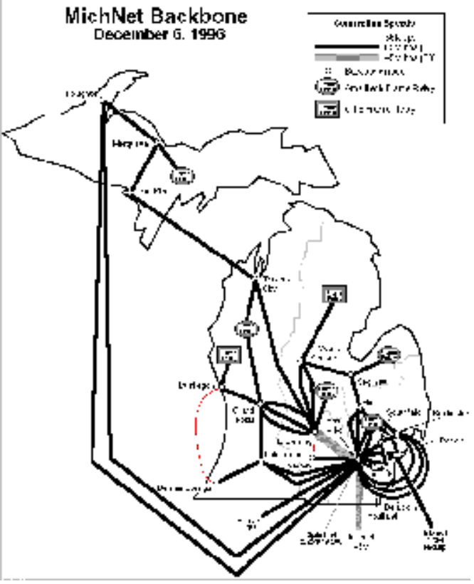
Regional Service Providers
Size roughly a state
There may be many
competing regionals
  MichNet (Merit, Inc.)
  Ameritech
  CICNET
Often there is some
cooperation

Slide 14
Michigan State University
Member of MichNet and CICNet
45Mb/Sec (DS3) connection through Ann Arbor to the National Network
Large organizations typically connect directly to a regional or even national network
Notes:
A large organization such as Michigan State University or Ford Motor Company generally connects directly to a regional network provider. Michigan State is a member of the Merit Network which operates the Michigan regional network. Because of this relationship, the link from MSU to the Internet is used for far more traffic than just the MSU traffic. Companies and educational institutions from western, central, and northern Michigan send their traffic through the MSU campus on the way to the Internet.
One aspect of the Internet is that the cost to connect a new site to the Internet depends on how far it is to the nearest well-connected site. Also when you improve the connectivity of a central site such as Michigan State University, the connectivity of the entire Northwestern area of the state is improved.

Slide 15
Local Service Providers
In the Lansing Area
  MSU Faculty, Staff, and Students “free”
  K-12 Teachers get it “free”
  AT&T, MCI, Merit
  America On-Line, Compuserve
  TCI Cable Modems
  Sojourn, Voyager, Arrownet
Yellow pages has about 10 companies
Notes:
Local Service providers may be national services providers, regional providers, or just a local company which purchases a connection to a regional or national network. The economics of a Local Service provider is to keep their customers happy (no busy signals) while paying for their modems, servers, telephone costs, staff costs, and network access fees and still make a bit of profit. There are thousands of local services providers around the country. At some point in the future there will be some shakeout among these smaller companies. The current rate for unlimited access over a 28. modem is from $10.00 - $20.00 per month. At those rates, the profit margin is small and the competition is fierce.
Unless end-users get access free through their job, they generally pay a fee only to the local provider - all of the national network infrastructure is included.

Slide 16
International Internet
University of London - 23rd Internet site
Other countries have a different relationship between government, Universities, and phone companies
Governments pushed “Non-Internet” network technologies - for a while
Phone systems are pretty compatible
Notes:
The Internet is nearly as pervasive outside the US as inside the US. There are a number of factors which make the Internet different outside the US. Most importantly, the governments of other countries are much more involved in the telephone companies. Further, in Europe, many countries develop similar approaches using International Standards ( www.iso.org ). These standards are developed through a long formal process. the Internet standards (TCP/IP) are developed in a much more informal manner (www.ietf.org ).
Throughout the 1970’s, 1980’s and early 1990’s the European countries pushed a packet switching networking technology called X.25. This was supplied through the phone companies. It was slow and expensive and did not really catch on with end-users. During that same period, the Internet was being developed using telephone lines but the actual Internet was under control of the National Science Foundation and a number of universities.
However, as the Universities in the US began to use the Internet more and more, the European and Japanese Universities began to use TCP/IP and the Internet. In the last 4-5 years as the Internet has been adopted by end-users, the infrastructure was already in place in the European and Japanese Universities. Because the phone systems and modems are completely compatible, Internet access is roughly uniform around the world.
Because of the historical power of the phone companies, the Internet may be deployed more “cleanly” in Europe. Japan also seems to be willing to allow the phone companies to participate in the Internet development in that country.

Slide 17
What is a “Packet”?
Like an Envelope and a Letter
A packet has “from” and “to” address
Can arrive out of order or not at all
Hosts must reassemble messages
120.17.42.98
35.8.1.10
Amanda
From
To
Data

Slide 18




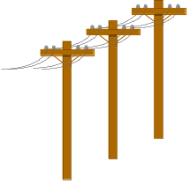
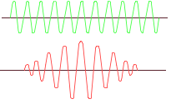


120.17.42.98
Unreliable Network
Hi There
Hi There
Amanda
35.8.1.10
Hi There
TCP/IP
Amanda

Slide 19
Probing the Internet
The most fundamental Internet command is ping
Send a single
packet
Destination
replies
Time it
Microsoft(R) Windows NT(TM)
(C) Copyright 1985-1996 Microsoft Corp.
C:\>ping stanford.edu
Pinging stanford.edu [36.56.0.10] with 32 bytes of data:
Reply from 36.56.0.10: bytes=32 time=60ms TTL=243
Reply from 36.56.0.10: bytes=32 time=50ms TTL=243
Reply from 36.56.0.10: bytes=32 time=60ms TTL=243
Reply from 36.56.0.10: bytes=32 time=60ms TTL=243
C:\>

Slide 20
Magical Cloud

Slide 21
Technical Details

Slide 22
Exposing Details - Traceroute
Normally cannot determine the routing details
Traceroute (tracert) - Sends packets 1,2,3,4.. hops and gets a reply
Shows the route - may change an instant later
There are Web sites which can do traceroute
Notes:
Each packet in TCP/IP has a field called “Time to live” or TTL. Each time the packet passes across a hop, this count is decremented by on. If this count reaches zero, the packet is discarded and the sending host is notified. Normal packets are sent with the TTL set to 255.
The traceroute (UNIX) or tracert (Windows) command sends a packet out with TTL set to 1. Then it sets the count to 2 and sends the packet again. By doing this until a packet reaches its final destination, the traceroute command can determine the path a packet takes through the Internet.
The “best” route through the Internet may change at any instant - even while a traceroute command is running.
Interestingly, traceroute will work to some degree when the destination does not exist. Try
tracert 111.222.333.222
You can experiment with traceroute at
http://www.cps.msu.edu/cgi-user/crs/scncweb_traceroute

Slide 23
tracert www.cs.stanford.edu
C:> tracert www.cs.stanford.edu
Tracing route to www.cs.stanford.edu [36.56.0.10]
over a maximum of 30 hops:
1 10 ms <10 ms <10 ms eng-gw-fd1.msu.edu [35.9.32.1]
2 <10 ms <10 ms <10 ms cc2-gw-fd00.msu.edu [35.8.100.1]
3 <10 ms <10 ms 10 ms fdd0-0.msu2.mich.net [35.9.6.3]
4 <10 ms 10 ms <10 ms hss1-2.michnet1.mich.net [35.125.0.1]
5 <10 ms 10 ms 10 ms cpe3-fddi-1.WillowSprings.mci.net [192.203.195.5]
6 30 ms 10 ms 20 ms borderx2-hssi2-0.WillowSprings.mci.net [204.70.104.117]
7 10 ms 10 ms 20 ms core2-fddi-1.WillowSprings.mci.net [204.70.104.65]
8 60 ms 60 ms 60 ms bbn-planet.SanFrancisco.mci.net [166.48.15.254]
9 60 ms 60 ms 60 ms bbn-planet.SanFrancisco.mci.net [166.48.15.254]
10 60 ms 60 ms 60 ms su-pr1.bbnplanet.net [131.119.0.199]
11 60 ms 61 ms 60 ms sunet-gateway.stanford.edu [198.31.10.1]
12 60 ms 60 ms 60 ms Core-gateway.Stanford.EDU [171.64.1.33]
13 60 ms 60 ms 60 ms Gates-1-gateway.Stanford.EDU [171.64.1.68]
14 61 ms 60 ms 70 ms labrea.Stanford.EDU [171.64.67.150]
Trace complete.
C:\>

Slide 24
Challenges in the Internet
Limited national backbone capability
  Phone lines max out at 45Mb/sec
  Need to move to 1Gb/sec+ over Fiber
Local connections are getting faster
  28.8Kb POTS -> 128Kb ISDN -> 10Mb
Local phone companies feeling a pinch
Audio and video consume continuous bandwidth - Surfing != Internet Phone
Notes:
As our capability for local access gets faster and faster, the national backbone will have difficulty keeping up. Most of the national connections are at the maximum 45Mb/second rate. To go faster (1Gb/sec) requires the use of fiber. One experimental national network is already in place http://www.vbns.net/ which is operating at 1GB/sec. While the speed of fiber is 20 times faster, it is far more expensive than the current high speed lines. Furthermore as the local connections increase a factor of five as we go from Plain Old Telephone Service (POTS) to ISDN and the number of Internet users increase, this factor of 20 will be consumed.
As we use the Internet more and more for multi-media, our access patterns will change. When a user is surfing the web and actually reading the material on their screen, they might only use 10-20% of their available connection. If a user is listening to audio or viewing video over the Internet, they use 100% of their connection. Also the use of Internet Phone technology uses a large amount of bandwidth.
Even the local telephone company who charges 8.3 cents per phone call is feeling the pinch. Many users with two lines, keep their Internet connection all day long. Given that the average voice phone call is about 3 minutes, areas with a high population of Internet users are concerned about their telephone system capacity.
At some point all these issues come down to an economic issue. We will either redesign the Internet to some degree or the cost will increase as our use of the net increases. But for now intense competition keeps the costs down.

Slide 25
Internet .vs. Telephone
Telephone company
  Bandwidth (amount of data) is guaranteed
  No difference to the phone company between silence and singing
  Real-time delivery - no pauses
  Data lines are “synchronous” - You pay whether or not you move data or not
  Cost is by connection time - long distance
Notes:
The telephone company moves voice between two phones. There is no difference if you are shouting or thinking silently. If you dial the phone, and then don’t talk for 30 minutes, you cannot ask for a refund of your money. For data connections and for ISDN data connections, once a connection is made, data is passed continuously regardless of whether or not the two systems actually have anything to say.
The phone company can afford to guarantee the bandwidth because you pay for it whether or not you use it or not when you are dialing long distance. Unfortunately for local calls, there is no such connect-time charge. This is one of the reasons that phone companies are unhappy about the long local phone calls made by Internet users.
The telephone companies are breaking this mold of continuous data in the introduction of ASDL (Asymmetric Digital Subscriber Line) technology.

Slide 26
Internet .vs. Telephone
Internet
  Data is transmitted in “packets” - no guarantee of bandwidth or reliability
  Information is broken into many packets
  Packets can be sent over various links
  When a system is idle it transmits no packets, using no resources
  Most systems on the Internet are idle 95+ percent of the time
Notes:
The data transmitted over the Internet is in the form of “packets” each packet is separately addressed and can take any path through the network. Packets may arrive out of order or not at all. The primary advantage of packets is that an idle system sends no packets and does not take any of the network resources.
Of course the local phone connection is still taking resources from the phone company. One the national links, millions of packets are sent on the same link. The idea of the Internet is to lease on expensive phone line and have potentially thousands of users transmitting data over the leased line at the same time. The net result is that real-time information such as Internet Phone works very well across the Internet unless there is a great deal of traffic in which case Internet phone will experience skips and pauses.

Slide 27
Internet .vs. Telephone
Will the Internet consume the phone Companies or the other way?
Internet
  Wants to guarantee bandwidth real-time
  Needs to charge for connection time
Phone Companies
  Already capable of guaranteed bandwidth
Who will do it cheaper? Will we care?
Notes:
In the long run (which may be 30 years) the telephone companies will probably consume the Internet. There is little economic reason to have thousands of companies which make up the Internet to completely re-engineer the Internet to do things which the phone companies already do. The current situation simply assures us that if the phone companies are incapable of providing good quality data service at reasonable prices, the Internet will eat their lunch and the phone companies may eventually just be leasing long-distance fiber optic cables to the Internet companies.
The biggest challenge to telephone companies is to abandon the synchronous data transmission and allow idle periods to cost far less than active periods.
What is your prediction?

Slide 28
Telephone .vs. Cable
Holy Grail: fiber-optic two-way digital connection to the telephone pole
Cable
  Willing to try new things
  Fighting with digital satellite
Telephone
  Knows data communication
  Has money
Notes:
There has been significant discussion as to whether the telephone companies or the cable companies will be our eventual communication providers. While I don’t want to predict that either will win or lose, our services will be some combination of:
Broadcast Media
Pay Per View Media
High Speed Data Communications
The way this is done will be some combination of Fiber, Copper, and satellite communication. We probably will have a single high speed connection into our home for voice/data/video. We may also have a Satellite dish in the country.

Slide 29



Future of Phone and/or Cable?
2000
Compressed
Video
Channels
On Demand
Video
Data
Network
300
Compressed
Channels
Phone
Network
20 Compressed
Video Channels

Slide 30
Internet .vs. AOL
While the Internet is 30 years old, it has only been popular for a few years
AOL has been popular for much longer
AOL worked with 2400 baud modems
Because of protocol overhead, Internet is only usable with >14,400 bps
AOL is specific - Internet is very flexible
Notes:
While in 1996, many people think of the Internet as far superior to AOL, we must remember that AOL was successful in the broad marketplace long before the Internet. Because of the overhead and specifications of the TCP/IP protocols, using the Internet at 2400 baud is just not practical. With the advent of 14,400 and 28,800 modems using the Internet at home has became more practical..
Unfortunately in the world of High-Tech, the pertinent question is, “What have you done for me lately?”. AOL is struggling to find its place in a marketplace where it is continuously compared to the Internet rather than Prodigy and Compuserve.

Slide 31

AOL Network
East
Lansing
AOL
MCI Internet
Local
Internet
Provider
Sprint Internet
www.cs.stanford.edu

Slide 32
Internet .vs. AOL
AOL is a complete solution
  Content
  E-Mail
  National network
  Regional network
  Local provider
  Internet for surfing and E-Mail
AOL can fund all of its infrastructure
Notes:
AOL in a sense provides a complete networking solution. AOL owns a national network, regional networks, and local networks in most cities with dial-up modems. AOL also provides the AOL software, electronic mail, and network content.
With total control over its infrastructure, AOL could theoretically provide a far superior service to the Internet. Users of both the Internet and AOL, often prefer AOL for interpersonal communication. AOL could solve many of the technical problems of the Internet because it has a completely proprietary solution. AOL has accounting and could easily charge for reliable long-distance “Internet Phone”.
The problem that AOL faces is that it loses users to fixed-cost Internet providers. At the end of 1996, AOL introduced a competitive fixed-rate plan. It is not clear that they can afford to support the increase in use that the fixed-rate plan will cause.
At some point AOL may have to give up its national, regional and local networks and concentrate on providing content across the Internet.

Slide 33
Internet .vs. World-Wide-Web
World-Wide-Web is one type of information accessed using the Internet
Internet Chat is one type of information accessed using the Internet
E-Mail is one type of information accessed using the Internet
The Internet is the “highway”
Web, Chat, E-Mail are Bus, Truck, Car

Slide 34
Chuck’s Top 6
www.switchboard.com
www.four11.com
www.mapquest.com
www.weather.com
www.intellicast.com
http://digital.altavista.com

Slide 35
Summary
Internet is currently very exciting and works pretty well
Non-nerd people find the Internet useful enough to pay for it
Internet is not ready to take over Cable TV and Telephone service “yet”
Today Internet may actually be a bargain
Notes:
In 1997, it is dangerous to assume that the Internet is the way that it will be forever. The “Internet” is here to stay but the way we use it, how well it works, and how we pay for it are all in a state of flux.
To appreciate the challenge in making the Internet work, imagine that there were no telephone network. We all have hand-held radios with a 10 mile range and a few people have radios which can reach across the country but only to five places around the country. Try to get a message from East Lansing, Michigan to Palo Alto California in six hundredths of a second and back.

