Slide 1
Basics of Advanced Multimedia
Dr. Charles Severance

Slide 2
Raw Audio
Formats
  .au - 8Khz - 8 bit samples = 64000 bps
  One second = 3 seconds download
  CD mono - 44kHz - 16 bit samples = 704000 bps
  One second = 30 seconds download
Simple to record and play
Notes:
Early audio was not practical ot use over dial-up access to the web. Its long download time made it unusable.

Slide 3
Raw Video
Massive Bandwidth
  Broadcast Quality 90Mb/sec - 40GB/Hour
  VHS Quality 16Mb/Sec - 7GB/Hour
  Quarter Frame 4Mb/Sec - 1.8GB/Hour
We generally don’t work with raw video with computers

Slide 4
Compressed Audio
  Requires encoder and decoder
  Audio does not naturally compress
  Must “extract features” - “listen”
  Encoding takes powerful CPU
  Voice quality 6000 bps
    Can play in real-time on 14.4 modem
    1.44Mb floppy can hold hour of compressed audio
  CD mono quality 64000 bps
Notes:
Raw audio samples appear to be random data to a compression program so there are no parrterns which the compression program can identify. Because of this typical compression techniques such as ZIP are useless when dealing with audio.

Slide 5
Compressed Video
Quicktime / AVI
MPEG - Motion Picture Experts Group
MJPEG - Motion JPEG
RealVideo - Internet Video
  Compression in software - loss of quality - low bandwidth

Slide 6
QuickTime
Quicktime - .qt .mov
  Earliest format for audio and video
  Apple format used for Macintosh
  Designed for CD-ROM
  Simple compression for slow CPUs
  www.apple.com
Notes:
There are pseudo-streaming Quicktime players but they are best suited to use over high speed (non-dialup) connections to the Internet.

Slide 7
Video - AVI
The native video format for MS-Windows
Software compression and decompression
Compression designed to be played on slower CPUs
Not a very dense format (CD-ROM = 1 Hour)

Slide 8
Video - MPEG
Based on a standard
Formats for both video and audio
“Motion Picture Experts Group”
MPEG encoding does “motion estimation”
Used in the small satellite dishes
Wide range of compressions
  MPEG-1 1.5 Mb/sec
Notes:
http://www.crs4.it/HTML/LUIGI/MPEG/mpegfaq.html
http://www.ml.tele.fi/eng/media/movie.html

Slide 9
More MPEG
Currently need hardware for real-time encoding
Pentium MMX may change this
Can decode in real-time
  www.xingtech.com
  Streamworks
MPEG-4 audio can compress to 28.8
Notes:
Many of the Pentium MMX instructions were designed to perform the motion estimation required by MPEG very quickly.
http://mmx.com/mmx/product/mmx.htm
http://www.intel.com/procs/perf/mmx/imb.htm

Slide 10
Real Media
RealNetworks has encoder and player
  Both are free
  Small streaming server is free
Several different speeds
  Audio 5Kb/sec - 56Kb/sec
  Video 28Kb/sec -128Kb/sec
More bits = better quality
Notes:
If you do not have the RealAudio streaming server, the .ra file must be completely downloaded before it begins to play.

Slide 11
Media in Real-Time
In order to compensate for network delays, player must buffer data ahead before playing it.
After 2-15 second delay, can keep up in real time
First successful streaming media was (www.real.com)
Notes:
An advantage of real-time audio delivery over the internet is the concept of “narrowcasting”. A perfect example is the broadcast of Colege sports to alumni across the globe. On any given weekend there may be hundresd of college sporting events, with only 2-3 on national Television. With the Internet people can have access to all of the events without using broadcast television.

Slide 12



Normal Viewing
View locally
Copy to system
Real Time
View while loading
Special Protocol
Notes:
Some of the comanies which work with streaming media, develop their own protocol which allows them to adapt to changing network conditions. Often the company makes their money selling server licenses while giving away the viewer and encoder. More recently companies (www.vivo.com) areusing standard protocols to stream their data which is much more cost effective.
Often while companies feel that a proprietary protocol has some inherent advantages, often there are disadvantages as well. Given that the use of a proprietary protocol often has a cost factor involved, usually approaches which use a standard protocol will be more successful in the long run.

Slide 13
Streaming
Requires RealNetwork Server
Quick start-up and random access
Uses special protocol - pnm:
Often pnm: URL is different from the http: URL
Sometimes you must move the *.rm and *.ra files into a special directory

Slide 14

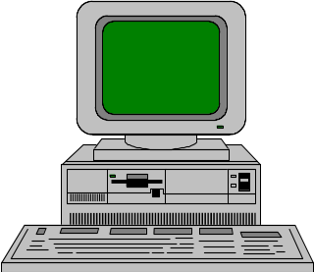

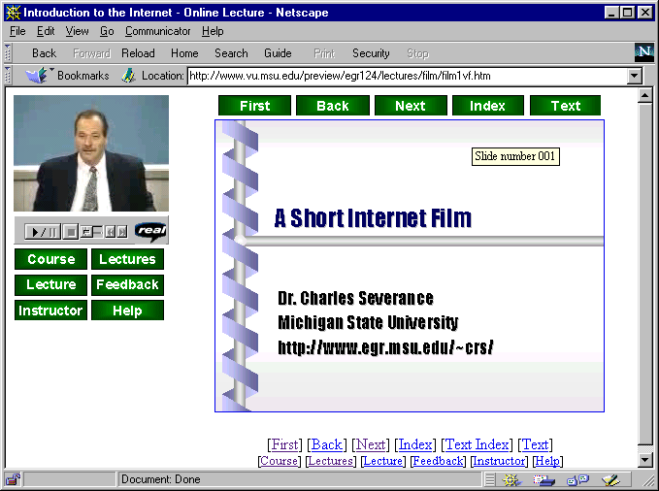
Data is sent from the server to the player in packets. Depending on the performance of the connection, more or less data is sent. Data is played a short time after it arrives.
When you skip around, the player sends a message BACK to the server to begin sending packets from the new location of the file. After a brief moment the player begins playing from the new location.

Slide 15
Pseudo Streaming
In pseudo-streaming the plug-in is told to make a standard http connection to retrieve the data. It begins to retrieve the data onto disk. Once it has gotten ahead it behind to play off the disk. Hopefully it can download fast enough that the playing never catches up.

Slide 16
Entire file is copied to disk across the Internet as quickly as possible using
HTTP/TCP
Once sufficient data has been buffered, play begins from the disk - playing continues unless the player “catches up” to the download

Slide 17
Pseudo-Streaming
Advantages
  Works on ANY web server
  Works across firewalls that pass web traffic
  May be good when network is congested
Disadvantages
  Cannot move around randomly
  Skip ahead might take 20 minutes while all of the intervening data is downloaded

Slide 18
Producing Internet Video
Better quality hardware and faster processors improve quality
You end up with plenty of “studio” problems
  Bad audio levels
  Lousy lighting
  Wires everywhere

Slide 19
Producing RealVideo
Can digitize live straight from Camera or VCR to RealVideo
  Pentium 166 - 1.5 frames/sec
  Pentium 300 - 5 frames/sec
Two Step Process
  Capture to AVI (lots of disk)
  Batch convert to RealVideo
  Gives excellent quality on slower systems

Slide 20
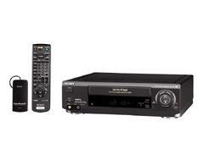
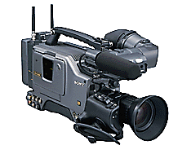
Real Encoder
AVI Capture

Slide 21
Conclusion
To deliver audio or video effectively using the Internet, it must be compressed
Producing Internet video requires some skill with audio and video equipment

