Slide 1
Food
A Cool Internet Lecture

Slide 2
Why Food?
Because food is universal
Because food is essential
Because food is fun!
Notes:
This is an example of some notes

Slide 3
Food Choices
Fast or Slow
Rich or Lean
Hot or Cold
Spicy or Bland
Fancy or Simple

Slide 4
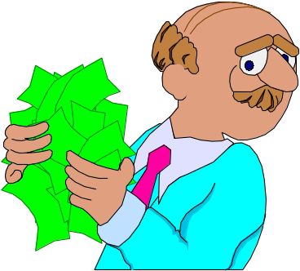
Conclusion
Food is an interesting topic
Food is a great place to do research
We have just begun to scratch the surface of food
Lets do lunch and talk some more

