Slide 1
Sync-O-Matic 3000
Dr. Charles Severance
Michigan State University
http://www.egr.msu.edu/~crs/projects/syncomat/

Slide 2
Purpose
Sync-O-Matic is a tool which can improve the ability to deploy on-line lecture content
  Faculty can tape a lecture in a studio and studio staff can produce high quality on-line lecture within hours
  Faculty can use their own personal computer to produce lecture content with minimum of effort

Slide 3
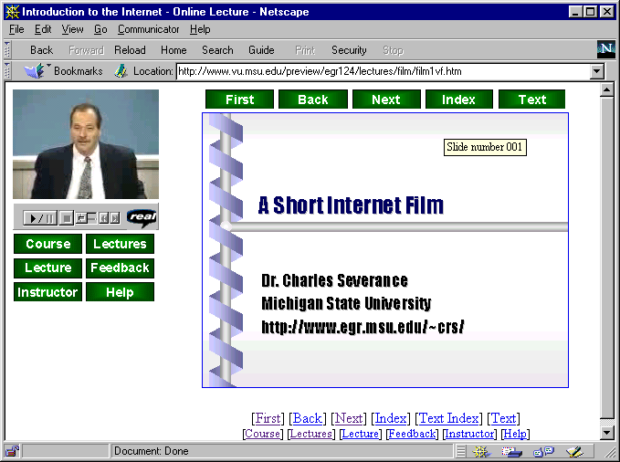

Why
Audio
Video
Sync-O-Matic
Slide Timing
PowerPoint
Style Files

Slide 4
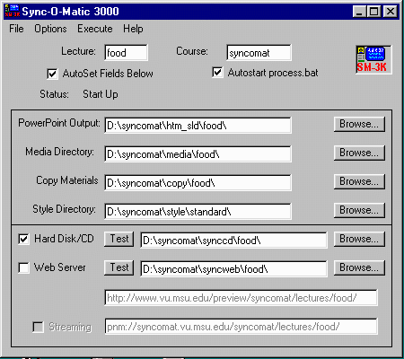
User Interface

Slide 5
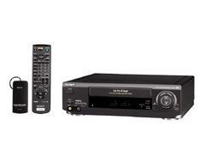
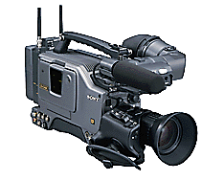
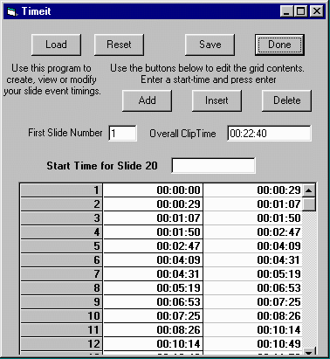
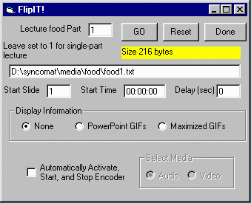
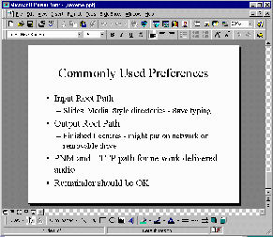
Media Directory
Audio/Video
Timing
Real Encoder
AVI Capture
PowerPoint
HTML
Directory
HTML Export

Slide 6


Media Directory
Audio/Video
Timing
PowerPoint
HTML
Directory
CD-ROM
Version
Directory
Web
Version
Directory
Upload

